Slide 1
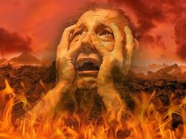
Hell: What is it? Where is it? How to Get There
Robert C. Newman

Slide 2
Introduction
Why am I giving a talk like this when I don’t like in-your-face confrontation?
Because of an incident I witnessed in the summer of 1966 at the Madison (Wisconsin) Zoo.
Some children were playing very near the elephant cage, inside the outer barrier.
I thought this was foolish, but their mothers were present, so I thought I’d better not interfere.
A few minutes later, I heard a scream. The youngest child had crawled thru the bars, and was being trampled to death by the elephant.

Slide 3
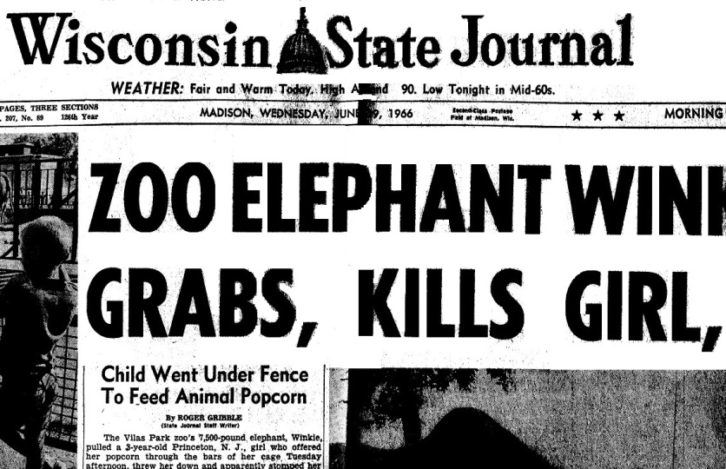

Slide 4
Impact on My Life
Some months later, I decided to take this incident as a sort of parable.
It suggested I ought to use my life helping people avoid hell, even if some of them might not appreciate being warned.
It is better to do this than let them go there without a warning.

Slide 5
What is Hell?
There are many misconceptions about hell due to various traditional ideas:
Satan as the jailer rather than a prisoner
The demons as tormentors
As a result, many dismiss the whole idea as merely ancient superstition.
What does the Bible have to tell us about this subject?
Let us look at the Biblical descriptions of hell, or (more accurately) at what happens when we die.

Slide 6
Isaiah 66:22-24 (NIV)
²² “As the new heavens and the new earth that I make will endure before me,” declares the Lord, “so will your name and descendants endure. ²³ From one New Moon to another and from one Sabbath to another, all mankind will come and bow down before me,” says the Lord. ²⁴ “And they will go out and look on the dead bodies of those who rebelled against me; the worms that eat them will not die, the fire that burns them will not be quenched, and they will be loathsome to all mankind.”

Slide 7
Hell is Characterized
Corpses, worms, fire, loathsomeness

Slide 8
Daniel 12:1-3 (NIV)
12 “At that time Michael, the great prince who protects your people, will arise. There will be a time of distress such as has not happened from the beginning of nations until then. But at that time your people—everyone whose name is found written in the book—will be delivered. ² Multitudes who sleep in the dust of the earth will awake: some to everlasting life, others to shame and everlasting contempt. ³ Those who are wise will shine like the brightness of the heavens, and those who lead many to righteousness, like the stars for ever and ever.

Slide 9
Hell is Characterized
Corpses, worms, fire, loathsomeness
Shame, everlasting contempt

Slide 10
Matthew 10:28 (NIV)
²⁸ Do not be afraid of those who kill the body but cannot kill the soul. Rather, be afraid of the One who can destroy both soul and body in hell.

Slide 11
Hell is Characterized
Corpses, worms, fire, loathsomeness
Shame, everlasting contempt
Destruction of both body and soul

Slide 12
Matthew 13:40-42, 49-50
⁴⁰ As the weeds are pulled up and burned in the fire, so it will be at the end of the age. ⁴¹ The Son of Man will send out his angels, and they will weed out of his kingdom everything that causes sin and all who do evil. ⁴² They will throw them into the blazing furnace, where there will be weeping and gnashing of teeth….
⁴⁹This is how it will be at the end of the age. The angels will come and separate the wicked from the righteous ⁵⁰ and throw them into the blazing furnace, where there will be weeping and gnashing of teeth.

Slide 13
Hell is Characterized
Corpses, worms, fire, loathsomeness
Shame, everlasting contempt
Destruction of both body and soul
Fiery furnace, weeping, gnashing of teeth

Slide 14
Mark 9:42-48
⁴² If anyone causes one of these little ones—those who believe in me—to stumble, it would be better for them if a large millstone were hung around their neck and they were thrown into the sea. ⁴³ If your hand causes you to stumble, cut it off. It is better for you to enter life maimed than with two hands to go into hell, where the fire never goes out. ⁴⁵ And if your foot causes you to stumble, cut it off. It is better for you to enter life crippled than to have two feet and be thrown into hell. ⁴⁷ And if your eye causes you to stumble, pluck it out. It is better for you to enter the kingdom of God with one eye than to have two eyes and be thrown into hell, ⁴⁸ where “the worms that eat them do not die, and the fire is not quenched.”

Slide 15
Hell is Characterized
Corpses, worms, fire, loathsomeness
Shame, everlasting contempt
Destruction of both body and soul
Fiery furnace, weeping, gnashing of teeth
Better to lose one’s life, hand, foot, eye

Slide 16
Luke 16:19-24
¹⁹ “There was a rich man who was dressed in purple and fine linen and lived in luxury every day. ²⁰ At his gate was laid a beggar named Lazarus, covered with sores ²¹ and longing to eat what fell from the rich man’s table. Even the dogs came and licked his sores.
²² “The time came when the beggar died and the angels carried him to Abraham’s side. The rich man also died and was buried. ²³ In Hades, where he was in torment, he looked up and saw Abraham far away, with Lazarus by his side. ²⁴ So he called to him, ‘Father Abraham, have pity on me and send Lazarus to dip the tip of his finger in water and cool my tongue, because I am in agony in this fire.’

Slide 17
Luke 16:25-31
²⁵ “But Abraham replied, ‘Son, remember that in your lifetime you received your good things, while Lazarus received bad things, but now he is comforted here and you are in agony. ²⁶ And besides all this, between us and you a great chasm has been set in place, so that those who want to go from here to you cannot, nor can anyone cross over from there to us.’
²⁷ “He answered, ‘Then I beg you, father, send Lazarus to my family, ²⁸ for I have five brothers. Let him warn them, so that they will not also come to this place of torment.’
²⁹ “Abraham replied, ‘They have Moses and the Prophets; let them listen to them.’
³⁰ “‘No, father Abraham,’ he said, ‘but if someone from the dead goes to them, they will repent.’
³¹ “He said to him, ‘If they do not listen to Moses and the Prophets, they will not be convinced even if someone rises from the dead.’”

Slide 18
Hell is Characterized
Corpses, worms, fire, loathsomeness
Shame, everlasting contempt
Destruction of both body and soul
Fiery furnace, weeping, gnashing of teeth
Better to lose life, hand, foot, eye
Torment, agony of fire, no relief

Slide 19
2 Thessalonians 1:9
⁹ They will be punished with everlasting destruction and shut out from the presence of the Lord and from the glory of his might.

Slide 20
Hell is Characterized
Corpses, worms, fire, loathsomeness
Shame, everlasting contempt
Destruction of both body and soul
Fiery furnace, weeping, gnashing of teeth
Better to lose life, hand, foot, eye
Torment, agony of fire, no relief
Everlasting destruction, shut out from God’s presence

Slide 21
Revelation 14:9-11
⁹ A third angel followed them and said in a loud voice: “If anyone worships the beast and its image and receives its mark on their forehead or on their hand, ¹⁰ they, too, will drink the wine of God’s fury, which has been poured full strength into the cup of his wrath. They will be tormented with burning sulfur in the presence of the holy angels and of the Lamb. ¹¹ And the smoke of their torment will rise for ever and ever. There will be no rest day or night for those who worship the beast and its image, or for anyone who receives the mark of its name.”

Slide 22
Hell is Characterized
Corpses, worms, fire, loathsomeness
Shame, everlasting contempt
Destruction of both body and soul
Fiery furnace, weeping, gnashing of teeth
Better to lose life, hand, foot, eye
Torment, agony of fire, no relief
Everlasting destruction, shut out from God’s presence
Wrath of God, tormented with fire & sulfur, smoke rises forever, no rest

Slide 23
Revelation 20:10-15
¹⁰ And the devil, who deceived them, was thrown into the lake of burning sulfur, where the beast and the false prophet had been thrown. They will be tormented day and night for ever and ever.
¹¹ Then I saw a great white throne and him who was seated on it. The earth and the heavens fled from his presence, and there was no place for them. ¹² And I saw the dead, great and small, standing before the throne, and books were opened. Another book was opened, which is the book of life. The dead were judged according to what they had done as recorded in the books. ¹³ The sea gave up the dead that were in it, and death and Hades gave up the dead that were in them, and each person was judged according to what they had done. ¹⁴ Then death and Hades were thrown into the lake of fire. The lake of fire is the second death. ¹⁵ Anyone whose name was not found written in the book of life was thrown into the lake of fire.

Slide 24
Hell is Characterized
Corpses, worms, fire, loathsomeness
Shame, everlasting contempt
Destruction of both body and soul
Fiery furnace, weeping, gnashing of teeth
Better to lose life, hand, foot, eye
Torment, agony of fire, no relief
Everlasting destruction, shut out from God’s presence
Wrath of God, tormented with fire & sulfur, smoke rises forever, no rest
Lake of fire, second death

Slide 25
Hell is Characterized
This is not a complete listing of passages about hell.
It does include most of the major passages and pictures…
… except for the concept of “outer darkness” given in Matthew 22 and 25.

Slide 26
Where is Hell?
There are also misconceptions here, based on the literal idea that the Bible teaches a three-story universe with heaven as the attic and hell as the basement.
The view of Dante in his Divine Comedy is only slightly more sophisticated.

Slide 27
Where is Hell?
Others claim the biblical view of hell is a physical cavern in the earth to which bodies roll after burial.
This is absurd, as it doesn’t fit some of the phenomena observed by the ancients themselves.
The Jews gathered up the bones about a year after burial and stored them away in bone boxes.

Slide 28
The Biblical View of Its Location
We can illustrate the Bible’s teaching from two passages we looked at earlier:
Luke 16:9-31
Isaiah 66:22-24
Let’s see.

Slide 29
Luke 16:19-31
What happens to the two men when they die?
Lazarus died and the angels carried him away (22).
The rich man died and was buried… In Hades, he looked up & saw Abraham far off (23).
In these two cases, we seem to have a picture of the “temporary hell” between death & the final resurrection.
This is somewhat similar to what is reported in out-of-the-body experiences.

Slide 30
Isaiah 66:22-24
This passage appears to be describing the situation after the resurrection, so the “permanent hell” most commonly referred to in the Bible.
Here hell is located outside the New Jerusalem, fitting a dozen passages where “Gehenna” is used, referring to the place where trash was burned outside the old Jerusalem.

Slide 31
So Where is Hell?
Permanent Hell
Lake of fire
Not yet ready
Located near New Jerusalem on the new earth
Temporary Hell
Located in the unseen world
Various biblical passages on the unseen world suggest it is in some other spatial dimension.

Slide 32
How do you get there?
Let’s look at the passages describing hell.
Isa 66:24: they rebelled against God
Matt 10:28: they were afraid of those who kill merely the body (rather than of God)
Matt 13:41: all who do evil; 13:49: wicked
Mark 9:42: better to mutilate oneself or be murdered than to sin or cause another to commit sin.

Slide 33
How do you get there?
Luke 16:19-21: selfish, ignoring the needs of others
2 Thess 1:8: do not know God or obey the Gospel of Jesus
Rev 14:9: worship the beast (Antichrist)
Rev 20:12, 15: judged by what you have done, name not written in the book of life

Slide 34
How do you get there?
Apparently most will get there just by going on as they are:
Matt 7:13-14: ¹³ Enter through the narrow gate. For wide is the gate and broad is the road that leads to destruction, and many enter through it. ¹⁴ But small is the gate and narrow the road that leads to life, and only a few find it.

Slide 35
The Two Great Commandments
Matt 22:35-40: ³⁵ One of them, an expert in the law, tested him with this question: ³⁶ “Teacher, which is the greatest commandment in the Law?”
³⁷ Jesus replied: “‘Love the Lord your God with all your heart and with all your soul and with all your mind.’ ³⁸ This is the first and greatest commandment. ³⁹ And the second is like it: ‘Love your neighbor as yourself.’ ⁴⁰ All the Law and the Prophets hang on these two commandments.”
Do you obey them?
Have you ever obeyed them?

Slide 36
Your Response?
God takes no pleasure in anyone going to hell.
Ezek 33:11: ¹¹ Say to them, ‘As surely as I live, declares the Sovereign Lord, I take no pleasure in the death of the wicked, but rather that they turn from their ways and live. Turn! Turn from your evil ways! Why will you die, people of Israel?’
2 Pet 3:9: ⁹ The Lord is not slow in keeping his promise, as some understand slowness. Instead he is patient with you, not wanting anyone to perish, but everyone to come to repentance.

Slide 37
Your Response?
So flee to God and seek his pardon.
This he freely offers, on the basis of what Jesus did:
He lived a perfectly righteous life.
He died a terrible death to pay for human sins.
If we trust in Jesus
His good life is credited to us.
His death counts as our punishment.

Slide 38
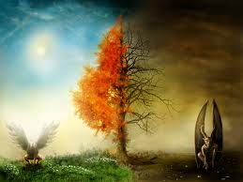
The End
Is not yet; what will you do with the time you have been given?

