Slide 1
Hebrews
Robert C. Newman

Slide 2
Authorship of Hebrews

Slide 3
Variety of Views on Author
Paul
Paul & Luke
Paul & Clement of Rome
Luke
Barnabas
Apollos
Other Less Likely Suggestions

Slide 4
Internal Evidence on Author
Explicit indications
Associate of Timothy
Not one of the original 12 apostles
Appears to be one author, male
Content
Similarities to Paul
Differences from Paul

Slide 5
Internal Evidence on Author
Style
More Hellenistic than (other) Pauline letters
Differences in phrasing

Slide 6
External Evidence on Author
Hebrews is attested as early as any NT work.
The Alexandrian fathers all refer to it.
Tertullian (c200) assigns it to Barnabas.
Generally:
The W churches denied Pauline authorship.
The E churches favored it, w/ qualification.

Slide 7
Summary on Author
Not Timothy!
Most likely named candidate is Paul.
But have to make special assumptions re/ its style
"Not Paul" more likely, but no single candidate would gain more votes.
God allowed knowledge of its author to be lost.

Slide 8
Recipients of Hebrews

Slide 9
The People
Surely Jewish.
Professing Christians.
We can say a good bit about their circumstances.
See under Background, later.

Slide 10
Their Location
Usual suggestions:
Rome
Jerusalem
Alexandria
Antioch
Critical passage (13:24) ambiguous
"Those from Italy greet you"

Slide 11
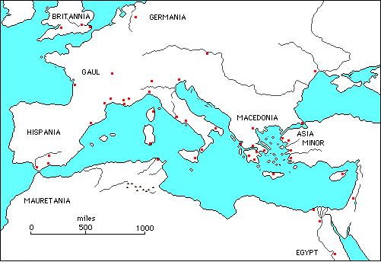
Their Location
Rome 
 Antioch
 Jerusalem
Alexandria 

Slide 12
Their Location
Following Lenski, I favor Rome as the letter’s destination.
Probably written to a Jewish house church in Rome facing Nero's persecution.
In any case, the remark to greet all the other leaders (13:24) favors a subgroup within a larger whole, such as a house church in a city with many such.

Slide 13
Date of Hebrews

Slide 14
Date of Hebrews
Latest possible – 95 AD
Must precede 1 Clement
Earliest possible – well after 30 AD
"heard" (2:3) implies church has secondary sources of information
"considering the outcome of their lives" (13:7) sounds like original leaders have died, though possibly martyred

Slide 15
Date of Hebrews
More refinement attempted
The temple is still functioning, so before 70 AD
If the Timothy is Paul's companion, not till after 50 AD
Apparently not safe (where recipients are) to be a Christian, but still safe to be a Jew
If Rome, probably between 64 and 66 AD
Other locations might have wider window

Slide 16
Background of Recipients

Slide 17
Their Conversion
Apparently converted by immediate disciples of Christ (2:3), who had confirmed truth of their message by miracles (2:4)
The writer is confident that they (most of them) are saved (6:9), in spite of his warning for their need to hold on (3:14)

Slide 18
Their Christian Life & Ministry
Had seen some persecution earlier
Had been Christians long enough for their first leaders to die
But recently they had stagnated

Slide 19
Their Problem
Knew the basics of Christianity, but were backsliding
Were in severe danger of apostasy
Not into paganism or some other heresy
But into returning to Judaism
Writer argues that Xy supercedes OT
Jesus is the final mediator
He typologically fulfills the OT sacrifices

Slide 20
Outline of Hebrews

Slide 21
Outline of Hebrews
Prologue: God's revelation climaxes in his Son (1:1-4)
Superior to the OT mediators (1:5-7:28)
Angels (1:5-2:18)
Moses (& Joshua) (3:1-4:13)
Aaronic Priests (5:1-7:28)

Slide 22
Outline of Hebrews
Superior to the OT provisions (8:1-10:39)
Better covenant (8:1-13)
Better sanctuary (9:1-12)
Better sacrifice (9:13-10:18)
Exhortation & Final Plea for Faith (10:19-12:29)
Concluding Exhortations (13:1-25)

Slide 23
The Argument of Hebrews
See text in Course Notes

Slide 24
The End
Hebrews deserves a lifetime of repeated study

