Slide 1

Heaven & Hell
R. Todd Mangum
Robert C. Newman

Slide 2
Introduction
"Heaven" and "Hell" are not entirely satisfactory terms, because they are used in several different ways in the Bible and in popular culture.
Here we use them as shorthand for the future destinies of the righteous (heaven) and unrighteous (hell).

Slide 3
Heaven
The Bible describes the future of the righteous as follows:

Slide 4
Heaven
We are with God/Christ.
We are rewarded for righteous deeds.
We get a glorified body.
We share in Christ's reign.
We live in an eternal kingdom/city/home prepared by God/Jesus.

Slide 5
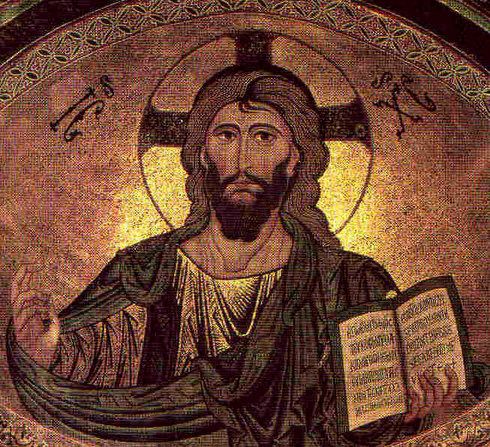
We are with God/Christ
Psalm 16:11
Isaiah 33:17
Malachi 3:17
Matthew 3:12
John 12:26
Colossians 3:4
1 Thessalonians 4:17

Slide 6
Psalm 16:11
You will make known to me the path of life;
In Your presence is fullness of joy;
In Your right hand there are pleasures forever.
We are with God/Christ.

Slide 7
Isaiah 33:17
Your eyes will see the King in His beauty;
They will behold a far-distant land.
We are with God/Christ.

Slide 8
Malachi 3:17
16 Then those who feared the Lord spoke to one another, and the Lord gave attention and heard [it], and a book of remembrance was written before Him for those who fear the Lord and who esteem His name.
17 "They will be Mine," says the Lord of hosts, "on the day that I prepare [My] own possession, and I will spare them as a man spares his own son who serves him."
We are with God/Christ.

Slide 9
Matthew 3:12
His winnowing fork is in His hand, and He will thoroughly clear His threshing floor; and He will gather His wheat into the barn, but He will burn up the chaff with unquenchable fire.
We are with God/Christ.

Slide 10
John 12:26
If anyone serves Me, he must follow Me; and where I am, there My servant will be also; if anyone serves Me, the Father will honor him.
We are with God/Christ.

Slide 11
Colossians 3:4
When Christ, who is our life, is revealed, then you also will be revealed with Him in glory.
We are with God/Christ.

Slide 12
1 Thessalonians 4 :17
Then we who are alive and remain will be caught up together with them in the clouds to meet the Lord in the air, and so we shall always be with the Lord.
We are with God/Christ.

Slide 13

We are rewarded for righteous deeds
Daniel 12:3
Matthew 25:34-35
Colossians 1:5-6
Hebrews 10:34
1 Peter 1:4

Slide 14
Daniel 12:3
Those who have insight will shine brightly like the brightness of the expanse of heaven, and those who lead the many to righteousness, like the stars forever and ever.
We are rewarded for righteous deeds.

Slide 15
Matthew 25:34-35
34 Then the King will say to those on His right, "Come, you who are blessed of My Father, inherit the kingdom prepared for you from the foundation of the world. 35 For I was hungry, and you gave Me [something] to eat; I was thirsty, and you gave Me [something] to drink; I was a stranger, and you invited Me in…"
We are rewarded for righteous deeds.

Slide 16
Colossians 1:5-6
5 ... because of the hope laid up for you in heaven, of which you previously heard in the word of truth, the gospel 6 which has come to you, just as in all the world also it is constantly bearing fruit and increasing, even as [it has been doing] in you also since the day you heard [of it] and understood the grace of God in truth;
We are rewarded for righteous deeds.

Slide 17
Hebrews 10:34
For you showed sympathy to the prisoners and accepted joyfully the seizure of your property, knowing that you have for yourselves a better possession and a lasting one.
We are rewarded for righteous deeds.

Slide 18
1 Peter 1:3-4
3 Blessed be the God and Father of our Lord Jesus Christ, who according to His great mercy has caused us to be born again to a living hope through the resurrection of Jesus Christ from the dead, 4 to [obtain] an inheritance [which is] imperishable and undefiled and will not fade away, reserved in heaven for you…
We are rewarded for righteous deeds.

Slide 19
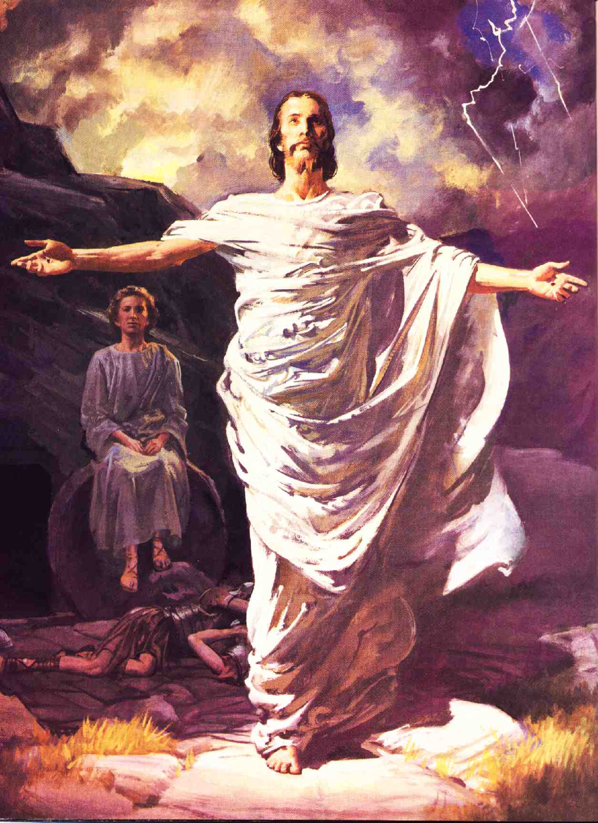
We get a glorified body
Isaiah 26:19
Daniel 12:2-3
Matthew 13:43
1 Corinthians 15:42-44
2 Corinthians 5:1-2

Slide 20
Isaiah 26:19
Your dead will live; Their corpses will rise. You who lie in the dust, awake and shout for joy, For your dew [is as] the dew of the dawn, And the earth will give birth to the departed spirits.
We get a glorified body

Slide 21
Daniel 12:2-3
2 Many of those who sleep in the dust of the ground will awake, these to everlasting life, but the others to disgrace [and] everlasting contempt. 3 Those who have insight will shine brightly like the brightness of the expanse of heaven, and those who lead the many to righteousness, like the stars forever and ever.
We get a glorified body

Slide 22
Matthew 13:43
Then the righteous will shine forth as the sun in the kingdom of their Father. He who has ears, let him hear.
We get a glorified body

Slide 23
1 Corinthians 15:42-44
42 So also is the resurrection of the dead. It is sown a perishable [body], it is raised an imperishable [body]; 43 it is sown in dishonor, it is raised in glory; it is sown in weakness, it is raised in power; 44 it is sown a natural body, it is raised a spiritual body. If there is a natural body, there is also a spiritual [body].
We get a glorified body

Slide 24
2 Corinthians 5:1-2
1 For we know that if the earthly tent which is our house is torn down, we have a building from God, a house not made with hands, eternal in the heavens. 2 For indeed in this [house] we groan, longing to be clothed with our dwelling from heaven,
We get a glorified body

Slide 25
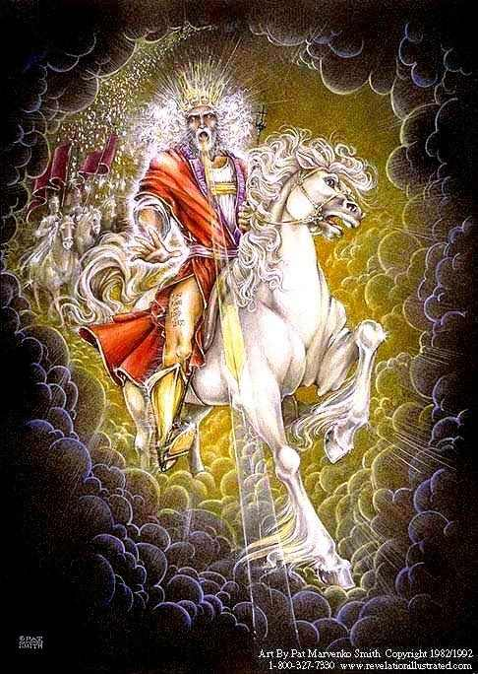
We share in Christ’s reign
Daniel 7:26-27
Luke 22:28-30
1 Corinthians 6:2-3
Revelation 3:21
Revelation 20:4

Slide 26
Daniel 7:26-27
26 But the court will sit [for judgment], and his dominion will be taken away, annihilated and destroyed forever. 27 Then the sovereignty, the dominion and the greatness of [all] the kingdoms under the whole heaven will be given to the people of the saints of the Highest One; His kingdom [will be] an everlasting kingdom, and all the dominions will serve and obey Him.
We share in Christ’s reign

Slide 27
Luke 22:28-30
28 You are those who have stood by Me in My trials; 29 and just as My Father has granted Me a kingdom, I grant you 30 that you may eat and drink at My table in My kingdom, and you will sit on thrones judging the twelve tribes of Israel.
We share in Christ’s reign

Slide 28
1 Corinthians 6:2-3
2 Or do you not know that the saints will judge the world? If the world is judged by you, are you not competent [to constitute] the smallest law courts? 3 Do you not know that we will judge angels? How much more matters of this life?
We share in Christ’s reign

Slide 29
Revelation 3:21
He who overcomes, I will grant to him to sit down with Me on My throne, as I also overcame and sat down with My Father on His throne.
We share in Christ’s reign

Slide 30
Revelation 20:4
Then I saw thrones, and they sat on them, and judgment was given to them. And I [saw] the souls of those who had been beheaded because of their testimony of Jesus and because of the word of God, and those who had not worshiped the beast or his image, and had not received the mark on their forehead and on their hand; and they came to life and reigned with Christ for a thousand years.
We share in Christ’s reign

Slide 31
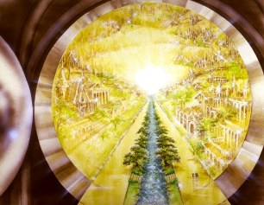
We live in a place prepared by God/Jesus Himself
Psalm 23:6
Matthew 25:34
John 14:2-3
Hebrews 12:22-24
2 Peter 1:11
2 Peter 3:13

Slide 32
Psalm 23:6
Surely goodness and lovingkindness will follow me all the days of my life,
And I will dwell in the house of the Lord forever.
We live in a place prepared by God/Jesus Himself

Slide 33
Matthew 25:34
Then the King will say to those on His right, "Come, you who are blessed of My Father, inherit the kingdom prepared for you from the foundation of the world."
We live in a place prepared by God/Jesus Himself

Slide 34
John 14:2-3
2 In My Father's house are many dwelling places; if it were not so, I would have told you; for I go to prepare a place for you. 3 If I go and prepare a place for you, I will come again and receive you to Myself, that where I am, [there] you may be also.
We live in a place prepared by God/Jesus Himself

Slide 35
Hebrews 12:22-24
22 But you have come to Mount Zion and to the city of the living God, the heavenly Jerusalem, and to myriads of angels, 23 to the general assembly and church of the firstborn who are enrolled in heaven, and to God, the Judge of all, and to the spirits of [the] righteous made perfect, 24 and to Jesus, the mediator of a new covenant, and to the sprinkled blood, which speaks better than [the blood] of Abel.
We live in a place prepared by God/Jesus Himself

Slide 36
2 Peter 1:10-11
10 Therefore, brethren, be all the more diligent to make certain about His calling and choosing you; for as long as you practice these things, you will never stumble; 11 for in this way the entrance into the eternal kingdom of our Lord and Savior Jesus Christ will be abundantly supplied to you.
We live in a place prepared by God/Jesus Himself

Slide 37
2 Peter 3:13
But according to His promise we are looking for new heavens and a new earth, in which righteousness dwells.
We live in a place prepared by God/Jesus Himself

Slide 38
Further Observations
Apparently we will be able to recognize others.
Hard to know how literally to take the scenes of Revelation 14:1-3 (Lamb and 144K on Mt Zion), 15:2 (sea of glass & fire), or even Revelation 21-22.
How continuous is the millennium with the eternal state, or the new heavens & earth with the old?

Slide 39
Heaven
We are with God/Christ.
We are rewarded for righteous deeds.
We get a glorified body.
We share in Christ's reign.
We live in an eternal kingdom/city/home prepared by God/Jesus.

Slide 40
Hell
In Scripture, the future dwelling of the unrighteous is described as:

Slide 41
Hell a place of:
Fire
Darkness
Weeping & gnashing of teeth
Punishment, torturers, beating, cutting in pieces
Destruction
Away from the presence of the Lord

Slide 42
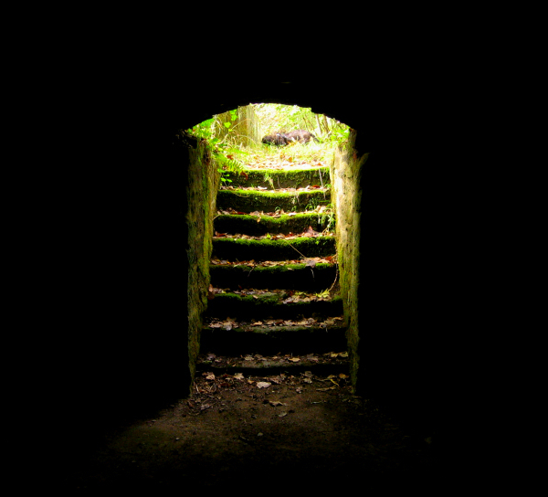
Hell as Darkness
Matthew 8:12
Matthew 22:13
Matthew 25:30
2 Peter 2:4
Jude 6
But compare Revelation 9:1-2

Slide 43
Matthew 8:12
(Context: Feast w/ Abraham)
…but the sons of the kingdom will be cast out into the outer darkness; in that place there will be weeping and gnashing of teeth.
Hell as Darkness

Slide 44
Matthew 22:13
(Parable of Wedding Banquet)
Then the king said to the servants, "Bind him hand and foot, and throw him into the outer darkness; in that place there will be weeping and gnashing of teeth."
Hell as Darkness

Slide 45
Matthew 25:30
(Parable of Talents)
Throw out the worthless slave into the outer darkness; in that place there will be weeping and gnashing of teeth.
Hell as Darkness

Slide 46
2 Peter 2:4
(Fallen Angels)
For if God did not spare angels when they sinned, but cast them into hell and committed them to pits of darkness, reserved for judgment…
Hell as Darkness

Slide 47
Jude 6
(Fallen Angels)
And angels who did not keep their own domain, but abandoned their proper abode, He has kept in eternal bonds under darkness for the judgment of the great day…
Hell as Darkness

Slide 48
Revelation 9:1-2
(Fifth Trumpet)
1 Then the fifth angel sounded, and I saw a star from heaven which had fallen to the earth; and the key of the bottomless pit was given to him. 2 He opened the bottomless pit, and smoke went up out of the pit, like the smoke of a great furnace; and the sun and the air were darkened by the smoke of the pit.
Hell as Darkness

Slide 49
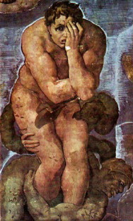
Hell as Weeping…
Matthew 8:12
  seen under Darkness
Matthew 13:42
Matthew 13:50
Matthew 22:13
  seen under Darkness
Matthew 25:30
  seen under Darkness

Slide 50
Matthew 13:41-42
(Parable of Wheat & Weeds)
41 The Son of Man will send forth His angels, and they will gather out of His kingdom all stumbling blocks, and those who commit lawlessness, 42 and will throw them into the furnace of fire; in that place there will be weeping and gnashing of teeth.
Hell as Weeping…

Slide 51
Matthew 13:49-50
(Parable of Dragnet)
49 So it will be at the end of the age; the angels will come forth and take out the wicked from among the righteous, 50 and will throw them into the furnace of fire; in that place there will be weeping and gnashing of teeth.
Hell as Weeping…

Slide 52
Hell as Punishment, etc.
Matthew 18:34
Matthew 24:51
Matthew 25:46
Luke 12:46-48

Slide 53
Matthew 18:34-35
(Parable of Unmerciful Servant)
34 And his lord, moved with anger, handed him over to the torturers until he should repay all that was owed him. 35 My heavenly Father will also do the same to you, if each of you does not forgive his brother from your heart.
Hell as Punishment

Slide 54
Matthew 24:50-51
(Parable of Wicked Servant)
50 the master of that slave will come on a day when he does not expect [him] and at an hour which he does not know, 51 and will cut him in pieces and assign him a place with the hypocrites; in that place there will be weeping and gnashing of teeth.
Hell as Punishment

Slide 55
Matthew 25:46
(Parable of Sheep & Goats)
These will go away into eternal punishment, but the righteous into eternal life.
Hell as Punishment

Slide 56
Luke 12:46-48
46 the master of that slave will come on a day when he does not expect [him] and at an hour he does not know, and will cut him in pieces, and assign him a place with the unbelievers. 47 And that slave who knew his master's will and did not get ready or act in accord with his will, will receive many lashes, 48 but the one who did not know [it], and committed deeds worthy of a flogging, will receive but few. From everyone who has been given much, much will be required; and to whom they entrusted much, of him they will ask all the more.
Hell as Punishment

Slide 57
Hell as Destruction
Matthew 7:13-14
Matthew 10:28
2 Thessalonians 1:9

Slide 58
Matthew 7:13-14
(Sermon on Mount)
13 Enter through the narrow gate; for the gate is wide and the way is broad that leads to destruction, and there are many who enter through it. 14 For the gate is small and the way is narrow that leads to life, and there are few who find it.
Hell as Destruction

Slide 59
Matthew 10:28
Do not fear those who kill the body but are unable to kill the soul; but rather fear Him who is able to destroy both soul and body in hell.
Hell as Destruction

Slide 60
2 Thessalonians 1:9
These will pay the penalty of eternal destruction, away from the presence of the Lord and from the glory of His power…
Hell as Destruction

Slide 61
Hell's Torment as
Eternal & Conscious
Daniel 12:1-2
Mark 9:47-48
Isaiah 66:23-24
Revelation 14:9-12
Revelation 22:14-15

Slide 62
Daniel 12:1-2
1 Now at that time Michael, the great prince who stands [guard] over the sons of your people, will arise. And there will be a time of distress such as never occurred since there was a nation until that time; and at that time your people, everyone who is found written in the book, will be rescued. 2 Many of those who sleep in the dust of the ground will awake, these to everlasting life, but the others to disgrace [and] everlasting contempt.
Hell’s Torment as Eternal & Conscious

Slide 63
Mark 9:47-48
(Causing Little Ones to Sin)
47 If your eye causes you to stumble, throw it out; it is better for you to enter the kingdom of God with one eye, than, having two eyes, to be cast into hell, 48 where their worm does not die, and the fire is not quenched.
Hell’s Torment as Eternal & Conscious

Slide 64
Isaiah 66:23-24
(New Heavens & New Earth)
23 And it shall be from new moon to new moon And from sabbath to sabbath, All mankind will come to bow down before Me, says the Lord. 24 Then they will go forth and look On the corpses of the men Who have transgressed against Me. For their worm will not die And their fire will not be quenched; And they will be an abhorrence to all mankind.
Hell’s Torment as Eternal & Conscious

Slide 65
Revelation 14:9-12
9 Then another angel, a third one, followed them, saying with a loud voice, "If anyone worships the beast and his image, and receives a mark on his forehead or on his hand, 10 he also will drink of the wine of the wrath of God, which is mixed in full strength in the cup of His anger; and he will be tormented with fire and brimstone in the presence of the holy angels and in the presence of the Lamb. 11 And the smoke of their torment goes up forever and ever; they have no rest day and night, those who worship the beast and his image, and whoever receives the mark of his name." 12 Here is the perseverance of the saints who keep the commandments of God and their faith in Jesus.
Hell’s Torment as Eternal & Conscious

Slide 66
Revelation 22:14-15
14 Blessed are those who wash their robes, so that they may have the right to the tree of life, and may enter by the gates into the city. 15 Outside are the dogs and the sorcerers and the immoral persons and the murderers and the idolaters, and everyone who loves and practices lying.
Hell’s Torment as Eternal & Conscious

Slide 67
Hell a place of:
Fire
Darkness
Weeping & gnashing of teeth
Punishment, torturers, beating, cutting in pieces
Destruction
Away from the presence of the Lord

Slide 68
Some Clarifications
Hell is not (in the Bible) pictured as a place were Satan & the demons are tormenting anyone.
Rather, Satan & his helpers are chief prisoners of hell.

Slide 69
The End
Do all you can to make sure that your end is life and not death!

