Slide 1
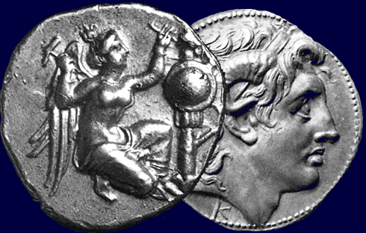
Greco-Roman Symbolism in the Book of Revelation
Robert C. Newman

Slide 2
Old Testament Allusions
Revelation makes many allusions to the Old Testament, but doesn’t quote from it.
UBS Greek New Testament has no entries for Revelation in its 'Index of Quotations'
Has 632 entries in its 'Index of Allusions and Verbal Parallels'

Slide 3
Old Testament Allusions
Some of these allusions are to a specific passage or theme:
Rev 1:7 'he is coming with the clouds'
To Dan 7:13 'one like a son of man, coming with the clouds of heaven'
Rev 5:6 'a lamb, looking as if it had been slain'
To the theme of sacrifice found throughout the Old Testament

Slide 4
Old Testament Allusions
Other allusions are more complex:
The several references to a two-edged sword coming from Jesus' mouth are a combination:
Of Isa 49:2 'He made my mouth like a sharpened sword'
And Isa 11:4 'He will strike the earth with the rod of his mouth; with the breath of his lips he will slay the wicked'
The beast of Revelation 13 is a combination:
Of the four beasts of Daniel 7

Slide 5
Other Allusions
Besides these many Old Testament allusions, some suggest that Revelation includes allusions to non-biblical works:
UBS Greek New Testament 'Index of Allusions and Verbal Parallels' has 32 entries for apocryphal and pseudepigraphal Jewish works.
Our interest here is with Greco-Roman connections rather than Jewish ones.

Slide 6
Greco-Roman Allusions
William M. Ramsay has found a number of these in the letters to the seven churches (Rev 2-3). Some examples:
Sardis was never taken by storm, but only by stealth at night (cp Rev 3:3): (NIV) Remember, therefore, what you have received and heard; obey it, and repent. But if you do not wake up, I will come like a thief, and you will not know at what time I will come to you.
Laodicea was plagued with a water supply which was only lukewarm by the time it reached the city (cp Rev 3:16): (NIV) So, because you are lukewarm--neither hot nor cold--I am about to spit you out of my mouth.
These are not controversial.

Slide 7
Greco-Roman Allusions
Evangelicals are more skeptical about alleged allusions to Greco-Roman paganism:
Partly due to biblical teaching against idolatry
Partly to impression some commentators give that author of Revelation was faking a vision
I suggest another spin on this data, that God (the book’s ultimate author) was communicating to his Greco-Roman readers in terms they would understand, since most of them were raised in paganism.
Let's see.

Slide 8
Symbols with Little or No Old Testament Background

Slide 9
Little or No OT Background
(1) The white stone (Rev 2:17)
(2) Deep secrets & mysteries (Rev 2:24; 10:7)
(3) The seven hills (Rev 17:9)
(4) Title on her forehead (Rev 17:5)

Slide 10
The White Stone
Jesus promises the overcomer: "I will give him a white stone with a new name written on it" (Rev 2:17)
Jury voting with colored stones:
White = innocent
Black = guilty
Pebbles as admission tickets to a banquet
So acquittal at judgment or admission to the Messianic banquet

Slide 11
Deep Secrets
Rev 2:24 – reference to 'deep secrets' of Satan
Rev 10:7 – allusion to 'the mystery of God'
These bring to mind the mystery religions of the Greco-Roman world, with the attraction of their secret rites and initiations. Everyone would have some acquaintance with these.
Lesson: There are evil mysteries and there are good mysteries. You need to have the right 'mystery religion.'

Slide 12
Seven Hills
The harlot seated on the seven hills in Rev 17:9 would suggest Rome to nearly any reader of John’s time.
Familiar from Horace, Virgil, Martial, Cicero, Propertius
This provides reader a hint that the harlot is not only Babylon but also Rome.

Slide 13
Name on Forehead
Rev 17:5 – title on forehead of harlot
Other occurrences in Revelation:
Rev 13;16-17 – name of beast on foreheads of its followers
Rev 14:1 – name of God and the Lamb on foreheads of their followers
Exodus 28:36-38 – high priest has gold plate on his forehead with name of God

Slide 14
Name on Forehead
Yet Roman harlots wore a label with their names on their brows, and the title on the forehead of the harlot here in Revelation is her name, not someone else's.
So Revelation gives its original readers a vivid picture of a harlot, such as they would often see in the streets of their own cities.

Slide 15
Symbols with OT Background but Unique Features

Slide 16
Some Unique Features
(5) Crowns to the overcomers (Rev 2:10, 3:11)
(6) The four horsemen (Rev 6)
(7) The seven-sealed scroll (Rev 5)
(8) He who is, and was, and is to come (Rev 1:4, 8; 4:8; 11:17; 16:5)
(9) The seven stars (Rev 1:16, 20)

Slide 17
Crowns to Overcomers
Rev 2:10 – 'crown of life' promised to one who overcomes
Rev 3:11 – hold on so 'no one will take your crown'
Though crowns are mentioned frequently in the Old Testament, the figure here seems to be that of a crown as reward.
This is common for victors in Greco-Roman world, both:
Military victory
Athletic victory

Slide 18
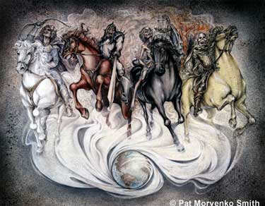
Four Horsemen
These horses and riders in Revelation 6 have a background in Zechariah 1 and 6.
Yet the figures in Rev 6 are allegorical in a way those in Zechariah are not.
This fits the Greco-Roman penchant for allegory, seen in their artwork & coinage.

Slide 19
Four Horsemen
Whatever the first horseman represents, the others are surely:
(2) War
(3) Famine
(4) Death
I suggest the 1st is also allegorical, representing Conquest, rather than Christ or Antichrist as often suggested.

Slide 20
Seven-Sealed Scroll
Sealed documents were a standard practice in the ancient near east to protect legal transactions from fraud:
Dan 12:9
Isa 29:11

Slide 21
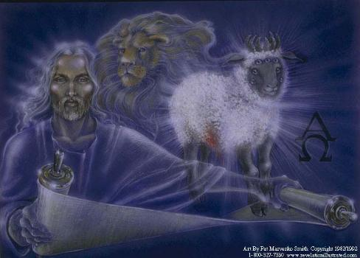
Seven-Sealed Scroll
But seven seals has no OT background, whereas Roman wills and some other legal documents were typically sealed with seven seals.
Perhaps this is intended to be Jesus' will he is opening, or the title deed to planet earth.

Slide 22
He Who Is…
The triple characterization of God (who is, was, and is to come) seen in Rev 1:4, 8; 4:8, with a shorter double version in 11:17 and 16:5, clearly has roots in God’s revelation to Moses in Ex 3:14.
Yet this triplet is more elaborate than either the Hebrew or Greek in Exodus.

Slide 23
He Who Is…
GK Beale notes that "a similar threefold formula is found in pagan Greek literature as a title of the gods…"
This suggests that Revelation may use the phrase to remind its readers who really is the everlasting God.

Slide 24
The Seven Stars
The stars in Jesus' hand (Rev 1:16, 20) are the seven angels associated with the seven churches.
The number seven is a major feature of the structure of Revelation.
Yet it is possible that there is a reference here to some particular seven stars:
The Pleiades
The Great Bear (Big Dipper)
The Seven Planets

Slide 25
Symbols Resembling Pagan Mythology

Slide 26
Resembling Pagan Mythology
(10) The woman, the child and the dragon (Rev 12)
(11) The harlot riding the beast (Rev 17)

Slide 27
Woman, Child, Dragon
This incident has attracted much attention.
Each item separately can be reproduced from the OT and Jewish sources, but not the whole.
The shape of the story is close to:
(1) The Egyptian myth of Isis begetting Horus, opposed by the red dragon Typhon, with Horus later killing the dragon.
(2) The Greek myth of Leto bearing Apollo, opposed by the dragon Python, and Apollo later killing it.

Slide 28
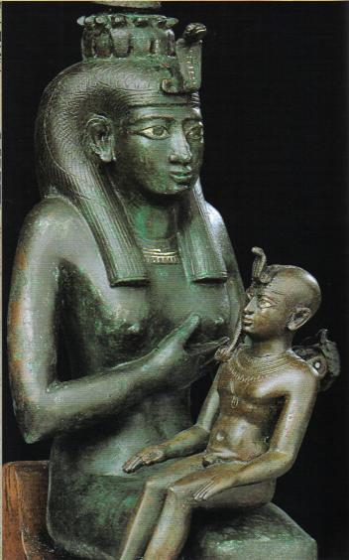
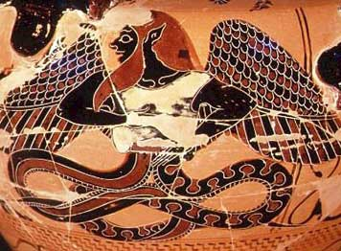
Isis w/ Horus, and Typhon

Slide 29
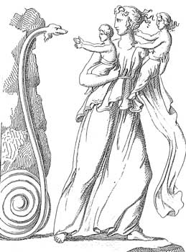
Leto with Children

Slide 30
Woman, Child, Dragon
What should we make of this?
RH Charles has John borrowing from paganism.
CS Lewis, in Pilgrim’s Regress and in Till We Have Faces, suggests that God implanted stories among the pagans, which (though distorted & corrupted by them) still testify to God's redemptive purpose.
This would fit Jesus' remark in John 12:23-24 (when Greeks came to him) about a grain of wheat dying & rising to produce many seeds.

Slide 31
Woman, Child, Dragon
It would also fit recent suggestions by some missiologists regarding redemptive analogies:
See Don Richardson, Eternity in Their Hearts
See a similar approach in Ernest L. Martin, The Star That Astonished the World and my PowerPoint talk, "The Star of Bethlehem: What Was It?"

Slide 32
Harlot Riding Beast
In Rev 17, John sees a vision of the harlot Babylon riding the beast of chapter 13.
Again, both components have OT background, but not the combination.

Slide 33
Harlot Riding Beast
The harlot has OT symbolic background along two lines:
Israel as harlot:
Isa 1:21
Jer 2:20
Ezek 16
Pagan city as harlot:
Tyre – Isa 23:17
Nineveh – Nahum 3:4

Slide 34
Harlot Riding Beast
The riding motif does not occur in the OT.
But in Greco-Roman mythology, there is a striking parallel in the Europa myth. According to Apollodorus and Ovid:
Zeus sees Europa, daughter of a Phoenician king, playing with her friends at the seashore.
He disguises himself as a bull & gets Europa to climb on his back.
He heads out to sea, takes her to Crete, & has children by her.
Clearly, the rider was not here in control of the mount!

Slide 35
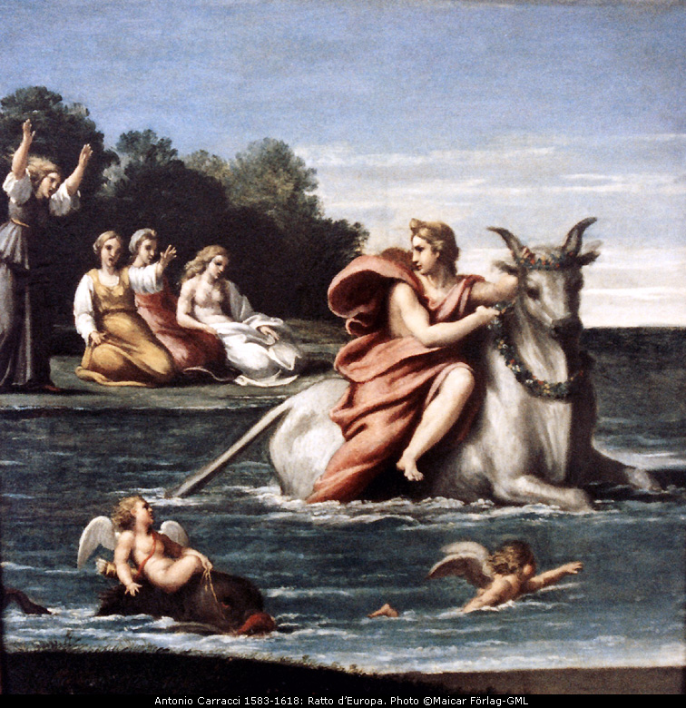
Zeus & Europa

Slide 36
Harlot Riding Beast
For believers seeking to correlate Revelation with current events, it is intriguing to note that the Europa symbol has recently been used to represent the European Union:
UK stamp
TIME article
Der Spiegel cover
2 Euro coin
Perhaps we are to read the harlot picture as alluding to Europe as well as Babylon & Rome.

Slide 37
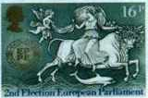
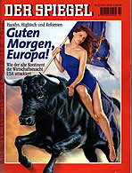
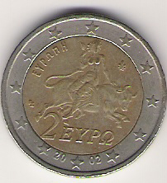
Harlot Riding Beast

Slide 38
Conclusions

Slide 39
Conclusions
In our quick tour of Revelation, we found a number of allusions to Greco-Roman symbols, more than ten.
I suspect a real inhabitant of the ancient Greco-Roman culture could have found even more.
Most of the pictorial elements chosen to make Revelation vivid to its original readers come from Scripture, which is not surprising since the readers are professing Christians.

Slide 40
Conclusions
Yet a significant number are from their background Gentile culture, and some even from pagan mythology.
It is true that Revelation does not tell us it is getting these pictures from the culture, but neither does it tell us it is getting the others from the OT.
Only the person who is familiar with the material will recognize the allusions.

Slide 41
Conclusions
Regarding the question of contextualizing the Gospel, the example of Revelation needs to be factored into our thinking.
This should also cause us to consider, what sort of presence did God maintain among the Gentiles during those centuries when he concentrated on Israel?
What sort of presence is He maintaining even now?

Slide 42
For Further Reading
A more detailed treatment of this topic is given in my paper, "Greco-Roman Symbolism in the Book of Revelation," available from the Theological Research Exchange Network, at www.tren.com.

Slide 43
The End

