Slide 1
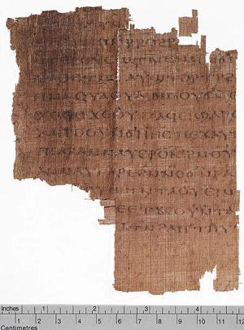
The Gospel of Judas
Robert C. Newman

Slide 2
Announcement
Press conference April 6, 2006
National Geographic Society
Only known surviving manuscript of the ancient Gospel of Judas
Part of a booklet:
Containing three Gnostic works
Dating from about AD 300

Slide 3
Why This Talk?
Discovery has been heavily hyped in the media.
News releases rarely give much of the ancient background.
I have been asked to comment on the find on several occasions.

Slide 4
Previous Knowledge
Details of text have been lost for many centuries.
But known by title and brief descriptions since early in church history.
Earliest account is given by Christian apologist Irenaeus about AD 180.

Slide 5
Irenaeus
Bishop of Lyon in Southern France
Flourished about AD 180
Was raised in Asia Minor
Studied under two students of the apostle John:
Papias
Polycarp
Wrote an extensive work reponding to Gnosticism, Against Heresies.

Slide 6
Irenaeus, Against Heresies, "Doctrines of the Cainites"
Others again declare that Cain derived his being from the Power above [the Gnostic high God], and acknowledge that Esau, Korah, the Sodomites, and all such persons, are related to themselves [the Cainites]. On this account, they add, they have been assailed by the Creator [the lesser, ignorant god who made the universe], yet no one of them has suffered injury. For Sophia [one of the gnostic gods, or aeons] was in the habit of carrying off that which belonged to her from them to herself.

Slide 7
Irenaeus, Against Heresies, "Doctrines of the Cainites"
They declare that Judas the traitor was thoroughly acquainted with these things, and that he alone, knowing the truth as no others did, accomplished the mystery of the betrayal; by him all things, both earthly and heavenly, were thus thrown into confusion. They produce a fictitious history of this kind, which they style the Gospel of Judas.

Slide 8
Observations
It looks like we now have the text of the work Irenaeus describes.
Since it was in circulation by 180, it was probably written in the range 130-170.
After this sort of Gnosticism arose
Early enough to have attracted attention
The text may be found on the web at www.tertullian.org.

Slide 9
Content of Gospel of Judas
Opens with statement: "the secret account of the revelation that Jesus spoke in conversation with Judas Iscariot…"
Gnostics typically claimed their accounts had been kept secret, an early conspiracy theory!

Slide 10
Jesus Laughs
At disciples, for giving thanks for a meal.
By this prayer, he says, "your god" will be praised.
Apparently he is pictured as distinguishing their god, the Creator, from his God.
This is a typical Gnostic motif, since they believed matter was bad and could not have been created by the highest God.

Slide 11
Judas shows special insight
He says to Jesus: "I know where you come from. You are from the immortal realm of Barbelo [a Gnostic aeon also named Sophia]. I am not worthy to utter the name of the one who has sent you [presumably the highest god, variously named in the different Gnostic theological systems]."

Slide 12
Jesus visits another realm
Jesus speaks of having visited "another great and holy generation" which "no one born of this aeon" can see or associate with and "no host of angels of the stars will rule over."
This sounds like the Gnostic theme that spirit beings rule over our world and salvation is escape from this world.

Slide 13
Judas' Vision
Judas tells Jesus that he had a vision of the 12 apostles persecuting & stoning him.
Jesus tells Judas he will be the 13th disciple, to be cursed by the 12, but that he "will come to rule over them."

Slide 14
Jesus gives Judas the "real scoop" on Creation
He gives the Gnostic creation account as opposed to that in Genesis.
The invisible nameless Spirit (high God) calls into being the angel Self-Generated.
S-G calls into being lesser aeons and angels.
Other beings such as Adamas and Seth are created [the Cainites are a subset of the Sethian Gnostics]

Slide 15
Jesus gives Judas the "real scoop" on Creation
Seth is identified as the Christ.
There are eventually 12 aeons, 72 heavens, 360 firmaments, and innumerable angels.
Twelve angels are created to rule over chaos and the underworld.
One of these is Saklas, the creator of humans.

Slide 16
Judas' Destiny
After some discussion of the destiny of Adam and mankind, Jesus tells Judas about his (Judas') destiny:
"But you will exceed all of them. For you will sacrifice the man that clothes me."
That is, Judas is to bring about the death of Jesus' body, so that his spirit may escape from the world of matter.

Slide 17
End of Gospel of Judas
Judas accepts money from the high priests.
He turns Jesus over to them for execution.

Slide 18
Conclusions
The Gospel of Judas fits the well-known pattern of second-century Gnosticism.
Since matter is bad, so is the Creator, and those who oppose him in the biblical narratives are exalted by the Gnostics.
Thus some of the Gnostic groups are named Cainites, Ophites, etc., for those they identify with.

Slide 19
Conclusions
As one prominent scholar in Gnostic studies has noted, we are here looking at second-century mythology, not first-century history.
There is no reason to think that the Gospel of Judas gives us any reliable insights on the ministry of Jesus not found in the canonical Gospels.

Slide 20
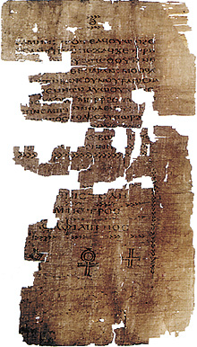
The End
… of this talk.
We can expect to hear regularly of other Christs, as Jesus himself predicted.

