Slide 1
Gospel Genres
Robert C. Newman
Biblical Theological Seminary

Slide 2
What is a Genre?
"A kind, sort, type; said of works of literature, art, etc." Webster’s New World Dictionary
Literature: fiction, biography, novel, poetry, murder mystery, limerick, sermon …
Art: portrait, landscape, abstract, still life, cartoon, caricature, art deco …
A sort of written, oral or visual communication that arouses particular expectations in the reader/listener due to certain distinctive markers.

Slide 3
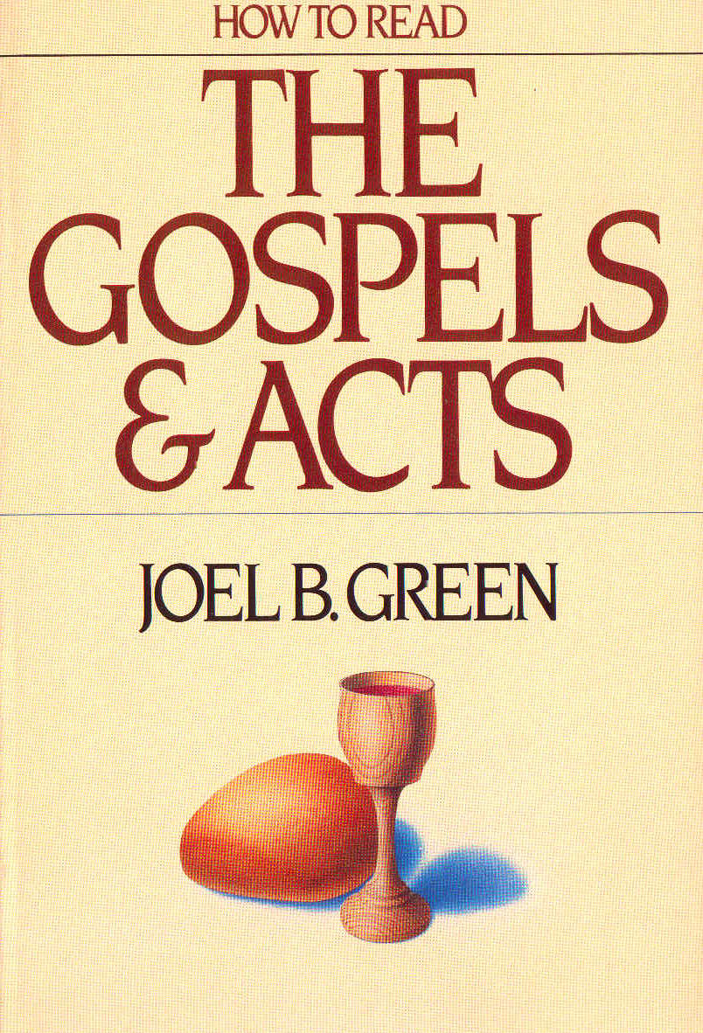
Common Genres in the Gospels
Narrative
Dialogue
Miracle Account
Controversy Account
Discourse
Parable
Symbolic Action
Genealogy

Slide 4
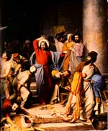
What sorts of things characterize narratives?
A narrative is a story or tale of events, either factual or fictional.
Components of a narrative:
Actors/Characters
Events/Action
Scene(s)
Plot(s)

Slide 5
Types of narrative in the Gospels
Annunciation/nativity stories
Calling/vocation stories
Recognition stories
Witness stories
Encounter stories
Conflict/controversy stories
Pronouncement stories
Miracle stories
Passion stories
Hybrid stories

Slide 6
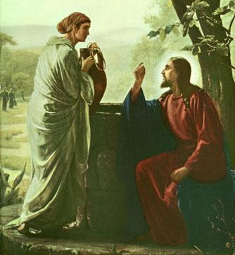
What characterizes dialogue?
Recorded speech of two or more speakers interacting with one another
Characterized by:
Direct discourse
Relatively little narration
Used to:
Show character
Record debate/argument
Answer questions

Slide 7
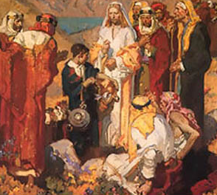
What characterizes a miracle account?
Obviously, a narrative in which a miracle is the central action
Characteristics:
The need is described
Jesus’ help is sought
Person in need (or helper) expresses faith
Jesus performs miracle
Characters respond to miracle/Jesus

Slide 8
What characterizes a controversy account?
Narrative dominated by a controversy
May be more dialogue or more discourse
Interpretive Qs:
Plot – what is the controversy?
Actors – where are they coming from?
Actions – what do they say/do; how relate to the controversy?

Slide 9
What characterizes discourse?
The speech of a single speaker
May be included in narrative or may stand alone
Things to look for:
What is the topic?
How is speaker developing the topic?
What is the flow of the argument?

Slide 10
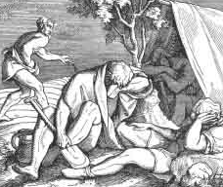
What characterizes a parable?
A brief story, told to illustrate a spiritual or ethical teaching
So it has characteristics of:
narrative
story-telling
It usually teaches by analogy:
Tenor – the lesson topic being taught
Vehicle – the story being used
Points of resemblance – how the tenor is analogous to the vehicle

Slide 11
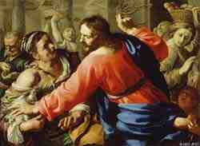
What characterizes a symbolic action?
This is an acted parable
The action is often unusual:
Cursing fig tree, washing feet
The audience/reader is expected to:
Realize that the action is symbolic
Try to discern what it is symbolic of
i.e., what is the tenor of which the action is the vehicle?

Slide 12
What characterizes a genealogy?
More common in the OT than the NT
A list of names of ancestors & descendants, usually marked to indicate which are which
Interpretive questions:
What is the author’s purpose in giving this genealogy?
Why does he include or exclude various items?

Slide 13
The End
There is probably no end to this sort of analysis, but this is a start, and we need to stop here!

