Slide 1

The Gospels as Literary Works
Robert C. Newman
Biblical Theological Seminary

Slide 2


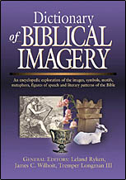
Leland Ryken
Words of Life: A Literary Introduction to the New Testament
Words of Delight – expanded for the whole Bible
See also his Dictionary of Biblical Imagery

Slide 3
Their Literary Form
What kind of writings are the Gospels?

Slide 4
What is the Overall
Genre of the Gospels?
Some Suggestions:
Biography?
Propaganda?
Dramatic History?
Collections of Stories?

Slide 5
Genre "Biography"?
Obviously Gospels are:
  Presenting information about Jesus
  Jesus actually lived in history
  So biographical in some sense
Not biography in modern scholarly sense:
  Not by uninvolved, detached observer
  Not giving all important dates & facts
  Not primarily personal reminiscences and character studies

Slide 6
Genre "Biography"?
More like biography in ancient, popular sense:
  Author has practical concerns
  Acquainting reader w/ historical person
  Giving an account of his deeds, words
  Resemble ancient biographies about:
    Socrates, Epictetus, Apollonius
  But Gospels concentrate on Jesus' death, and on reactions to him

Slide 7
Genre "Propaganda"?
Also popularly called:
  PR, sales pitch, hype
The Gospels are trying to convince readers that Jesus is vitally important & to move them to respond to him.
But propaganda
  Seeks to propagate ideas or attitudes
  A dirty word today, since it usually involves:
    Playing fast & loose with the truth;
    Working on fears, prejudices, exciting emotions.

Slide 8
Genre "Propaganda"?
Gospel writers are inviting a reader response.
  Not mainly interest or imagination
  But rather faith or trust in Jesus
Gospel writers are surprising:
  They restrain their post-Easter faith in telling the story.
  They let the events tell their own story.

Slide 9
Genre "Dramatic History"?
The Gospels are telling a dramatic story of the person, actions, and impact of Jesus, a real figure in history.
They do in some ways look more like plays than modern narratives.
Roland Frye thinks the Gospels should be classed as dramatic histories, like those of:
  Shakespeare
  George Bernard Shaw

Slide 10
Characteristics of
Dramatic History
Essentially fair representation of events
Directed to a broad, general audience
Condensed to hold attention
Use representative (sample) people, incidents, actions to give accurate picture while keeping length down

Slide 11
Collections of Stories?
In contrast to modern biographies, the Gospels are most striking in being a collection of stories:
  Incidents, speeches, sayings
The Gospels are action-packed
  Numerous brief stories allow more of this than connected narrative does.

Slide 12
Collections of Stories?
They center on Jesus
  Person and work
  Explain and celebrate Jesus
  Use narrative to show:
    His actions
    His words
    Responses of others to him

Slide 13
Collections of Stories?
They contain varied materials
  Probably used independently before compilation
  Various categories of narratives
    Sketched or detailed events, dialogues
  Words of Jesus:
    Brief sayings
    Extended discourse
    Parables

Slide 14
Summary on Genre
Gospels are like:
Ancient, popular biography
Seeking to propagate faith
Dramatic history
Collections of stories

Slide 15
Their Techniques
How do the Gospels do this?

Slide 16
Gospel Techniques
Restraint & objectivity
Concise, compressed accounts
Very concrete narration
Selection of materials
Variety
Sampling

Slide 17
Restraint & Objectivity
Gospels unusual here, even compared to ancient biographies
Authors let Jesus speak & act
  Do not try to persuade or to influence the reader by evaluative comments
  Only technique used here is selection

Slide 18
Concise & Compressed
Especially in the Synoptics, most incidents are:
  Single scene
  Two actors (group as unit)
  Told w/ very economical use of words
John works with fewer accounts, but longer and more detailed.

Slide 19
Concrete Narration
To avoid danger in brief accounts of generality, blandness…
… Use specific incidents, with short, vivid description (like artist’s sketch)
… Use direct discourse
… Characterization by actor's words or actions rather than by description

Slide 20
Selection of Materials
The author selects:
  Which event he will recount
  How he will tell it
Author communicates his emphasis:
  Not by evaluation
  But by space provided
  By expectations aroused

Slide 21
Variety
The author groups material to provide variety:
  Alternation of actions/words
  Alternation of miracles/controversies
  Alternation of followers/opponents
Helps keep attention of audience

Slide 22
Sampling
Rather than give a full report, the Gospel writers give us samples of Jesus' speech and actions.
Various kinds of samples:
  Types of miracles
  Various kinds of people
  Sorts of opposition
  Speeches on various occasions

Slide 23
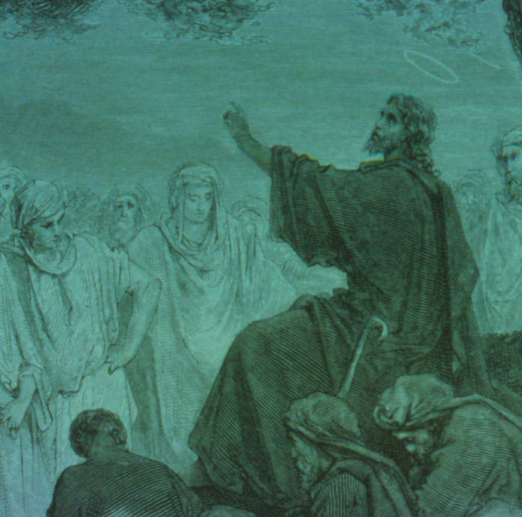
Jesus' Speeches
Typical features of his discourses

Slide 24
Jesus' Speeches
Aphoristic
Poetic
Patterned
Subversive
Fusion of genres
Structured

Slide 25
Aphoristic
Brief (sound-bites)
Memorable (structure, word-play)
Proverb-like
"Do not judge, or you too will be judged."
"If the blind lead the blind, both will fall into the ditch."

Slide 26
Poetic
Not rhyming or metric, but …
Often Hebrew parallelism
Concrete images
Metaphor and simile
Paradox
Hyperbole
"It is easier for a camel to go thru the eye of a needle than for a rich man to enter heaven."

Slide 27
Patterned
Repetition
Balance
"Ask and it will be given to you; seek and you will find; knock and the door will be opened to you…"

Slide 28
Subversive
Jesus attacks our everyday way of thinking
He undermines our conventional values
Consider the Beatitudes

Slide 29
Fusion of Genres
Sermon on Mount:
Beatitude
Character sketch
Proverb
Satire
Lyric
Parable
Sermon as whole:
Utopian literature
Inaugural address
Wisdom literature

Slide 30
Structured
Simple
Highly artistic
Single themes or three-fold examples
"The artistry of the design is apparent. There is no reason why the sermon as it stands could not be exactly the form Jesus' longer sermons took." – WOL,120

Slide 31
The End
Try to be on the lookout for these features.

