Slide 1
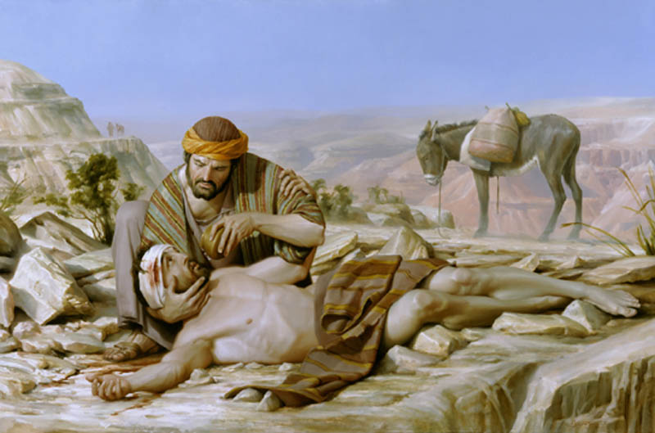
The Good Samaritan
Luke 10:25-37
Robert C. Newman

Slide 2
A Sample Parable
This parable is one of a group which are unique to Luke, called ‘sample’ parables.
Such a parable provides a sample of the attitudes or actions which we are to copy or to avoid.
This is in contrast to the more usual ‘translation’ parables, in which an earthly story functions as an analogy for a heavenly story.

Slide 3
Other Sample Parables
Rich Fool (12:16-21)
Death, wealth, security
Places of Honor (14:8-11)
Selfishness, looking out for #1
Whom to Invite (14:12-14)
Kindness, selfless generosity
Rich Man & Lazarus (16:19-31)
After death, concern for lost
Pharisee & Tax Collector (18:10-14)
Pride, self-righteousness, salvation

Slide 4
The Text (1)
Luke 10:25 (NIV) On one occasion an expert in the law stood up to test Jesus. "Teacher," he asked, "what must I do to inherit eternal life?" 26 "What is written in the Law?" he replied. "How do you read it?" 27 He answered: “ ‘Love the Lord your God with all your heart and with all your soul and with all your strength and with all your mind’ {Deut. 6:5}; and, ‘Love your neighbor as yourself.’ {Lev. 19:18}"
28 "You have answered correctly," Jesus replied. "Do this and you will live." 29 But he wanted to justify himself, so he asked Jesus, "And who is my neighbor?"

Slide 5
The Text (2)
Luke 10:30 (NIV) In reply Jesus said: "A man was going down from Jerusalem to Jericho, when he fell into the hands of robbers. They stripped him of his clothes, beat him and went away, leaving him half dead. 31 A priest happened to be going down the same road, and when he saw the man, he passed by on the other side. 32 So too, a Levite, when he came to the place and saw him, passed by on the other side. 33 But a Samaritan, as he traveled, came where the man was; and when he saw him, he took pity on him. 34 He went to him and bandaged his wounds, pouring on oil and wine. Then he put the man on his own donkey, took him to an inn and took care of him. 35 The next day he took out two silver coins and gave them to the innkeeper. ‘Look after him,’ he said, ‘and when I return, I will reimburse you for any extra expense you may have.’ "

Slide 6
The Text (3)
Luke 10:36 (NIV) "Which of these three do you think was a neighbor to the man who fell into the hands of robbers?"
37 The expert in the law replied, "The one who had mercy on him."
Jesus told him, "Go and do likewise."

Slide 7
The Context
Given in response to the legal expert’s question “Who is my neighbor?”
He had previously asked Jesus what to do to inherit eternal life.
Jesus then led the expert to answer his own question by means of a summary of the Old Testament Law in the two great commandments.

Slide 8
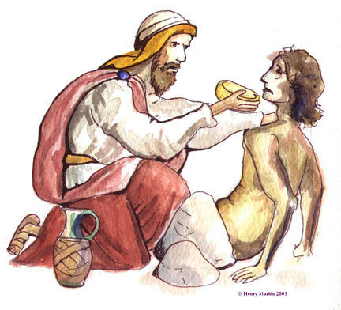
The Story of the Parable

Slide 9
The Traveller Attacked
A man is travelling down the Jericho road, the usual route from Jerusalem to both Perea and Galilee.
The road is dangerous to travel alone, being isolated and troubled by robbers.
The fellow is attacked, robbed, beaten, and left for dead, though in fact he still barely survives.

Slide 10
The Priest & the Levite
Two men come along singly, but each passes him by without helping.
They are probably in a hurry, as otherwise they would not be travelling alone.
There is some danger in stopping to help:
Where are the robbers now?
Is this guy a decoy?
They may have other rationalizations.

Slide 11
Other Rationalizations?
Their Reasoning:
Service responsibilities?
Cleanliness?
Someone else will help?
But the man will surely die if not helped, and these two would be the most likely:
Fellow Jews
Especially involved in religious work

Slide 12
The Samaritan
Only the Samaritan stops to help, yet he has better reasons than they do for not helping.
He is helping someone he doesn’t know from a hostile ethnic group.
He is endangering himself, perhaps even more than the priest or Levite
He gives up considerable time & money.

Slide 13
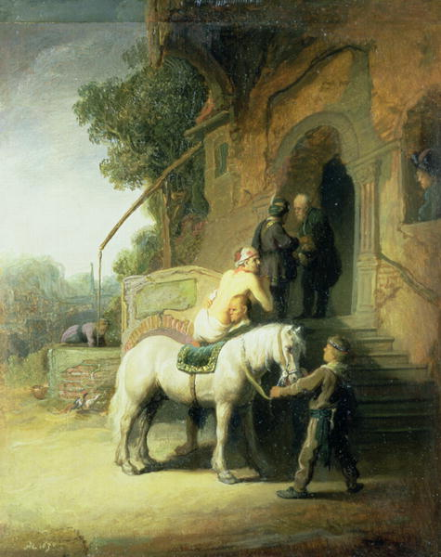
The Teaching of the Parable

Slide 14
Jesus Answers the Lawyer
Who is my neighbor?
Answer: anyone you come in contact with that you can help
The real question is not “who is my neighbor?” but “who am I going to be a neighbor to?”
Jesus also shows the lawyer (and us) something about how to go about this.

Slide 15
How to Go About It
You need compassion:
Contrast priest and Levite.
Compassion is what caused the Samaritan to get involved.
You need to take risks:
Surely a main reason priest & Levite didn’t do anything.
Samaritan’s compassion was strong enough to overcome his fear.

Slide 16
How to Go About It
You need to spend some time.
Perhaps p & L were in a hurry.
Priest (at least) was not headed for work, but perhaps he was in a hurry to get home.
Samaritan’s compassion was strong enough to take the time needed.
You need to spend some money.
Materials, night’s lodging
Two denarii (two days’ wages)
Authorization for innkeeper to spend more

Slide 17
How to Go About It
The Samaritan met the need.
Presumably the stranger didn’t die.
He surely would have if left untreated in the Judean wilderness.
He involved others.
He helped the innkeeper (whom he apparently knew) to get involved.

Slide 18
How to Go About It
Yet the Samaritan appears to have been thrifty.
Looks like two denarii is his estimate of what is needed to get the stranger back in shape to leave the inn.
He is willing to put up more, but lets the innkeeper take the initiative here.
Compare Jesus having the disciples gather up the leftovers after feeding the 5,000.

Slide 19
Lessons for Us
Go and do likewise!
Help people who are in distress:
Physical
Emotional
Intellectual
Spiritual
Expect it to involve danger, time, money.
It will be worth it all when we see Jesus!

Slide 20
The End
May we too be
Good Samaritans

