Slide 1


Going Home
Mom’s Funeral
28 August 2004
Robert C. Newman

Slide 2
Nothing Happens
It’s all over when you die.
There is no existence after death.
This is the view of atheism.
But atheism cannot explain…
The origin of the universe
The design of the universe
The origin of life

Slide 3
Reincarnation
When you die, you are born again…
… and you die again, and are born again… cycle after cycle after cycle.
This is the view of:
  The New Age Movement
  Buddhism
  Hinduism
But it looks like there is one mind behind the universe (as Christianity says).
And it is hard to see how karma works without a mind to run it.

Slide 4
A One-Time Transition
When you die, you transition into another permanent state, either:
  One of marvelous blessedness…
  Or one of great sorrow & anguish.
This is the view of biblical Christianity.
We will return to which view is true as we close.

Slide 5
Biblical Pictures of What Lies Beyond
Going Home

Slide 6
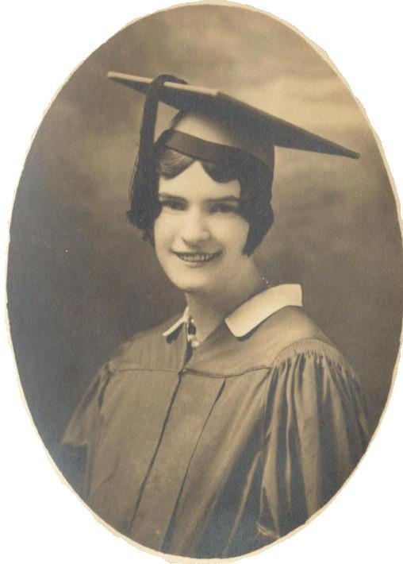
Going Home
Though she died at 92, an old woman, Mom won’t be old up there.
She’ll be young again, as in this picture.
In fact, for the believer, death is something like a graduation.

Slide 7
Biblical Pictures
Moving to the perfect city.
Living as an honored guest in the royal palace
Being wed to the King

Slide 8
Moving to the Perfect City
The New Jerusalem
Revelation 21
Isaiah 54
Hebrews 12

Slide 9
Revelation 21
1 (NIV) Then I saw a new heaven and a new earth, for the first heaven and the first earth had passed away, and there was no longer any sea. 2 I saw the Holy City, the new Jerusalem, coming down out of heaven from God, prepared as a bride beautifully dressed for her husband.
3 And I heard a loud voice from the throne saying, "Now the dwelling of God is with men, and he will live with them. They will be his people, and God himself will be with them and be their God. 4 He will wipe every tear from their eyes. There will be no more death or mourning or crying or pain, for the old order of things has passed away." 5 He who was seated on the throne said, "I am making everything new!" Then he said, "Write this down, for these words are trustworthy and true."

Slide 10
Revelation 21
21:9 (NIV) One of the seven angels who had the seven bowls full of the seven last plagues came and said to me, "Come, I will show you the bride, the wife of the Lamb." 10 And he carried me away in the Spirit to a mountain great and high, and showed me the Holy City, Jerusalem, coming down out of heaven from God. 11 It shone with the glory of God, and its brilliance was like that of a very precious jewel, like a jasper, clear as crystal.

Slide 11
Revelation 21
21:17 (NIV) He measured its wall and it was 144 cubits by man's measurement, which the angel was using. 18 The wall was made of jasper, and the city of pure gold, as pure as glass. 19 The foundations of the city walls were decorated with every kind of precious stone. The first foundation was jasper, the second sapphire, the third chalcedony, the fourth emerald, 20 the fifth sardonyx, the sixth carnelian, the seventh chrysolite, the eighth beryl, the ninth topaz, the tenth chrysoprase, the eleventh jacinth, and the twelfth amethyst. 21 The twelve gates were twelve pearls, each gate made of a single pearl. The great street of the city was of pure gold, like transparent glass.

Slide 12
Isaiah 54
11 (NIV) "O afflicted city, lashed by storms and not comforted,
I will build you with stones of turquoise, your foundations with sapphires. 12 I will make your battlements of rubies, your gates of sparkling jewels, and all your walls of precious stones. 13 All your sons will be taught by the LORD, and great will be your children's peace. 14 In righteousness you will be established: Tyranny will be far from you; you will have nothing to fear. Terror will be far removed; it will not come near you. 15 If anyone does attack you, it will not be my doing; whoever attacks you will surrender to you. 16 See, it is I who created the blacksmith who fans the coals into flame and forges a weapon fit for its work. And it is I who have created the destroyer to work havoc; 17 no weapon forged against you will prevail, and you will refute every tongue that accuses you. This is the heritage of the servants of the LORD, and this is their vindication from me," declares the LORD.

Slide 13
Hebrews 12
18 (NIV) You have not come to a mountain that can be touched and that is burning with fire; to darkness, gloom and storm; 19 to a trumpet blast or to such a voice speaking words that those who heard it begged that no further word be spoken to them, 20 because they could not bear what was commanded: "If even an animal touches the mountain, it must be stoned.“ 21 The sight was so terrifying that Moses said, "I am trembling with fear." 22 But you have come to Mount Zion, to the heavenly Jerusalem, the city of the living God. You have come to thousands upon thousands of angels in joyful assembly, 23 to the church of the firstborn, whose names are written in heaven. You have come to God, the judge of all men, to the spirits of righteous men made perfect, 24 to Jesus the mediator of a new covenant, and to the sprinkled blood that speaks a better word than the blood of Abel.

Slide 14
Moving to Perfect City
So heaven is like moving to the perfect city.
You sometimes hear about the ten best cities in the US to live in.
This will be the one best city in the universe to live in!

Slide 15
Honored Guest in the Palace
Psalm 23 tells us about the relationship of the believer to God using figures familiar to David.
He was a shepherd, so the first half is about God as a shepherd and we as the sheep.
David was later a king, and the second half pictures God as king and we as a guest in his palace, like Mephibosheth (2 Sam 9) and Kimham (2 Sam 19).
This is also seen in Jesus’ parable of Lazarus and the Rich Man, Luke 16.

Slide 16
Luke 16
19 (NIV) "There was a rich man who was dressed in purple and fine linen and lived in luxury every day. 20 At his gate was laid a beggar named Lazarus, covered with sores 21 and longing to eat what fell from the rich man's table. Even the dogs came and licked his sores.
22 "The time came when the beggar died and the angels carried him to Abraham's side. The rich man also died and was buried. 23 In hell, where he was in torment, he looked up and saw Abraham far away, with Lazarus by his side. 24 So he called to him, `Father Abraham, have pity on me and send Lazarus to dip the tip of his finger in water and cool my tongue, because I am in agony in this fire.'

Slide 17
Luke 16
Luke 16:25 (NIV) "But Abraham replied, `Son, remember that in your lifetime you received your good things, while Lazarus received bad things, but now he is comforted here and you are in agony.
26 And besides all this, between us and you a great chasm has been fixed, so that those who want to go from here to you cannot, nor can anyone cross over from there to us.' 27 "He answered, `Then I beg you, father, send Lazarus to my father's house,
28 for I have five brothers. Let him warn them, so that they will not also come to this place of torment.' 29 "Abraham replied, `They have Moses and the Prophets; let them listen to them.' 30 "`No, father Abraham,' he said, `but if someone from the dead goes to them, they will repent.' 31 "He said to him, `If they do not listen to Moses and the Prophets, they will not be convinced even if someone rises from the dead.'"

Slide 18
Luke 16
Story of a wealthy fellow who doesn’t help the beggar outside his door
After death, a transition
  Before, rich man feasting, poor man begging outside
  Now, poor man feasting with Abraham, rich man begging outside
None of us is good enough, but if we are trusting in Jesus, he is good enough and gives us what we ourselves do not deserve.

Slide 19
Wed to the King
The Bible pictures this both individually and collectively.
Let’s look at Psalm 45, where it speaks of the King’s bride.
And Revelation 19, which speaks of the marriage banquet of the Lamb (Jesus).

Slide 20
Psalm 45
45:1 (NIV) My heart is stirred by a noble theme as I recite my verses for the king; my tongue is the pen of a skillful writer. 2 You are the most excellent of men and your lips have been anointed with grace, since God has blessed you forever. 3 Gird your sword upon your side, O mighty one; clothe yourself with splendor and majesty. 4 In your majesty ride forth victoriously in behalf of truth, humility and righteousness; let your right hand display awesome deeds. 5 Let your sharp arrows pierce the hearts of the king's enemies; let the nations fall beneath your feet. 6 Your throne, O God, will last for ever and ever; a scepter of justice will be the scepter of your kingdom.

Slide 21
Psalm 45
45:7 (NIV) You love righteousness and hate wickedness;
therefore God, your God, has set you above your companions by anointing you with the oil of joy. 8 All your robes are fragrant with myrrh and aloes and cassia;
from palaces adorned with ivory the music of the strings makes you glad. 9 Daughters of kings are among your honored women; at your right hand is the royal bride in gold of Ophir. 10 Listen, O daughter, consider and give ear: Forget your people and your father's house. 11 The king is enthralled by your beauty; honor him, for he is your lord. 12 The Daughter of Tyre will come with a gift,
men of wealth will seek your favor.

Slide 22
Psalm 45
45:13 (NIV) All glorious is the princess within [her chamber]; her gown is interwoven with gold. 14 In embroidered garments she is led to the king; her virgin companions follow her and are brought to you. 15 They are led in with joy and gladness; they enter the palace of the king. 16 Your sons will take the place of your fathers; you will make them princes throughout the land. 17 I will perpetuate your memory through all generations; therefore the nations will praise you for ever and ever.

Slide 23
Revelation 19
19:6 (NIV) Then I heard what sounded like a great multitude, like the roar of rushing waters and like loud peals of thunder, shouting: "Hallelujah! For our Lord God Almighty reigns. 7 Let us rejoice and be glad and give him glory! For the wedding of the Lamb has come, and his bride has made herself ready. 8 Fine linen, bright and clean, was given her to wear." (Fine linen stands for the righteous acts of the saints.) 9 Then the angel said to me, "Write: `Blessed are those who are invited to the wedding supper of the Lamb!'" And he added, "These are the true words of God."

Slide 24
Conclusion
We will be going home.
Christianity is true, and so is its view of what happens at death.
Mom has begun to experience this bliss.
What about you?
Don’t be left outside.
Mom would want everyone here to trust in Jesus.

Slide 25
What is Heaven Like?
Do you remember that song?
Just think of stepping ashore and finding it heaven..
Of touching a hand and finding it God’s…
Of breathing new air & finding it celestial…
Of waking in glory and finding it home!

