Slide 1
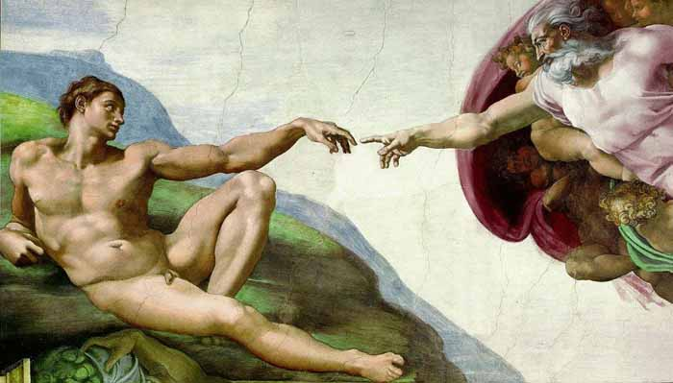

God's Image & the Sanctity of Human Life
Some Comments on Genesis 9:6
Robert C. Newman

Slide 2
Genesis 9:1-7 (NIV) Then God blessed Noah and his sons, saying to them, "Be fruitful and increase in number and fill the earth. 2 The fear and dread of you will fall upon all the beasts of the earth and all the birds of the air, upon every creature that moves along the ground, and upon all the fish of the sea; they are given into your hands. 3 Everything that lives and moves will be food for you. Just as I gave you the green plants, I now give you everything. 4 But you must not eat meat that has its lifeblood still in it. 5 And for your lifeblood I will surely demand an accounting. I will demand an accounting from every animal. And from each man, too, I will demand an accounting for the life of his fellow man. 6 Whoever sheds the blood of man, by man shall his blood be shed; for in the image of God has God made man. 7 As for you, be fruitful and increase in number; multiply on the earth and increase upon it."

Slide 3
What is this "image of God"?
God created mankind in His image:
  Genesis 1:26-27 (NIV) Then God said, "Let us make man in our image, in our likeness, and let them rule over the fish of the sea and the birds of the air, over the livestock, over all the earth, and over all the creatures that move along the ground." 27 So God created man in his own image, in the image of God he created him; male and female he created them.

Slide 4
What is this "image of God"?
Humans pass on this image to their descendants, so we are still in God's image today:
  Genesis 5:3 (NIV) When Adam had lived 130 years, he had a son in his own likeness, in his own image; and he named him Seth.
  Acts 17:29 (NIV) Therefore since we are God's offspring, we should not think that the divine being is like gold or silver or stone–an image made by man's design and skill.
  James 3:9 (NIV) With the tongue we praise our Lord and Father, and with it we curse men, who have been made in God's likeness.

Slide 5
Investigating Our Passage
Why does Genesis 9:6 say it is wrong to "shed human blood" (that is, to take human life)?
  Because we are made in the image and likeness of God.
Something similar is also said in James 3:9, where James notes that it is wrong for us even to curse other humans.

Slide 6
Investigating Our Passage
What does it mean for humans to be made in God’s image?
  Somehow, we humans resemble God.
  In the creation account, this seems to be set in contrast to the animals and plants, which are made "according to their kinds" (Genesis 1:11,12, 21, 24, 25).
  Apparently, the implication is that we humans resemble God in ways that plants and animals do not.
  One way to understand this would be to make a list of words that describe God and compare with a list that describes humans, but not plants or animals.
  We’ll do something of this sort by and by.

Slide 7
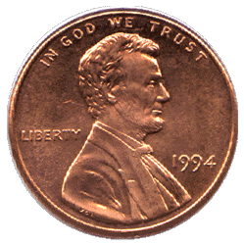
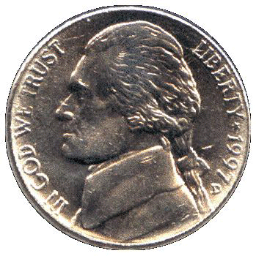
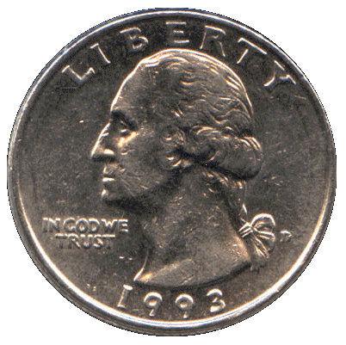
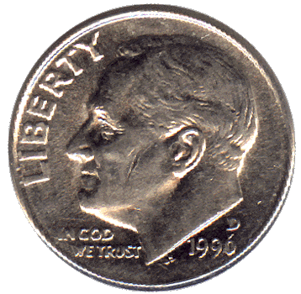
What is an Image?
What does it mean for something to be made in our image?
Whose images are on US coins… ?
  Cent?
  Nickel?
  Dime?
  Quarter?
Why do we call these images?
Does a photograph contain our image?

Slide 8
What is God Like?
According to the Westminster Shorter Catechism:
  God is a Spirit, infinite, eternal, and unchangeable, in his being, wisdom, power, holiness, justice, goodness and truth.
So by comparison, we might say:
  We humans are spirits, finite, temporal, and changeable, in our being, wisdom, power, holiness, justice, goodness and truth.

Slide 9
Why is it wrong to make images of God?
God warns us against doing this, so it must be wrong.
Several passages suggest that the images of God that we make are distortions.
Thus God is saying, "Let me make the image of God that I want you to have!"
  Humans are one example of an image of God that he has made.

Slide 10
What does it mean to say that Christ is the image of God?
2 Corinthians 4:4 (NIV) The god of this age has blinded the minds of unbelievers, so that they cannot see the light of the gospel of the glory of Christ, who is the image of God.
Colossians 1:15 (NIV) He [Christ] is the image of the invisible God, the firstborn over all creation.

Slide 11
What does it mean to say that Christ is the image of God?
Apparently we are to understand this in contrast with ourselves being images of God.
  Jesus is a better image of God than we are.
  For one thing, He is God!
  For another, as a human, He is sinless, and so the image of God in Him as a human has not been marred by sin.

Slide 12
How shall we someday be in the image of God as we are not now?
Romans 8:29 (NIV) For those God foreknew he also predestined to be conformed to the likeness of his Son, that he might be the firstborn among many brothers.
1 Corinthians 15:49 (NIV) And just as we have borne the likeness of the earthly man, so shall we bear the likeness of the man from heaven.
Colossians 3:9-10 (NIV) Do not lie to each other, since you have taken off your old self with its practices 10 and have put on the new self, which is being renewed in knowledge in the image of its Creator.

Slide 13
How shall we someday be in the image of God as we are not now?
One day, if we are trusting in Christ, we will be rescued from sin.
We will awaken at the resurrection:
  Not only to a new body…
  But changed in character so as no longer even to want to sin.
Then we will be far more like Christ–like God–than we have ever been in this life!

Slide 14
So What Does This Mean for the Sanctity of Human Life?
Human life is sacred because we are made in the image of God.
When we harm humans, we are damaging God's image in them.
An illustration:
  It is like damaging or destroying an image of someone we ought rather to love.

Slide 15
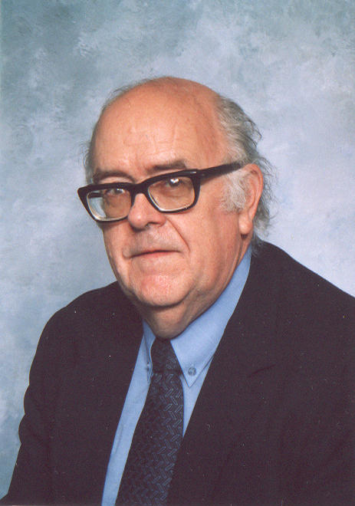

Slide 16
The End
May we respect other humans as made in God's image.

