Slide 1
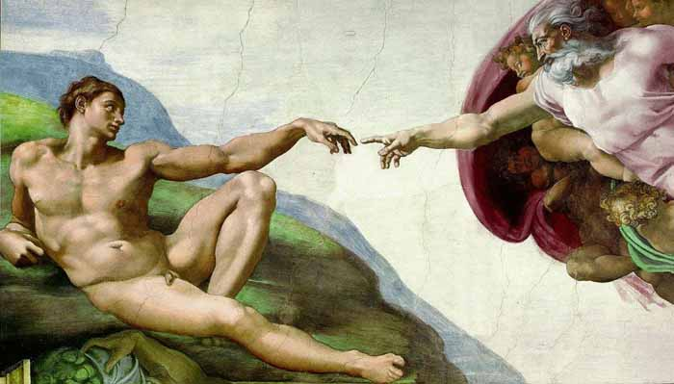

God in Action
Robert C. Newman

Slide 2
God in Action
Creation
  Evidence of God in Creation
  Creation and Evolution
Providence
  History as God’s Story
  Guidance and Prayer
Revelation
  General and Special Revelation
  Revelation: Then and Now

Slide 3
God in Action:
Creation

Slide 4
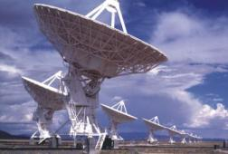
Evidence of God in Creation

Slide 5
Introduction
Is there any evidence of God in our world?
  This is often denied, but the Bible says, "Yes, there is."
  Psalm 19:1 (NIV) The heavens declare the glory of God; the skies proclaim the work of his hands.
  Romans 1:20 (NIV) For since the creation of the world God's invisible qualities–his eternal power and divine nature–have been clearly seen, being understood from what has been made, so that men are without excuse.

Slide 6
Introduction
Psalm 19 – the heavens declare God's glory by means of his handiwork.
Romans 1 – mankind is without excuse for ignoring God, humans must suppress the truth to avoid Him.
Let’s look at some of this evidence.

Slide 7
Evidence from Cosmology
The universe had an origin.
  The alternatives have bitten the dust over the past generation.
  Now the only alternative is to argue that our universe is a 3-D bubble expanding from a larger, invisible universe.
The universe shows evidence of design.
The universe points beyond itself to its Creator.

Slide 8
Evidence from Life
Life had an origin.
  Some want to bring life here from elsewhere in the universe, but this does not ultimately avoid the problem, given the apparent history of the universe.
Life shows evidence of design.
  Its complex, intelligible structure makes it look like an artifact.
Life points beyond itself to its Creator.

Slide 9
Evidence from Conscience
Mankind has conscience, a set of standards by which humans judge themselves, and (mainly) others.
This is found in all cultures, and its content is very similar everywhere.
  See CS Lewis, Mere Christianity and Abolition of Man.
Conscience does not appear to have evolved.

Slide 10
Evidence from Conscience
Conscience does not appear to have evolved.
  There is good evidence it is no better now than it was 1000s of years ago.
  It was not obeyed very closely then or now.
  Any changes seem to relate to religious reformation or to apostasy.
Conscience points beyond mankind to a Moral Maker.

Slide 11
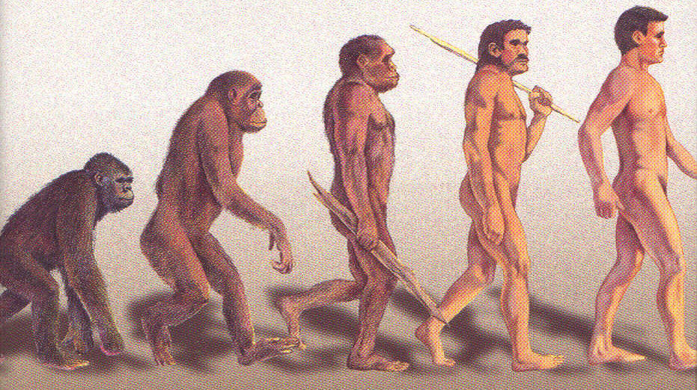
Creation and Evolution

Slide 12
Introduction
Evolutionary thinking dominates modern society, not just in biology, but also in education, government, penology …
The Bible is not easily reconciled with evolution:
  It is possible to read "Let … bring forth" as evolution, but one runs into trouble with the biblical material on human origins.

Slide 13
Problems for the
Naturalistic Origin of Life
The complexity involved is too great:
  Simple cell has information = 100 million pages of the Encyclopaedia Britannica.
The chemistry doesn’t look right:
  DNA often involves millions of atoms properly arranged, which the cell assembles by robots.
  Many chemicals are more stable than DNA.
  There are lots of competing reactions.
  Humans are only able to make complex bio-chemicals by continual intelligent intervention.

Slide 14
Problems for the
Naturalistic Origin of Life
The time necessary is too great:
  The estimated time to form just one 100-link amino acid chain of a particular sort (a small protein) would give only one chance for this happening in 10²⁸ over the whole history of the universe so far.
  We need thousands of such proteins of a great variety of sorts, and they need to be in close proximity to one another.

Slide 15
Problems for the
Naturalistic Development of Life
The complexity involved is too great:
  A human has several trillion coordinated cells of great diversity.
Lack of transitions in the fossil record.
  There are systematic gaps between all the upper levels of the biological classification system.
  Evolutionary theory has had to move to small populations evolving rapidly to fit fossil record, but this does not explain large changes.

Slide 16
Problems for the
Naturalistic Development of Life
Lack of a demonstrable mechanism.
  Mutation and natural selection works for micro-evolution, where nothing really new arises.
  But not even computer simulations will produce significant innovation & organization.
  Currently, the search is on for some other mechanisms.

Slide 17
Problems for the
Naturalistic Origin of Mankind
The same problems of mechanism are seen here as in macro-evolution in general.
There are huge mental & spiritual chasms between humans & apes
  In spite of many attempts to teach apes human languages, little has been accomplished.
  There is no evidence of spiritual interest in apes or any other known animals.

Slide 18
Problems for the
Naturalistic Origin of Mankind
The Genesis Account doesn't fit well.
  Genesis 2 points to man becoming a living being when God breathes life into him, not switching from ape to human when God breathes a soul into him.
  The creation of Eve doesn’t fit the usual evolutionary scheme.
The existence & nature of mankind points beyond to a Maker.

Slide 19
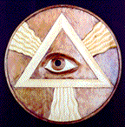
God in Action:
Providence

Slide 20
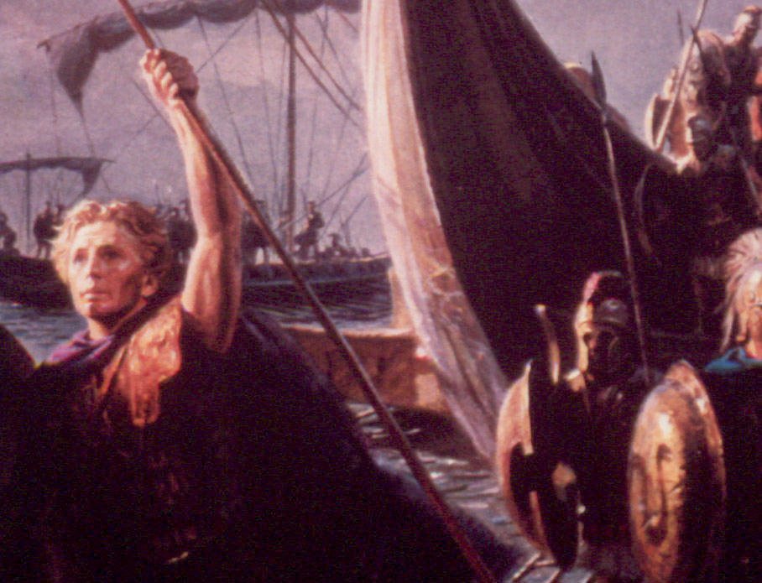
History as God's Story

Slide 21
Is History Meaningless?
"Life's but a walking shadow, a poor player that struts and frets his hour upon the stage, and then is heard no more: it is a tale told by an idiot, full of sound and fury, signifying nothing" – the title character in Shakespeare's MacBeth 5.5.17.
The Bible has a different take on this matter, and it claims to be from the One who knows.

Slide 22
Biblical Testimony
Acts 17 – God & the Nations
  From one man God made every nation.
  God determined the times & places they would live.
  God did this so men might seek him.
  He formerly overlooked idolatry, but now he commands everyone to return to him.
  He has set a day to judge all mankind.
  His designated judge has been marked out by resurrection from the dead.

Slide 23
Biblical Testimony
Acts 13 – God & Israel
  God chose Israel's ancestors, made them a nation during their captivity in Egypt.
  He led them from Egypt with great power, put up with them in the desert.
  He gave them Canaan by dispossessing its former inhabitants.
  He provided judges, then kings, then his own choice David.

Slide 24
Biblical Testimony
Acts 13 – God & Israel, continued
  From David's descendants, he brought a savior, Jesus, accredited by John the Baptist.
  The people & rulers did not acknowledge Jesus, but fulfilled prophecy in rejecting him.
  Though unjustly condemned & executed, God vindicated Jesus by raising him from the dead.
  Through Jesus, people may be declared righteous in a way impossible via the Law of Moses.

Slide 25
What Does the History of Societies Tell Us?
It demonstrates human sinfulness.
  Pre-flood: Genesis 6:5 (NIV) The LORD saw how great man's wickedness on the earth had become, and that every inclination of the thoughts of his heart was only evil all the time.
  Babel: Genesis 11:4-7: God confuses their language and scatters them to hinder their rebellion.
  Judges: Judges 17:6 (NIV) In those days Israel had no king; everyone did as he saw fit.
  World empires: Daniel 7: These empires are pictured as ravenous animals.

Slide 26
What Does the History of Societies Tell Us?
It demonstrates God’s wisdom.
  Deuteronomy 4:5 (NIV) See, I have taught you decrees and laws as the LORD my God commanded me, so that you may follow them in the land you are entering to take possession of it. 6 Observe them carefully, for this will show your wisdom and understanding to the nations, who will hear about all these decrees and say, "Surely this great nation is a wise and understanding people."
  Daniel 4:17,37: God raises up nations, he puts them down.

Slide 27
What Does the History of Societies Tell Us?
It warns of the wrath to come.
  Luke 13:1 (NIV) Now there were some present at that time who told Jesus about the Galileans whose blood Pilate had mixed with their sacrifices. 2 Jesus answered, "Do you think that these Galileans were worse sinners than all the other Galileans because they suffered this way? 3 I tell you, no! But unless you repent, you too will all perish. 4 Or those eighteen who died when the tower in Siloam fell on them--do you think they were more guilty than all the others living in Jerusalem? 5 I tell you, no! But unless you repent, you too will all perish."
  Daniel 7: God will intervene, judge, set up his own government.

Slide 28
What Does the History of Individuals Tell Us?
It demonstrates human sin.
  Romans 1:21-32 (NIV) For although they knew God, they neither glorified him as God nor gave thanks to him, but their thinking became futile and their foolish hearts were darkened. 22 Although they claimed to be wise, they became fools 23 and exchanged the glory of the immortal God for images made to look like mortal man and birds and animals and reptiles… 26 Because of this, God gave them over to shameful lusts. Even their women exchanged natural relations for unnatural ones… 28 Furthermore, since they did not think it worthwhile to retain the knowledge of God, he gave them over to a depraved mind, to do what ought not to be done. 29 They have become filled with every kind of wickedness, evil, greed and depravity… 32 Although they know God's righteous decree that those who do such things deserve death, they not only continue to do these very things but also approve of those who practice them.
  Rejection of God leads to increasing sinfulness.

Slide 29
What Does the History of Individuals Tell Us?
It demonstrates God's grace.
  Abraham – a pagan chosen by God to be the father of God's own people
  Rahab – a prostitute spared from the destruction of her people
  Thief on the cross – a dying criminal given a place in paradise
  Paul – a persecutor of Christians turned around to serve Jesus

Slide 30
What Does the History of Individuals Tell Us?
It demonstrates God's patience.
  Luke 13:8-9 (NIV) "Sir," the man replied, "leave it alone for one more year, and I'll dig around it and fertilize it. 9 If it bears fruit next year, fine! If not, then cut it down."
  Romans 9:22-23 (NIV) What if God, choosing to show his wrath and make his power known, bore with great patience the objects of his wrath–prepared for destruction? 23 What if he did this to make the riches of his glory known to the objects of his mercy, whom he prepared in advance for glory.

Slide 31
Conclusions
We don't know all the details about what God is doing in history.
We do have generic information regarding our own lives.
Are you going to be a demonstration of God's grace or merely of His patience?
May you flee to Jesus and find God’s grace and a life worth living!

Slide 32
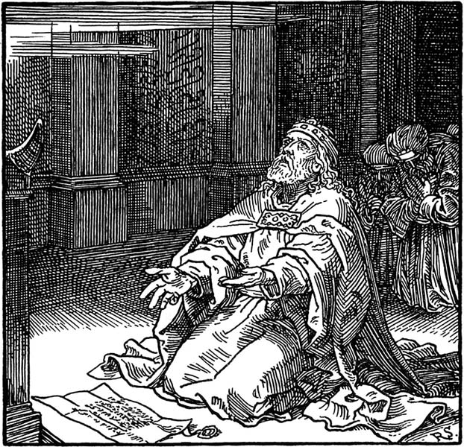
Guidance & Prayer

Slide 33
Introduction
There's a lot of confusion about prayer and guidance today.
  Some claim that God provides supernatural guidance to any Christian who has sufficient faith.
  Others claim that God doesn't want you to be sick or poor, so you’ve only got to name it and claim it to get whatever you want.
  Others claim that God doesn't exist, or if he does, he has better things to do than listen to your prayers and provide you with guidance.

Slide 34
How Does God Guide?
By His Word
  Psalm 119:105 (NIV) Your word is a lamp to my feet and a light for my path.
  2Timothy 3:16-17 (NIV) All Scripture is God-breathed and is useful for teaching, rebuking, correcting and training in righteousness, 17 so that the man of God may be thoroughly equipped for every good work.
  Many are dissatisfied with this; it is too generic; they want specific guidance.
  But as JI Packer has noted, God's guidance is more like teaching us how to drive well, rather than giving us MapQuest directions.

Slide 35
How Does God Guide?
Supernaturally?
  Certainly, the Bible provides examples of this, e.g., for Paul on his 2nd missionary journey: Acts 16:6, 7, 9-10
  But Paul doesn't rebuke Christians for not seeking such guidance when he writes his letters to them.
By circumstances?
  Open or closed door? 1 Corinthians 16:9
  But easy to make mistakes here.

Slide 36
How Does God Guide?
In hindsight?
  Genesis 50:20 (NIV) You intended to harm me, but God intended it for good to accomplish what is now being done, the saving of many lives.
  Psalm 32:8 (NIV) I will instruct you and teach you in the way you should go; I will counsel you and watch over you. 9 Do not be like the horse or the mule, which have no understanding but must be controlled by bit and bridle or they will not come to you.
  Yes, looking back we can often see how God has guided us; I suspect we will see it all when we see Jesus.

Slide 37
Why Should We Pray?
Not to let God know our needs; God already knows what we will pray for.
  Matt 6:31 (NIV) So do not worry, saying, "What shall we eat?" or "What shall we drink?" or "What shall we wear?" 32 For the pagans run after all these things, and your heavenly Father knows that you need them.
Not to get God to change His mind; if it isn’t His will, you won’t get it.
  Matt 26:39 (NIV) Going a little farther, he fell with his face to the ground and prayed, "My Father, if it is possible, may this cup be taken from me. Yet not as I will, but as you will."

Slide 38
Why Should We Pray?
Not to convince God we need something; He knows what we need better than we do.
  Matt 7:11 (NIV) If you, then, though you are evil, know how to give good gifts to your children, how much more will your Father in heaven give good gifts to those who ask him!
So why bother to pray?

Slide 39
Why Should We Pray?
God commands it.
  Matt 5:44 (NIV) But I tell you: Love your enemies and pray for those who persecute you…
  Matt 6:5 (NIV) And when you pray, do not be like the hypocrites, for they love to pray standing in the synagogues and on the street corners to be seen by men…7 And when you pray, do not keep on babbling like pagans, for they think they will be heard because of their many words. 8 Do not be like them, for your Father knows what you need before you ask him. 9 This, then, is how you should pray: "Our Father in heaven, hallowed be your name…"

Slide 40
Why Should We Pray?
God commands it (continued):
  Psalm 32:6 (NIV) Therefore let everyone who is godly pray to you while you may be found; surely when the mighty waters rise, they will not reach him. 7 You are my hiding place; you will protect me from trouble and surround me with songs of deliverance.
  2Chronicles 7:14 (NIV) if my people, who are called by my name, will humble themselves and pray and seek my face and turn from their wicked ways, then will I hear from heaven and will forgive their sin and will heal their land.

Slide 41
Why Should We Pray?
God provides in answer to prayer.
  James 4:2 (NIV) You want something but don't get it. You kill and covet, but you cannot have what you want. You quarrel and fight. You do not have, because you do not ask God.
Prayer is part of a training program.
  God as Father, we as his children
Prayer is getting to know a friend.

Slide 42
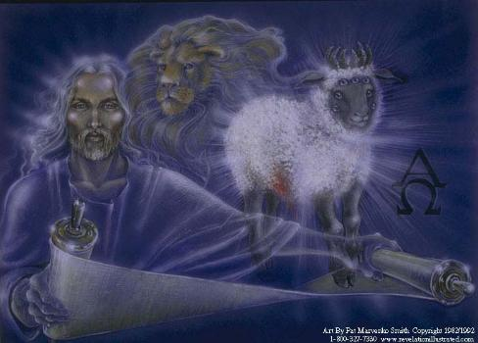
God in Action:
Revelation

Slide 43
Revelation: General & Special
How does God reveal Himself to mankind?
Through His world and His word:
  Psalm 19:1 (NIV) The heavens declare the glory of God; the skies proclaim the work of his hands. 2 Day after day they pour forth speech; night after night they display knowledge. 3 There is no speech or language where their voice is not heard. 4 Their voice goes out into all the earth, their words to the ends of the world… 7 The law of the LORD is perfect, reviving the soul. The statutes of the LORD are trustworthy, making wise the simple.

Slide 44
What does general revelation tell us?
God exists and is powerful.
  Romans 1:18-20 (NIV) The wrath of God is being revealed from heaven against all the godlessness and wickedness of men who suppress the truth by their wickedness, 19 since what may be known about God is plain to them, because God has made it plain to them. 20 For since the creation of the world God's invisible qualities–his eternal power and divine nature–have been clearly seen, being understood from what has been made, so that men are without excuse.
  See also Psalm 19:1-4.

Slide 45
What does general revelation tell us?
He has set moral standards for us.
  Romans 2:1 (NIV) You, therefore, have no excuse, you who pass judgment on someone else, for at whatever point you judge the other, you are condemning yourself, because you who pass judgment do the same things. 2 Now we know that God's judgment against those who do such things is based on truth. 3 So when you, a mere man, pass judgment on them and yet do the same things, do you think you will escape God's judgment? 4 Or do you show contempt for the riches of his kindness, tolerance and patience, not realizing that God's kindness leads you toward repentance?

Slide 46
What does general revelation tell us?
We fail these standards miserably.
  Romans 1:21 (NIV) For although they knew God, they neither glorified him as God nor gave thanks to him, but their thinking became futile and their foolish hearts were darkened. 22 Although they claimed to be wise, they became fools 23 and exchanged the glory of the immortal God for images made to look like mortal man and birds and animals and reptiles.
  Even the daily newspapers and TV reveal this.

Slide 47
What does general revelation tell us?
Is there hope for God’s mercy?
  General revelation does not tell us.
  We can only guess there might be from the very fact that God provided general revelation.
  Something like the Ninevites did when Jonah brought the message of judgment: Jonah 3:9-10 (NIV) "Who knows? God may yet relent and with compassion turn from his fierce anger so that we will not perish." 10 When God saw what they did and how they turned from their evil ways, he had compassion and did not bring upon them the destruction he had threatened.

Slide 48
What does special revelation tell us?
It confirms God's existence, power, and standards by its own statements, plus its evidence that the Bible is not just the guesswork of ancient humans.
It identifies God as the God of the Bible
  by its own statements,
  by pre-knowledge of science,
  by fulfilled prophecy,
  by changed lives.

Slide 49
What does special revelation tell us?
It tells us much more about God and about us humans, giving explicit revelation:
  of God's nature,
  of God's requirements,
  of human nature, especially as corrupted by the fall.
It tells us the Good News:
  There is mercy through Jesus Christ.
  By Jesus, God can forgive and still be just.

Slide 50
Conclusions
What are you going to do about God’s revelation?
  Pretend it is not clear enough?
    Go on living the way you want to?
    Hoping that if there is a judgment God will agree with you, or at least let you off?
  Admit that God has made things sufficiently clear?
    Trust God that you will be better off letting Him have the place He deserves in your life?
    Come to Jesus for forgiveness?

Slide 51
Revelation Then & Now
Can we expect further revelation today like people had in Bible times?
Some think 1 Corinthians 13 rules this out:
  1Cor 13:8 (NIV) Love never fails. But where there are prophecies, they will cease; where there are tongues, they will be stilled; where there is knowledge, it will pass away. 9 For we know in part and we prophesy in part, 10 but when perfection comes, the imperfect disappears.
  However, the context suggests that this "perfection" comes at Jesus' second coming, not when the canon is closed.

Slide 52
Bible on Further Revelation
Revelation 22 tells us not to mess with God’s revelation:
  18 (NIV) I warn everyone who hears the words of the prophecy of this book: If anyone adds anything to them, God will add to him the plagues described in this book. 19 And if anyone takes words away from this book of prophecy, God will take away from him his share in the tree of life and in the holy city, which are described in this book.

Slide 53
Bible on Further Revelation
But this was in force from the beginning:
  Deuteronomy 4:1 (NIV) Hear now, O Israel, the decrees and laws I am about to teach you. Follow them so that you may live and may go in and take possession of the land that the LORD, the God of your fathers, is giving you. 2 Do not add to what I command you and do not subtract from it, but keep the commands of the LORD your God that I give you.
  Proverbs 30:5 (NIV) Every word of God is flawless; he is a shield to those who take refuge in him. 6 Do not add to his words, or he will rebuke you and prove you a liar.

Slide 54
Bible on Further Revelation
The structure of Revelation suggests it was designed to close the Bible, a kind of mirror image of Genesis:
  Old creation – new creation
  Tree of life – tree of life restored
  Curse comes – curse removed
  Death comes – death ended
In any case, the Bible provides us with tests for claims to have revelation from God.

Slide 55
Biblical Tests re/ Revelation
No error in prediction
  Deuteronomy 18:20 (NIV) But a prophet who presumes to speak in my name anything I have not commanded him to say, or a prophet who speaks in the name of other gods, must be put to death. 21 You may say to yourselves, "How can we know when a message has not been spoken by the LORD?" 22 If what a prophet proclaims in the name of the LORD does not take place or come true, that is a message the LORD has not spoken. That prophet has spoken presumptuously. Do not be afraid of him.

Slide 56
Biblical Tests re/ Revelation
No false teaching:
  1 Corinthians 14:29 (NIV) Two or three prophets should speak, and the others should weigh carefully what is said.
  Deuteronomy 13:1 (NIV) If a prophet, or one who foretells by dreams, appears among you and announces to you a miraculous sign or wonder, 2 and if the sign or wonder of which he has spoken takes place, and he says, "Let us follow other gods" (gods you have not known) "and let us worship them," 3 you must not listen to the words of that prophet or dreamer. The LORD your God is testing you to find out whether you love him with all your heart and with all your soul.

Slide 57
Biblical Tests re/ Revelation
No false teaching (continued):
  1John 4:1-3 (NIV) Dear friends, do not believe every spirit, but test the spirits to see whether they are from God, because many false prophets have gone out into the world. 2 This is how you can recognize the Spirit of God: Every spirit that acknowledges that Jesus Christ has come in the flesh is from God, 3 but every spirit that does not acknowledge Jesus is not from God. This is the spirit of the antichrist, which you have heard is coming and even now is already in the world.
  Galatians 1:6-9 (NIV) I am astonished that you are so quickly deserting the one who called you by the grace of Christ and are turning to a different gospel– 7 which is really no gospel at all. Evidently some people are throwing you into confusion and are trying to pervert the gospel of Christ. 8 But even if we or an angel from heaven should preach a gospel other than the one we preached to you, let him be eternally condemned! 9 As we have already said, so now I say again: If anybody is preaching to you a gospel other than what you accepted, let him be eternally condemned!

Slide 58
Conclusions
We are not trying to rule out real revelation today (God can do what He wants!), but to test claimed revelation in order not to be led astray.
We cannot afford to let claimants bamboozle us:
  Warning against blasphemy of Holy Spirit,
  Claiming it is more spiritual to believe without tests.
God Himself commands us to test.
  1Thessalonians 5:19 (NIV) Do not put out the Spirit's fire; 20 do not treat prophecies with contempt. 21 Test everything. Hold on to the good. 22 Avoid every kind of evil.

Slide 59
The End
May we be on the lookout
for God in action!

