Slide 1
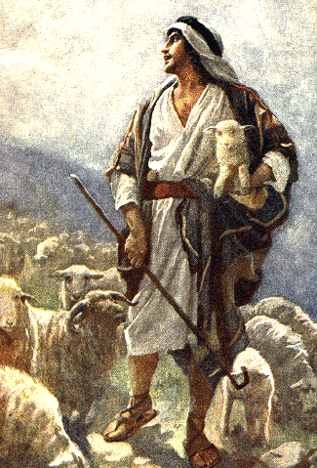
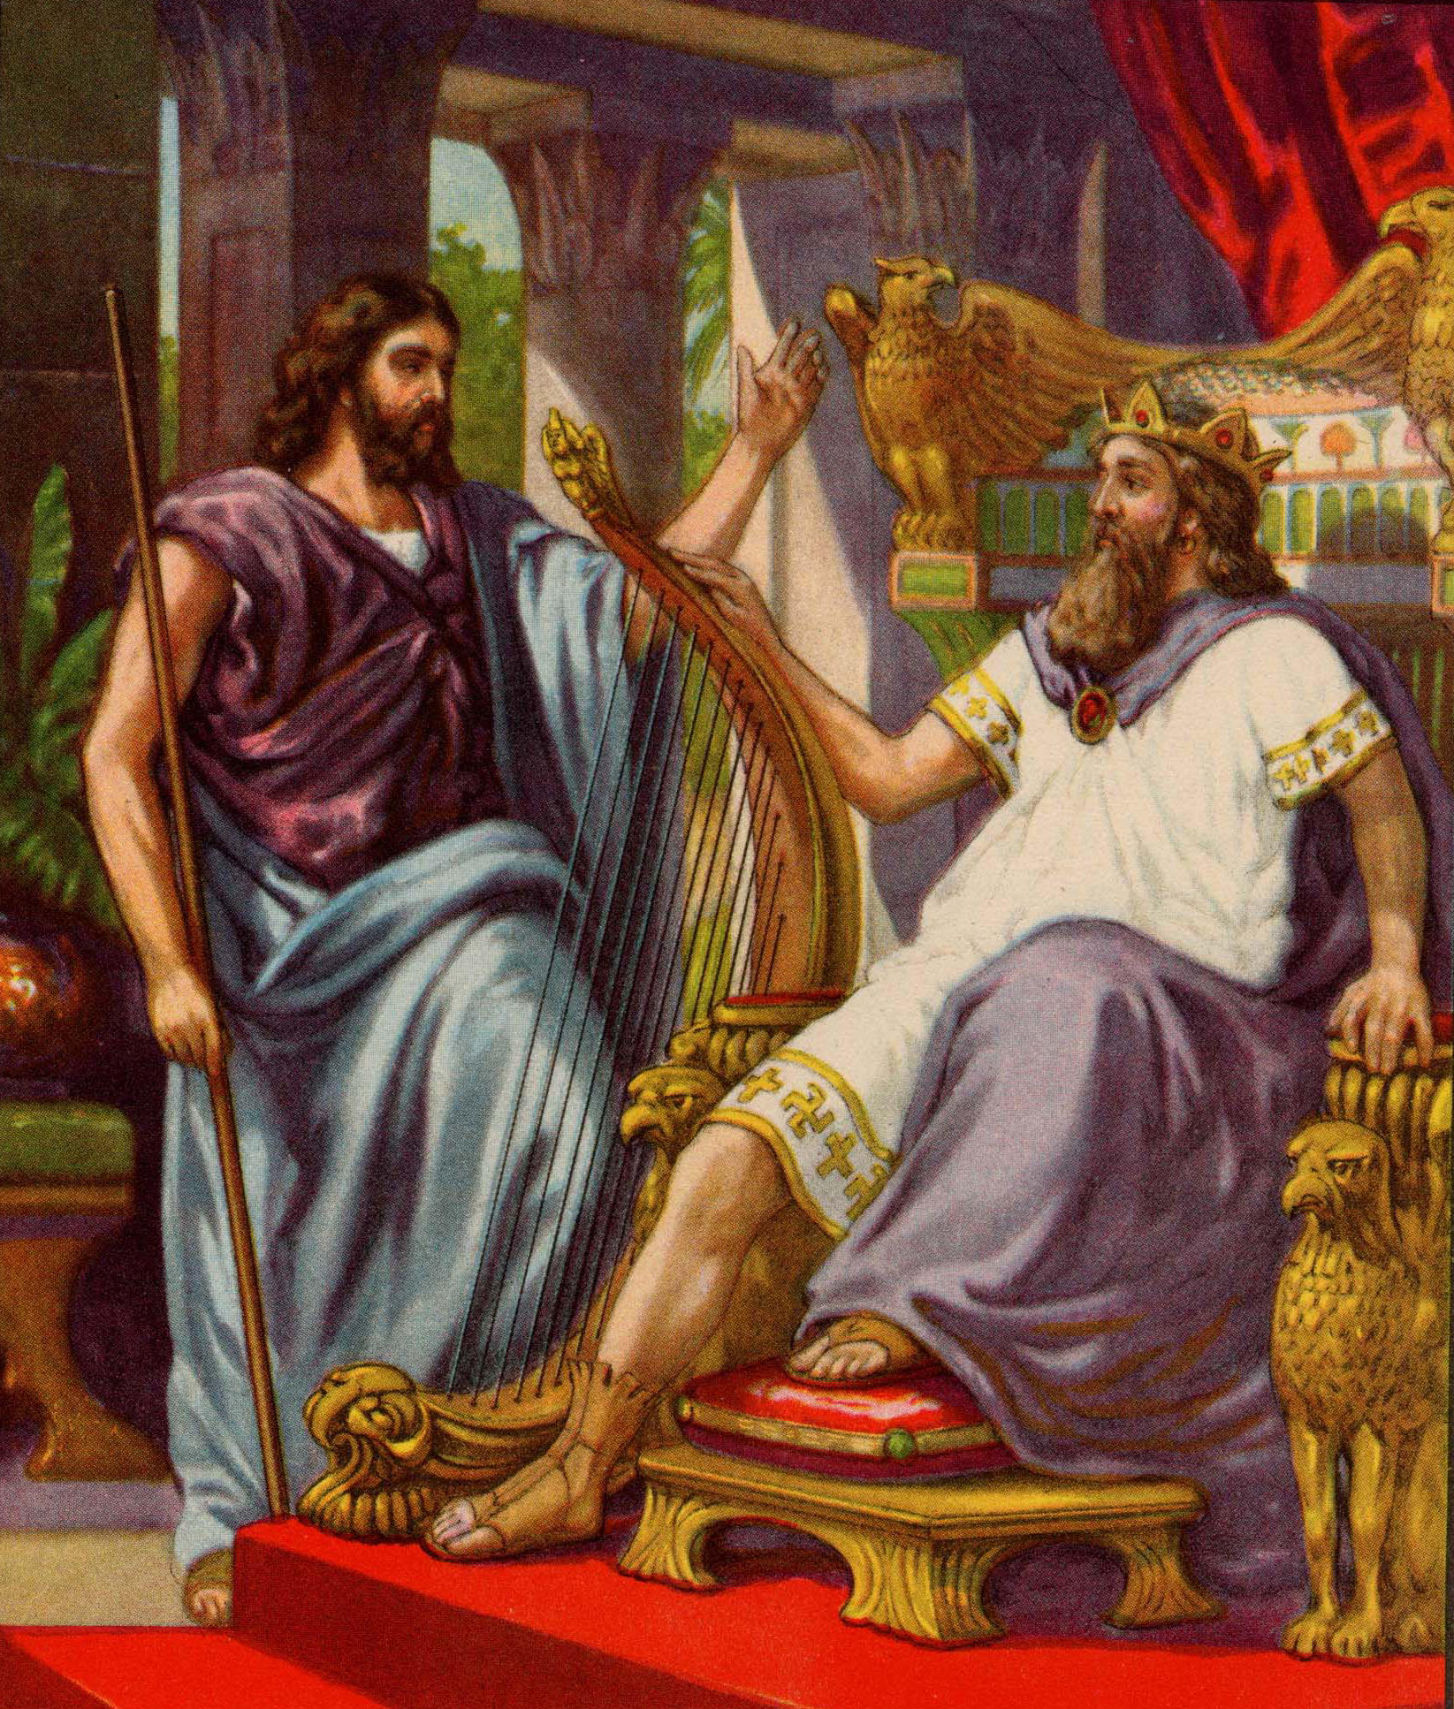

Psalm 23
God: Our Shepherd,
Our Host
Robert C. Newman

Slide 2
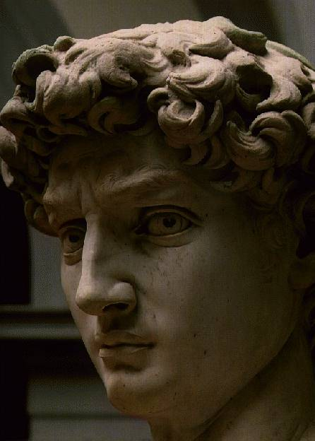
David the Author
David’s life experience provides the background for this psalm.
First part: God as Shepherd
  David was a shepherd for his father’s sheep.
Second part: God as Royal Host
  David became God’s king, had numerous guests in his palace.

Slide 3
The Psalm Translated
A sacred song to musical accompaniment,
composed by David
(1) The LORD is my shepherd
I lack nothing.
(2) In pastures of tender grass
He makes me lie down,
To waters of refreshment
He leads me;
(3) He revives my life.
He leads me in right paths
For His name's sake.

Slide 4
The Psalm Translated
(4) Indeed, when I walk in the valley of death-shadow
I will fear no evil,
For You are with me;
Your club and staff,
They comfort me.

Slide 5
The Psalm Translated
(5) You will set a table before me,
In the presence of my enemies.
You anoint my head with oil,
My cup overflows.
(6) Surely Goodness and Kindness will attend me
All the days of my life
And I will dwell in the house of the LORD
My whole life long.

Slide 6
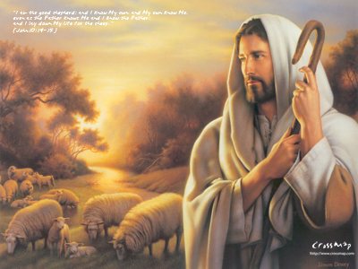
God Our Shepherd
Verses 1-4

Slide 7
Verse 1
(1) The LORD is my shepherd
I lack nothing.
Verse 1 is a summary:
Just as the sheep of a good shepherd lack nothing they need,
so we as God's people lack nothing we need.

Slide 8
Verses 2-3
(2) In pastures of tender grass
He makes me lie down,
To waters of refreshment
He leads me;
(3) He revives my life.
He leads me in right paths
For His name's sake.

Slide 9
Verses 2-3
These appear to follow the shepherd and sheep through a typical day.
Tender grass - pretty rare in wilderness areas where sheep are usually herded
  God provides our needed sustenance.
Calls the sheep together at noon to huddle and lie down for rest.
  God provides the rest we need.

Slide 10
Verses 2-3
See thoughtfulness of shepherd for his flock.
  Domesticated sheep are not smart enough to fend for themselves.
  We are not smart enough to fend for ourselves spiritually.
Leads them to water of refreshment.
  Sheep will not drink from running water.
  Water is usually drawn by shepherd from wells.
  God provides our refreshment .

Slide 11
Verses 2-3
Restores life
  Probably the result of above; with rest and water, the sheep are able to go on.
  Similarly God helps us keep on.
    Compare the promise in Isa 40:29-31.

Slide 12
Isaiah 40:29-31
29 (NIV) He gives strength to the weary
and increases the power of the weak.
30 Even youths grow tired and weary,
and young men stumble and fall;
31 but those who hope in the LORD
will renew their strength.
They will soar on wings like eagles;
they will run and not grow weary,
they will walk and not be faint.

Slide 13
Verses 2-3
Restores life
  Probably the result of above; with rest and water, sheep able to go on
  Similarly God helps us keep on, cp Isa 40:29-31.
Guidance in right paths
  Shepherd's reputation depends on getting sheep to pasture, water, sheepfold, etc.
  So God will guide us for His Name's sake.

Slide 14
Verse 4
(4) Indeed, when I walk in the valley of death-shadow,
I will fear no evil,
For You are with me;
Your club and staff,
They comfort me.

Slide 15
Verse 4
Sheep return home as deep shadows fall.
They are protected by the shepherd.
  rod/club - from enemies
  staff - from self
So God protects us, especially when death is near.

Slide 16
God Our Host
Verses 5-6

Slide 17
Verses 5-6
Picture:
  Some commentators try to maintain shepherd/sheep figure throughout psalm,
  But it looks more like the figure shifts here, to that of a lifelong guest in the palace of a king.
Compare:
  Mephibosheth, 2 Sam 9:11-13
  Barzillai & Kimham, 2 Sam 19:33ff

Slide 18
Mephibosheth
2 Sam 9:11 (NIV) Then Ziba said to the king, "Your servant will do whatever my lord the king commands his servant to do." So Mephibosheth ate at David's table like one of the king's sons…
13 And Mephibosheth lived in Jerusalem, because he always ate at the king's table, and he was crippled in both feet.

Slide 19
Barzillai & Kimham
2 Sam 19:33 (NIV) The king said to Barzillai, "Cross over with me and stay with me in Jerusalem, and I will provide for you." 34 But Barzillai answered the king, "How many more years will I live, that I should go up to Jerusalem with the king?... 37 Let your servant return, that I may die in my own town near the tomb of my father and mother. But here is your servant Kimham. Let him cross over with my lord the king. Do for him whatever pleases you." 38 The king said, "Kimham shall cross over with me, and I will do for him whatever pleases you. And anything you desire from me I will do for you."

Slide 20
The Transition
Probably based on time:
  Sheep come home in evening
  Guest entertained at dinner in evening
Even more, the shift probably corresponds to our death (valley of death-shadow) and subsequent promotion from sheep to guest.

Slide 21
Verses 5-6
(5) You will set a table before me,
In the presence of my enemies.
You anoint my head with oil,
My cup overflows.
(6) Surely Goodness and Kindness will attend me
All the days of my life
And I will dwell in the house of the LORD
My whole life long.

Slide 22
Verses 5-6
Prepared table before enemies:
  Honor & vindication provided by host
  Enemies spectators at banquet?
    One rabbinic parable has this
    So, too, parable of Rich Man & Lazarus
Anointed head:
  When entering house, honor
  Perhaps also joy
    Compare Ps 45:7; Ps 133.

Slide 23
Psalm 45:7
(NIV) You love righteousness and hate wickedness;
therefore God, your God, has set you above your companions
by anointing you with the oil of joy.

Slide 24
Psalm 133
1 (NIV) How good and pleasant it is
when brothers live together in unity!
2 It is like precious oil poured on the head,
running down on the beard,
running down on Aaron's beard,
down upon the collar of his robes.
3 It is as if the dew of Hermon
were falling on Mount Zion.
For there the LORD bestows his blessing,
even life forevermore.

Slide 25
Verses 5-6
Full cup:
  Welcome
  Filled to brim to symbolize abundance
Goodness, Loving-Kindness
  Apparently these are personified as waiters closely attending on guest.
Dwelling in house:
  Not the temple, but the king's palace
  So communion, fellowship

Slide 26
Verses 5-6
(6) Surely Goodness and Kindness will attend me
All the days of my life
And I will dwell in the house of the LORD
My whole life long.
Lifelong guest:
  Hebrew has ‘for length of days.’
  Going from picture to reality, this translates to eternal life with God.

Slide 27
Conclusions
Contrast picture of:
  Sheep w/ shepherd vs.
  Guest w/ host
  So it gives us a glimmer of the difference between life now and the life beyond.
Are you now one of God's sheep, and so a guest later, or not?
  See John 10:24ff

Slide 28
John 10:24ff
24 (NIV) The Jews gathered around him, saying, "How long will you keep us in suspense? If you are the Messiah, tell us plainly." 25 Jesus answered, "I did tell you, but you do not believe. The miracles I do in my Father's name speak for me, 26 but you do not believe because you are not my sheep. 27 My sheep listen to my voice; I know them, and they follow me. 28 I give them eternal life, and they shall never perish; no one can snatch them out of my hand. 29 My Father, who has given them to me, is greater than all; no one can snatch them out of my Father's hand. 30 I and the Father are one."

Slide 29
The End
May You Be a Guest
at God’s Banquet!

