Slide 1

God as Lord of Our Time
Robert C. Newman

Slide 2
Lordship
Payment of tribute has typically been symbolic of Lordship in ancient times.
Tribute in the form of money paid to a ruler
Tribute paid to God
Tribute in the form of labor
The Levites given to God as part of Israel’s tribute

Slide 3
Tribute in Money
2 Kings 23:33 (NIV) Pharaoh Neco put him in chains at Riblah in the land of Hamath so that he might not reign in Jerusalem, and he imposed on Judah a levy of a hundred talents [about 3 3/4 tons] of silver and a talent [about 75 pounds] of gold.

Slide 4
Tribute to Rulers
Ezra 4:13 (NIV) Furthermore, the king should know that if this city is built and its walls are restored, no more taxes, tribute or duty will be paid, and the royal revenues will suffer…. 20 Jerusalem has had powerful kings ruling over the whole of Trans-Euphrates, and taxes, tribute and duty were paid to them.

Slide 5
Tribute to God
Numbers 31:28 (NIV) From the soldiers who fought in the battle, set apart as tribute for the LORD one out of every five hundred, whether persons, cattle, donkeys, sheep or goats.

Slide 6
Tribute in Labor
Joshua 16:10 (NIV) They did not dislodge the Canaanites living in Gezer; to this day the Canaanites live among the people of Ephraim but are required to do forced labor.

Slide 7
Tribute in Labor
1 Kings 5:13 (NIV) King Solomon conscripted laborers from all Israel n thirty thousand men. 14 He sent them off to Lebanon in shifts of ten thousand a month, so that they spent one month in Lebanon and two months at home. Adoniram was in charge of the forced labor.

Slide 8
Levites as Tribute
Numbers 3:11 (NIV) The LORD also said to Moses, 12 "I have taken the Levites from among the Israelites in place of the first male offspring of every Israelite woman. The Levites are mine, 13 for all the firstborn are mine. When I struck down all the firstborn in Egypt, I set apart for myself every firstborn in Israel, whether man or animal. They are to be mine. I am the LORD."

Slide 9
Sabbath a Tribute?
I suggest that observance of the Sabbath was a token of God’s lordship over our time.
The Sabbath commandments emphasize God’s creation and redemption of His people.

Slide 10
Sabbath & Creation
Exodus 20:8 (NIV) "Remember the Sabbath day by keeping it holy. 9 Six days you shall labor and do all your work, 10 but the seventh day is a Sabbath to the LORD your God. On it you shall not do any work, neither you, nor your son or daughter, nor your manservant or maidservant, nor your animals, nor the alien within your gates. 11 For in six days the LORD made the heavens and the earth, the sea, and all that is in them, but he rested on the seventh day. Therefore the LORD blessed the Sabbath day and made it holy.

Slide 11
Sabbath & Redemption
Deuteronomy 5:12 (NIV) "Observe the Sabbath day by keeping it holy, as the LORD your God has commanded you. 13 Six days you shall labor and do all your work, 14 but the seventh day is a Sabbath to the LORD your God. On it you shall not do any work, neither you, nor your son or daughter, nor your manservant or maidservant, nor your ox, your donkey or any of your animals, nor the alien within your gates, so that your manservant and maidservant may rest, as you do. 15 Remember that you were slaves in Egypt and that the LORD your God brought you out of there with a mighty hand and an outstretched arm. Therefore the LORD your God has commanded you to observe the Sabbath day.

Slide 12
Lord of Our Time
Romans 14:5 (NIV) One man considers one day more sacred than another; another man considers every day alike. Each one should be fully convinced in his own mind. 6 He who regards one day as special, does so to the Lord. He who eats meat, eats to the Lord, for he gives thanks to God; and he who abstains, does so to the Lord and gives thanks to God.

Slide 13
Lord of Our Past

Slide 14
Sin as Debt
Matthew 6:12 (NIV) Forgive us our debts, as we also have forgiven our debtors.

Slide 15
Sin as Debt
Matt 18:21 (NIV) Then Peter came to Jesus and asked, "Lord, how many times shall I forgive my brother when he sins against me? Up to seven times?" 22 Jesus answered, "I tell you, not seven times, but seventy-seven times. 23 Therefore, the kingdom of heaven is like a king who wanted to settle accounts with his servants. 24 As he began the settlement, a man who owed him ten thousand talents was brought to him. 25 Since he was not able to pay, the master ordered that he and his wife and his children and all that he had be sold to repay the debt. 26 The servant fell on his knees before him. `Be patient with me,' he begged, `and I will pay back everything.'
27 The servant's master took pity on him, canceled the debt and let him go.

Slide 16
Sin as Debt
Matthew 18:28 "But when that servant went out, he found one of his fellow servants who owed him a hundred denarii. He grabbed him and began to choke him. `Pay back what you owe me!' he demanded. 29 His fellow servant fell to his knees and begged him, `Be patient with me, and I will pay you back.' 30 But he refused. Instead, he went off and had the man thrown into prison until he could pay the debt. 31 When the other servants saw what had happened, they were greatly distressed and went and told their master everything that had happened. 32 Then the master called the servant in. `You wicked servant,' he said, `I canceled all that debt of yours because you begged me to. 33 Shouldn't you have had mercy on your fellow servant just as I had on you?' 34 In anger his master turned him over to the jailers to be tortured, until he should pay back all he owed. 35 This is how my heavenly Father will treat each of you unless you forgive your brother from your heart."

Slide 17
Remembering
As those who have been forgiven, we owe God a great deal:
Romans 8:12 (NIV) Therefore, brothers, we have an obligation n but it is not to the sinful nature, to live according to it.
Rather, our obligation is to live as children of God, as those who owe God not only our existence as His creatures, but our redemption from His rightful judgment.

Slide 18
Forgetting
Don’t dwell on the past, but live up to what we have been called to be:
Phil 3:13 (NIV) Brothers, I do not consider myself yet to have taken hold of it. But one thing I do: Forgetting what is behind and straining toward what is ahead, 14 I press on toward the goal to win the prize for which God has called me heavenward in Christ Jesus. 15 All of us who are mature should take such a view of things. And if on some point you think differently, that too God will make clear to you. 16 Only let us live up to what we have already attained.

Slide 19

Lord of Our Present

Slide 20
Living Righteous Lives
Don’t let busyness distort proper priorities:
Amos 8:4 (NIV) Hear this, you who trample the needy and do away with the poor of the land, 5 saying, "When will the New Moon be over that we may sell grain, and the Sabbath be ended that we may market wheat?"n skimping the measure, boosting the price and cheating with dishonest scales, 6 buying the poor with silver and the needy for a pair of sandals, selling even the sweepings with the wheat.

Slide 21
Busy Serving God
1Cor 15:58 (NIV) Therefore, my dear brothers, stand firm. Let nothing move you. Always give yourselves fully to the work of the Lord, because you know that your labor in the Lord is not in vain.
John 9:4 (NIV) As long as it is day, we must do the work of him who sent me. Night is coming, when no one can work.

Slide 22
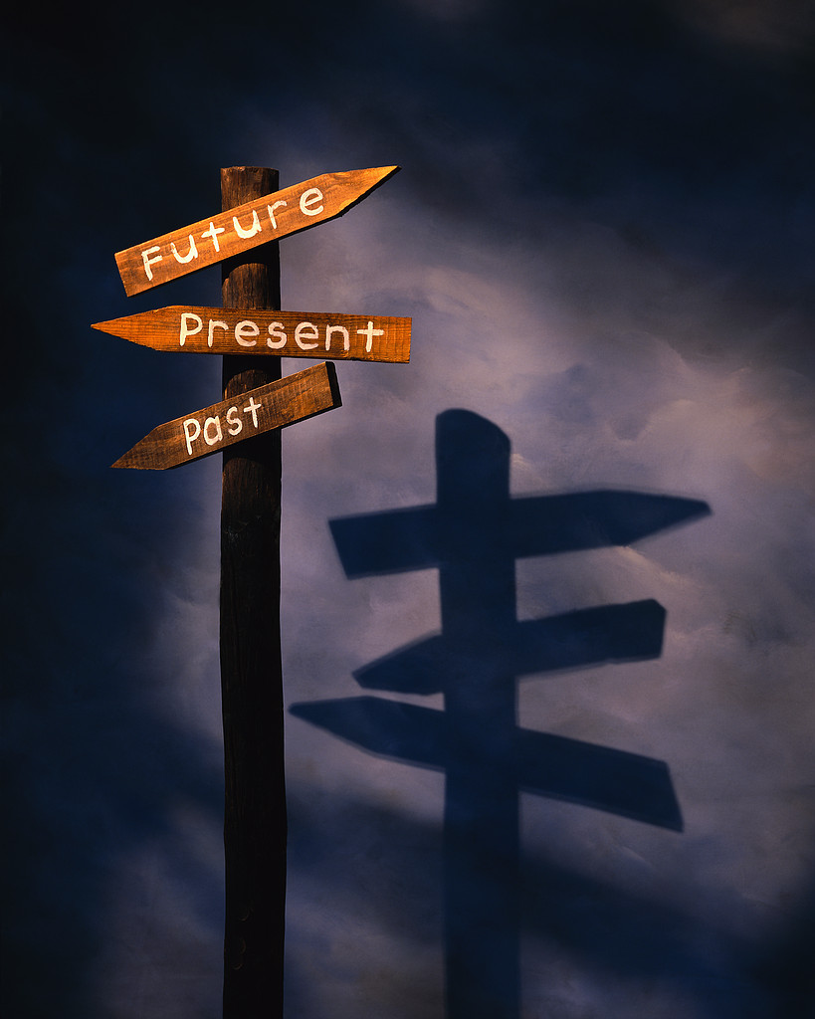
Lord of Our Future

Slide 23
A Future of Hope
Romans 8:22 (NIV) We know that the whole creation has been groaning as in the pains of childbirth right up to the present time. 23 Not only so, but we ourselves, who have the firstfruits of the Spirit, groan inwardly as we wait eagerly for our adoption as sons, the redemption of our bodies. 24 For in this hope we were saved. But hope that is seen is no hope at all. Who hopes for what he already has? 25 But if we hope for what we do not yet have, we wait for it patiently. 26 In the same way, the Spirit helps us in our weakness. We do not know what we ought to pray for, but the Spirit himself intercedes for us with groans that words cannot express.

Slide 24
A God-Ordained Future
Romans 8:28 (NIV) And we know that in all things God works for the good of those who love him, who have been called according to his purpose. 29 For those God foreknew he also predestined to be conformed to the likeness of his Son, that he might be the firstborn among many brothers. 30 And those he predestined, he also called; those he called, he also justified; those he justified, he also glorified.

Slide 25
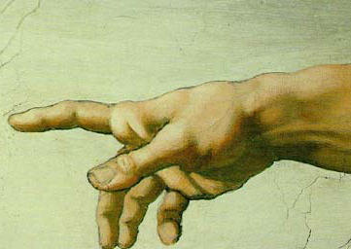
The End
May we live all our lives in the realization that God is the Lord of our time.

