Slide 1
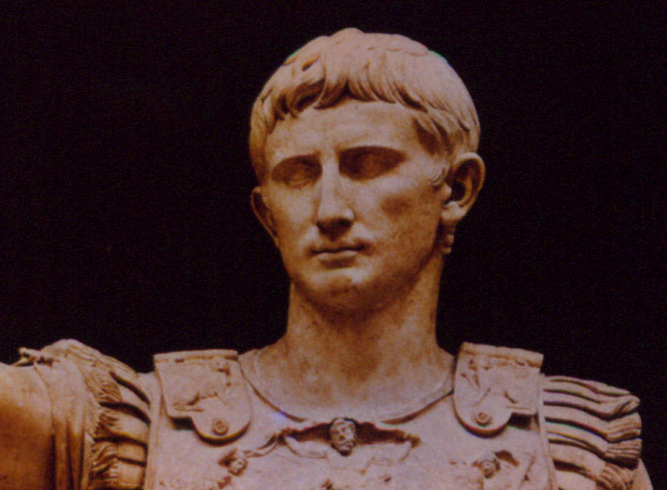
God & Caesar
Matthew 22:15-22
Robert C. Newman

Slide 2
Matthew 22:15-22
Matt 22:15 (NIV) Then the Pharisees went out and laid plans to trap him in his words. 16 They sent their disciples to him along with the Herodians. "Teacher," they said, "we know you are a man of integrity and that you teach the way of God in accordance with the truth. You aren't swayed by men, because you pay no attention to who they are. 17 Tell us then, what is your opinion? Is it right to pay taxes to Caesar or not?" 18 But Jesus, knowing their evil intent, said, "You hypocrites, why are you trying to trap me? 19 Show me the coin used for paying the tax." They brought him a denarius, 20 and he asked them, "Whose portrait is this? And whose inscription?" 21 "Caesar's," they replied. Then he said to them, "Give to Caesar what is Caesar's, and to God what is God's." 22 When they heard this, they were amazed. So they left him and went away.

Slide 3
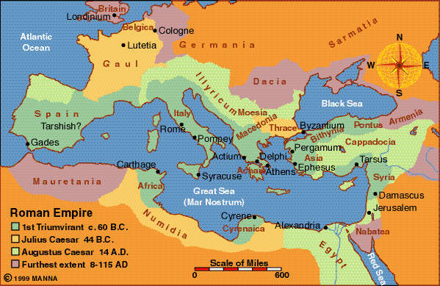
The Background
Political & Religious

Slide 4
Political Background
In 63 BC, Palestine was conquered by Rome, ending about 80 years of Jewish independence.
Following two generations under Jewish client rulers, in 6 AD the Romans sent in their own governors.
In 30 AD, at the time of Jesus’ ministry, this governor was Pontius Pilate.

Slide 5
Pontius Pilate
According to Josephus & the Bible, Pilate was a rather insensitive ruler.
He had tried to bring the Roman army’s standards into Jerusalem, in spite of their having pagan symbols on them.
He had appropriated Temple money to build an aqueduct.
He had used violence against suspected rebels, even in the Temple on one occasion.

Slide 6
Jewish Reaction to Roman Rule
This varied among the people & the diverse Jewish groups, but was generally negative:
The Sadducees were the most favorable, as they profited from Roman rule.
The Herodians were apparently next, though they preferred that Herod’s family rule.
The Pharisees were anti-Roman but cautious.
The Zealots were fiercely anti-Roman, willing to assassinate opponents & start a revolt.

Slide 7
Religious Background
Since Augustus’ time, the Roman emperor or his genius had often been worshiped in the Eastern Roman Empire.
Pontius Pilate had put a picture of the pagan priest’s staff (lituus) on copper coins minted for use in Judea.
Silver & gold coins had a picture of the emperor on the front, with inscriptions & symbols that were offensive to Jews.

Slide 8
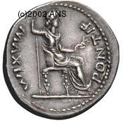
Silver Denarius
Front: picture of Tiberius, with text: “Tiberius Caesar Augustus, Son of the Divine Augustus”
Rear: picture of a goddess(?) with text: “Pontifex Maximus” (i.e., the chief priest of the Roman religion).

Slide 9
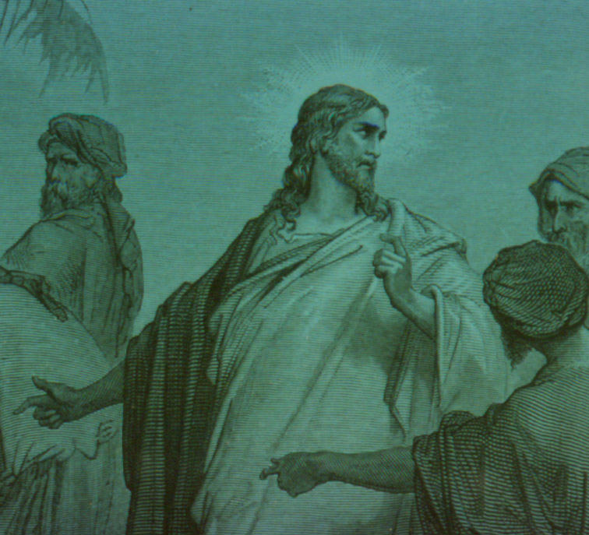
The Confrontation

Slide 10
Paying Roman Taxes
The Pharisees figured they had devised the perfect plot to discredit Jesus:
If Jesus said to pay taxes, then:
They could accuse him of tacitly accepting idolatry and Roman rule.
This would ruin his influence with the people.
If he said not to pay taxes, then:
The Herodians could accuse him to Pilate.
He could be executed for sedition.

Slide 11
Jesus’ Response
Jesus sees through their plan, asks them for a coin of the taxation (the denarius above).
Probably they think he is stalling for time, so they rush to provide one.
But in doing this, they inadvertently admit that they are using such coins themselves!
From then on, the rest of Jesus’ answer leaves them shot down, with nothing to use to accuse Jesus, either to the people or the Romans!

Slide 12
Jesus’ Response
Jesus asks them whose picture & inscription is on the coin.
They answer “Caesar’s.”
As is often seen on coins of this period, the name of the ruler is given in the genitive case, meaning “belonging to…”
So Jesus tells them to give back to Caesar what belongs to him, & give back to God what belongs to Him!

Slide 13
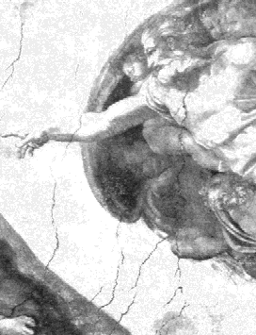
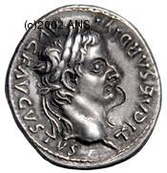
The Message

Slide 14
Give to Caesar…
Give your government the honor that God demands for it.
It is established by God & is to receive some of the honor due to Him.
Our duty to government is not dependent on how good it is or what it does for us.
We owe to government the payment of taxes, showing respect, & helping to make it better (so much as lies within our power).

Slide 15
Give to God…
Give God the honor He demands.
All things come from Him, every good & perfect gift, so we owe him everything.
He needs nothing from us, so we cannot profit Him, nor earn favor with Him.
We are to worship Him, not a human ruler.
We were designed to find our real fulfilment in loving & serving Him, so honoring & obeying God is totally to our advantage!

Slide 16
You Can’t Outsmart God
As the Pharisees & Herodians tried to do with Jesus.
They were trying to reap the benefits of Roman government without paying taxes, showing respect, or supporting the ruler.
They were acting the same way toward God.
How do we stand with God & government?

Slide 17
The End
Give to Caesar what is Caesar's, and to God what is God's.

