Slide 1
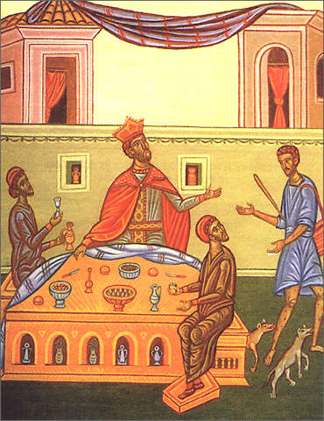
A Glimpse Beyond This Life
Robert C Newman

Slide 2
What Lies Beyond This Life?
Lots of opinions on this question:
Nothing (atheist view)
Reincarnation (Hindu, Buddhist, New Age)
Soul sleep (SDA, etc.)
Only good things (near-death experiences, at least those widely published)

Slide 3
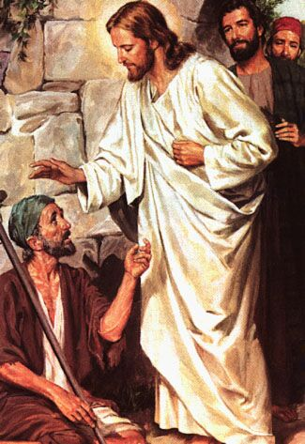
What Lies Beyond This Life?
But humans are often wishful thinkers.
And there are spirit-beings who are inveterate liars.
Jesus tells us what it is like.
Let's look at his account in Luke 16.

Slide 4
Luke 16
19 (NIV) There was a rich man who was dressed in purple and fine linen and lived in luxury every day. 20 At his gate was laid a beggar named Lazarus, covered with sores 21 and longing to eat what fell from the rich man's table. Even the dogs came and licked his sores. 22 The time came when the beggar died and the angels carried him to Abraham's side. The rich man also died and was buried. 23 In hell, where he was in torment, he looked up and saw Abraham far away, with Lazarus by his side. 24 So he called to him, "Father Abraham, have pity on me and send Lazarus to dip the tip of his finger in water and cool my tongue, because I am in agony in this fire." 25 But Abraham replied, "Son, remember that in your lifetime you received your good things, while Lazarus received bad things, but now he is comforted here and you are in agony."

Slide 5
Luke 16
26 "And besides all this, between us and you a great chasm has been fixed, so that those who want to go from here to you cannot, nor can anyone cross over from there to us." 27 He answered, "Then I beg you, father, send Lazarus to my father's house, 28 for I have five brothers. Let him warn them, so that they will not also come to this place of torment." 29 Abraham replied, "They have Moses and the Prophets; let them listen to them." 30 "No, father Abraham," he said, "but if someone from the dead goes to them, they will repent." 31 He said to him, "If they do not listen to Moses and the Prophets, they will not be convinced even if someone rises from the dead."

Slide 6
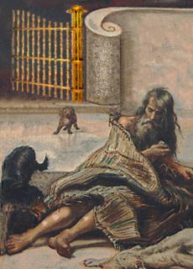
The Story

Slide 7
The Rich Man Described
Dressed in purple: cloth dyed with an expensive dye made from the shellfish Murex; color ranges from red to blue
Fine linen: the best had a texture like silk, woven with 500 threads per inch lengthwise, 100 per inch crosswise; also very expensive
Lived in luxury every day

Slide 8
The Poor Man Described
Lazarus: short for Eleazar, "God is my help"; a hint re/ his trust?
Beggar: laid at rich man's gate, presumably a good location for charity
Covered w/ sores: disease, malnutrition?
Longed for scraps: didn't get them?
Dogs licked his sores: his only friends? Added to his misery?

Slide 9
Both Die
Lazarus goes to Abraham’s side
literally, bosom; compare John 13:23
Rich man is buried.
A nice funeral?
In Hades – invisible world of the dead
In torment – already hell begins at death

Slide 10
John 13
21 (NIV) After he had said this, Jesus was troubled in spirit and testified, "I tell you the truth, one of you is going to betray me." 22 His disciples stared at one another, at a loss to know which of them he meant. 23 One of them, the disciple whom Jesus loved, was reclining next to him (literally, in his bosom). 24 Simon Peter motioned to this disciple and said, "Ask him which one he means." 25 Leaning back against Jesus, he asked him, "Lord, who is it?"
This usage suggests that Lazarus is banqueting with Abraham, like “the disciple whom Jesus loved” is with Jesus.

Slide 11
Note the Contrasts
In this life:
Rich man feasting, Lazarus begging.
Beyond:
Rich man begging, Lazarus feasting.
In this life:
Rich man could have helped, knows Lazarus' name.
Beyond:
Lazarus cannot help rich man.

Slide 12
Abraham's Remark
25 But Abraham replied, "Son, remember that in your lifetime you received your good things, while Lazarus received bad things, but now he is comforted here and you are in agony."
I suggest this means:
For those who ignore God, all the good things they'll ever have will come to them in this life.
For those who trust God, all the bad things they'll ever have will come to them in this life.

Slide 13
Rich Man's Response
He continues to sin, even while he is in torment.
Perhaps this explains the eternality of hell.
Would think a finite sin means a finite punishment…
…but, having rejected God's only remedy for sin, nothing remains but to keep on sinning
…and to keep on receiving punishment for each new sin.

Slide 14
Rich Man's Response
Send Lazarus to warn my brothers.
Sounds compassionate, but implies God didn't give him sufficient warning.
Abraham: no good; they won't believe even if one came back from the dead.
This is exactly what happened!
See next panel.

Slide 15
Reaction of Chief Priests
John 12:9 (NIV) Meanwhile a large crowd of Jews found out that Jesus was there and came, not only because of him but also to see Lazarus, whom he had raised from the dead. 10 So the chief priests made plans to kill Lazarus as well, 11 for on account of him many of the Jews were going over to Jesus and putting their faith in him.
Matt 28:11 (NIV) While the women were on their way, some of the guards went into the city and reported to the chief priests everything that had happened. 12 When the chief priests had met with the elders and devised a plan, they gave the soldiers a large sum of money, 13 telling them, "You are to say, 'His disciples came during the night and stole him away while we were asleep.' "

Slide 16
Abraham's Response
God could provide more evidence, but that might do nothing but make our guilt worse.
God has provided enough evidence that we can know if we really want to.
John 7:17 (NIV) If anyone chooses to do God's will, he will find out whether my teaching comes from God or whether I speak on my own.

Slide 17
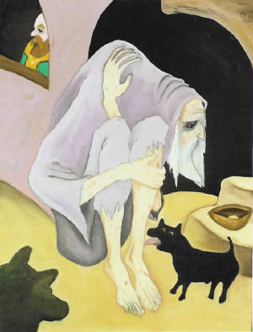
Some Lessons for Us

Slide 18
Some Lessons
Our existence doesn't end with death.
"When you’re dead, you’re dead" is true, but it doesn't mean what a lot of people think it does.
Likewise "You only go thru life once" is true, but the rich man's way of "getting all the gusto you can" didn’t work very well!
The story gives us extreme examples of wealth & poverty to show that our condition in this life is not a good predictor of our condition beyond.
It's our attitude toward God that really counts.

Slide 19
Some Lessons
Our condition after death is conscious.
For the saved, comfort.
For the lost, torment.
There is no second chance after death.
No reincarnation.
No more mercy.
Only justice.

Slide 20
Some Lessons
God's revelation in the Bible is sufficient to leave us without excuse:
For ignoring his claims on our life
For ignoring his provision for our salvation
Even the unsaved see the importance of evangelism when they die and awaken to what really lies beyond this life.

Slide 21
Some Lessons
What about you?
Are you ignoring God?
Are you living by the principle, "Eat, drink, and be merry"?
Or are you depending on God alone, as Lazarus was?
Having had a glimpse beyond, you still have time to make some course corrections.

Slide 22
The End

