Slide 1
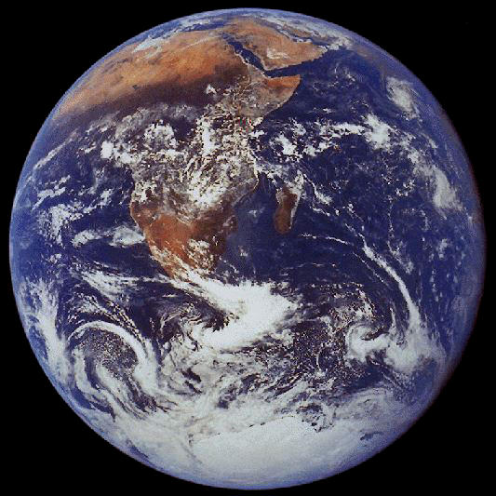

Genesis One & the Origin of the Earth
Robert C. Newman

Slide 2
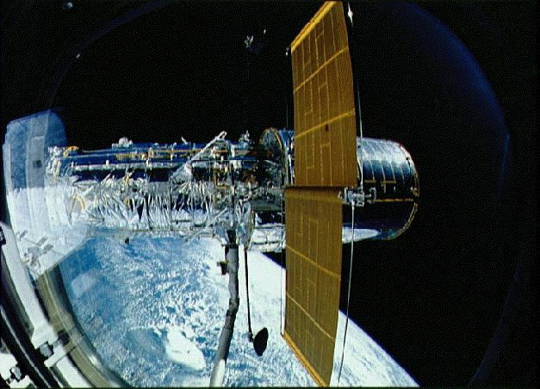
Origin of the Earth
Recent advances have aided our understanding:
  Improved optical telescopes
  Space probes
  Computer power
  Better techniques for detecting planets
As a result, now have considerable evidence for testing origin theories.

Slide 3
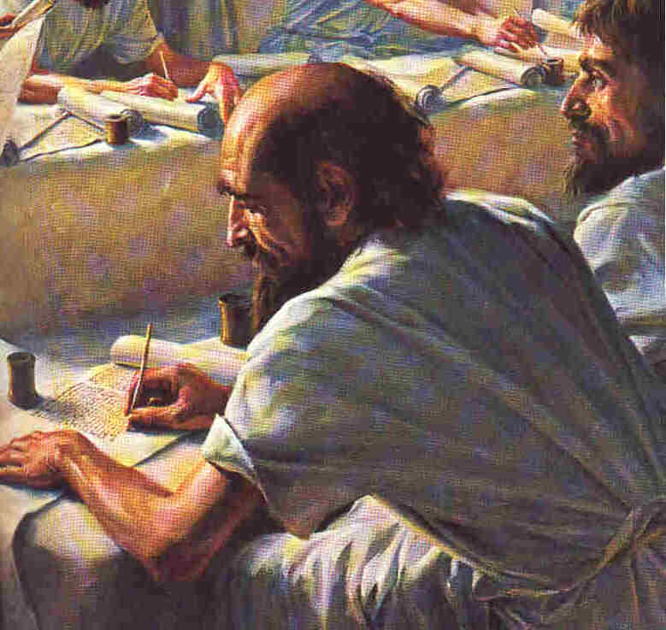
Genesis One
Bible written over 2000 years ago, when humans had no way to study universe as we do now.
Can such a book really tell us anything about earth's origin?
Bible claims to come from earth's Creator.

Slide 4
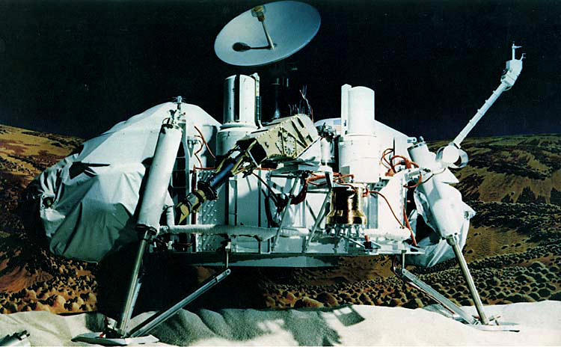
Scientific Data

Slide 5
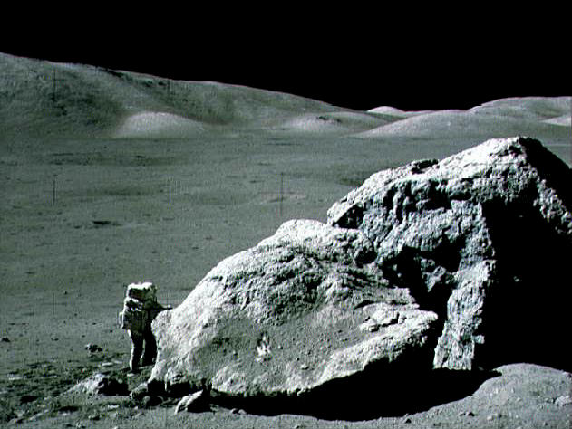
Scientific Data
Mass distribution
Angular momentum distribution
Shape of orbits
Alignment of orbits
Chemical composition of planets

Slide 6
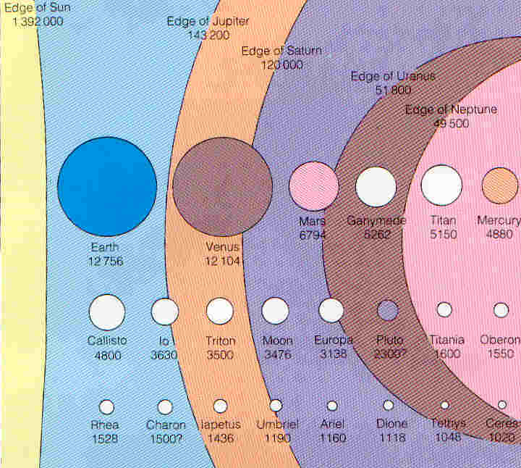
Mass Distribution
Mass not evenly distributed.
Most of mass concentrated in sun.
The distribution is:
  Sun 750 parts
  Rest 1 part

Slide 7
Angular Momentum: What?
Linear momentum – tendency to move in straight line.
Angular momentum – tendency to keep rotating.
Both depend on object's speed & mass.
Both kinds need force to change them.

Slide 8
Angular Momentum Distribution
Angular momentum of solar system not evenly distributed
Distributed quite differently than mass
Distribution:
  Sun has 1 part
  Planets 200 parts

Slide 9
Planetary Orbits
Planets move in nearly circular orbits rather than elongated ones.
They all go around the sun in the same direction.
Their orbital planes nearly coincide with that of the sun's equator.

Slide 10
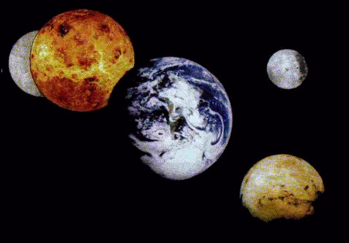
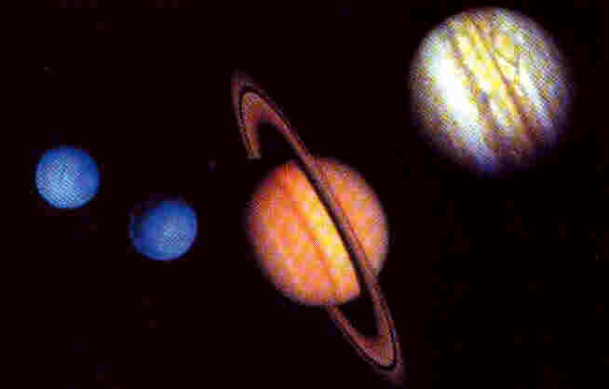
Chemical Composition
Planets have the same elements as sun and earth, but in very different proportions.
The inner planets form one group:
  Small
  Heavy
  Non-volatile
The outer planets form another:
  Large
  Light
  Volatile

Slide 11
Scientific Models

Slide 12

Random Capture Models
Velikovsky, Patten are proponents.
Planets formed elsewhere, captured by sun.
Compare novel When Worlds Collide.
This gives randomly oriented, non-circular orbits.

Slide 13

Close-Approach Models
Chamberlain, Moulton, Jeans are proponents.
Near-collision between stars
Tidal forces pulled out gas, formed planets
Gives co-planar orbits, but not circular
Not likely to form planets
Rare in any case

Slide 14
Star-Formation Models
Kant, Laplace, Gold, Hoyle are proponents.
Planets are a natural by-product of star-formation under certain conditions.
This model is generally favored today.
It naturally explains features of mass, angular momentum, orbit & composition mentioned earlier.
It predicts planets will be relatively common, now known to be the case.
Let's examine this model in some detail.

Slide 15
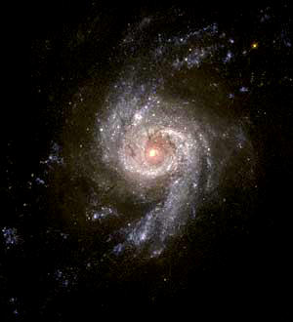
Starts with a Gas Cloud
Spiral galaxies have gas & dust clouds.
These contain mostly H and He with 1% heavier elements as dust or ices.
These clouds are very diffuse, a few atoms per cubic centimeter.
Some are rather hot (1000 ºK), others rather cold (100 ºK).

Slide 16
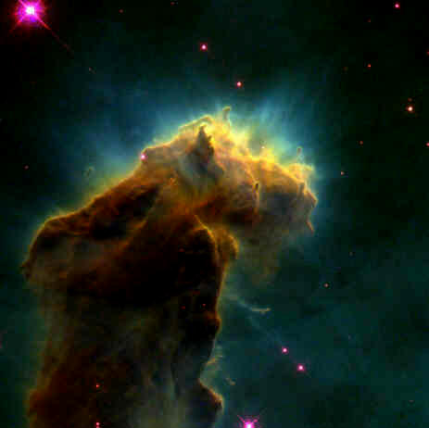
Collapsing Gas Cloud
Sometimes a gas cloud will begin to collapse.
  Cooler, denser clouds more likely
  A jolt may start it.
Once cloud begins to collapse, it will typically continue.

Slide 17
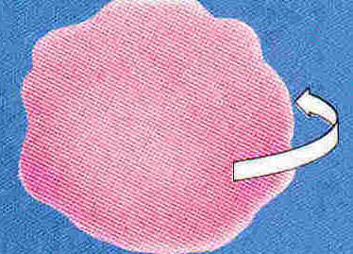
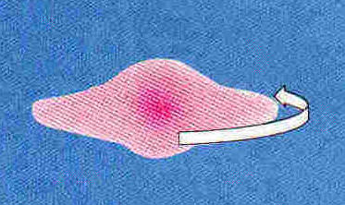
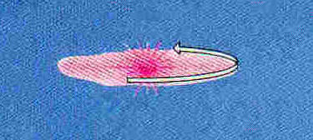
Rotating Gas Cloud
Random motions in the cloud will cancel, leaving only movement & rotation.
The rotation will be highly magnified as the collapse continues.
This would typically produce a pancake shape unless other forces intervene.

Slide 18
Other Forces
If rotation is too fast, the cloud will split, forming two or more stars, but probably few or no planets.
As the cloud collapses, it will get hotter and denser, especially near its center.
This will eventually ionize the gas, bringing in an additional force, electro-magnetism.

Slide 19
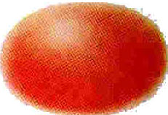


Ionized Cloud
This new force will split the cloud into two regimes:
  Central bulge → sun
  Outer band → planets
Magnetic forces will connect these regions.

Slide 20
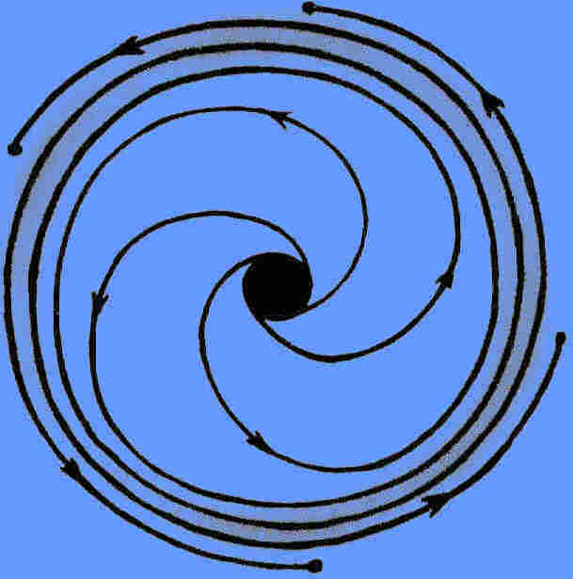
Formation of Planetesimals
As outer band picks up angular momentum, it moves away from center and cools.
The various chemicals condense out, the non-volatiles in close, the volatiles further out.
This band will form the planets, rotating in the same direction as the sun.

Slide 21
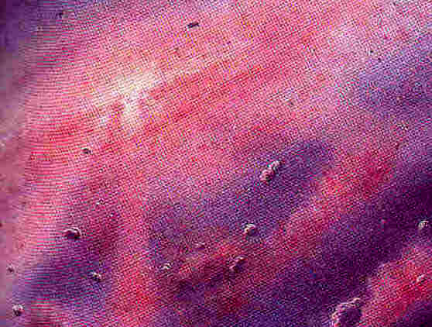
Formation of Planets
The planetesimals collide & adhere to form larger objects.
They gradually sweep up all the solid materials in the region.
The final collisions are violent, involving much larger objects.
This produces irregularities in orbits & rotation.

Slide 22
Formation of Planets
The inner planets are formed from close-in material, so less volatile; there is less of this, so planets are small.
The outer planets are formed from outer materials, so more volatile; there is more of this, so planets are larger.
The planets form cold, but heat up from radioactivity, pressure and collisions.

Slide 23
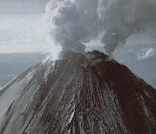
Formation of Atmospheres
The outer planets collect gases from nearby.
The inner planets lose this sort of gas due to heat of sun & less gravity.
The inner planets get their atmosphere from inside as the planet heats and loses its volatiles originally adsorbed on dust & ice grains.

Slide 24
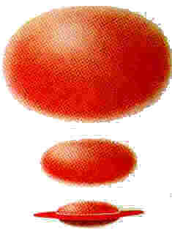
Review of Star-Formation Model
Shapeless, empty gas cloud begins to collapse.
It becomes hotter & denser as it collapses.
Rotation makes the cloud flatten.
Ionization splits cloud into flat band & rounded center. Band gains angular momentum.
The band moves outward, cools and condenses.

Slide 25
Review of Model
Condensing ices & dust first form planetesimals, then planets.
The planets rotate around sun in one plane aligned with sun's equator, revolving in same direction as sun.
Interior radioactive decay, pressure & meteor bombardment heat the inner planets, driving out gases inside.

Slide 26
Evidence for This Theory
It fits the data sketched above, as it was designed to do. No other does as well.
It also explains irregularities in this data.
It predicts that planets will be common, as now seems to be the case.
It predicts that planet formation is still going on, as also seems to be so.

Slide 27
Biblical Data

Slide 28
Fit with Genesis One?
This model doesn't seem to fit very well with the traditional interpretation.
But the traditional interpretation was made by people who didn't know the science.
It doesn't follow that the model doesn't fit with what the Genesis account actually says.
Let's see.

Slide 29
Fit with Genesis One
We will look at what the Biblical text says in the Hebrew.
We will try to see if it can be understood in harmony with solid scientific data, since God is author of both nature and Scripture.

Slide 30
Genesis 1:1-5
In the beginning God created the heavens and the earth. Now the earth was formless and empty, darkness was over the surface of the deep, and the Spirit of God was hovering over the waters. And God said, "Let there be light," and there was light. God saw that the light was good, and he separated the light from the darkness. God called the light "day," and the darkness he called "night." And there was evening, and there was morning – one day.

Slide 31
Genesis 1:1-5
A beginning when God created
The earth initially formless & empty; solar system formed from amorphous gas cloud.
Darkness; as the cloud collapses, it becomes denser, darker.
Cloud begins to glow as it ionizes.
Equatorial band pushed outside glow.
Rotating planets have day/night sequence.

Slide 32
Genesis 1:6-8
And God said, "Let there be an expanse between the waters to separate water from water." So God made the expanse and separated the water under the expanse from the water above it. And it was so. God called the expanse "sky." And there was evening, and there was morning – a second day.

Slide 33
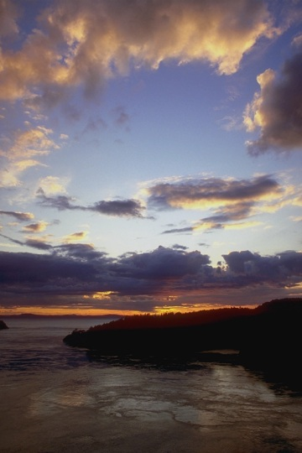
Genesis 1:6-8
An expanse is formed to separate the waters — the atmosphere.
This expanse forms our blue sky; no need to see it as a solid dome.
No need to have the waters "above" be outside our atmosphere.
The order fits the scientific view re/ outgassing.

Slide 34
Job 38:8-9
Who shut up the sea behind doors when it burst forth from the womb, when I made the clouds its garment and wrapped it in thick darkness?

Slide 35
Job 38:8-9
God is here speaking to Job in poetic language about the birth of the oceans.
The womb is apparently the earth, just as the scientific outgassing model suggests.
The earth was then cloud-covered and dark, suggesting (when harmonized with Genesis one) the simultaneous formation of atmosphere and ocean.

Slide 36
Genesis 1:9-10
And God said, "Let the water under the sky be gathered to one place, and let dry ground appear." And it was so. God called the dry ground "land" and the gathered water "seas." And God saw that it was good.

Slide 37
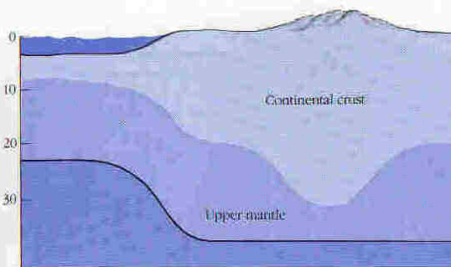
Genesis 1:9-10
We now know that earth's surface is great, thin plates of crust, moving slowly on the mantle beneath.
There are two types of crust:
  Light, thick continent
  Heavy, thin ocean basin
It looks like the oceans drained off into the basins when the crust split into two kinds.

Slide 38
Genesis 1:11-13
Then God said, "Let the land produce vegetation: seed-bearing plants and trees on the land that bear fruit with seed in it, according to their various kinds." And it was so. The land produced vegetation… And God saw that it was good. And there was evening, and there was morning – a third day.

Slide 39
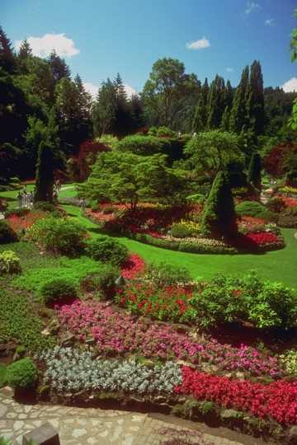
Genesis 1:11-13
Naturally, there is no land vegetation without land to have it on.
The order is interesting here:
  Plants are narrated before animals, which depend on them.
  Plants are narrated before sun, moon & stars, seen as contradicting science.
But something more subtle is going on here.

Slide 40
Genesis 1:14-19
And God said, "Let there be lights in the expanse of the sky to separate the day from the night, and let them serve as signs to mark seasons and days and years. And let them be lights in the expanse of the sky to give light upon the earth." And it was so. God made two great lights – the greater light to dominate the day and the lesser light to dominate the night. He also made the stars. God set them in the expanse of the sky to give light on the earth, to dominate the day and the night, and to separate light from darkness. And God saw that it was good. And there was evening, and there was morning – a fourth day.

Slide 41
Genesis 1:14-19
Though often overlooked, this fits science very well.
Viewed from earth, this describes the clearing of the atmosphere so that sun, moon & stars become visible.
This clearing is the direct result of vegetation, which removes carbon dioxide and replaces it with oxygen.

Slide 42
Synthesis
In the beginning God created heaven & earth.
  A beginning – the big bang, perhaps.
Earth is formless & empty.
  Earth an amorphous, tenuous gas cloud.
Darkness on the face of the deep.
  After contraction, cloud becomes dark.
Let there be light.
  Further contraction & cloud begins to glow.

Slide 43
Synthesis
Light divided from darkness
  Planetary material thrust outside.
Light = day, darkness = night
  Planet formed from planetesimals.
  Sun & rotation give day & night.
Waters burst forth from womb of earth, expanse appears in midst of waters.
  Heating earth drives out water & gases.

Slide 44
Synthesis
Division of waters above & below
  Atmosphere allows both surface & atmospheric water.
Gathering of waters, dry land appears.
  Development of continental crust.
Earth brings forth vegetation.
  Land vegetation appears.

Slide 45
Synthesis
Lights appear in sky to mark off days, seasons & years; sun & moon dominate day & night.
  Photosynthesis by vegetation replaces CO₂ by oxygen, lowering temperature & clearing atmosphere so stars, etc. visible; also prepares atmosphere for animals and humans.

Slide 46
Genesis One & Origin of Earth
A reasonable interpretation of biblical & scientific data is consistent in a striking, non-trivial way.
The correlation between Genesis 1 & science is much better than between Genesis & other ancient creation accounts.
We suggest this is so because the Creator is the author of Genesis.

Slide 47
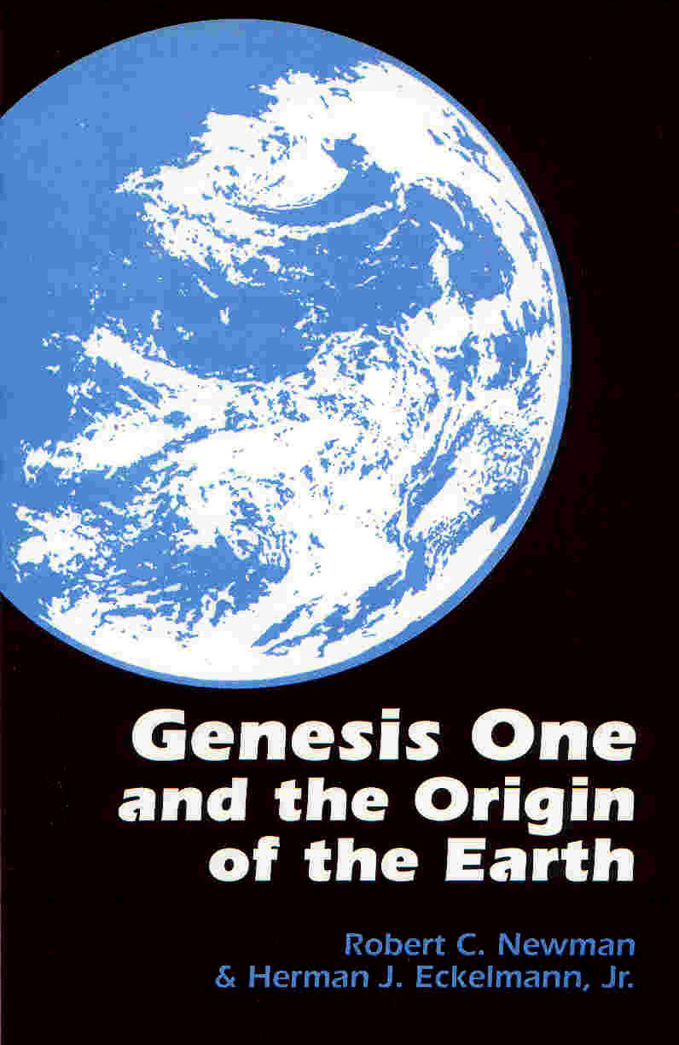
For Further Reading
Newman & Eckelmann, Genesis One & the Origin of the Earth
John Wiester, The Genesis Connection
Hugh Ross, The Creator & the Cosmos

