Slide 1

Genetic Engineering & Cloning
Robert C Newman
& Bartholomew J Votta

Slide 2
What is Genetic Engineering?
"Genetic engineering is the technology for modifying the genetic information in a plant, animal or human in order to produce some desired trait or characteristic"

Slide 3
A Brief History of Genetic Engineering
The name is new, the practice is not.
Plants and animals have been bred for thousands of years.
Human breeding has also been done now and then.
All of this has worked by trying to enhance desired characteristics, without knowing how they are transmitted.

Slide 4
Genetic Engineering in the 20th Century
There have been great advances in our knowledge of genetics:
  How genetic information is stored
  How it is transmitted
  How it is used
The entire DNA sequence of several organisms is now known, with human DNA just about done.
We are just beginning to decipher what each unit means and how it works.

Slide 5
Prospects for
Genetic Engineering
Designing plants & animals "from scratch"
  This is not going to happen anytime soon
Transgenic Engineering
  Putting genetic information from one type of plant or animal into another
Cloning
  Making genetic copies of an existing plant or animal
Let’s look at the latter two of these.

Slide 6
Transgenic Organisms
An organism is called "transgenic" if it has genetic information added to it from a different type of organism.
Viruses do something of this sort when they infect plants, animals or humans.
Humans have begun to do this with plants and animals.
We are not yet making flying pigs!

Slide 7
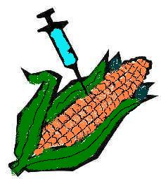
Transgenic Plants
This is the work that is furthest along:
  Corn with its own insecticide
  Soybeans & cotton resistant to herbicides
  Papayas resistant to viruses
Transgenic crops are being grown in the Americas, South Africa, Europe, Australia and China

Slide 8
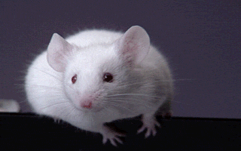
Transgenic Animals
The work is less advanced here.
Human genes have been inserted into:
  Bacteria
  Mice
To produce various human proteins for treating diseases.

Slide 9
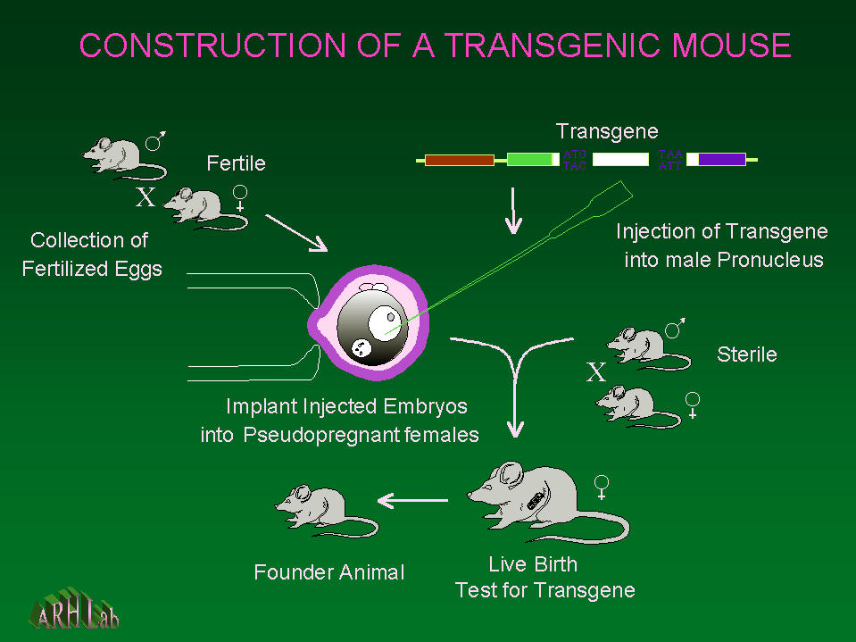
Making
Transgenic Mice

Slide 10
Advantages of Transgenic Engineering
Plants:
  More disease-resistant
  Larger yields
  More transportable
  More nutritious
Animals:
  Make proteins for medicinal purposes
  Make organs for transplant to humans

Slide 11
Concerns about
Transgenic Engineering
Plants:
  Are they safe to eat?
  Will they harm wildlife?
  Will some become super-pest weeds?
  Replace or contaminate natural plants?
Animals:
  Will they be harmful?
  Replace or contaminate natural animals?

Slide 12
Cloning
A "clone" is a copy of something.
Computers that mimic IBMs are called "clones."
In genetics, a clone is a genetic copy of another organism.
Clones occur naturally:
  Asexual breeding in plants & lower animals
  Identical twins (triplets) in higher animals

Slide 13
A Brief History of Cloning
For centuries it has been known that simple animals – worms & starfish – can be cloned by cutting them in half.
This doesn't work for higher animals!
Part of the problem is cell specialization:
  Nerve
  Bone
  Muscle, etc.

Slide 14
Cloning in the
20th Century
We now realize that each specialized cell has all the genetic information, but much of it is turned off.
Problem – how to reset the "program" so this information is usable?
Cloning of frogs successful in 1950s
Cloning of livestock from fetal cells in 1970s

Slide 15
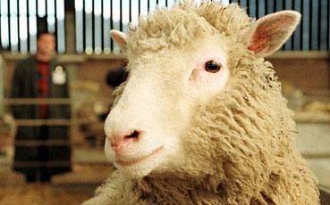
Dolly - 1996
Clone from an adult sheep cell by Scots researchers under Ian Wilmut
Had only one success in 300 tries.
Dolly grew to maturity, and successfully had a lamb by natural means in 1998.
But Dolly seems to be prematurely old.

Slide 16
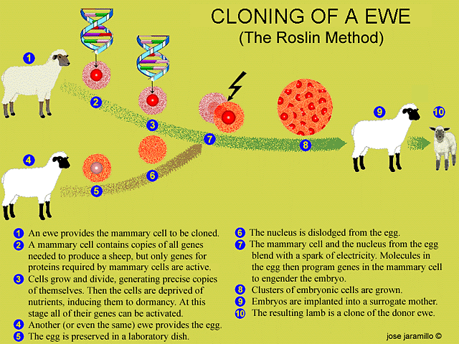
Cloning Dolly

Slide 17
Cloning since Dolly
Cloning of this sort has now been done on cattle, pigs and mice also.
The success rate has improved considerably.
Cloning humans begins to show up in science fiction in 1970s.
This is now a realistic possibility.

Slide 18
Advantages of Cloning
With an adult plant or animal, the breeder knows what its traits are; this is not the case with fetal cell cloning.
Cloning allows making a genetically identical copy of the desired plant or animal.

Slide 19
Concerns re/ Cloning
The success rate from adult animal cells is still rather low.
This would be unacceptable for cloning humans in most societies.
The evidence suggests that the clones which survive are still not right.
The genetic program has probably not been completely reset.
We still don’t understand what we are doing in cloning from adult cells.

Slide 20
How Should
Christians React?
How should we respond to:
  Food containing transgenic ingredients?
  Making mice which produce insulin?
  Making pigs to harvest for human organ replacements?
What does the Bible have to say about such things?
  Nothing directly, but important principles

Slide 21
God's Commandments in Eden
God's Purposes (Genesis 1:26):
  Mankind to be in God's image
  Humans to rule over animals, etc.
God's Commands (Gen 1:28):
  Be fruitful, multiply, fill the earth.
  Subdue the earth.
  Rule over animals, fish, birds.

Slide 22
God's Commandments at Ararat
Be fruitful, increase, fill the earth.
Animals will fear you.
Animals are given into your hands.
They will be your food, but you must not eat their lifeblood.
Neither you nor they may shed human blood. (Gen 9:1-7)

Slide 23
Treatment of Animals
"A righteous man cares for the needs of his animal, but the kindest acts of the wicked are cruel." (Proverbs 12:10)

Slide 24
God's Commands at Sinai
Have no other gods but God.
Make & worship no images.
Don't misuse God's name.
Remember to keep his Sabbath rest.
Honor your parents.
Don't murder, commit adultery, steal.
Don't give false testimony.
Don't desire what is not yours. (Ex 20:3-17)

Slide 25
What Should We Expect?
Technology is good, because creation is.
Mankind is fallen, "a ruin" (Buswell).
  Not just a pile of shapeless stones, an artifact.
  Not what it was designed to be.
Man has always used the latest technology, for good or evil.
This is bound to happen with genetic engineering, too.

Slide 26
What Should We Expect?
By God's mercy, there has been less nuclear, chemical, biological warfare than we had any right to expect.
Given the world situation, we can expect genetic engineering will be used for both good and evil.
This will surely include human cloning unless it backfires terribly.

Slide 27
What Should We Do?
We should act as Christians are supposed to, whatever the situation:
  Salt – taste, preservative, thirst, stings
  Light – visible, illuminating
We should obey God’s commands ourselves & encourage others to righteousness as best we can.
We should pray that God will be glorified and Jesus lifted up in whatever situation God puts us in.

Slide 28
What This Means
Seek first God's rule and God's righteousness, and all these things (food, clothing, etc.) will be yours as well.
We may have to take unpopular stands.
Don't let short-term benefits outweigh doing what is right & compassionate.

Slide 29
Genetic Engineering & Cloning
Not The End!

