Slide 1
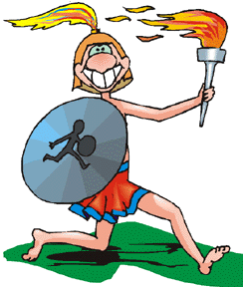
Foot Racing Image
Background to Hebrews 12
Robert C. Newman

Slide 2
History of Foot Racing
Origin lost in antiquity
Probably began (like most other ancient sports) as practice for warfare

Slide 3
Ancient Athletics
Greece is our main source of information on the ancient period.
After Alexander the Great, Greek culture spread through most of the Mediterranean world.
This culture was continued (with some additions) by the Romans.

Slide 4
Ancient Athletic Meets
In ancient Greece, there were four main competitive meets, held for centuries every two or four years.
These were:
Olympic Games
Pythian Games
Isthmian Games
Nemean Games

Slide 5
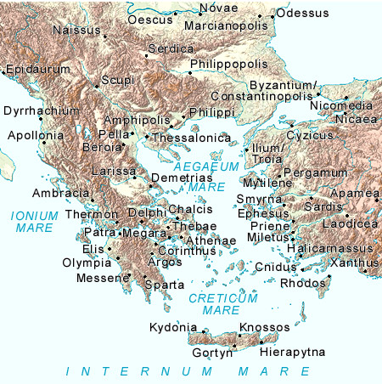
Olympic Games
Every four years, in August of the 1st year of the Olympiad
At Olympia in the W Peloponnesus
In honor of Zeus
Prize an olive wreath

Slide 6
Olympic Games
Originally only men were competitors; later boys & adolescents.
Events:
Various Footraces
Discus
Javelin
Broad jump
Boxing
Wrestling
Pankration
Pentathlon

Slide 7
Pythian Games
Every four years, in August of the 3rd Olympiad year
At Delphi, 80 mi NW of Athens
In honor of Apollo
Prize a laurel wreath.
Events similar to Olympics, plus musical competition

Slide 8
Isthmian Games
Every two years, in Apr/May of 2nd & 4th Olympiad years
At Corinth
In honor of Poiseidon
Prize was dry celery wreath, later pine
Not as prestigious as Olympics

Slide 9
Nemean Games
Every two years, in July of 2nd & 4th Olympiad years
At Nemea, 15 mi SW of Corinth
In honor of Zeus
Prize a wreath of fresh wild celery

Slide 10
Other Games
By New Testament times, every major city in the Roman empire had games annually or at longer periods, with much less prestige than these four.
Prizes were more valuable, but less prestigious.
Athletics by this time had become dominated by professionals.

Slide 11
Ancient Footracing
Little information about non-Greek footracing

Slide 12
Various Footraces
Stadion or dromos
The standard-length race, one length of the stadium, about 200 yards
Diaulous
One turn at end of stadium, ~400 yds
Dolichos
Various longer races, up to 3 miles (24 stades)
Hoplite
Racing in full or partial armor, 2-15 stades

Slide 13
Stadium
Long, narrow (200 x 30 yd) with stands all around
Up to 20 runners ran side-by-side
Turned at one or more posts at end, rather than having an oval track.
Delphi Stadium

Slide 14
Sources
Encyclopaedia Britannica (1970)
E. N. Gardiner, Athletics of the Ancient World (1930)
Athletics in Antiquity, The Ancient World (March 1983)
Ancient Games & Athletics, The Ancient World (August 1984)
www.perseus.tufts.edu/Olympics

Slide 15
The End
Run so as to obtain the prize!

