Slide 1
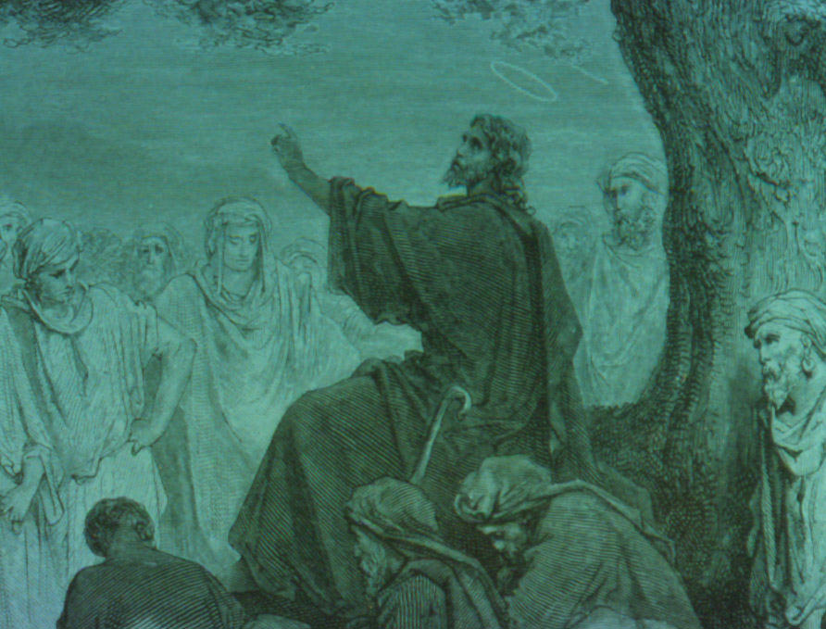
Exegeting Jesus' Parables
Robert C. Newman
Biblical Theological Seminary

Slide 2
What is a Parable?
Dictionary
Short, fictitious story that illustrates a moral attitude or religious principle
Literary
A simile expanded into a story
New Testament
A rather broad genre of illustration, including parable (above), allegory, similitude, and sample parable, also proverb and paradox

Slide 3
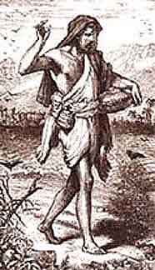
How Parables Work
Parables are stories
Brief
Unified
Few actors
Direct discourse
Serial development
Rule of three
Repetition
Binary opposition
End-stress
(often) Resolution by reversal
(usually) Two-level

Slide 4
How Parables Work
See John W. Sider, Interpreting the Parables
Parables are analogies:
Verbal comparison
Tenor – "heavenly meaning"
Vehicle – "earthly story"
Point(s) of resemblance

Slide 5
An Analogy from Shakespeare
"As flies to wanton boys are we to the gods – they kill us for their sport."
Tenor – relation of gods to humans
Vehicle – relation of boys to flies
Point of resemblance – re/ how mistreated

Slide 6
The Analogy Diagramed
Tenor Vehicle
We: gods = flies: (wanton) boys
With respect to how they mistreat us
Point of Resemblance

Slide 7
An Example from Jesus' Parables
Wheat & Weeds – Matt 13:24-30, 36-43
Story: Man sows good seed, his enemy weeds. When discovered, slaves want to remedy situation right away; owner has them wait till harvest.
Tenor: kingdom of heaven
Vehicle: story above
Points of Resemblance: several

Slide 8
Parables in the Gospels
Christological
Lost & Found
Forgiveness & Mercy
Prayer
Transformation
Stewardship
Invitation & Rejection

Slide 9
Parables in the Gospels
Second Coming
Warning & Judgment
Kingdom
Illustrative (example) Parables
Acted Parables

Slide 10
The End
Let's begin to make the parables come alive for our audience!

