Slide 1
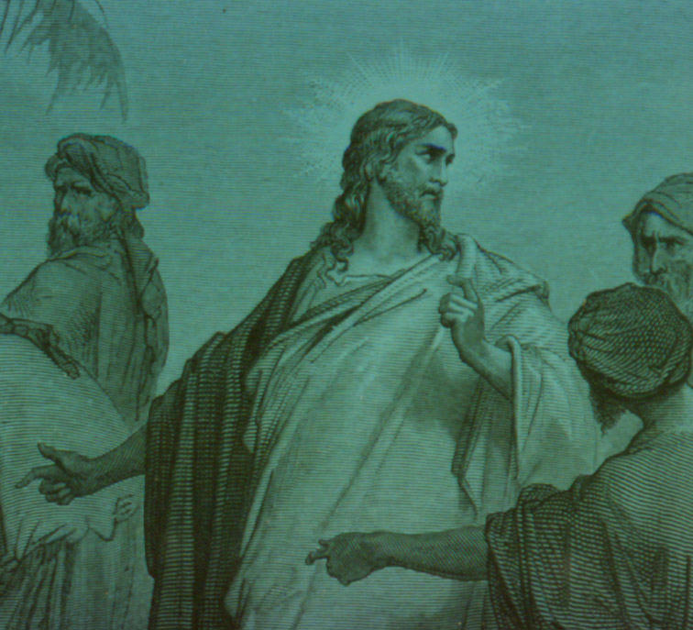

Exegeting Controversy Passages
Robert C. Newman
Biblical Theological Seminary

Slide 2
What are Controversy Passages?
Can be either:
  Narrative – Jesus responding in dialog fashion to an opponent
  Discourse – report of Jesus' speech dealing with a controversial subject
In either case, there are certain things to look for/think about so as to be sure we don't misunderstand what is going on.

Slide 3
What to Look For
Jesus may not be addressing the particular controversy you are concerned about; after all, his first concern is the controversy that is going on in his own time.
  Thus, you need to see what that controversy is about.
Who are Jesus' opponents? Where are they coming from ideologically?

Slide 4
What to Look For
What is Jesus' view of this matter that is being debated in his time?
How is Jesus arguing for his position?
  Remember that his opponents do not accept his claims, so they are not about to take his word for it.
  Can we understand his words as actually arguing from where they are to where he is?

Slide 5
What to Look For
Jesus may leave out some steps in his argument that would be easily understood by his original audience or opponents.
  It does not follow that we will understand him unless we can supply those steps.
Once we understand what Jesus is saying to his original opponents & audience, we are ready to see how this carries over to us & to situations we face today.

Slide 6
Controversy & Dialogue Accounts in the Synoptics
Here (in our Synoptic Gospels notes) is a list of passages that more or less fall into this genre in the Synoptics. One of them is a controversy involving John the Baptist rather than Jesus.
We look at a few of these below.

Slide 7
Calling Matthew – Mt 9:9-13
9 (NIV) As Jesus went on from there, he saw a man named Matthew sitting at the tax collector's booth. "Follow me," he told him, and Matthew got up and followed him. 10 While Jesus was having dinner at Matthew's house, many tax collectors and "sinners" came and ate with him and his disciples. 11 When the Pharisees saw this, they asked his disciples, "Why does your teacher eat with tax collectors and `sinners'?" 12 On hearing this, Jesus said, "It is not the healthy who need a doctor, but the sick. 13 But go and learn what this means: 'I desire mercy, not sacrifice.' {[13] Hosea 6:6} For I have not come to call the righteous, but sinners."

Slide 8
Calling Matthew – Mt 9:9-13
Who are the opponents?
  Pharisees
What are they concerned about?
  Jesus keeping bad company
How does Jesus answer them?
  By an analogy of sin to sickness
  By an OT citation (Hosea 6:6)
  By a summary of his mission

Slide 9
Taxes to Caesar – Mt 22:15-22
15 (NIV) Then the Pharisees went out and laid plans to trap him in his words. 16 They sent their disciples to him along with the Herodians. "Teacher," they said, "we know you are a man of integrity and that you teach the way of God in accordance with the truth. You aren't swayed by men, because you pay no attention to who they are. 17 Tell us then, what is your opinion? Is it right to pay taxes to Caesar or not?" 18 But Jesus, knowing their evil intent, said, "You hypocrites, why are you trying to trap me? 19 Show me the coin used for paying the tax." They brought him a denarius, 20 and he asked them, "Whose portrait is this? And whose inscription?" 21 "Caesar's," they replied. Then he said to them, "Give to Caesar what is Caesar's, and to God what is God's." 22 When they heard this, they were amazed. So they left him and went away.

Slide 10
Taxes to Caesar – Mt 22:15-22
Who are Jesus' opponents?
  Pharisees & Herodians
What are they trying to do?
  Trap Jesus into saying something disastrous about taxes
How does Jesus respond?
  Gets them to provide coin
  The rest is easy!
  Give borrowed property back to its owner!

Slide 11
Marriage & Resurrection – Mt 22:23-33
Matt 22:23 (NIV) That same day the Sadducees, who say there is no resurrection, came to him with a question. 24 "Teacher," they said, "Moses told us that if a man dies without having children, his brother must marry the widow and have children for him. 25 Now there were seven brothers among us. The first one married and died, and since he had no children, he left his wife to his brother. 26 The same thing happened to the second and third brother, right on down to the seventh. 27 Finally, the woman died.
28 Now then, at the resurrection, whose wife will she be of the seven, since all of them were married to her?"

Slide 12
Marriage & Resurrection – Mt 22:23-33
29 Jesus replied, "You are in error because you do not know the Scriptures or the power of God. 30 At the resurrection people will neither marry nor be given in marriage; they will be like the angels in heaven. 31 But about the resurrection of the dead--have you not read what God said to you, 32 'I am the God of Abraham, the God of Isaac, and the God of Jacob‘ {[32] Exodus 3:6}? He is not the God of the dead but of the living." 33 When the crowds heard this, they were astonished at his teaching.

Slide 13
Marriage & Resurrection – Mt 22:23-33
Who are Jesus' opponents?
  Sadducees, who deny resurrection
What are they trying to do?
  Make resurrection look ridiculous
How does Jesus respond?
  Looks like he leaves out some steps
  I think Jesus' point is that resurrection is necessary for God to keep his covenant promise.

Slide 14
Mary & Martha – Lk 10:38-42
Luke 10:38 (NIV) As Jesus and his disciples were on their way, he came to a village where a woman named Martha opened her home to him. 39 She had a sister called Mary, who sat at the Lord's feet listening to what he said. 40 But Martha was distracted by all the preparations that had to be made. She came to him and asked, "Lord, don't you care that my sister has left me to do the work by myself? Tell her to help me!" 41 "Martha, Martha," the Lord answered, "you are worried and upset about many things,
42 but only one thing is needed. {[42] Some manuscripts but few things are needed—or only one} Mary has chosen what is better, and it will not be taken away from her."

Slide 15
Mary & Martha – Lk 10:38-42
Who is Jesus' opponent?
  Martha
What is she trying to do?
  Embarrass Mary to get her to help
What does Jesus do?
  He defends Mary
  Perhaps he suggests Martha's preparations are too elaborate.
  In any case, that Mary's concern is better.

Slide 16
The End
Make sure you understand what Jesus and his opponents are arguing about!

