Slide 1
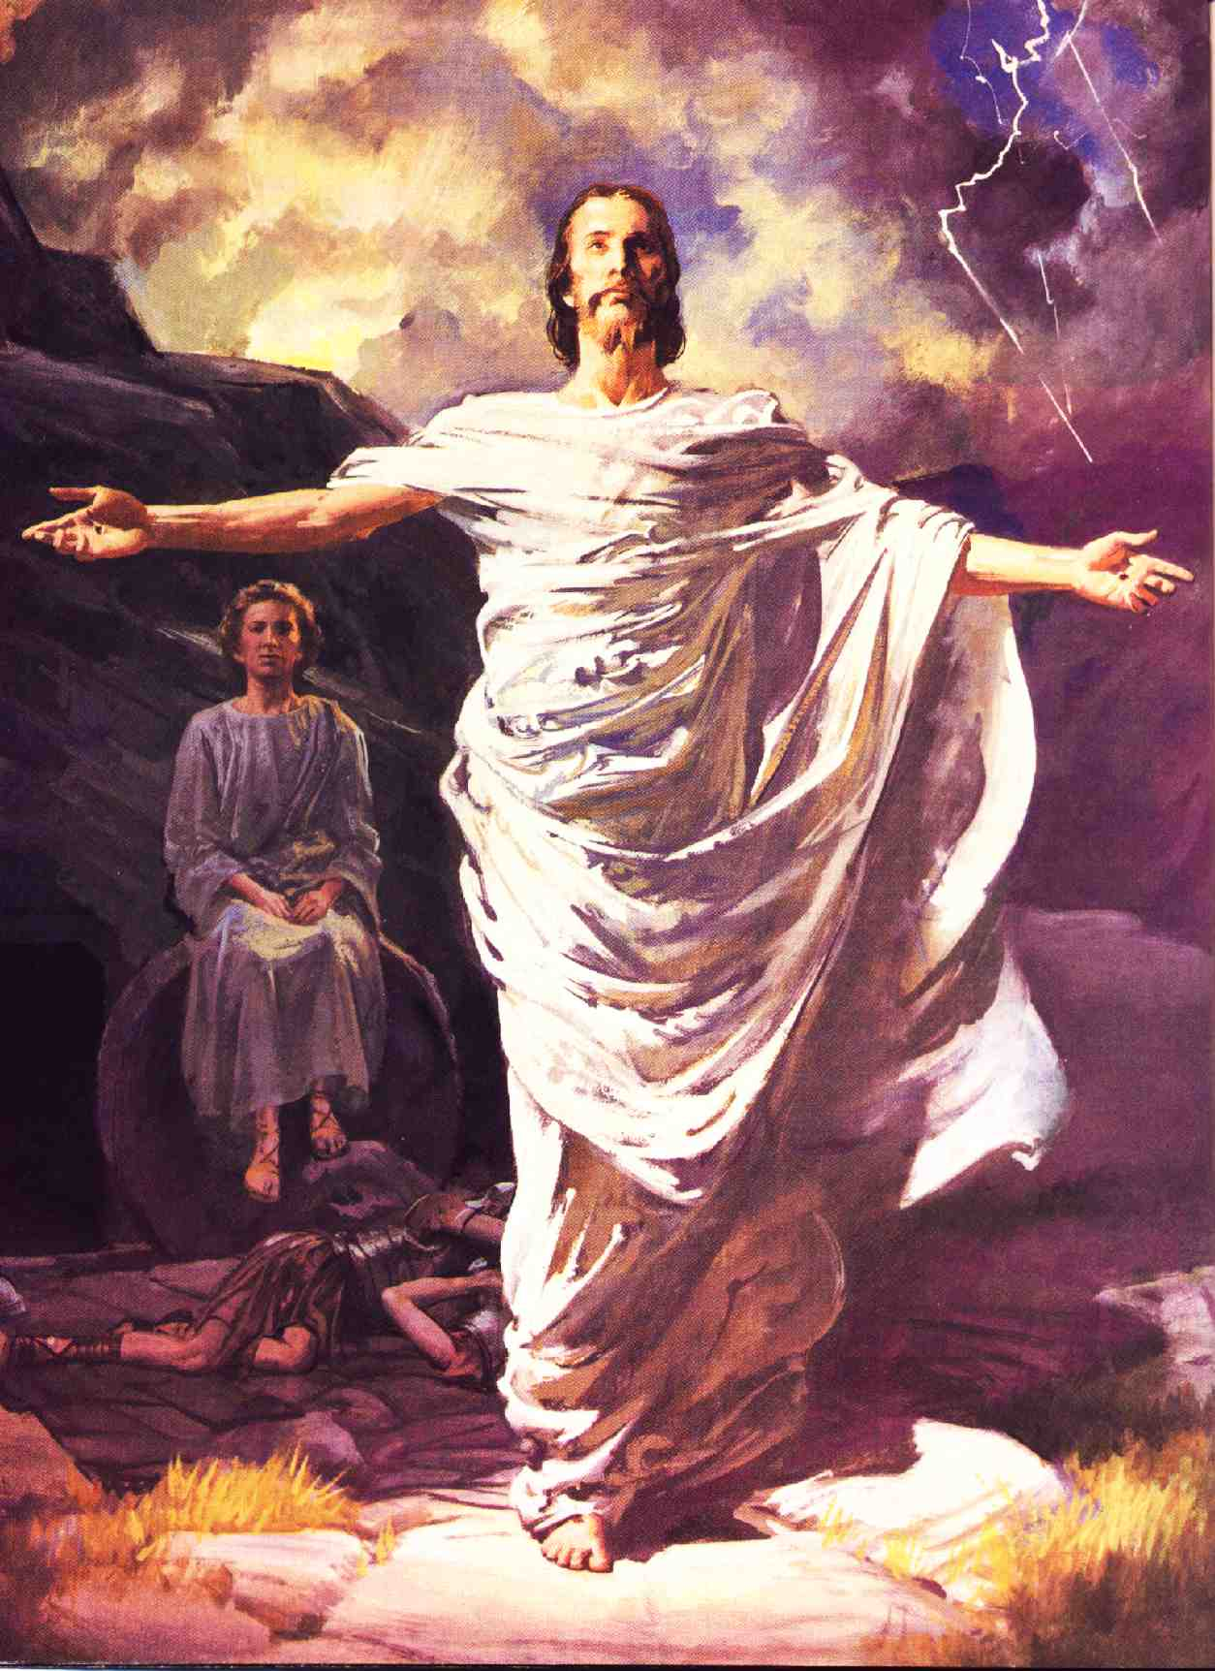
Evidence for the Resurrection
From Prophecy & History
Robert C. Newman

Slide 2
The Importance of Jesus' Resurrection
Validates Jesus' claims vs charge for which he was executed
Indicates God accepted Jesus' sacrifice
Points to a life beyond this one
Reminds us that history is controlled by God

Slide 3
Alternative Theories
There have been several theories proposed over the centuries to avoid Jesus' resurrection:
Stolen Body Theory
Coma Theory
Hallucination Theory
Let's look at each of these first.

Slide 4
Stolen Body Theory
The oldest alternative: disciples stole the body
Earliest version has soldiers testifying to events which happened while they were asleep!
Theory cannot explain:
Tactics of apostles
Career of Paul
Content of New Testament

Slide 5
How is that?
Tactics of the apostles
Began proclamation right in Jerusalem
Gave their lives for truth of their testimony
Did not use force to advance their views
Career of Paul
Changed sides: powerful, wealthy → weak, poor
Continually risked life to proclaim message
Content of the New Testament
Emphasis on truth-telling, multiple witnesses
Readers invited to check for themselves

Slide 6
Coma Theory
Jesus, unconscious, revives in tomb.
But:
How get out of tomb?
How convince disciples he’d conquered death?
Fatal problem is physiology of crucifixion: person will strangle in coma.

Slide 7
Hallucination Theory
Women go to wrong tomb, mistake gardener for Jesus, begin to have hallucinations.
But:
How mistake tomb in broad daylight?
How avoid authorities producing body?
Hallucinations do not produce hour-long, multiple-sense, multiple-witness appearances.

Slide 8
Evidence for Jesus' Resurrection
From History:
Historical evidence points strongly to Jesus' resurrection as an event which really happened.
Alternative explanations must do funny things with the data.
From Prophecy:
Old Testament passages predict something of this sort for the Messiah.
These passages were written centuries in advance.

Slide 9
Evidence from History
We can't go back in time to see what really happened, but we do have several significant lines of evidence:
Existence of the Church
Existence of the New Testament
Testimony of the New Testament

Slide 10
Existence of the Church
Lots of religions have arisen with false beliefs.
But:
Jesus' followers were completely demoralized by his death.
Within a short time they were boldly proclaiming his resurrection in the city where he was killed.
Most of the apostles died as martyrs, not willing to retract their claims to have seen the risen Jesus.
The church expanded to fill the Roman Empire without use of military evangelism.

Slide 11
Existence of the New Testament
Several religions have holy books…
But:
The NT records spectacular events and comes from within a century of the events it records.
External evidence points to two apostles & two associates as authors of the Gospels, and to a former enemy as author of most of the NT letters.
The uniform testimony of the NT is to multiple eyewitnesses, extended appearances, multiple senses.
The evidence for the reliability of the NT is as good as for any ancient history.

Slide 12
Testimony of the New Testament
We have accounts of post-resurrection appearances in six NT books:
1 Corinthians 15:1-9
Mark 16:1-8 (9-20)
Matthew 28
Luke 24
John 20-21
Acts 1, 9, 22, 26

Slide 13
Questions to Consider
How many post-resurrection appearances?
How long did they last?
When did they occur?
Where did they occur?
What form did Jesus take?
To whom did he appear?
What was the chronological order?

Slide 14
Suggested Scenario
Book/chap 1 Cor15 Mk16 Mt28 Lk24 Ac1 Jn20
Women 9
Mary M. 9 11-17
Peter 5 34
2 on Road 12 13-31
10 Apostles 5? 36-48 19-23
11 Apostles 5? 14? 26-29

Slide 15
Suggested Scenario
Book/chap 1 Cor15 Mk16 Mt28 Lk24 Ac1 Jn21
7 at Sea 1-22
11 on Mt 6? 16
James 7
Ap @ meal 7? 14? 4-5
Ap @ ascension 7? 14? 49-51 6-8
Paul @ Damasc 8

Slide 16
Conclusions on NT Accounts
The accounts are harmonizable.
They don't look like they were contrived to fit.
They indicate 11-13 recorded appearances.
They occur from the 3rd day to the 40th, plus the later appearances to Paul.
The longer appearances take on the order of an hour each.

Slide 17
Evidence from Prophecy
Consider the three major OT passages which point to the resurrection of the Messiah:
Psalm 16
Psalm 22
Isaiah 53

Slide 18
Text of Psalm 16
I have set the LORD always before me. Because he is at my right hand, I will not be shaken. Therefore my heart is glad and my tongue rejoices; my body also will rest secure, because you will not abandon me to the grave, nor will you let your Holy One see decay. You have made known to me the path of life; you will fill me with joy in your presence, with eternal pleasures at your right hand.

Slide 19
Content of Psalm 16
Speaker does not fear being shaken.
God is with him.
His body is safe.
It will not be abandoned to the grave.
It will not see decay.
Instead he will experience:
Life
Joy of God's presence
Eternal pleasures

Slide 20
Text of Psalm 22
My God, my God, why have you forsaken me?… All who see me mock me, they hurl insults, shaking their heads…. You lay me in the dust of death…. Dogs have surrounded me, a band of evil men has encircled me, they have pierced my hands and my feet…. They divide my garments among them and cast lots for my clothing…. I will declare your name to my brothers; in the congregation I will praise you…. The poor will eat and be satisfied…. All the ends of the earth will remember and turn to the LORD…. Posterity will serve him; future generations will be told about the Lord. They will proclaim his righteousness to a people yet unborn – for he has done it.

Slide 21
Content of Psalm 22
Speaker is:
Abandoned by God
Laid in dust of death
Opponents (mockers, dogs) surround him:
Piercing his hands and feet
Casting lots for his clothing
Speaker will be rescued, resulting in:
Help for poor
Message for whole world & future generations

Slide 22
Isaiah 52:13-53:2
See, my servant will act wisely; he will be raised and lifted up and highly exalted. Just as there were many who were appalled at him – his appearance was so disfigured beyond that of any man and his form marred beyond human likeness – so will be sprinkle many nations, and kings will shut their mouths because of him. For what they were not told, they will see, and what they have not heard, they will understand. Who has believed our message, and to whom has the arm of the LORD been revealed? He grew up before him like a tender shoot, like a root out of dry ground.

Slide 23
Content of Isa 52:13-53:2
God's servant will be exalted.
Many were appalled at his disfiguration.
He will sprinkle many nations.
Kings will shut their mouths when they understand.
This message will be hard to believe.

Slide 24
Isaiah 53:2-5
He had no beauty or majesty to attract us to him, nothing in his appearance that we should desire him. He was despised and rejected by men, a man of sorrows and familiar with suffering. Like one from whom men hide their faces he was despised and we esteemed him not. Surely he took up our infirmities and carried our sorrows, yet we considered him stricken by God, smitten by him and afflicted. But he was pierced for our transgressions, he was crushed for our iniquities; the punishment that brought us peace was upon him, and by his wounds we are healed.

Slide 25
Content of Isa 53:2-5
God's servant not majestic:
Despised and rejected
Familiar with suffering
We thought God had struck him.
But instead:
He carried our sorrows.
He was pierced for our transgressions.
His punishment brought us peace.

Slide 26
Isaiah 53:6-9
We all, like sheep, have gone astray, each of us has turned to his own way; and the LORD laid on him the iniquity of us all. He was oppressed and afflicted, yet he did not open his mouth; he was led like a lamb to the slaughter, and as a sheep before her shearers is silent, so he did not open his mouth. By oppression and judgment he was taken away. And who can speak of his descendants? For he was cut off from the land of the living; for the transgressions of my people he was stricken. He was assigned a grave with wicked men, yet he was with a rich man in his death, because he had done no violence, nor was any deceit in his mouth.

Slide 27
Content of Isa 53:6-9
We were straying, but God put our sin on His servant.
He was unusually silent when suffering.
He was taken away by oppression & judgment.
Though assigned a grave with wicked men, he was with a rich man in his death.

Slide 28
Isaiah 53:10-12
Yet it was the LORD's will to crush him and cause him to suffer, and though the LORD makes his life a guilt offering, he will see his offspring and prolong his days, and the will of the LORD will prosper in his hand. After the suffering of his soul, he will see the light of life and be satisfied; by knowledge of him my righteous servant will justify many, and he will bear their iniquities. Therefore I will give him a portion among the great, and he will divide the spoils with the strong, because he poured out his life unto death, and was numbered with the transgressors. For he bore the sin of many, and made intercession for the transgressors.

Slide 29
Content of Isa 53:10-12
God makes him a guilt offering.
But he will live again:
See his offspring
Prolong his days
See the light (of life)
Many will be justified by knowing him.
He will be counted great & strong because:
He died while considered a sinner.
But actually he bore the sins of others.

Slide 30
Summary on Prophecy
Psalm 16
God will not abandon his Holy One to the grave, nor let him see decay.
Psalm 22
He is pierced in hands & feet, surrounded by enemies, laid in dust of death, clothes gambled away
He is rescued & this becomes worldwide news down through the generations
Isaiah 53
Unbelievable report of servant's exaltation
Despised by Israel, suffers as a sin offering
Then he will see his offspring, prolong his days.

Slide 31
Conclusions on Resurrection
Evidence for resurrection of Jesus is about as good as one could get for a controversial event in history.
Having it occur in a time of more advanced technology would not avoid objections.
Knowing God & finding out what he is like is important! We dare not ignore it.

Slide 32
The Importance of Jesus' Resurrection
Validates Jesus' claims vs charge for which he was executed
Indicates God accepted Jesus' sacrifice
Points to a life beyond this one
Reminds us that history is controlled by God

Slide 33
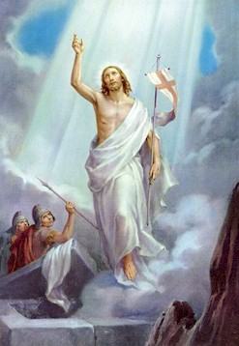
The End
… of this talk
But the beginning of a new life…
… if you put your trust in Jesus!

