Slide 1
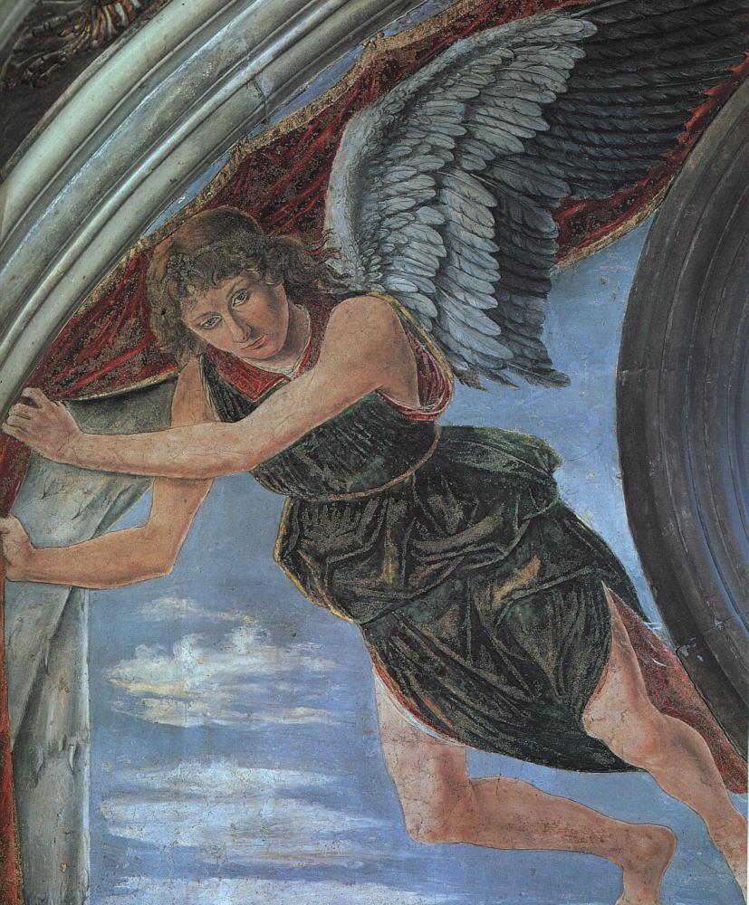
Rumors of Angels
Intelligent Design & the Detection of Malevolent Spiritual Agents
Robert C. Newman

Slide 2
The Disappearance of Angels
Angels are fairly common in biblical accounts.
They disappear with the rise of modern science.
Now ignored altogether in disciplines such as:
History
Science
Even systematic theologies written in the past century don’t devote much space to angels.

Slide 3
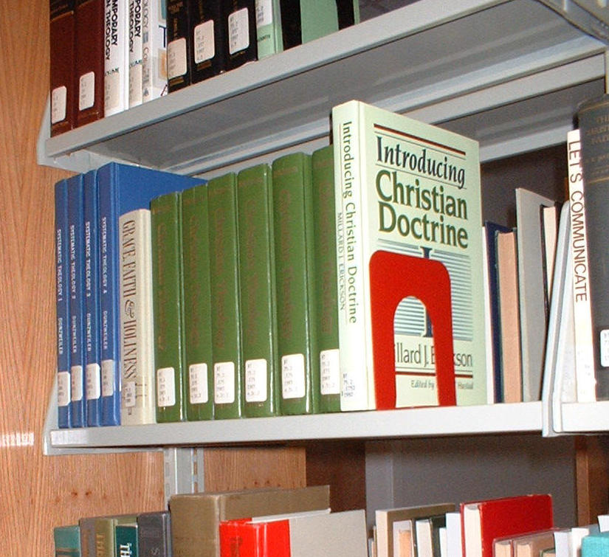
Angels in Theologies
Typically get no space in liberal theologies.
Don't get a lot in many evangelical theologies; lowest are:
Hoeksema – 0.5%
Hodge – 0.6%
Buswell – 0.7%
Most space given to angels in:
Grudem – 3.6%
Grenz – 4.5%
Chafer – 4.6%

Slide 4
The reason for this?
Perhaps this is a result of books such as:
Andrew Dickson White, A History of the Warfare of Science with Theology in Christendom (1896).
This book is still in print today.

Slide 5
White Ridicules Angels
White shows how some ancients and medievals believed angels produced weather, human disease, and insanity.
He claims science has shown all these phenomena are the result of natural laws.
As a result, scholars have tended to treat the idea of angelic activity as beneath contempt.

Slide 6
Our Proposal
Those ancients who believed that angels produced all the phenomena of weather, disease, and insanity were mistaken.
But so too are those moderns who believe that:
Angels are mythological, or
Angels produce no effects in the natural world.
Rather, angels exist, are able to — and do — interact with nature.

Slide 7
Angelic Action in Nature according to the Bible

Slide 8
Angels in the Bible
Mentioned on over 160 occasions
Angels are "spirit beings" of some sort
Spirit = non-material
Contrasted with flesh
Usually understood to be immaterial
Spirit = person
So spirit = person without body
Or spirit = non-body part of a corporal person

Slide 9
Angels in the Bible
"Angel" transliterates Greek angelos
Greek word means "messenger" generically
In Bible, usually for a supernatural messenger from God
Hebrew has a corresponding word mal'ak
About same range as Greek word
Not sure whether other supernatural beings in Bible are to be classified under "angel" or not.
For our purposes here, we will lump them together.

Slide 10
Demons
Used in the Bible (esp New Testament) for some sort of spirit being which can "inhabit" humans and animals.
They apparently are viewed as taking over the physical operation of their hosts.
Some think demons are fallen angels; others distinguish between the two groups.

Slide 11
Satan
"Satan" is the English transliteration of the Hebrew word meaning "adversary, accuser."
Used for a specific individual of a malevolent spirit sort.
Greek equivalent is diabolos, from which English "devil." Generic meaning is "slanderer, malicious one."

Slide 12
Summary on Angels
Persons who are immaterial, or at least their connection with our world is different than ours.
Their appearance?
They can be invisible.
They can take on human appearance.
We don't know what they really look like.
Some are benevolent, obedient to God.
Others are malevolent, in rebellion against God.

Slide 13
What Do Angels Do?
Act as messengers for God
To Mary re/ conception of Jesus
To shepherds re/ birth of Jesus
Malevolent angels may pretend to give God’s word.
Bring judgment on humans
On Sodom & Gomorrah
On firstborn of Egypt
Rescue or protect humans
Jesus nourished in wilderness
Peter & apostles rescued from prison

Slide 14
Angelic Activity
Bible pictures them as able to produce physical effects, and as actually doing so.
They open gates
They provide food
They influence the course of human history
On individual level
On collective level

Slide 15
Demonic Activity
Demons can inhabit humans
Drastically affecting their lives
Drastically affecting others around them
Demons can inhabit animals
Less information given here
Demons are involved in pagan worship
Possession is doubtless one mode

Slide 16
Satanic Activity
Satan can converse with humans
Influencing their actions
Can produce physical effects
Job 1:
Guides two raiding parties
Brings down fire from heaven
Calls up a fierce wind
Times arrival of four messengers
Job 2:
Strikes Job with disease

Slide 17
Summary on Biblical Picture
Angels, demons, Satan can produce physical effects in our world.
They can act:
Through humans
More directly, without human agency

Slide 18
Science and Angels

Slide 19
Detecting Angels Scientifically
How could we detect the actions of beings that (like angels) are invisible at will?
Actual observation of such beings will not be repeatable, so the evidence is only anecdotal.
The things that we could study would be the natural effects that these beings produce.
By analogy, consider how scientists would expect to detect extra-terrestrial intelligences.

Slide 20
Detecting Terrestrial Intelligence
Early in the space age, weather satellite photos were used to look for signs of intelligence on earth.
Because of limited sensitivity & resolution, the only evidence found was a massive logging operation in Canada.
Intelligent activity might be at work, but we might not have the tools to detect it.

Slide 21
The "Mars Head"
An early fly-by of Mars photographed an object that looked like a huge head staring back into space!
Much was made of this by some (not by NASA!) in the following years.

Slide 22
The "Mars Head"
Recently pictures were taken of the same site at higher resolution and a different sun angle.
These showed the "head" was only a fluke of observation, rather like seeing objects in clouds and inkblots.

Slide 23
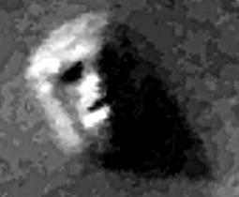
The "Mars Head"
So, we too might see what looks like intelligent activity, but it is really not.
This is what Richard Dawkins claims for all apparent design in living things.

Slide 24
Salmonella in Oregon
Some years ago, an epidemic in Wasco County, Oregon.
Some health officials suspected the followers of guru Bhagwan Shree Rajneesh living nearby.
They were unable to find convincing evidence that the epidemic wasn’t natural.
Later, some cult members confessed, the community was searched; the group had been developing a germ warfare program!
Even a large effect might be seen as natural when it isn’t.

Slide 25
Unknown Artifacts
Back in 1980-81, the Smithsonian had an exhibit of unidentified artifacts.
These were not alien artifacts, but items made in the 19th century.
Not even the curators knew what all of them had been made for.
So products of intelligent design might only be recognized by evidence of artifice.

Slide 26
How find scientific evidence for angelic activity?
We here suggest that angelic activity does not operate continuously, like natural laws.
Rather, angels (being persons) would interact with nature sporadically, as we humans do.
So they probably would not be detected by being observed while they are doing something.
Rather, they might be detected through long-lasting effects of their actions.
In any case, we are not trying to detect all their actions, but only some of them.

Slide 27
Would angelic actions leave unmistakable traces?
This is just the sort of thing the methods of the Intelligent Design movement should be able to detect.
William Dembski, Michael Behe, and others have developed tools for distinguishing the work of intelligent agents from purely natural phenomena.

Slide 28
Detecting Intelligent Design
Dembski shows how one can distinguish between events that are either:
Random
Law-bound
Intentional
Such an approach has been used in some branches of science for many years.

Slide 29
Detecting Intelligent Design
Anthropology and Archeology
To distinguish artifacts from natural products
E.g., intentionally vs accidentally chipped stones
Forensics
To recognize murder in cases of suspicious death
To detect cheating:
In gambling
In scientific research
In academic work
Essentially, the method involves detecting highly improbable features which fit a pattern.

Slide 30
Detecting Intelligent Design
The Intelligent Design movement suggests that a superhuman intellect is at work in:
The fine-tuning of the universe's basic forces
The rarity of a truly earth-like environment
The apparent design of living things
Though the ID movement is cautious about the nature of this intellect, the late Sir Fred Hoyle's remark is suggestive:

Slide 31
Hoyle on Design
"… a superintellect has monkeyed with physics, as well as with chemistry and biology." The Universe: Past & Present Reflection, 16
This would seem to put even Zeus, Jupiter, and Thor in the shade!

Slide 32
Levels of Intelligent Design?
How would we distinguish between different sources of intelligent design?
For example, between:
God – infinite in power, intelligence
Angels, Demons, Satan – finite in power, intelligence
Humans – also finite, but presumably with less power & intelligence than angels

Slide 33
Various Alternatives
Agent Power/Scale Character Quality Example
God Unlimited Good Perfect Fine-tuning
Angels Large Good Imperfect ?
Demons Large Evil Imperfect ?
Humans Small Both Imperfect H Artifact

Slide 34
Angelic Capabilities
What might be some examples that lie within the range of angelic capabilities?
Depends on angelic capabilities!
That angels are finite does not tell us much, since the universe itself appears to be finite.
Can they influence events of the scale of the:
Cosmos?
Galaxy?
Solar System?
Earth?

Slide 35
Angelic Capabilities
Coming at this from the biblical text:
Satan calls up a fierce wind — local weather.
He brings down fire from heaven — local weather?
Rev 4:1 mentions angels over the four winds — regional or global weather?
Demons control ~2000 pigs — one each?
Gen 6:1-4 mates sons of God & daughters of men — genetic manipulation?

Slide 36
Angelic Capabilities
Most likely sort of angelic activities would seem to be:
Influencing people or events to change course of human history
Doing genetic manipulation to change course of biological history
I would be surprised if such beings could change any physical laws or constants.

Slide 37
Best Places to Search?
Most likely would be in areas of history, since history studies long-term effects of intermittent actions:
History of humans
History of life
We will not here look into human history, except to suggest that very unusual coincidences, especially those that are either very beneficial or very disastrous, would be our best candidates.

Slide 38
Design in Biology
Malevolent and Benevolent

Slide 39
Darwin to Hooker, 1856
"What a book a devil’s chaplain might write on the clumsy, wasteful, blundering, low, and horribly cruel works of nature!"
If Darwin’s feeling here is reliable, then it would suggest that malevolent intelligences may have been quite active in nature.

Slide 40
Darwin to Gray, 1860
"There seems to be too much misery in the world. I cannot persuade myself that a beneficent and omnipotent God would have designedly created the Ichneumonidae with the express intention of their feeding with the living bodies of Caterpillars, or that a cat should play with mice."

Slide 41
Ichneumon Wasps
Family of 40,000 species
It lays its eggs on/in the larva of an insect or spider.
The egg hatches, and the wasp larva devours the fats & body fluids of its host, but cleverly so that the host does not die while still needed.

Slide 42
Ichneumon Wasps
Is this behavior malevolent?
Many of the insects it kills are pests to human farmers, so this is often beneficial to humans.
From the perspective of the host caterpillar, it's certainly malevolent!

Slide 43
Actions of Benevolent Angels?
Would be hard to distinguish their work from God's, since God does not need to exert all his power in any given creation.
Perhaps angelic work might be recognized by being of imperfect design or limited scope.

Slide 44
The Panda's Thumb
A possible candidate for imperfect design with no signs of malevolence
Panda has its five regular digits structured as a paw, typical of four-footed animals.
Yet it also has an opposable "thumb," which it uses with great efficiency to strip leaves from bamboo shoots, its primary food.

Slide 45
The Panda's Thumb
"… ideal design is a lousy argument for evolution, for it mimics the postulated action of an omnipotent creator. Odd arrangements and funny solutions are the proofs of evolution — paths that a sensible God would never tread but that a natural process, constrained by history, follows perforce."

Slide 46
The Panda's Thumb
It is arguable whether the panda's thumb is a poor design.
But granting that it is, may it not be the work of genetic manipulation by angels, who are "constrained by history" to work with what is available in the ancestral panda lineage, rather than starting from scratch as God might?

Slide 47
Other Examples of Malevolence?
Parasitic wasps?
Parasitism in general?
Predation in general?
Disease?

Slide 48
Parasitic Wasps?
Ichneumonidae are only one of a large class of parasitic wasps, which employ many different strategies to attack their hosts.
If these mechanisms contain irreducible complexity which cannot be explained by unguided evolution, these too might be the work of malevolent spirit beings.
Ammophila

Slide 49
Parasitism?
Since parasitism is defined as a relationship in which the parasite does harm to the host…
Perhaps parasitism in general (as opposed to benevolent forms of symbiosis) might be examples of malevolent design.

Slide 50
Predation?
Could predation in general be malevolent design?
This is how Darwin viewed the morality of predation…
Though he, in his desire to remove intelligent design from nature, did not feel it was the action of moral agents.

Slide 51
Disease?
What about disease?
This has always been a problem for some in believing that a benevolent God is in control of history.
Consider two fierce diseases that were first encountered by humans in the late 20th century:
AIDS
Ebola

Slide 52
AIDS
AIDS (Acquired Immune Deficiency Syndrome) is a viral disease that collapses the immune system of humans by destroying the cells called lymphocytes, which are crucial to its operation.
The AIDS virus is too simple to live on its own
It must use the DNA copying mechanism of its host
But the AIDS virus is quite sophisticated in any case.
Consider how it operates.

Slide 53
AIDS Enters the Cell
The AIDS virus has co-receptors on its surface which bind to the CD4 receptor on the lymphocyte surface.
Thus it is able to enter the human lymphocyte cell when it would otherwise be kept out.

Slide 54
AIDS Converts RNA → DNA
Once inside, it converts its RNA to DNA in order to use the human copying mechanism.
This is done by a special enzyme in the AIDS virus, reverse transcriptase.

Slide 55
AIDS DNA Inserted
Then the AIDS DNA must be inserted into the human DNA in order to be copied.
But this requires another enzyme, an integrase.
The AIDS DNA may now remain dormant until activated, perhaps by another enzyme.

Slide 56
AIDS Virus Assembled
Once the AIDS DNA has been activated, converted to RNA and then proteins…
A protease is needed to get the proteins in the form needed to assemble into AIDS viruses.

Slide 57
AIDS Viruses Released
At this point, the many copies of the AIDS virus are still inside one lymphocyte, but to infect any others, they need to get out.
Another protein TSG101 is supplied for this purpose.

Slide 58
AIDS Statistics
Current statistics give 28 million deaths from AIDS in 20 years.
About 65 million are thought to have contracted the disease to date.
A fiendishly clever mechanism, don't you think?

Slide 59
Ebola
The technical name of this disease is Ebola hemorrhagic fever.
It is a fierce disease:
It begins with weakness, fever, headache, muscle pain, and sore throat.
It develops into vomiting, diarrhea, kidney & liver dysfunction, and bleeding (internal & external)
It ends in death for 50-90% of the cases.

Slide 60
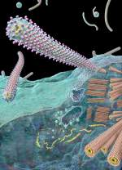
Ebola Mechanism
Less is known than with AIDS mechanism:
Ebola virus docks with cell membrane.
Viral RNA is released into the cytoplasm.
It directs the production of viral proteins and genetic material.
Viral genomes are coated w/ protein to make cores.
The cores migrate to the cell surface.
Transmembrane proteins (spikes) are produced & ferried to the cell surface.
The cores push thru the cell membrane, taking membrane and spikes along as they exit the cell.

Slide 61
Ebola Cure
Currently, there is no known cure.
The only treatment is:
To keep the patient as comfortable as possible;
To use extreme care to prevent the disease from spreading, which can occur from contact with the patient or any of his/her body fluids.

Slide 62
Ebola Statistics
The first cases of Ebola were recognized in 1976.
All known deaths so far have been in Africa.
As of 2002:
Some 1643 cases have been reported.
1152 have died.
Average fatality rate is 70%.

Slide 63
Our Proposal
Those ancients who believed that angels produced all the phenomena of weather, disease, and insanity were mistaken.
But so too are those moderns who believe that:
Angels are mythological, or
Angels produce no effects in the natural world.
Rather, angels exist, are able to — and do — interact with nature.

Slide 64
Conclusions
If our suggestions are valid, this will have serious consequences for doing historical forms of science.
If it is true that supernatural beings have significantly intervened in the history of biology, it will not do to ignore such causes by the use of methodological naturalism.
It is needful that someone with substantial biological training should investigate this question carefully.

Slide 65
The Problem of Evil
A positive answer to our proposal would have an impact on the philosophical problem of natural evil, considered by many atheists their best argument against the existence of God.
The atheist philosopher Brian Marston, for example, dismisses this alternative with the following comments:

Slide 66
Marston on Natural Evil
"However, while the thesis that fallen angels are responsible for natural evil is not clearly false, neither is it clearly true. There is no positive evidence that such beings exist and an argument based on their existence cannot be highly cogent. If the possibility that natural evils stem from the free choice of an agent other than man is disregarded on these grounds, then neither man nor a free willed agent other than man can be held accountable for natural evil. Therefore, the theist must attribute natural evil to the direct action of God."

Slide 67
An Invitation
We end this talk with a call to some dedicated Christian historians and biologists to take some time (and risk some ridicule) …
To see whether there is any evidence for taking the biblical pictures of angels, demons and Satan seriously as a picture of the real world, rather than as merely an ancient mythological worldview.

