Slide 1
Ethics: Some Thoughts on How We Should Live
Robert C. Newman

Slide 2
Back in the 1960s, when I was in college (Duke) and grad school (Cornell), a common saying seen on posters was:
DO IT!

Slide 3
Since then, it has been picked up as a slogan by Nike, a major maker of sports-wear & equipment.

Slide 4
The Ethics of "Do it!"
After 50+ years of reflection on this advice and observing the consequences that follow from obeying it …
It strikes me that this is one of the most foolish ethical principles imaginable.
It is not too far behind Faust's motto: "Evil, be thou my good!"
It would be interesting to know how many people in these intervening years have actually used this principle to guide their own lives.

Slide 6
Evaluating "Do it!"
There are, no doubt, many people who have some good plans, but because of their own timid nature, never try to put them into effect.
Such people, in such cases, may very well profit from obeying the advice of a friend to just do it.
But, as a general principle of action, this advice stinks.

Slide 7
Evaluating "Do it!"
Why is that?
Well, I have only lived in one head, so I cannot speak for others.
But I strongly suspect my experience is quite common, maybe even universal.
Now and then, an idea pops into my mind which is foolish, dangerous, or immoral.
It would thus be foolish, dangerous or immoral to obey such ideas.

Slide 8
Some Examples
When I was young, and had just learned to ride a bicycle, I wondered what would happen if I suddenly turned sharply to the right or left while riding along.
One doesn't need to major in physics (as I later did) to realize this would be quite disastrous. It's even very hazardous with an automobile.
It was good for my health that I never tried this to find out!

Slide 9
Some Examples
At some similar age, I noticed that a pair of tweezers had two prongs on the end, rather like those on an electrical plug.
I wondered what would happen if I stuck the tweezer prongs into an electrical outlet.
I "did it," and was extremely fortunate that I only blew a fuse instead of being electrocuted.
It's a wonder I survived to adulthood!

Slide 10
Some Examples
On a number of occasions while out hiking, I have stood at the top of a cliff.
I sometimes hear a voice inside my head that says "Jump!"
So far, I have not obeyed this impulse.
This sort of thing should make one suspicious of acting on ideas without evaluating them, that is, "just doing it!"

Slide 11
Some Examples
One wonders how many murders, rapes and other such wicked actions may not be the result of someone just acting upon an impulse that comes into his mind.
Clearly, "Just do it!" is not a good principle by which to conduct one’s life.
What could we put in place of this to help us decide how we should live?

Slide 13
The Golden Rule
We want to look at this in just a minute, but first a word from two famous philosophers: Calvin (not John) and Hobbs (not Thomas)…

Slide 14
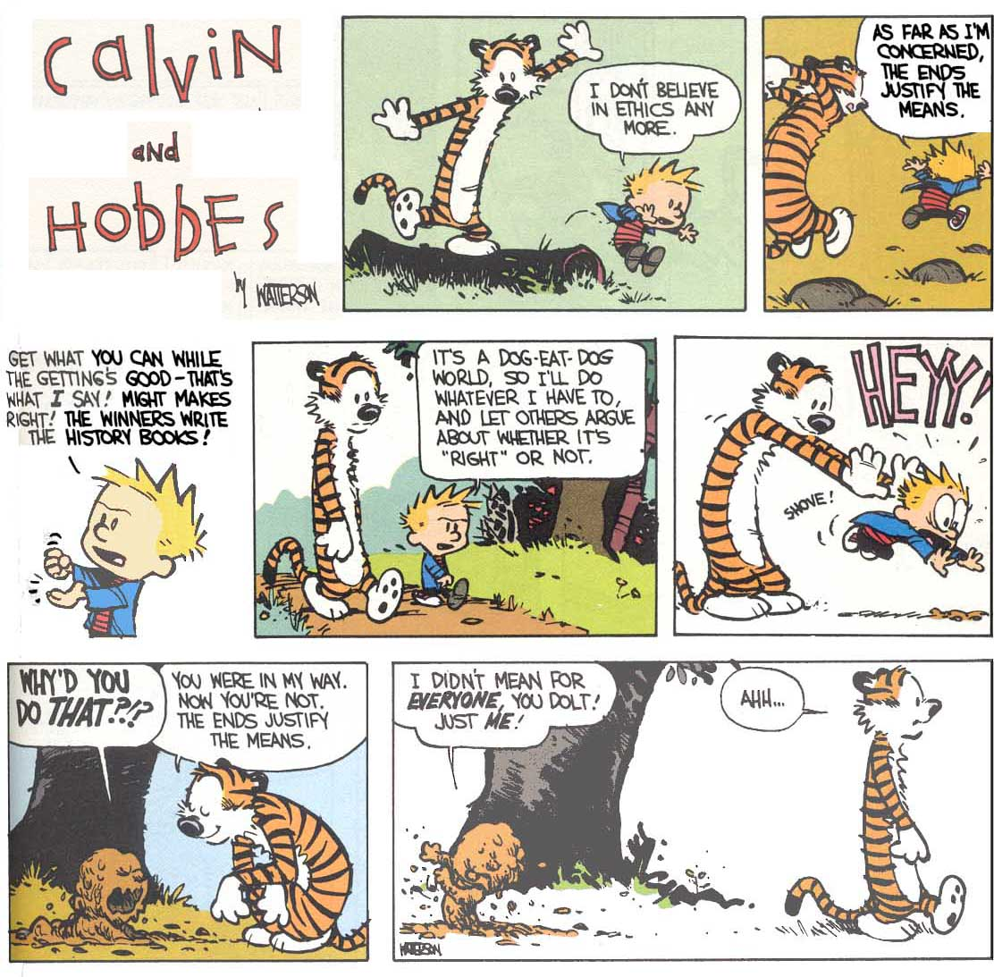

Slide 15
The so-called "golden rule," spoken by Jesus in Matthew 7:12, would be a good rule for living.
A somewhat similar idea is found in the ethics of numerous other cultures and religions.

Slide 16
The Golden Rule
Not all of the sayings on this poster are very close to the Golden Rule, but a number are.
Let's look at the closer examples.

Slide 17
Hinduism
This is the sum of duty: do not do to others what would cause pain if done to you.
Mahabharata 5:1317

Slide 18
Buddhism
Treat not others in ways that you yourself would find hurtful.
Udana-Varga 5.18

Slide 19
Confucianism
One word which sums up the basis of all good conduct … loving kindness. Do not do to others what you do not want done to yourself.
Analects 15.23

Slide 20
Taoism
Regard your neighbor’s gain as your own gain, and your neighbor’s loss as your own loss.
T'ai Shang K'am Ying P'ien, 213-218

Slide 21
Islam
Not one of you truly believes until you wish for others what you wish for yourself.
Muhammad, Hadith

Slide 22
Judaism
What is hateful to you, do not do to your neighbor. This is the whole Torah; the rest is commentary.
Hillel, Shabbat 31a

Slide 23
Jainism
One should treat all creatures in the world as one would like to be treated.
Mahurviru, Sutrakritanga

Slide 24
Zoroastrianism
Do not do unto others whatever is injurious to yourself.
Shayast-na-Shayast 13.29

Slide 25
These sayings are all rather similar, though most of them emphasize the negative (not doing what is harmful) rather than the positive (doing what is good).

Slide 26
A similar saying is that of Jesus, and of the Old Testament: "Love your neighbor as yourself."
Matthew 22:39 & Leviticus 19:18

Slide 27
If everyone lived by such ethical principles, life would almost be heaven on earth, wouldn't it?
But everyone doesn't live this way. Why not?

Slide 28
Fear
I think most people are afraid to try to live this way; they fear that someone will take advantage of them.
And given the way people are, they are probably right!
Yet the God of the Bible promises us that He works all things together for good for those who love Him. (Romans 8:28).

Slide 29
Fear
This doesn't mean there may not be any bad short-term consequences of such behavior, that no one will take advantage of us. They may very well do so.
It does mean that God will see to it that in the long run (perhaps beyond this life), it will be worth it all to have lived in this way.

Slide 30
Another Ethical Principle
This is where Christianity adds something that is often missing from other religions.
Jesus said that the greatest principle is not to love our neighbor as we love ourselves, but to love God with all our being.
Jesus replied: "'Love the Lord your God with all your heart and with all your soul and with all your mind.' This is the first and greatest commandment." Matt 22:37-38 (NIV)

Slide 31
Loving God
So if we love God with all we are and have, then we can trust Him that it is ultimately safe to love others.
We can trust Him that He will work all things together for good, even though this may not be obvious in the short-term.
This provides an important foundation on which to build & stabilize love for neighbor.

Slide 32
Inability
There’s another reason why people don’t live this way: we aren't good enough!
Try as we might, we often find ourselves doing things to others that we wouldn't want them to do to us, and not doing for them what we would wish others to do for us.
That is, whatever we may say or think, we really don't love others like we love ourselves.

Slide 33
A Solution
This is where the Christian teaching about the Holy Spirit comes in.
God Himself comes to live within us to cause us to want to be like Him & to do what is right.
This is also where the Christian teaching about the work of Jesus comes in.
Jesus, who is also God Himself, provides our righteousness and pays for our sins, thus providing room for us to begin to be what we ought to be.

Slide 34
Christianity & Ethics
Biblical Christianity is an ethical system, but it is more than just an ethical system.
It is also a rescue system, by which God solves the problem of our inability (& even unwillingness) to be what we ought to be.
Let's look at some more of the ethical principles of Biblical Christianity.
The ones I cite here are all very general.

Slide 35
The First Commandment
Love the Lord your God with all your heart and with all your soul and with all your mind.
Matthew 22:37

Slide 36
The Second Commandment
Love your neighbor as yourself.
Matthew 22:39

Slide 37
The Golden Rule
So in everything, do to others what you would have them do to you, for this sums up the Law and the Prophets.
Matthew 7:12

Slide 38
Micah's Principles
He has showed you, O man, what is good. And what does the LORD require of you?
To act justly and to love mercy
and to walk humbly with your God. Micah 6:8

Slide 39
The Fruit of the Spirit
But the fruit of the Spirit is love, joy, peace, patience, kindness, goodness, faithfulness, gentleness and self-control. Against such things there is no law.
Galatians 5:22-23

Slide 40
Conclusions
When we trust in what Jesus has done:
His death pays for our shortcomings.
His life provides the kind of ethical living that we cannot provide on our own.
The Holy Spirit begins to live within us, to begin to make us into what we were designed to be.
We are provided room to begin to be what we ought to be.

Slide 41
Conclusions
Jesus said:
"I have come that they may have life, and have it to the full.“ John 10:10
Would you like to have life to the full?
You can, by calling out to God for forgiveness, and trusting in what Jesus has done.

Slide 42
The End
May we find God, who is the Source of all true ethics!

