Slide 1
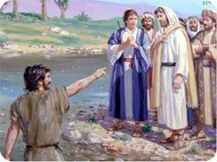
Encountering Jesus
John 1:43-51
Robert C. Newman

Slide 2
Knowing God / Jesus
Salvation is often pictured as knowing God or knowing Jesus; for example:
Isaiah 11:9
Jeremiah 31:33-34
John 10:14-15
Philippians 3:10-11

Slide 3
Isaiah 11:9
9 (NIV) They will neither harm nor destroy
on all my holy mountain,
for the earth will be full of the knowledge of the LORD
as the waters cover the sea.

Slide 4
Jeremiah 31:33-34
33 (NIV) "This is the covenant I will make with the house of Israel after that time," declares the LORD. "I will put my law in their minds and write it on their hearts. I will be their God, and they will be my people.
34 No longer will a man teach his neighbor, or a man his brother, saying, 'Know the LORD,' because they will all know me, from the least of them to the greatest," declares the LORD. "For I will forgive their wickedness and will remember their sins no more."

Slide 5
John 10:14-15
14 (NIV) "I am the good shepherd; I know my sheep and my sheep know men 15 just as the Father knows me and I know the Fathernand I lay down my life for the sheep.

Slide 6
Philippians 3:10-11
10 (NIV) I want to know Christ and the power of his resurrection and the fellowship of sharing in his sufferings, becoming like him in his death, 11 and so, somehow, to attain to the resurrection from the dead.

Slide 7
Knowing God / Jesus
The most important thing we can do with our lives is getting to know God, and then getting to know him better and better.
This includes knowing who Jesus is and what He has done.
Here, we want to look at a puzzling incident from Jesus’ time on earth where we learn something of who He is and what He has done.

Slide 8
John 1:43-46
43 (NIV) The next day Jesus decided to leave for Galilee. Finding Philip, he said to him, "Follow me."
44 Philip, like Andrew and Peter, was from the town of Bethsaida.
45 Philip found Nathanael and told him, "We have found the one Moses wrote about in the Law, and about whom the prophets also wrotenJesus of Nazareth, the son of Joseph."
46 "Nazareth! Can anything good come from there?" Nathanael asked.
"Come and see," said Philip.

Slide 9
John 1:47-51
47 (NIV) When Jesus saw Nathanael approaching, he said of him, "Here is a true Israelite, in whom there is nothing false."
48 "How do you know me?" Nathanael asked.
Jesus answered, "I saw you while you were still under the fig tree before Philip called you."
49 Then Nathanael declared, "Rabbi, you are the Son of God; you are the King of Israel."
50 Jesus said, "You believe because I told you I saw you under the fig tree. You shall see greater things than that."
51 He then added, "I tell you the truth, you shall see heaven open, and the angels of God ascending and descending on the Son of Man."

Slide 10
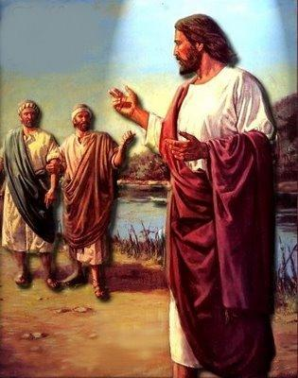
The Narrative

Slide 11
Verses 43-44
Jesus finds Philip and calls him to follow.
A sample of God taking the initiative, coming to look for us, calling us to follow Him.
Sometimes, of course, God takes the initiative in such a way that it looks like we were looking for Him rather than vice versa.

Slide 12
Verse 45
Philip goes and finds his friend Nathanael.
He tells him about Jesus, that He is the Messiah, the fulfillment of OT prophecies.
Like Philip, when we find Jesus, we will want to share Him with others.

Slide 13
Verse 45
How did Philip know Jesus was the Messiah?
We are not told.
If we assume that Philip is the unnamed disciple of John the Baptist mentioned in verses 35-39, then his testimony matches that of Andrew to Peter in verse 41 and is based on the same evidence.
If instead, John the Apostle is the unnamed disciple, we have to assume Philip had some similar unrecorded encounter with Jesus.

Slide 14
Verse 45
What did Jesus say to Philip & Andrew that day they spent together (verse 39)?
It must have had something to do with OT prophecy about the Messiah.
Perhaps Jesus explained some of the prophecies as he did to his disciples after His resurrection (Luke 24).
Perhaps he started with John’s cry “Look! The Lamb of God!” and explained the symbolic significance of the sacrificial system.
We don’t know.

Slide 15
Verse 45
But Philip found it convincing, even though Jesus has (apparently) not yet worked any miracles.
Remember that Philip did have the testimony of John the Baptist:
Whose preaching had turned many to God
Who had seen the sign from heaven at Jesus’ baptism
We don’t know how much of this John told Philip.

Slide 16
Verse 46
Nathanael is skeptical.
He has only the say-so of Philip, and it doesn’t sound very convincing to him.
Some fellow from one of the backwater villages in Galilee is the divinely promised Son of David, the Messiah that the Bible has been predicting for centuries?
Nathanael, being rather blunt, says so.

Slide 17
Verse 46
Philip decides the best way to respond is to introduce Nathanael to Jesus.
If the arguments that convinced us don’t convince someone else, maybe we should try to bring them into direct contact with Jesus.
Since Jesus is not visibly here, we should pray for them, try to get them to begin reading the Gospels, or to attend a church where there are people who have been genuinely transformed.
We cannot bring people into the kingdom ourselves, but God will let us share in His work.

Slide 18
Verse 47
When Nathanael arrives, Jesus takes the initiative.
He shows him that He knows intimate details about him that he could not know naturally.
He knows something about Nathanael’s character that Nathanael recognizes as true, distinctive and unusual.

Slide 19
Verse 48
When Nathanael asks how Jesus knows this…
Jesus gives further evidence of the same sort:
“I saw you under the fig tree before Philip called you.”

Slide 20
Verse 49
Nathanael’s response shows that this is not something Jesus could have known naturally…
Say by Jesus being only 50 yards away
Or by Philip telling Jesus.
Possibly Jesus was referring to some significant spiritual event that had recently occurred.
These two pieces of evidence ‘click’ for Nathanael; he accepts Philip’s claims.

Slide 21
Verses 50-51
Jesus ends this incident with a very puzzling remark.
“You believe because of this? You will see heaven open and the angels of God ascending and descending upon the Son of Man.”
Part of this statement resembles that to Thomas when he finally believes (20:29).
But this statement is something opposite: If you think this is something, you haven’t seen anything yet!

Slide 22
Verses 50-51
But what is this thing Nathanael is going to see?
Some connect it with the transfiguration.
But Philip was not present at this.
Others with the second coming.
I think neither of these is correct.

Slide 23
Cryptic Sayings of Jesus
My time has not yet come (2:4)
Destroy this temple (2:19)
You must be born again (3:2)
I give you living water (4:10)
Eat the flesh of the Son of Man (6:53)
Sickness not unto death (11:4)
Predictions re/ Peter & John (21:18, 22)

Slide 24
Jacob’s Ladder
The wording of Jesus’ statement is almost identical to that of an incident in Jacob’s dream in Genesis 28:
12 (NIV) He had a dream in which he saw a stairway {[12] Or ladder} resting on the earth, with its top reaching to heaven, and the angels of God were ascending and descending on it.
If this is Jesus’ point, then He is comparing Himself to Jacob’s Ladder.

Slide 25
Jesus Like Some OT Object
Lamb of God (1:29)
Temple (2:19)
Bronze Serpent (3:14)
Living Water? (4:10, 13; 7:37)
True Manna (6:32, 35)
Light of the World (8:12)
Pool of Siloam? (9:7)
Good Shepherd (10:14)
Dying Grain (12:24)
True Vine (15:1)

Slide 26
If So, What Does It Mean?
Lamb of God (1:29) – sacrifice for sin
Temple (2:19) – God dwelling with mankind
Bronze Serpent (3:14) – bringing healing
Living Water? (4:10, 13; 7:37) – giving life
True Manna (6:32, 35) – giving life
Light of the World (8:12) – giving light
Pool of Siloam? (9:7) – curing blindness
Good Shepherd (10:14) – lays down life for sheep
Dying Grain (12:24) – dying to bring increase
True Vine (15:1) – means of fruitfulness

Slide 27
Jacob’s Ladder?
It was obviously a connection between heaven and earth.
Jesus is the one mediator between God & mankind.
It was a way to God & to heaven.
Jesus is the Way, the Truth & the Life.
Perhaps “the true & living way”
There is no other way to God & heaven.

Slide 28
Jacob’s Ladder?
Are we to make anything of the angels ascending & descending on the Son of Man?
Not sure; not all features of these symbols carry over to Jesus (e.g., he is not a lamb).
Perhaps it is to indicate the He would become the ladder by being trodden upon, just as He becomes our food by being eaten.

Slide 29
Jacob’s Ladder?
I suggest this symbol pictures Jesus as the way in which we can return to God by means of His death on the cross.
So, even greater (than Jesus’ miraculous power to know Nathanael’s character & hidden actions) is Jesus’ love that He will lay down His life to rescue us from our sins & provide a way back to God.

Slide 30
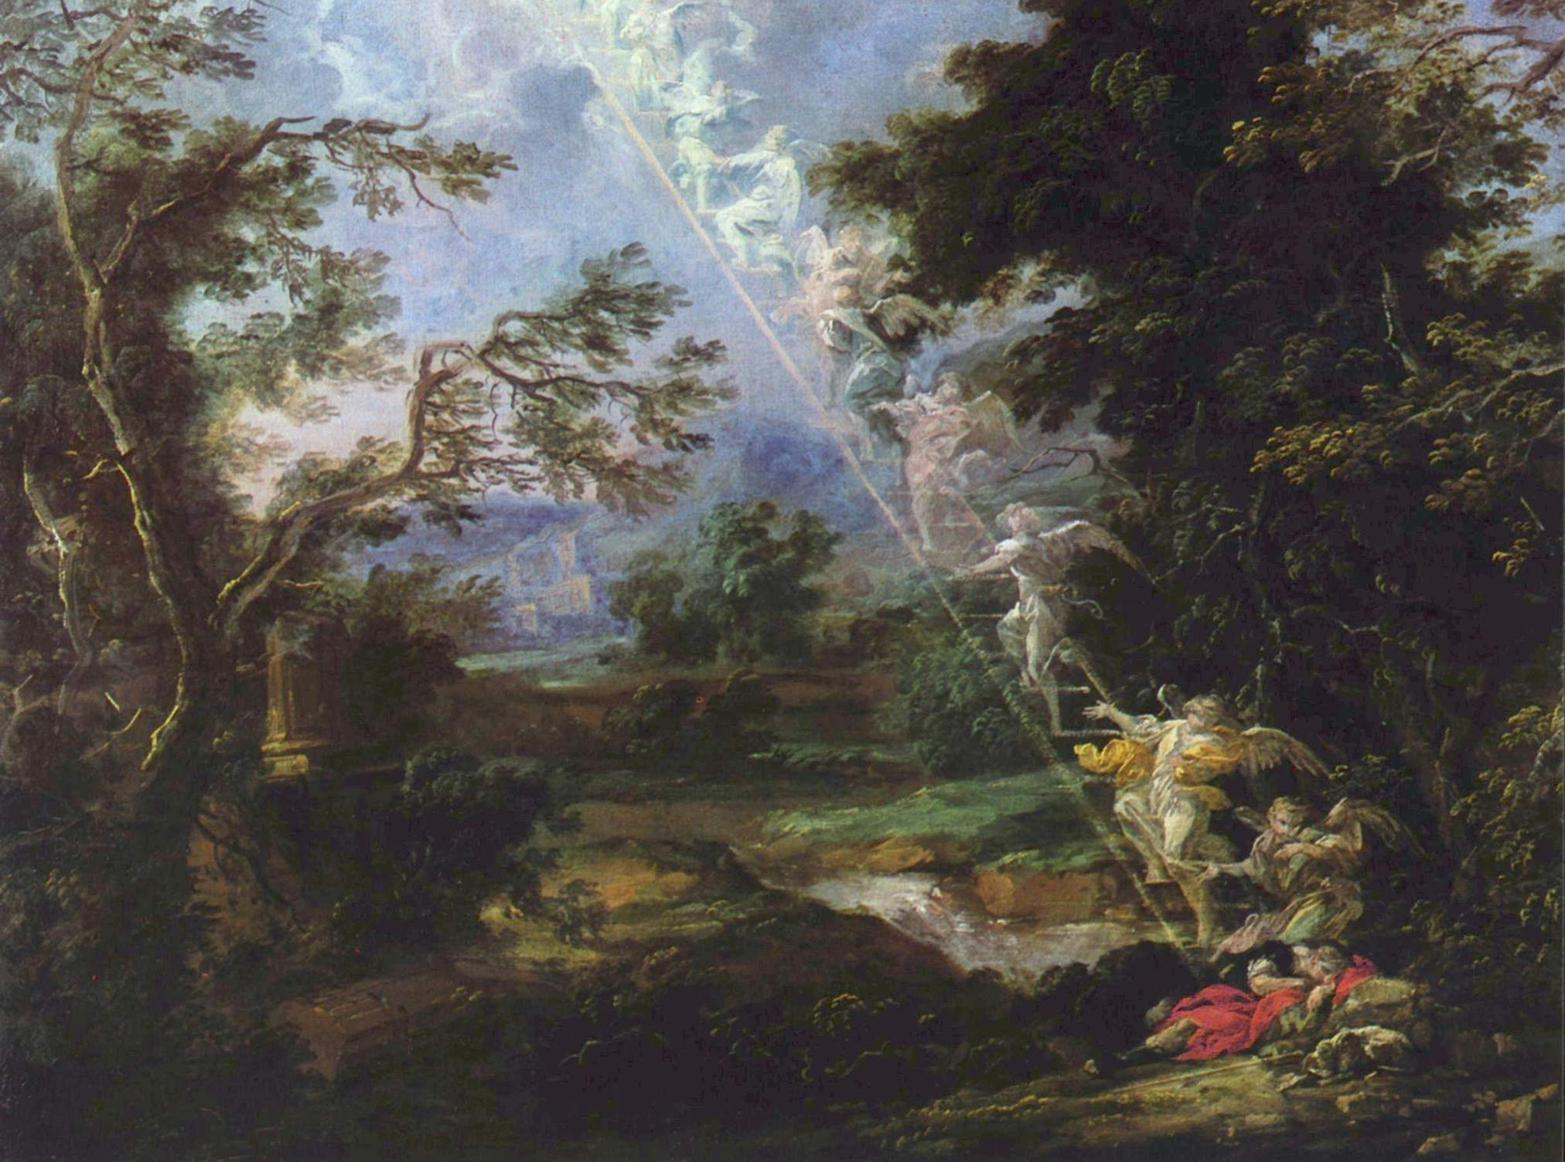
Some Lessons

Slide 31
Some Lessons
The narrative is Christ-centered.
Jesus is the center of the Gospels, and indeed, of human history.
There is more to Jesus than meets the eye, but we don’t need to know all of this right away.
We just need enough to come to Him.
The evidence God has provided is more than enough for this.

Slide 32
Some Lessons
Jesus takes the initiative with us as with Philip and Nathanael.
“The Son of Man has come to seek & to save the lost.”
Just as Philip goes to find his friend Nathanael, so our encounter with Jesus should cause us to want others to know Him too.

Slide 33
Some Lessons
Jesus knows us intimately; nothing about us is hidden from him.
In spite of this, He seeks us to be His own.
But even greater than His knowledge of us is His love for us:
That He would give His own life to bring us back to Him.

Slide 34
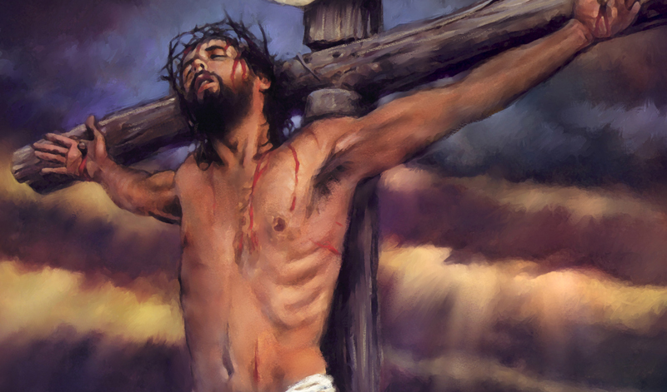
The End

