Slide 1

Earth & Sky
Robert C. Newman

Slide 2
Earth & Sky
To begin our discussion of astronomy, we want to think about how things look from down here on earth.
What is happening in the sky as viewed from down here?
We will consider three topics:
  Earth as a viewing platform
  The movement of heavenly objects
  The calendar

Slide 3
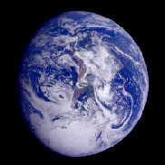
The Earth as
Viewing Platform

Slide 4
Earth Shape & Motion
The earth is round (more or less).
It is moving:
  Rotating on its axis
  Moving through space
These were not usually recognized by humans in ancient times, so they saw the things in the sky as moving instead.

Slide 5
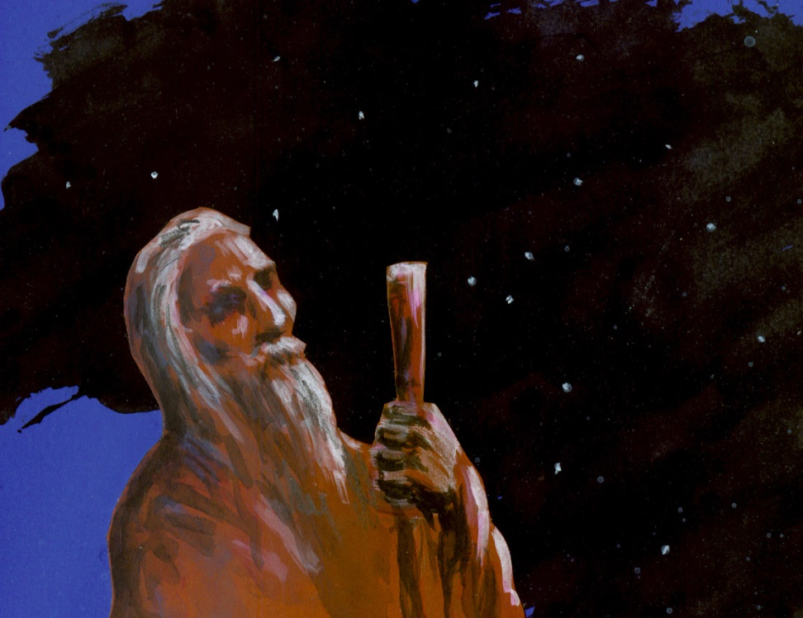
Earth Shape & Motion
The ancients weren't dumb.
We have the advantage of many centuries of observations & considerably more advanced technology.

Slide 6
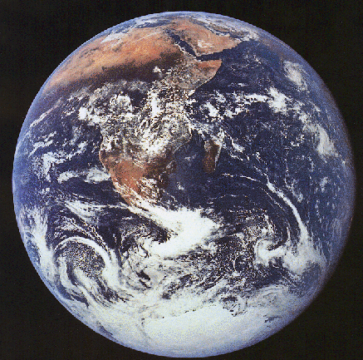
Earth is Round
The clues that the earth is round are somewhat subtle locally.
We moderns have a huge advantage on this due to advanced transportation & communication.

Slide 7
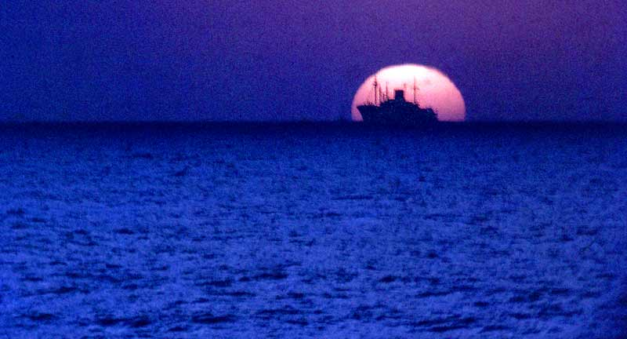
Ships on the Ocean
It is said that as a ship is moving away from you, the lower part disappears before the upper due to the roundness of the earth.
Probably few people but sailors have noticed this.

Slide 8
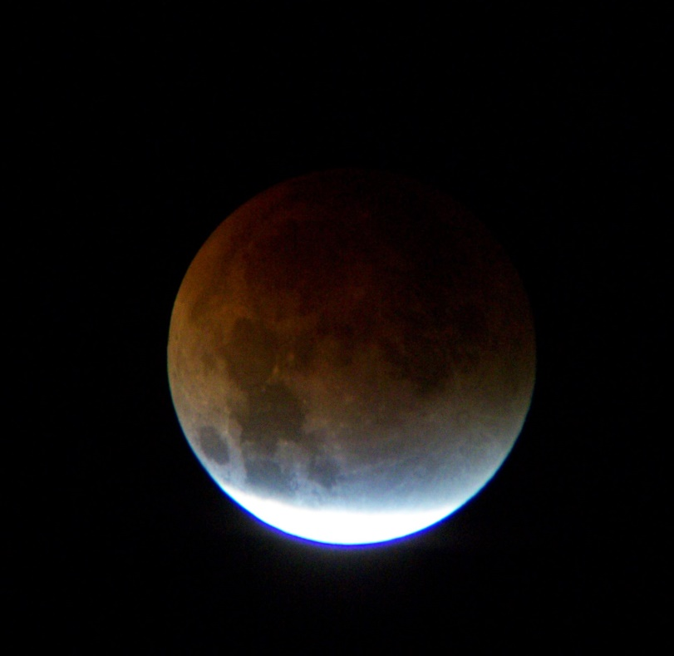
Lunar Eclipse
The shadow that the earth casts on the moon during its eclipse is round.
But not many people in ancient times would have understood an eclipse of the moon.

Slide 9

Height of the Sun
As one travels south, the sun gets higher in the sky, or lower if going north.
This was known some centuries before the time of Christ, and was used to estimate the size of the earth.

Slide 10
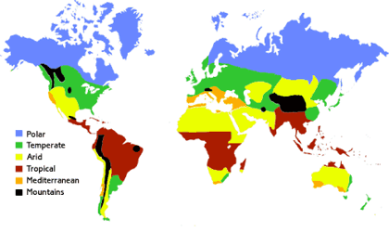
Climate Zones
Even more obvious to the average traveler was the fact that the climate gets hotter southward & colder northward.
Today, with easy travel & communication, we can see these things for ourselves.

Slide 11
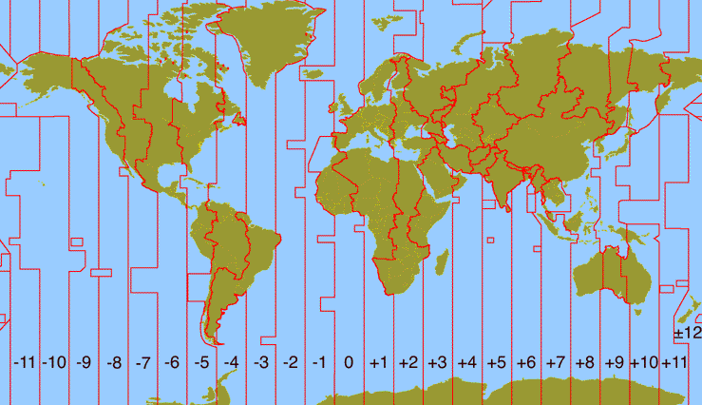
Time Zones
Traveling E or W, we notice the different time zones more easily than people even a century ago.
Most of us have had to reset our watches when travelling.

Slide 12
Earth is Round
Thus, even without pictures from space, we have lots of evidence for a round earth that the ancients did not have.

Slide 13
Earth is Moving
That the earth is moving is still more subtle.
The earth doesn't feel like it is moving.
But with modern closed vehicles that move smoothly, we sometimes are not sure whether we are moving or something outside the vehicle is moving.
Have you ever experienced this?

Slide 14
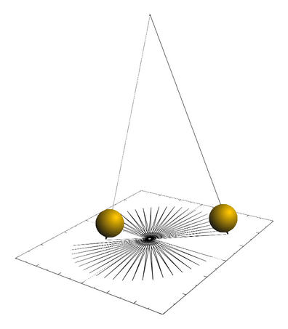
Foucault Pendulum
It is possible to build a pendulum with a long enough cord that we can observe the rotation of the earth under the pendulum.
Many museums have such a pendulum to demonstrate this.

Slide 15
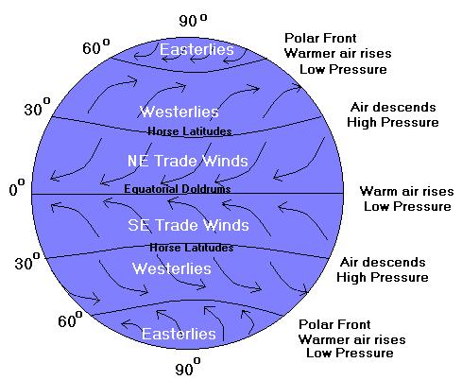
Coriolis Effect
The rotation of the earth also shows up in the way the wind turns right in the northern hemisphere and left in the southern.
A similar thing happens throwing a ball on a carousel.

Slide 16
The Earth is Moving Thru Space
This would have been even tougher for the ancients to detect, though there were some who believed that the earth was moving around the sun.
Today, with spaceflight, we can experience the earth’s motion relative to that of the sun and planets more directly.

Slide 17
Bug-on-Windshield Effect
Have you sometimes noticed all the bugs on your windshield on a hot day after a long drive in the country?
Were there any on the rear window?
Why not?
Something similar with meteors and the earth shows us the earth is moving thru space and tells us which way it moves.

Slide 18
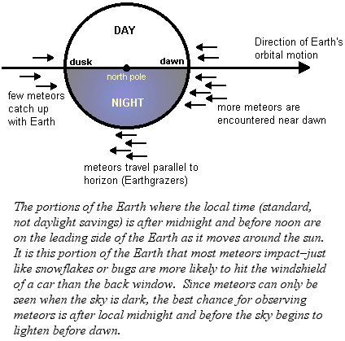
Meteors after Midnight
As the earth travels thru space, the side experiencing times after midnight & before noon is the ‘windshield’ & meteors are the bugs.
The other side of the earth is the 'rear window.'

Slide 19
The Earth is Moving Thru Space
Amateur star-gazers that do any meteor watching are familiar with this rule:
  The best time to look for meteors is after midnight.
This is because the earth really is moving thru space (in this case, around the sun), and the midnight to noon side is on the front of the moving earth.

Slide 20
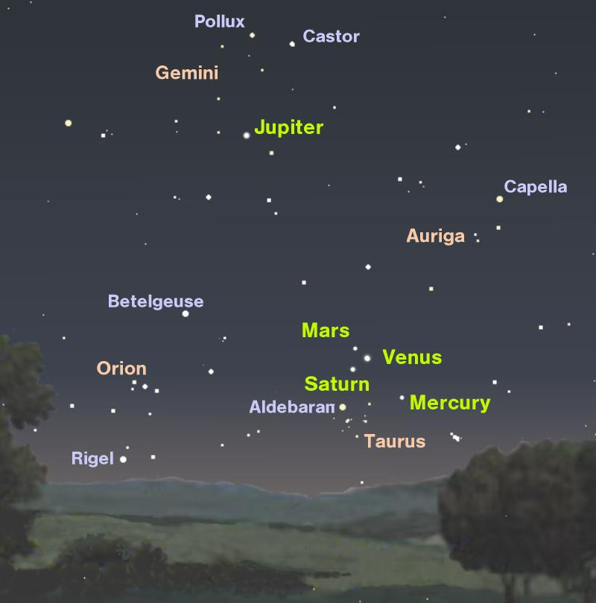
Movement of
Heavenly Objects

Slide 21

The Sun's Movement
As we stand on the earth, the sun moves across the sky once a day.
That is in fact what makes it day.
As we know now, this is due to the rotation of the earth.

Slide 22
The Movement of the Stars
Well-known to the ancients (but less so to us), the stars also move across the sky once a day.
If we watch the sky carefully, we will see that the stars seem to be about one degree further west each night.
This is due to the rotation of the earth, plus the movement of the earth around the sun once a year.

Slide 23
The Moon's Movement
The moon, too, moves across the sky about once a day.
On top of this motion is another:
  The moon moves eastward relative to the stars (and sun).
So the moon rises nearly an hour later each night. This is the moon going around the earth.
  The moon's phases are correlated with this.

Slide 24
Fixed Stars
We used to call the stars the 'fixed stars,' because they form patterns which look about the same for thousands of years.
These stars are actually moving rather rapidly (~200 mi/sec), but they are so far away it takes centuries or millennia to notice this.
We call these star patterns the constellations.

Slide 25
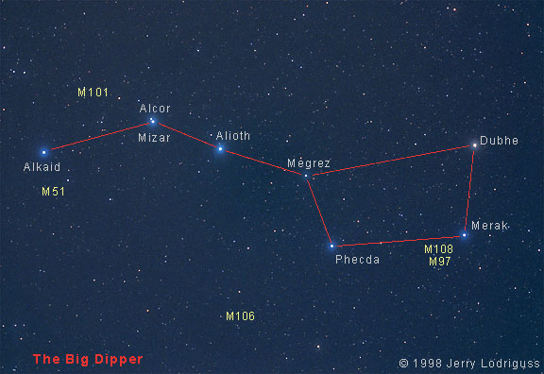
Big Dipper

Slide 26
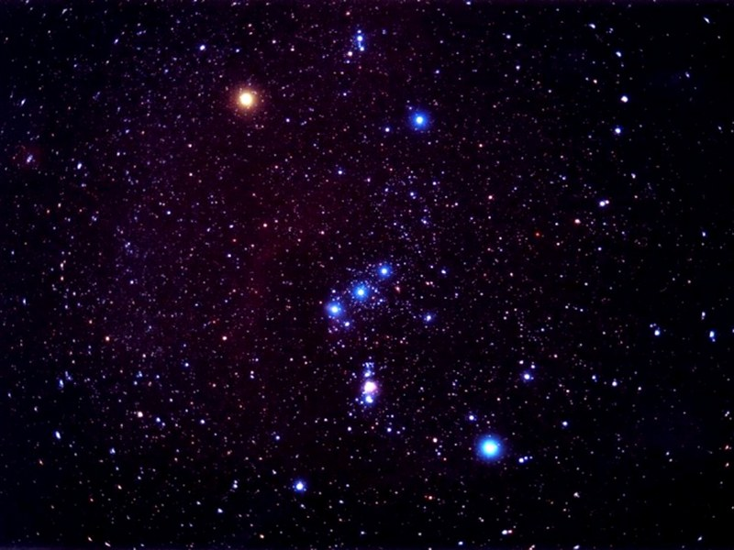
Orion

Slide 27
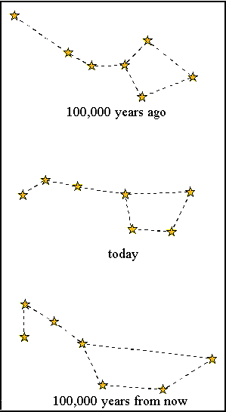
Changing Constellations
We don't have any good star charts far enough back to test this, but calculations suggest these pictures for the Big Dipper 100,000 years in the past & future.

Slide 28
Planets
In contrast to the fixed stars, the ancients called some other objects 'planets,' which comes from the Greek word 'wandering,' so wandering stars in contrast to fixed.
These objects seem to wander among the fixed stars over the course of days or weeks.

Slide 29
Ancient Planets
The ancients recognized seven planets:
  Sun
  Moon
  Mercury
  Venus
  Mars
  Jupiter
  Saturn

Slide 30
Modern Planets
Nowadays, we have promoted (or demoted) the sun to be our local star.
We have recognized that the earth is also a planet and that the moon is just our moon.
We have discovered 3 more planets: Uranus, Neptune & Pluto.
Recently, we have demoted Pluto to be a minor planet or Plutoid.

Slide 31
Movements of the Planets
All of them move across the sky once a day, like the sun, moon & stars.
Each has additional more complex movements:
  Mercury & Venus move back & forth on either side of the sun.
  The outer planets (Mars & beyond) move slowly eastward among the stars, with a strange westward loop.

Slide 32
Conjunctions, etc.
The movement of the planets among the stars (as seen from earth) meant that they would move among the constellations, and relative to each other.
This led to much of the complex fortune-telling that is called astrology.
See my PowerPoint talk on astrology for more details.

Slide 33
The Calendar

Slide 34
Basic Units of the Calendar
The shortest natural unit is the day, the time it takes from sunrise to sunrise, which we now know to be the time it takes for the earth to rotate once on its axis.
The other two natural units are the month and the year.

Slide 35
The Month
The month, originally, is the time it takes for the moon to come back to the same phase again (usually new moon to new).
This was fairly easy to measure in antiquity, but it turns out not to be an exact number of days, averaging a bit over 29.5 days.
Real months were commonly used in ancient calendars. We use 'fake' months.

Slide 36
The Year
The year is the time it takes for the seasons to come around again.
This is tougher to measure because of weather variations.
Since the seasons are driven by the tilt of the earth's axis and how that faces the sun, the year is the time it takes for the earth to go once around the sun.
This turns out to be a bit under 365.25 days, and this was known roughly in antiquity.

Slide 37
Various Calendars
Our calendar is modified from the ancient Roman calendar, with months of fixed length that don't match the moon's phases. This type is called a solar calendar.
Several other types of calendars had months which began at each new moon. These are lunar calendars.

Slide 38
Various Calendars
If a lunar calendar is adjusted to match the season (usually by adding a 13th month now and then), this is called a lunisolar calendar. The traditional Jewish calendar is of this sort.
If the lunar calendar is not adjusted, then each new year begins about 11 days earlier in the season than the previous one. The traditional Islamic calendar is like this.

Slide 39
The End
That's all, folks!

