Slide 1
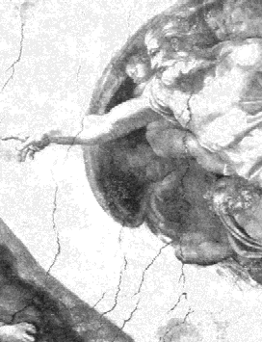

Doing Science in a Theistic Universe
Robert C. Newman

Slide 2
What is Science?
An Attempt at a Definition

Slide 3
What is Science?
Conforming hypotheses to data
(1) Looking at data
(2) Making a hypothesis
(3) Collecting more data
(4) Testing hypothesis against data
(5) Refining hypothesis
(6) Return to (3)

Slide 4
What is Science?
How distinguished from scholarship in other academic fields?
  History
  Economics
  Theology
The main difference will be the kind of data examined, and the sort of explanation being offered.

Slide 5
What is Science?
Goals and Methods:
What is its Goal?
  Just a device for organizing observations?
  Trying to understand reality?
Is it a Public Endeavor?
  Can it be shared by people with different worldviews?
  Or will they have their own brand of science?

Slide 6
What is Science?
One suggested definition:
Science is an attempt to explain nature
  By conforming the explanation to the data
  Without supernatural causes allowed
This is science as commonly practiced today.
Notice this is worldview-dependent.
  If there is no supernatural, it will converge with reality.
  It the supernatural exists, it won’t converge.

Slide 7
What is Science?
Another suggested definition:
Science is an attempt to explain nature:
  By conforming the explanation to the data
  Not limiting the character of the explanation
  But making inference to the best explanation
This will tend to converge on reality, even if reality corresponds to a different worldview than originally anticipated.

Slide 8
What is Science?
Distinguished from History, Philosophy, Theology
Kind of Data:
  Natural phenomena, as opposed to social, political, religious
Sort of Explanation:
  How things work
  What nature is like
  The history of nature

Slide 9
What Should We Expect
Nature to Be Like?
Worldview-Dependent Expectation

Slide 10
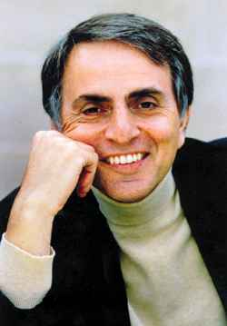
Atheistic Expectation
"The cosmos is all that is,
or ever was,
or ever will be."
Carl Sagan, Cosmos

Slide 11
Atheistic Expectation
If the cosmos is all that is, or ever was …
Then:
  Everything is nature.
  There can be no supernatural causes.
Therefore:
  We seek only natural causes.
  Supernatural causes are fictional.
  Whatever the data looks like, the cause must be natural.

Slide 12
Atheistic Expectation
"We take the side of science in spite of the patent absurdity of some of its constructs … in spite of the tolerance of the scientific community for unsubstantiated just-so stories, because we have a prior commitment, a commitment to materialism. It is not that the methods and institutions somehow compel us to accept a material explanation of the phenomenal world, but, on the contrary, that we are forced by our a priori adherence to material causes to create an apparatus of investigation and a set of concepts that produce material explanations, no matter how counterintuitive, no matter how mystifying to the uninitiated. Moreover, that materialism is absolute, for we cannot allow a Divine Foot in the door."
Richard Lewontin, NY Review of Books (9 Jan 97)

Slide 13
Theistic Expectation
"In the beginning, God created the heavens and the earth." – Moses
"When I consider your heavens, the work of your fingers, the moon and the stars, which you have set in place, what is man that you are mindful of him, the son of man, that you care for him?" – David
"The heavens declare the glory of God, the skies proclaim the work of his hands." – David

Slide 14
Theistic Expectation
If the cosmos is not all that is, or ever was …
Then:
  Nature is not everything.
  There are supernatural causes.
Therefore:
  We are open to both natural & supernatural causes.
  But we are limited in investigating supernatural causes.
  So we let the character of the data influence our decisions on the kind of causes.

Slide 15
Theistic Expectation
Some Clarification
It does not follow that we must plug a supernatural explanation into every gap.
We will probably use natural explanation as the default.
We need some criteria on when we opt for a supernatural explanation.

Slide 16
Some Criteria for Supernatural Explanation
Distinction between:
Providence
  God's oversight of nature, His usual action
  Probably by means of natural law
Miracle
  God's unusual intervention into nature
  Characterized in the Bible as:
    Powerful, amazing, significant, wondrous

Slide 17
Some Criteria for Recognizing Supernatural Causation
Sufficiently powerful, amazing, significant, wondrous that natural causation seems insufficient.
Therefore supernatural causation is a better inference.
How powerful, etc.?
  Michael Behe, Darwin’s Black Box
  William Dembski, The Design Inference

Slide 18
Some Candidates for Supernatural Causation
A Few Suggestions

Slide 19
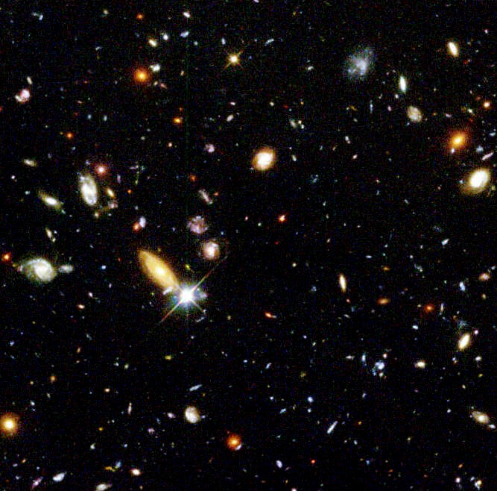
Cosmology
Evidence for a finite universe
  Apparently there is something beyond.
Evidence for a universe with a beginning
  Something apparently caused it to be.
Evidence for a "fine-tuned" universe
  The cause of the universe seems to have the characteristics of mind.

Slide 20
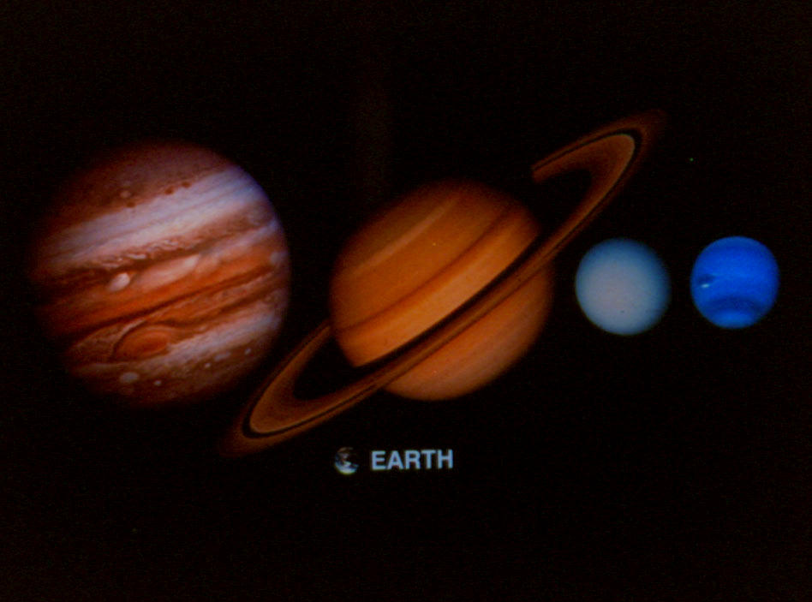
Planetary Astronomy
The rarity of "earth-like" planets
Obviously depends on meaning of "earth-like."
Should not get hung up on trivia.
Should pay attention to features that are necessary & striking.
But there are enough of these that it would be astonishing to have even one earth-like planet in our universe.

Slide 21
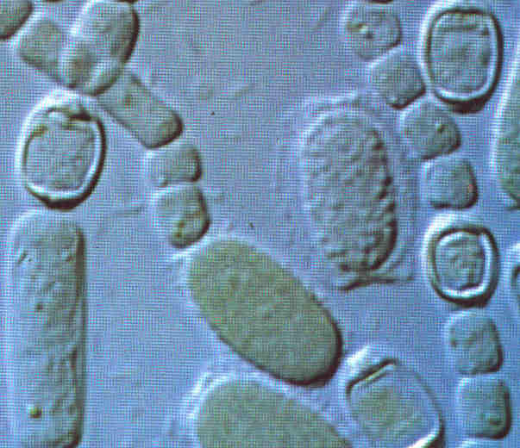
Biology
The origin of life
  Seems far beyond chance
"Fine-tuning" in living things
  See Michael Denton, Nature's Destiny
The shape of the fossil record
  Not what Darwinism predicts
The presence of "irreducible complexity"
  See Michael Behe, Darwin's Black Box

Slide 22
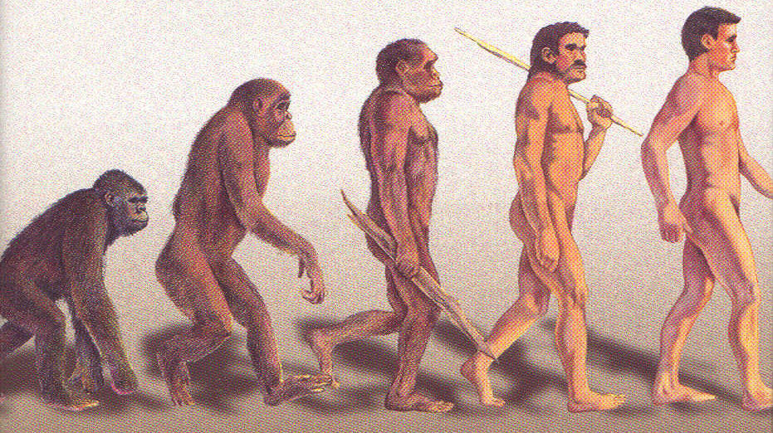
Anthropology
The gap between humans and other known animals
The problem of consciousness
The problem of self-initiation
The workability of logic
The problem of conscience

Slide 23
How to Do Science
In a Theistic Universe
Theists should be on the lookout for markers pointing to God in & behind the phenomena.
Because of the reductionism of secular science, we should not expect those practicing such science to be looking for this.
We should particularly be on the lookout for phenomena in our disciplines that are resisting naturalistic explanation.

Slide 24
Not the End, but the Beginning
Go Do It!

