Slide 1
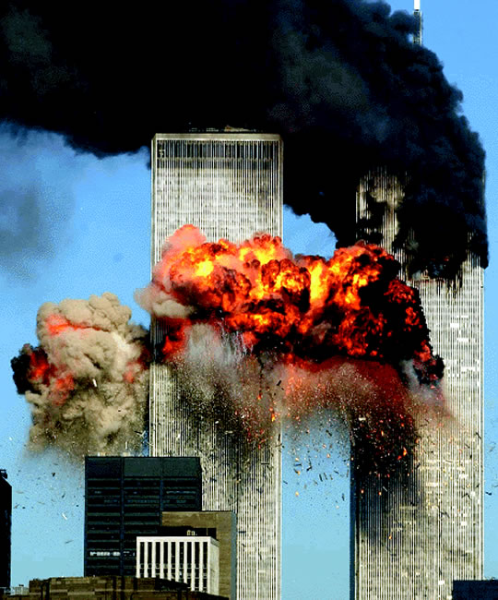

Disaster: What to Make of It?
Robert C. Newman

Slide 2
The Challenge of Disaster
Have you ever been challenged by someone who doubted that God exists because there is so much evil in the world?
  The article "Atheism" in the Encyclopedia of Philosophy uses this as its main argument.
Have you ever wondered how God could allow some wicked person to live so long?
  Say, Adolf Hitler, Idi Amin, Pot Pol…?
  Many Jews have said that the Holocaust ended their belief in God.

Slide 3
The Challenge of Disaster
Have you occasionally wondered how God could allow some disaster to happen?
  Some major national or world disaster?
  Some personal disaster to you or a loved one?
  Many people have been sorely tried by such things.
These problems are discussed several places in the Bible.
  Here, we want to look at Jesus' response.

Slide 4
Luke 13
1 (NIV) Now there were some present at that time who told Jesus about the Galileans whose blood Pilate had mixed with their sacrifices. 2 Jesus answered, "Do you think that these Galileans were worse sinners than all the other Galileans because they suffered this way? 3 I tell you, no! But unless you repent, you too will all perish. 4 Or those eighteen who died when the tower in Siloam fell on them–do you think they were more guilty than all the others living in Jerusalem? 5 I tell you, no! But unless you repent, you too will all perish."

Slide 5
The Crowd's Question
They tell Jesus about Pilate’s act of killing Galileans while they were in the temple sacrificing.
  We don’t know any more details about this event.
  It fits Pilate’s character as seen in Josephus:
    Shields, aqueduct, plainclothesmen
Not sure why they raise question:
  Are they Zealots trying to incite Jesus?
  Pharisees trying to entrap him?
  Practical theologians trying to deal with this problem?

Slide 6
Jesus' Response
Jesus' response is surprising and apparently rather harsh:
  Those killed were not worse sinners than normal.
  Unless you turn your lifestyle around, the same will happen to you!
This has application to:
  Those standing there & hearing Jesus
  Mankind as a whole, including us
In fact, for many of those who heard this, God did send the Romans to destroy them in AD 70.

Slide 7
Jesus' Counter-Question
Jesus goes on to make the problem worse.
  He moves from the problem of why God allows human wickedness…
  To why he allows natural disaster.
What about the tower in Siloam which fell and killed 18 people?
  We don't know anything else about this either.
  Siloam is in the S part of Jerusalem.
  Probably the tower is part of the city fortifications.
  Perhaps it fell during an earthquake.

Slide 8
Jesus' Response
Jesus' answer is the same as before:
  Those overcome by this disaster no worse than others.
  You deserve the same!
Our first lesson:
  The Bible teaches that disaster does not come selectively to more wicked people.
  We cannot judge the relative righteousness of a person by what happens in this life.

Slide 9
Luke 13
6 (NIV) Then he told this parable: "A man had a fig tree, planted in his vineyard, and he went to look for fruit on it, but did not find any. 7 So he said to the man who took care of the vineyard, 'For three years now I've been coming to look for fruit on this fig tree and haven't found any. Cut it down! Why should it use up the soil?' 8 'Sir,' the man replied, 'leave it alone for one more year, and I'll dig around it and fertilize it. 9 If it bears fruit next year, fine! If not, then cut it down.' "

Slide 10
Jesus' Justification
Jesus justifies his claim that we all deserve calamity by his illustration of the fruitless fig tree.
This tree was planted by its owner to give fruit.
  The owner has now been looking for fruit on it for 3 years, but not finding any.
  The tree deserves to be cut down.

Slide 11
Jesus' Justification
At Jesus' time, this was a good picture of Israel not being what God intended, so warning them of the disaster to come in AD 70.
For mankind in general, we are not what God made us to be.
  Consider the two greatest commandments.
Second lesson: Why do the righteous perish? There aren't any!

Slide 12
Jesus' Explanation of
Survival of the Wicked
In the person of the gardener, Jesus goes on to explain why God allows wicked people to survive.
  The gardener suggests (& is permitted) digging around tree & adding fertilizer to give the tree one more chance.
God did not destroy Israel at (or right after) the crucifixion, but allowed one more generation an opportunity to repent.

Slide 13
Jesus' Explanation of
Survival of the Wicked
And God, in his mercy, has allowed our generation to come and survive so far, in order that we (& others) might repent.
Third lesson: Why do the wicked survive? If they didn't, we’d all be in hell!
  Do you want to kick down the ladder after you have escaped to keep others from reaching safety?

Slide 14
Disaster as a Message
There is at least one other lesson from this passage, hidden in the phrase "you too" in verses 3 and 5.
God has designed many things about his world to convey spiritual messages:
  Large use of word-pictures to display the God-human relation: potter/clay; farmer/plant; shepherd/sheep; king/subject; master/slave; father/child; husband/wife

Slide 15
Disaster as a Message
God has designed many things about his world to convey spiritual messages:
  Word-pictures to display salvation: creation, rebirth, adoption, acquittal, freedom, homecoming…
  We develop these sets of word-pictures in two PowerPoint talks "God's Self-Portraits" and "Biblical Pictures of Salvation."

Slide 16
Disaster as a Message
In our Luke 13 passage, we have the suggestion that disaster itself is a foretaste of the wrath to come.
Fourth lesson: Disasters are scaled-down pictures of the wrath to come. It will fall on all (good and bad) who depend on their own righteousness. Disasters serve as advance warning to the survivors that they need to repent.

Slide 17
Conclusions
Four lessons from disaster:
It comes on good and bad alike; the health & wealth gospel is not true.
It reminds us that all have sinned and deserve God's punishment.
If God were to destroy all wickedness right now, we might be safe, but many whom God intends to save would not. If he had destroyed all wickedness somewhat earlier, we would be in hell!
Every disaster (Pompei, Titanic, World Trade Center) is a warning of the wrath to come. May we use them to warn others.

Slide 18
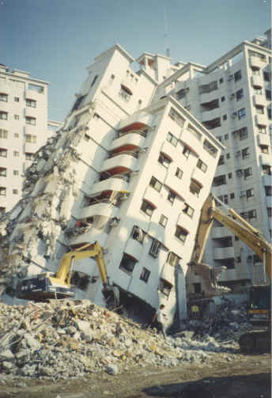
The End…
…is not yet, you still have a chance to repent!

