Slide 1
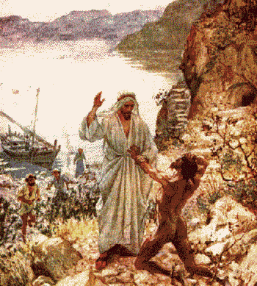
Jesus Heals Demon-Possession
Mark 5:1-20
Robert C. Newman

Slide 2
What is Demonism?
Well, we don’t know exactly. We are here working with what the Bible has to say, not with claims of various ancient or modern cultures or deliverance ministries.
It is some sort of situation in which a spirit-being obtains partial or complete control over a human (or animal).
We don’t know why or how this occurs.

Slide 3
Demonism
Theological liberals deny the reality of demonism, tending to see it rather as misdiagnosed mental illness.
Given the cure rates of psychiatrists and psychologists (about the same as witch doctors), it may well be that some mental illness is misdiagnosed demonism.

Slide 4
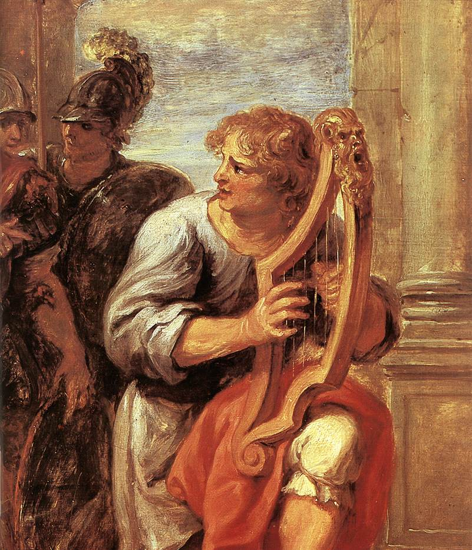
Old Testament Background

Slide 5
Demonism in the OT
If we think of Jesus’ disciples having only the OT as their Bible, what would this tell them about demonism?
The OT is explicit on the existence of Satan and evil supernatural powers.
It connects them with idolatry and false religion.
It sees Satan as capable of miraculous acts.
So were some humans, such as the magicians of Pharaoh in Egypt.

Slide 6
Demonism in the OT
As regards demonism in particular, we have possible references in:
The evil spirit that comes upon Saul (1 Samuel 16)
The lying spirit that misleads Ahab’s false prophets (1 Kings 22)
Let’s look at each of these passages.

Slide 7
Saul Demonized?
1 Sam 16:14 (NIV) Now the Spirit of the LORD had departed from Saul, and an evil [or injurious] spirit from the LORD tormented him. 15 Saul's attendants said to him, "See, an evil spirit from God is tormenting you. 16 Let our lord command his servants here to search for someone who can play the harp. He will play when the evil spirit from God comes upon you, and you will feel better."

Slide 8
Ahab’s Prophets Demonized?
1 Kings 22:19 (NIV) Micaiah continued, "Therefore hear the word of the LORD: I saw the LORD sitting on his throne with all the host of heaven standing around him on his right and on his left. 20 And the LORD said, `Who will entice Ahab into attacking Ramoth Gilead and going to his death there?' One suggested this, and another that. 21 Finally, a spirit came forward, stood before the LORD and said, `I will entice him.' 22 `By what means?' the LORD asked. `I will go out and be a lying spirit in the mouths of all his prophets,' he said. `You will succeed in enticing him,' said the LORD. `Go and do it.' 23 So now the LORD has put a lying spirit in the mouths of all these prophets of yours. The LORD has decreed disaster for you."

Slide 9
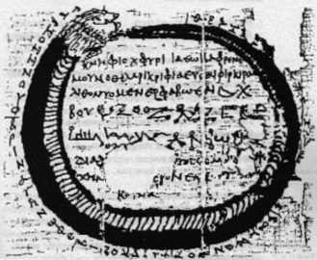
Background in NT Period

Slide 10
Demonism in the NT
Demonism shows up strongly in the Gospels:
Perhaps due to demons flocking to oppose Jesus
Perhaps to pagan influence coming into Judaism
We see a few examples in Acts.

Slide 11
Demon Exorcism Elsewhere
Exorcism is mentioned in Josephus.
Also in the apocryphal book of Tobit.
We have a number of magical papyri from the NT period, showing that the names of Yahweh & Jesus were viewed as powerful charms even among the pagans.
Recall also the incident in Acts 19 where Jewish exorcists tried to use the name of Jesus.

Slide 12
Josephus Antiquities
Ant 8.2.5 The manner of the cure was this: He put a ring that had a root of one of those sorts mentioned by Solomon to the nostrils of the demoniac, after which he drew out the demon through his nostrils; and when the man fell down immediately, he abjured him to return into him no more, making still mention of Solomon, and reciting the incantations which he composed.

Slide 13
The Book of Tobit
Tob 8:1 (NRSV Apoc) When they had finished eating and drinking they wanted to retire; so they took the young man and brought him into the bedroom. 2 Then Tobias remembered the words of Raphael, and he took the fish's liver and heart out of the bag where he had them and put them on the embers of the incense. 3 The odor of the fish so repelled the demon that he fled to the remotest parts of Egypt. But Raphael followed him, and at once bound him there hand and foot.

Slide 14
Paris Magical Papyrus
But write this phylactery upon a little sheet of tin: ‘Jaeo, Abraothioch, Phtha, Mesentiniao, Pheoch, Jaeo, Charsoc’, and hang it around the sufferer: it is a thing to be trembled at which he fears. Standing opposite, adjure him. The adjuration is this: ‘I adjure thee by the God of the Hebrews Jesu, Jaba, Jae, Abraoth, Aia, Thoth, Ele, Elo, Aeo, Eu, Jiibaech, Abarmas, Jabarau, Abelbel, Lona, Abra, Maroia, arm, thou that appearest in fire, thou that art in the midst of earth and snow and vapour, Tannetis: let thy angel descend, the implacable one, and let him draw into captivity the daemon as he flieth around this creature which God formed in his holy paradise.

Slide 15
Exorcism Elsewhere
Typical extra-biblical exorcism involved a great deal of mumbo-jumbo:
In Josephus, an Essene exorcist uses a ring containing a root prescribed by Solomon to draw the demon out through the man’s nose.
In Tobit, the exorcist burns a fish liver to make a powerful stink to drive the demon away.
In the magical papyri, long strings of foreign words & names are used as spells.

Slide 16
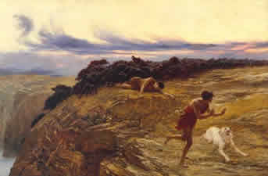
Jesus Heals the Demoniac
Mark 5:1-20

Slide 17
Mark 5:1-5
1 (NIV) They went across the lake to the region of the Gerasenes. 2 When Jesus got out of the boat, a man with an evil [unclean] spirit came from the tombs to meet him. 3 This man lived in the tombs, and no one could bind him any more, not even with a chain. 4 For he had often been chained hand and foot, but he tore the chains apart and broke the irons on his feet. No one was strong enough to subdue him. 5 Night and day among the tombs and in the hills he would cry out and cut himself with stones.

Slide 18
Mark 5:6-10
6 (NIV) When he saw Jesus from a distance, he ran and fell on his knees in front of him. 7 He shouted at the top of his voice, "What do you want with me, Jesus, Son of the Most High God? Swear to God that you won't torture me!" 8 For Jesus had said to him, "Come out of this man, you evil spirit!" 9 Then Jesus asked him, "What is your name?" "My name is Legion," he replied, "for we are many." 10 And he begged Jesus again and again not to send them out of the area.

Slide 19
Mark 5:11-15
11 (NIV) A large herd of pigs was feeding on the nearby hillside. 12 The demons begged Jesus, "Send us among the pigs; allow us to go into them." 13 He gave them permission, and the evil spirits came out and went into the pigs. The herd, about two thousand in number, rushed down the steep bank into the lake and were drowned. 14 Those tending the pigs ran off and reported this in the town and countryside, and the people went out to see what had happened. 15 When they came to Jesus, they saw the man who had been possessed by the legion of demons, sitting there, dressed and in his right mind; and they were afraid.

Slide 20
Mark 5:16-20
16 (NIV) Those who had seen it told the people what had happened to the demon-possessed mannand told about the pigs as well. 17 Then the people began to plead with Jesus to leave their region. 18 As Jesus was getting into the boat, the man who had been demon-possessed begged to go with him. 19 Jesus did not let him, but said, "Go home to your family and tell them how much the Lord has done for you, and how he has had mercy on you." 20 So the man went away and began to tell in the Decapolis [the Ten Cities] how much Jesus had done for him. And all the people were amazed.

Slide 21
Jesus’ Actions
Are very restrained, compared with those of contemporary exorcists.
He commands the demons to leave, and they have to do it.
Though there is some negotiation here for reasons that are not explained
Much of this narration is ambiguous, as we cannot always be sure who is in control in cases of possession.

Slide 22
Some Ambiguities
Does the demonized man run to Jesus seeking deliverance?
Or are the demons driving him there to harass Jesus & his disciples?
Do the pigs panic and stampede into the lake?
Or do the demons drive them in to get rid of Jesus?
Or does Jesus drive them in to get rid of the demons?

Slide 23
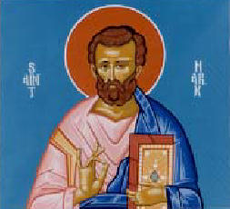
Some Teachings

Slide 24
Regarding Jesus
He is the Son of God (7, though the source here is not great).
He is able to subdue demons by the thousands (9-11).
He has compassion for those in bondage to Satan.
He will allow men to go their own way, if they wish (17-18)

Slide 25
Regarding Demons
They exist and are dangerous; they are not just a primitive model for insanity.
They can apparently see spiritual realities that we cannot (6-7).
They are stronger than men or animals, though perhaps they can only control one at a time.
They are, however, subject to God.

Slide 26
Regarding Humans
They tend to put material things ahead of spiritual things (17).
They are, in some cases, subject to demons.
They can witness to God’s work in their lives without special theological training (19-20).

Slide 27
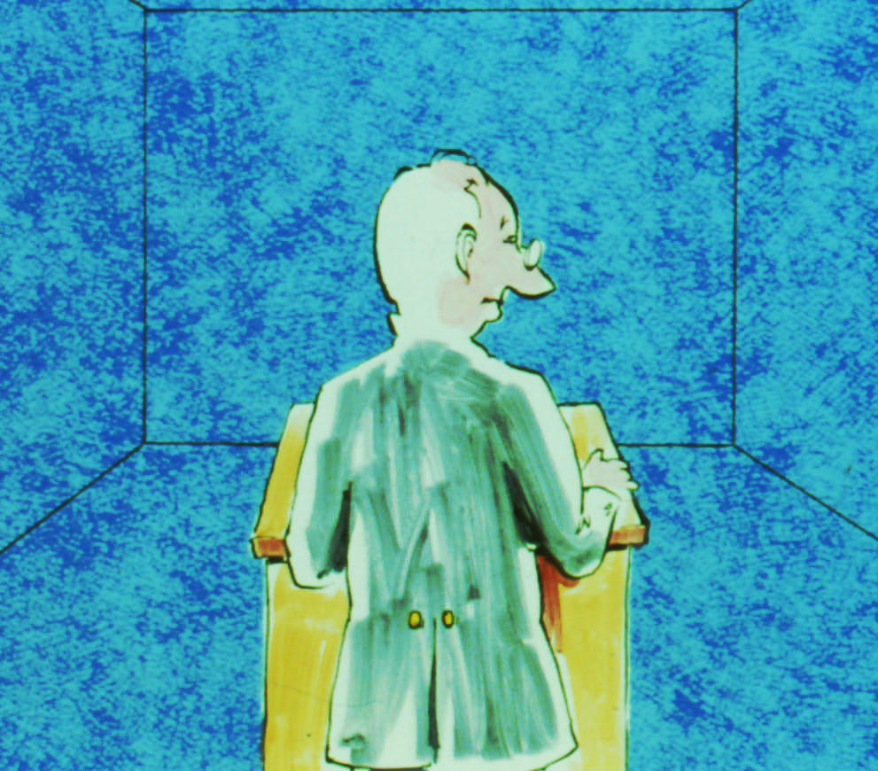
Some Practical Applications

Slide 28
Applications
Satanic power is real, not just a joke, superstition, or metaphor.
We need not fear it, for God is even now in control. Flee to Christ for protection & deliverance.
Beware of putting off God; He might just let us have our own way!
We Christians should be able to tell others what Christ has done for us personally.

Slide 29
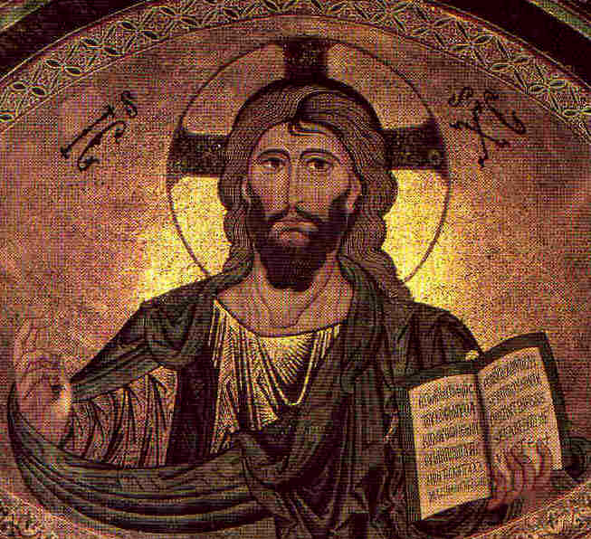
The End

