Slide 1
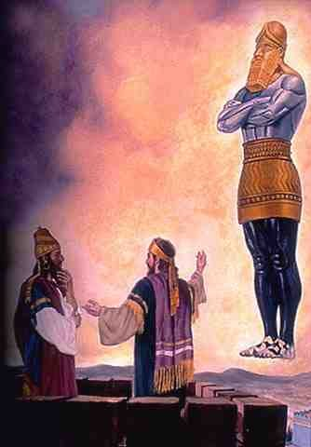
The Book of Daniel
An Overview
Robert C. Newman

Slide 2
Overview of Daniel
The first six chapters are largely narrative, with some prophecies interspersed. They narrate the life of Daniel from his exile in Babylon up to his old age.
The last six chapters are largely prophetic, with only a bit of narrative regarding how each vision came to him.

Slide 3
Mostly Narrative (chs 1-6)
Daniel trained in royal service (1)
Nebuchadnezzar’s image dream (2)
The golden image & fiery furnace (3)
Nebuchadnezzar's tree dream (4)
The handwriting on the wall (5)
Daniel in the lions' den (6)

Slide 4
Daniel trained in royal service (1)
Daniel is exiled to Babylon as a young boy.
He & other Israelites are drafted into training for royal government service.
Daniel & his 3 friends refuse to eat the royal food.
They find favor and come to excel in their studies.

Slide 5
Nebuchadnezzar's image (2)
An unusual image w/ gold head, silver upper body, bronze lower body, iron legs, iron & clay feet
Daniel interprets the parts as picturing world empires to come.

Slide 6
Golden image & fiery furnace (3)
Nebuchadnezzar has a golden image built which he commands all to bow down & worship.
Daniel's companions refuse to worship the image & are thrown in a fiery furnace.
God rescues them in the midst of the fire.

Slide 7
Nebuchadnezzar's tree dream (4)
A mighty tree is cut down, leaving only stump & roots.
Daniel: judgment to come for pride of Nebuchadnezzar.
Dream fulfilled: Nebuchadnezzar’s pride, madness, & recovery.

Slide 8
Handwriting on the wall (5)
Belshazzar uses the sacred dishware from God’s temple.
A mysterious message appears.
Daniel: your empire is at an end.
That night the kingdom is taken.

Slide 9
Daniel in the lions' den (6)
Daniel is punished for praying to anyone but the king.
God protects Daniel from the lions, but his accusers are later devoured.

Slide 10
Mostly Prophecy (chs 7-12)
Daniel’s dream of the four beasts (7)
His vision of the ram & goat (8)
His prayer & the message of the 70 sevens (9)
His vision of the heavenly man (10)
The angel's message (11-12)

Slide 11
The four beasts (7)
Lion, bear, leopard, & terrible beast appear.
Then a throne scene w/ Ancient of Days
Son of Man receives universal kingdom.
Four kingdoms to come, then judgment, then eternal kingdom of saints

Slide 12
Ram & goat (8)
Ram w/ 2 unequal horns conquers all.
He in turn is defeated by a goat with 1 horn, which horn breaks & is replaced by 4 horns.
Ram = Medes & Persians
Goat = Greece

Slide 13
The 70 sevens (9)
Daniel repents for self & Israel.
God sends an angel with this message.
70 sevens determined upon your people & your holy city…

Slide 14
The heavenly man (10)
Daniel sees a shining man, is terrorized
Is this Gabriel?
Mentions princes of Persia & Greece (seemingly angelic)
Comes with message for Daniel

Slide 15
The angel's message (11-12)
The doings of the coming kings of the north and the south
The king who exalts himself (Antichrist?)
The end-times
The wise will understand at that time.

Slide 16
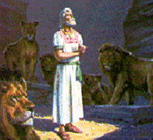
The End
What are some of the practical values of Daniel’s prophecy?

Slide 17
Some Practical Values
God's people must typically live as a minority in their dispersion. We need to know how to do so.
We (like Daniel) need to do our best in the situation God puts us in.
We need to use the opportunities He provides.
We gain strength and encouragement from knowing how it all ends.

