Slide 1


OT Messianic Prophecy
and The Da Vinci Code
Robert C. Newman

Slide 2
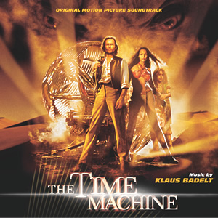
Testing the Past
Without time machines, how can we know what really happened in the past?
  Isn't it just one group's word against another's?
No, God has given us a better basis for assurance than this.
One important line of evidence is the fit between Old and New Testaments.

Slide 3
Testing the Past
We can see that the NT Gospels are in continuity with the OT, unlike the Gnostic Gospels, and unlike The Da Vinci Code.
Even liberal NT scholars admit:
  Jesus died by crucifixion ~ AD 30.
  His resurrection was believed immediately.
  Paul gives a very early picture of the meaning of Jesus' death.

Slide 4
Connections with OT
Astonishingly, these features all fit the predictions of the Old Testament!
  Isaiah 42 & 49 on the Messiah as a light to the nations
  Daniel 9 on the time of his execution
  Psalm 22 on the nature of his execution
  Isaiah 53 on the meaning of his execution & resurrection.
Let's see.

Slide 5
A Light to the Nations
I will appoint you as a covenant to the people [Israel], as a light to the nations, to open blind eyes, to bring out prisoners from the dungeon, and those who dwell in darkness from the prison.
Isaiah 42:6-7

Slide 6
A Light to the Nations
And now, says the LORD, who formed me from the womb to be His Servant, to bring Jacob back to Him, in order that Israel might be gathered to Him…. He says "It is too small a thing that you should be My Servant to raise up the tribes of Jacob, and to restore the preserved ones of Israel; I will also make you a light of the nations, so that My salvation may reach to the end of the earth."
Isaiah 49:5-6

Slide 7
A Light to the Nations
This fits Jesus!
Of the many claiming to be the Messiah, only he has started a world religion of Gentiles.
Before Jesus came, few non-Jews were believers in a single God, much less the God of the Bible.
Now nearly ½ the Gentiles in the world believe in the God of Abraham.
No one but God could engineer this!

Slide 8
Daniel 9 on the
Time of His Execution
Know and understand this: From the issuing of the decree to restore and rebuild Jerusalem until the Anointed One [Messiah] comes, there will be seven 'sevens' and 62 'sevens.' It will be rebuilt with streets and a trench, but in times of trouble. After the 62 'sevens,' the Anointed One will be cut off and will have nothing.
Daniel 9:25-26

Slide 9
Messiah was to come after the 69th sabbath cycle.
The unit of time-measurement appears to be cycles of sabbatical years, here translated 'sevens,' traditionally 'weeks.'
The starting point seems to be the command of King Artaxerxes 1 in his 20th year (445 BC).
The sabbatical cycle in which this starting point falls is 449-442 BC.
Using the usual inclusive method of counting, the 69th cycle is 28-35 AD.

Slide 10
Messiah was to come after the 69th sabbath cycle.
449 442 435 428 421 414 407 BC
⬇
1 2 3 4 5 6
… AD 7 14 21 28 35

65 66 67 68 69
⬇ Artaxerxes’ decree, 445 BC
 Jesus’ crucifixion, 30 AD

Slide 11
Daniel 9 on the
Time of His Execution
This 69th week (28-35) covers all standard dates for Jesus’ crucifixion.
Isn't it strange that the only Messianic claimant who started a world religion of Gentiles just happened to be cut off in the time-range specified centuries in advance?

Slide 12
Psalm 22 on the
Nature of His Execution
Why did Jesus cry out from the cross:
  "My God, my God, why have you abandoned me?"
He was quoting Psalm 22; it tells of one:
  Abandoned by God
  Surrounded by enemies
  Hands and feet pierced
  Clothes gambled away
  Thirsty
  Bones out of joint
  Laid in the dust of death
This describes crucifixion before it existed, and Jesus' crucifixion in particular!

Slide 13
Text of Psalm 22
My God, my God, why have you forsaken me?… All who see me mock me, they hurl insults, shaking their heads…. You lay me in the dust of death…. Dogs have surrounded me, a band of evil men has encircled me, they have pierced my hands and my feet…. They divide my garments among them and cast lots for my clothing…. I will declare your name to my brothers; in the congregation I will praise you…. The poor will eat and be satisfied…. All the ends of the earth will remember and turn to the LORD…. Posterity will serve him; future generations will be told about the Lord. They will proclaim his righteousness to a people yet unborn – for he has done it.

Slide 14
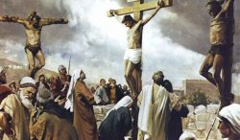
Psalm 22 on the
Nature of His Execution
The psalm goes on to note that God does answer him and rescue him.
These events will be remembered all over the world and down thru the generations.
This is just what happened in the crucifixion & resurrection of Jesus!

Slide 15
Isaiah 53 on the
Meaning of His Execution
In Isaiah 53, we have the most famous prophecy of someone’s death and resurrection.
God's servant:
  Rejected by humans
  Despised by Israel
  Dies for their sins
  Is raised to life again
  Is exalted by God
This fits what the NT says about Jesus.

Slide 16
Isaiah 52:13-15
See, my servant will act wisely; he will be raised and lifted up and highly exalted. Just as there were many who were appalled at him — his appearance was so disfigured beyond that of any man and his form marred beyond human likeness — so he will sprinkle many nations, and kings will shut their mouths because of him. For what they were not told, they will see, and what they have not heard, they will understand.

Slide 17
Isaiah 52:13-15
In these verses, we see that:
God’s servant will be highly exalted.
He will be disfigured so that many are appalled at him.
He will sprinkle (i.e., cleanse) many nations.

Slide 18
Isaiah 53:1-3
Who has believed our message, and to whom has the arm of the LORD been revealed? He grew up before him like a tender shoot, and like a root out of dry ground. He had no beauty or majesty to attract us to him, nothing in his appearance that we should desire him. He was despised and rejected by men, a man of sorrows and familiar with suffering. Like one from whom men hide their faces he was despised and we esteemed him not.

Slide 19
Isaiah 53:1-3
These three verses tell us:
Who would have believed it?
The servant has no beauty or majesty.
He is despised and rejected.
He is sorrowful and suffering.

Slide 20
Isaiah 53:4-6
Surely he took up our infirmities and carried our sorrows, yet we considered him stricken by God, smitten by him and afflicted. But he was pierced for our transgressions, he was crushed for our iniquities; the punishment that brought us peace was upon him, and by his wounds we are healed. All we, like sheep, have gone astray, each of us has turned to his own way; and the LORD has laid on him the iniquity of us all.

Slide 21
Isaiah 53:4-6
These 3 verses tell us:
The servant carried our sorrows, was punished for our sins.
But we thought God was punishing him because of what he had done.
By his punishment we are healed and have peace.

Slide 22
Isaiah 53:7-8
He was oppressed and afflicted, yet he did not open his mouth; he was led like a lamb to the slaughter, and as a sheep before her shearers is silent, so he did not open his mouth. By oppression and judgment he was taken away. And who can speak of his descendants? For he was cut off from the land of the living; for the transgression of my people he was stricken.

Slide 23
Isaiah 53:7-8
These two verses tell us:
The servant is strangely silent when oppressed.
He is put to death by unjust judgment.
His death was to pay for the transgressions of "my people."

Slide 24
Isaiah 53:9-10
He was assigned a grave with wicked men, yet he was with a rich man in his death, because he had done no violence, nor was any deceit in his mouth. Yet it was the LORD’s will to crush him and cause him to suffer, and though the LORD makes his life a guilt offering, he will see his offspring and prolong his days, and the will of the LORD will prosper in his hand.

Slide 25
Isaiah 53:9-10
These two verses tell us:
Though they planned to bury him with wicked men, he was actually with a rich man in his death.
God caused his suffering, making his life a guilt-offering.
Afterward, the servant will prolong his days.

Slide 26
Isaiah 53:11-12
After the suffering of his soul, he will see the light of life and be satisfied; by knowledge of him my righteous servant will justify many, and he will bear their iniquities. Therefore I will give him a portion with the great, and he will divide the spoils with the strong, because he poured out his life unto death, and was numbered with the transgressors. For he bore the sin of many, and made intercession for the transgressors.

Slide 27
Isaiah 53:11-12
These last two verses tell us:
After suffering, he will be satisfied.
After death, he will live.
Many will be justified by knowing him.
He will be counted among the great.
Though considered a transgressor, he actually bore their sins and made intercession for them.

Slide 28
Isaiah 53 on the
Meaning of His Execution
In Isaiah 53, we are told that God's servant will be:
  Rejected by humans
  Despised by Israel
  Dies for their sins
  Is raised to life again
  Is exalted by God
This fits what the NT says about Jesus.
It matches the NT doctrine of the atonement.
It was written centuries in advance.

Slide 29
Conclusions on
Messianic Prophecy
So, the features of the NT picture of Jesus fit OT Messianic prophecy in many ways that could not have been engineered by his followers.
Many of these could not have been faked by recording fulfillments in the NT where none occurred in history.

Slide 30
Conclusions
We have restricted our discussion of The Da Vinci Code to its allegations about Jesus and early Christianity.
It fares very poorly there.
Whatever the merits of its treatment of Leonardo da Vinci or the Priory of Sion, it is not good history for the first century of the Christian era.

Slide 31
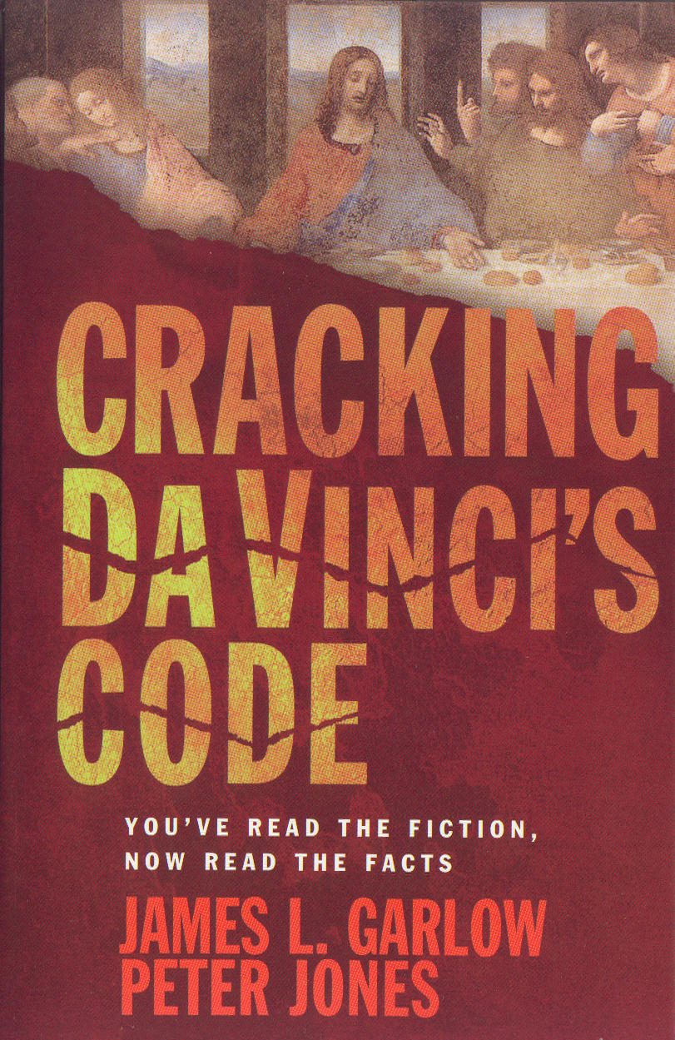
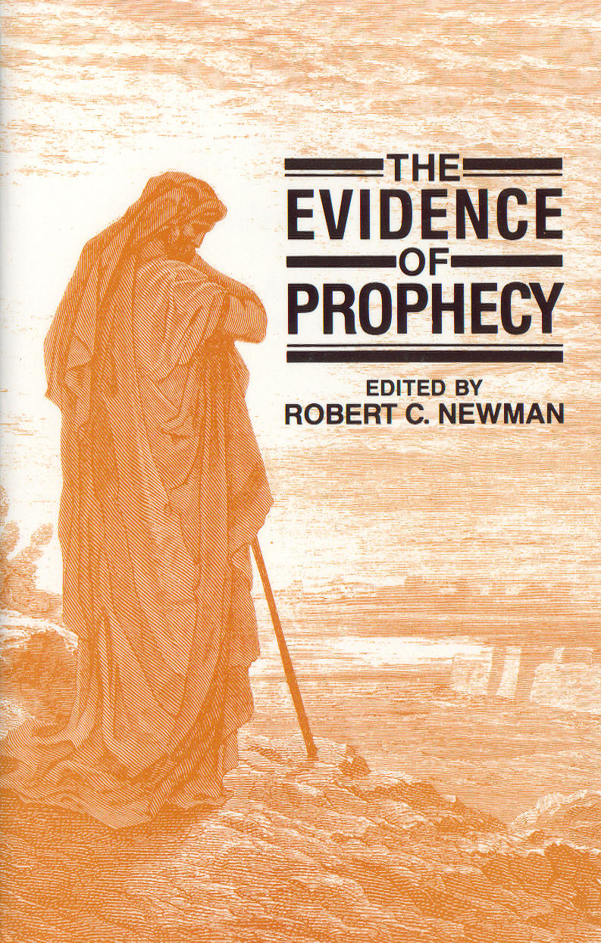
For Further
Reading

Slide 32
The End
OT Messianic Prophecy is fulfilled in the NT; it is not in The Da Vinci Code.

