Slide 1
The Canon of the New Testament
and The Da Vinci Code
Robert C. Newman

Slide 2
DV Code on the Bible
"The Bible is a product of man … not God. The Bible did not fall magically from the clouds. Man created it as a historical record of tumultuous times, and it has evolved through countless translations, additions, and revisions. History has never had a definitive version of the book." (231)

Slide 3
DV Code on the Gospels
"More than eighty gospels were considered for the New Testament and yet only a relative few were chosen for inclusion — Matthew, Mark, Luke and John among them."
"Who chose which gospels to include?"
"Aha! … The fundamental irony of Christianity! The Bible, as we know it today, was collected by the pagan Roman emperor Constantine the Great." (231)

Slide 4
DV Code on Jesus
"… until that moment in history [AD 325, the Council of Nicaea], Jesus was viewed by his followers as a mortal prophet … a great and powerful man, but a man nevertheless."
"Not the Son of God?"
"Right … Jesus' establishment as 'the Son of God' was officially proposed and voted on by the Council of Nicaea … a relatively close vote at that…" (233)

Slide 5
On Constantine & the NT Canon
"Because Constantine upgraded Jesus' status almost four centuries after Jesus' death, thousands of documents already existed chronicling His life as a mortal man. To rewrite the history books, Constantine knew he would need a bold stroke … [He] commissioned and financed a new Bible, which omitted those gospels which spoke of Christ's human traits and embellished those gospels which made Him godlike. The earlier gospels were outlawed, gathered up, and burned." (234)

Slide 6
Are These Claims Warranted?
Let's see.
We'll consider:
Early manuscripts of the Gospels
Early references and quotations in the writings of Christian leaders ('Church Fathers')

Slide 7
Early Manuscripts
This is papyrus p⁵², the oldest known fragment of any gospel.
The front is John 18:31-33 (shown), the back is John 18:37-38.
It is dated about AD 125, only 35 years after this Gospel was written.

Slide 8
Early Manuscripts
This is papyrus p⁶⁶, a manuscript of John in which nearly all of the Gospel has survived.
It is dated about AD 200.
This picture shows the first page.

Slide 9
Early Manuscripts
This is one page of papyrus p⁴⁵, which contains all four canonical Gospels and the book of Acts.
It is dated from the 3rd century, so before AD 300 and before Constantine.

Slide 10
Post-Constantine Manuscripts
From Constantine and onwards, we have the entire New Testament preserved on parchment, much more durable than papyrus.
This is Codex Sinaiticus, from the 4th century.
This was originally a complete Bible, though parts of the OT are now lacking.

Slide 11
Post-Constantine Manuscripts
This is Codex Alexandrinus, from the 5th century.
It was originally a complete Bible, but now lacks most of Matthew & part of John.

Slide 12
Post-Constantine Manuscripts
This is the Freer (or Washington) Codex, from the late 4th or 5th century.
It is a one-volume copy of the four Gospels.
Though its text is a mixture of the main text-types from antiquity, it shows no variations of the sort alleged in The Da Vinci Code.

Slide 13
Summary on Papyri
The graph at right lists the number of surviving manuscripts written on papyrus for the four Gospels.
The green indicates the number from before AD 300, and thus before Constantine. There are 22 of these.

Slide 14
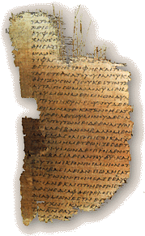
Summary on Papyri
The papyri, because of their age and the fragility of papyrus as a writing material, have all survived in only fragmentary condition.
Still, before AD 300, we have 22 papyri, which together preserve the following chapters of each Gospel (partial, entire):
Matthew: 1-3, 5, 11-12, 20-21, 23-26
Mark: 4-12
Luke: 1-10, 11-16, 17-18, 22, 23-24
John: 1-5, 6, 7-13, 14-21

Slide 15
Summary on Papyri
Comparing these texts with post-Constantine texts, the papyri show no evidence of tampering.
Thus, the claim Constantine upgraded Jesus in the Gospel accounts is unwarranted.
At most, he could only have selected the Gospels that fit the program he was trying to advance.
Is there any evidence he did this?
Let's see.

Slide 16
Evidence from Early Christian Leaders
Besides the evidence from manuscripts, we have the testimony of early Christian leaders regarding what gospels were in use in their churches.
This was, in fact, one of the criteria used to verify the authentic Gospels after persecution ended (at Constantine's time).

Slide 17
Apostolic Fathers
Some eight Christian leaders between AD 95-130 wrote letters and other writings that have survived.
Three of these explicitly quote NT passages as 'Scripture,' and one such passage quoted is from the Gospel of Matthew.
All of them make allusions to NT passages, including all four of the canonical Gospels and no others.

Slide 18
Marcion, ~140
The early heretic Marcion gives us the earliest list of books he thinks belong in the New Testament.
He includes only one Gospel, Luke, and ten letters of Paul, all modified to remove any indication that the God Jesus and Paul spoke of was the God of the Old Testament.
Marcion is usually considered a Gnostic, since Gnostics typically rejected the Old Testament.

Slide 19
Allusions by Other Gnostics
Basilides (120-140) quotes from 1 Corinthians as Scripture. He alludes to Matthew, Luke and John as authoritative.
Valentinus (~140) authored The Gospel of Truth, now available in the Nag Hammadi papyri. He cites Ephesians as Scripture and alludes to Matthew, Luke and John.

Slide 20
Justin Martyr (130-160)
A student of the Greek philosophers, Justin was converted to Christianity as an adult by talking to an elderly believer. He spent the rest of his life as a traveling Christian philosopher and died as a martyr.
In his two Apologies to the Roman emperor and his Dialogue with the Jewish scholar Trypho, Justin speaks of the "Gospels" and calls them "memoirs of the apostles and those who followed them."
He uses our four Gospels and no others.

Slide 21
Irenaeus (~180)
Irenaeus was bishop of Lyons in southern France, but he grew up in Asia Minor, an early stronghold of Christianity.
He had studied under two students of the apostle John — Papias and Polycarp.
He wrote an extensive book Against Heresies, responding to the Gnostics, quoting from all the NT but a few of the shorter letters.

Slide 22
Irenaeus (~180)
Irenaeus takes our four Gospels for granted, and even seeks to give symbolic reasons for why there are exactly four of them.
He also says, "So firm is the ground upon which these Gospels rest, that the very heretics themselves bear witness to them, and starting from these documents, each one of them endeavors to establish his own peculiar doctrine."

Slide 23
The Muratorian Canon (~180)
This is the oldest canonical list preserved from the orthodox side.
It is anonymous, but was written from Italy in the late 2nd century by a Christian leader there.
Our only manuscript is broken at the beginning, but it starts with Luke as the 3rd Gospel, followed by John as the 4th.
It rejects the writings of the Gnostics and the Montanists.

Slide 24
Clement of Alexandria (~200)
Clement was head of the Christian school in Alexandria, which trained new converts and Christian leaders.
He uses some of the non-canonical Gospels, but he distinguishes them from those "that have been handed down."

Slide 25
Origen (~230)
Successor to Clement as head of the Christian school in Alexandria, Origen later moves to Caesarea, where he develops the largest Christian library in antiquity.
Origen gives some insight into the status of the canon question in his time. He notes that two categories were commonly recognized by the orthodox:
Books acknowledged by all Christians (21)
4 Gospels, Acts, 13 Paul, 1 Peter, 1 John, Revelation
Books disputed by some Christians (10)
Hebrews, James, 2 Peter, 2-3 John, Jude,
Ps-Barnabas, Hermas, Didache, Gospel of Hebrews

Slide 26
Eusebius (~325)
Writing at Constantine’s time.
Four categories for canon discussion then:
Acknowledged (21-22)
Gospels, Acts, Paul + Hebrews, 1 Peter, 1 John, Revelation (?)
Disputed but familiar to most (5)
James, 2 Peter, 2-3 John, Jude
Spurious but orthodox
Acts of Paul, Hermas, Apoc of Peter, Ps-Barnabas
Didache, Revelation (?), Gospel of Hebrews
Heretical
Gospels of Peter, Thomas, Matthaias, etc.
Acts of Andrew, John, etc.

Slide 27
Summary on Canon
Thus the evidence is clear that Constantine did not suddenly set off in a new direction, putting together a new Bible.
Rather, the four Gospels had been recognized by orthodox Christians as authoritative for at least 150 years.
Final decisions on the exact boundaries of the NT canon are made in the generation following Constantine, but this involves only one book that could be called a gospel.

Slide 28
On Constantine & the NT Canon
"Because Constantine upgraded Jesus' status almost four centuries after Jesus' death, thousands of documents already existed chronicling His life as a mortal man. To rewrite the history books, Constantine knew he would need a bold stroke … [He] commissioned and financed a new Bible, which omitted those gospels which spoke of Christ's human traits and embellished those gospels which made Him godlike. The earlier gospels were outlawed, gathered up, and burned." (234)

Slide 29
Conclusions
We have restricted our discussion of The Da Vinci Code to its allegations about the canon of the New Testament.
It fares very poorly here.
Whatever the merits of its treatment of Leonardo da Vinci or the Priory of Sion, it is not good history for the first centuries of the Christian era.

Slide 30
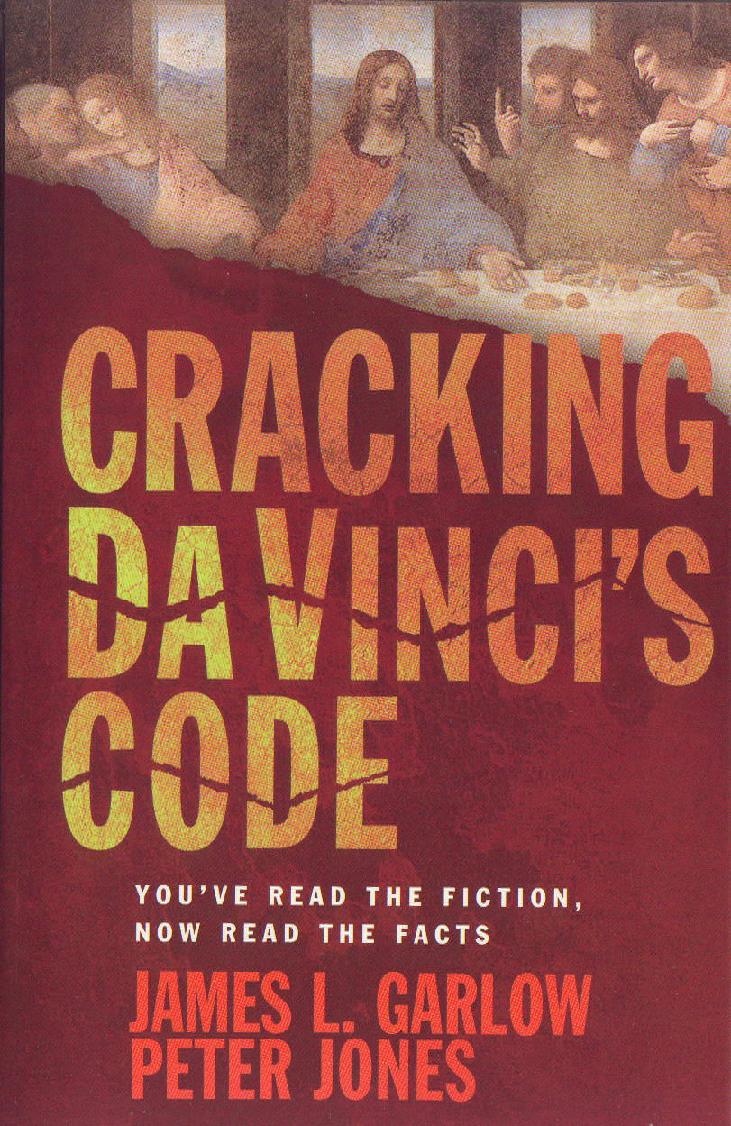
For Further Reading

Slide 31
The End
Evidence on the NT Canon
Does Not Support
The Da Vinci Code

