Slide 1


The Da Vinci Code: What to Make of It?
Robert C. Newman

Slide 2
What’s the Buzz?
The Da Vinci Code is a novel that has attracted an enormous amount of attention:
  A murder mystery
  Of the thriller sort
  Containing 454 pages in 105 short chapters
  A real page-turner!
Yet it claims to be some sort of historical novel:
  Historically accurate
  With fictional plot and main characters
  Consider this claim it makes:

Slide 3
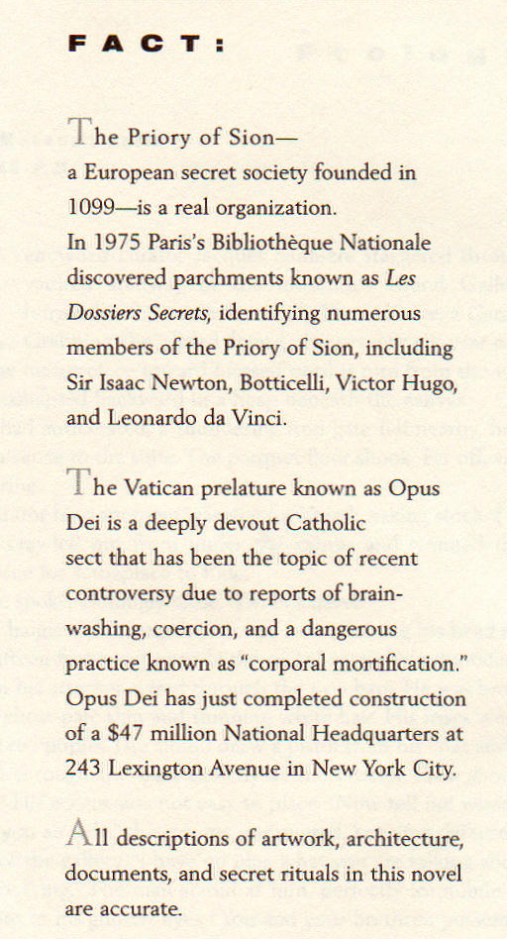
The complete text of page one of The Da Vinci Code.
The Priory of Sion – a European secret society founded in 1099 – is a real organization.
All descriptions of artwork,
architecture, documents,
and secret rituals in this
novel are accurate.

Slide 4
What’s the Buzz?
The book has sold extremely well.
  Published April 2003, immediate best-seller
  Still on NY Times best-seller list May 2006
  40 million copies sold in 44 languages
A movie based on the book has now been released.
The book is exciting & well-written (as this sort of book goes).
The book is highly controversial.

Slide 5
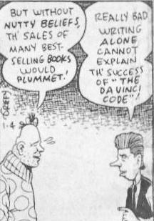
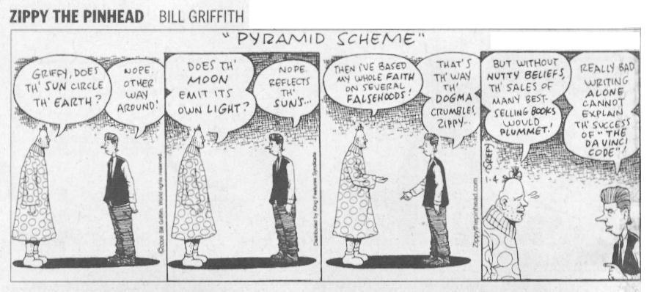
The Book is Controversial

Slide 6
The Book is Controversial
Indeed, the book’s popularity is not just its attraction as a mystery thriller.
Much of the interest surely involves its claim that traditional Christianity is a hoax.

Slide 7
The Plot of The
Da Vinci Code

Slide 8
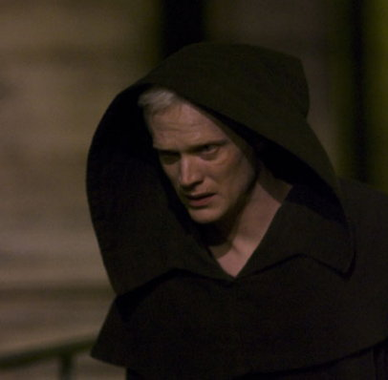
The Murder
Victim: Jacques Saunière
  Curator of the Louvre
  (Secretly) Grand Master of the Priory of Sion
Murderer: Silas
  Large albino Monk connected with Opus Dei
Master Plotter: The Teacher
  Mysterious, unseen, provides info to Silas

Slide 9
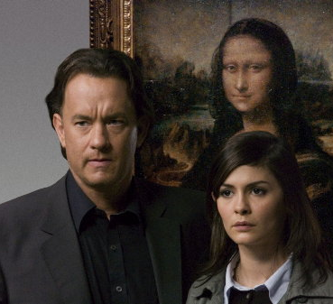
The Hero & Heroine
Robert Langdon
  Prof of Religious Symbology at Harvard
  In Paris to give a lecture when murder occurs
Sophie Neveu
  Cryptographer for French Judicial Police
  Grand-daughter of murder victim

Slide 10
The Plot
Story begins with the murder ~ 11 pm, inside the Louvre.
Langdon is awakened at his hotel an hour & a half later by a phone call from the police.
He is summoned to meet with Bezu Fache, crack investigator of the Judicial Police, at the scene of the crime.
Fache secretly suspects Langdon, as Langdon’s name was in Saunière’s calendar for a meeting earlier that evening.

Slide 11
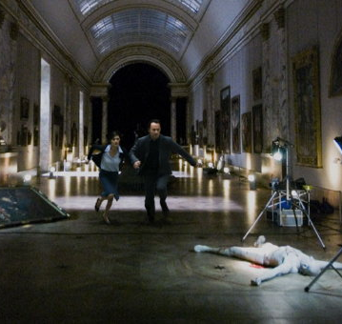
The Murder Scene
Saunière has been found dead, naked, and lying in a pose that matches that of Da Vinci’s “Vitruvian Man.”
In the few minutes between being shot & dying, he managed to leave several cryptic clues about what is going on.

Slide 12
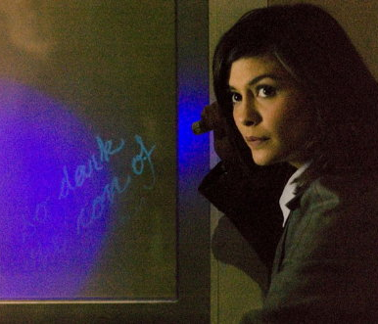
The Plot Thickens
As the police prepare to arrest Langdon, Sophie manages to spirit him away.
They decipher clues her grandfather has left behind.
These involve a secret group guarding a devastating secret about the Church.

Slide 13
The Plot Moves On
The rest of the book is a combination of their flight from the French police (and from Silas the murderer), while simultaneously seeking to locate and decipher the clues Saunière has left behind to direct them to the Grail.
In the course of their flight, Sophie and Langdon travel to several places in France, then to London, and finally to Scotland.

Slide 14
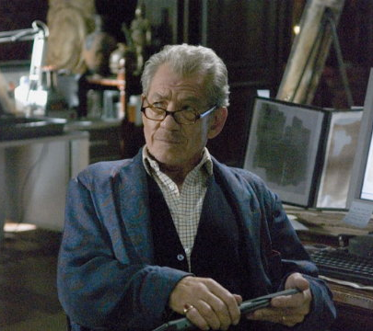
Sir Leigh Teabing
They seek out Leigh Teabing, ex-British Royal Historian, who lives in a chateau outside Paris.
Teabing is one of the world’s experts on the Grail & Priory of Sion.
Teabing fills them in on the Grail secret.

Slide 15
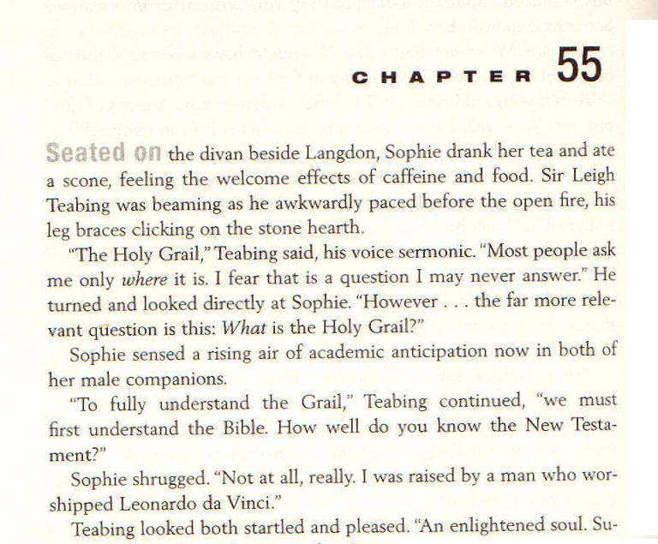
Page 230
What is the Holy Grail?

Slide 16
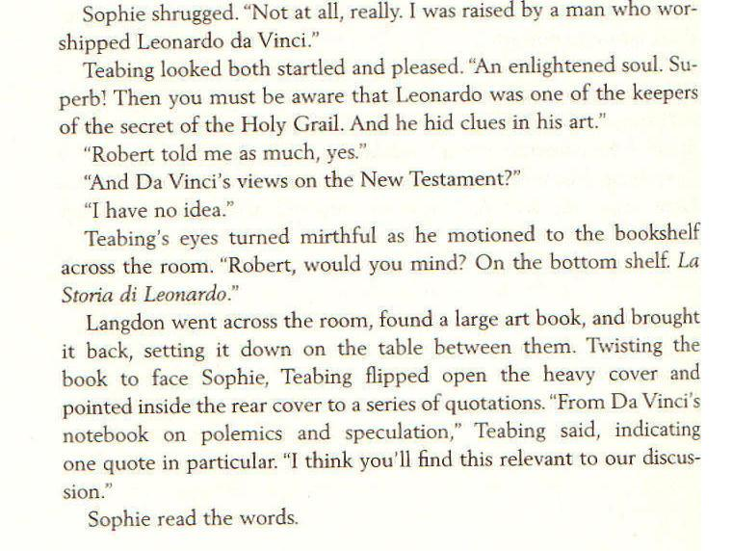
Page 230
Leonardo da Vinci one of the keepers of the secret of the Holy Grail. He hid clues in his art.

Slide 17
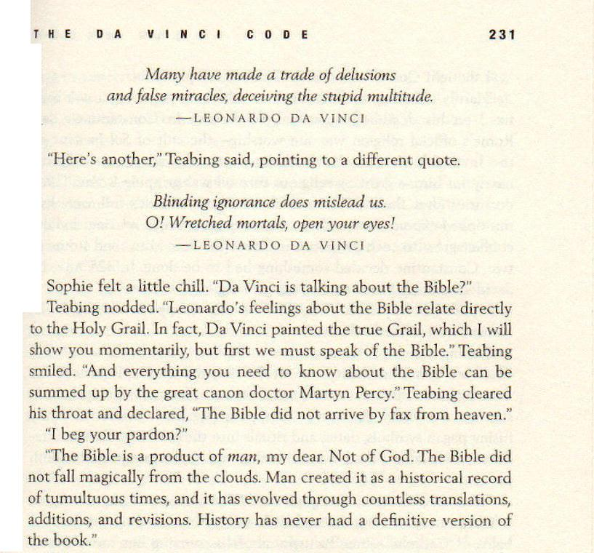
The Bible is a product of man … Not of God.

Slide 18
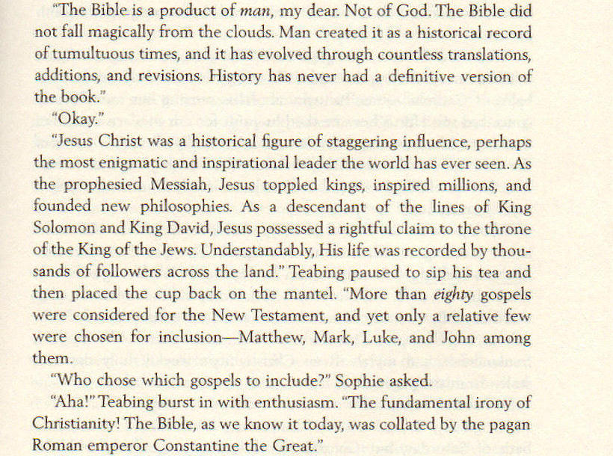
p 231
More than 80 Gospels were considered for the New Testament…

Slide 19
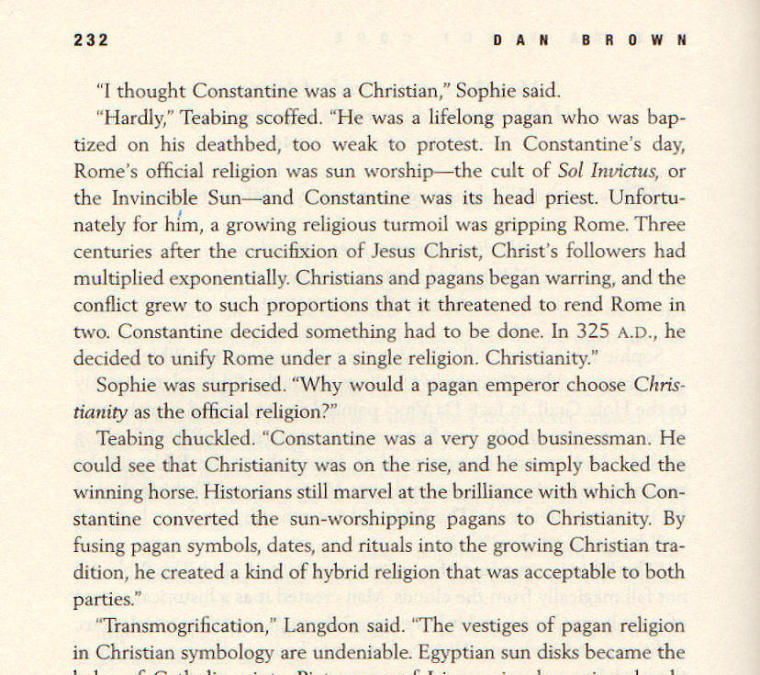
Constantine a lifelong pagan… baptized on his deathbed, too weak to protest

Slide 20
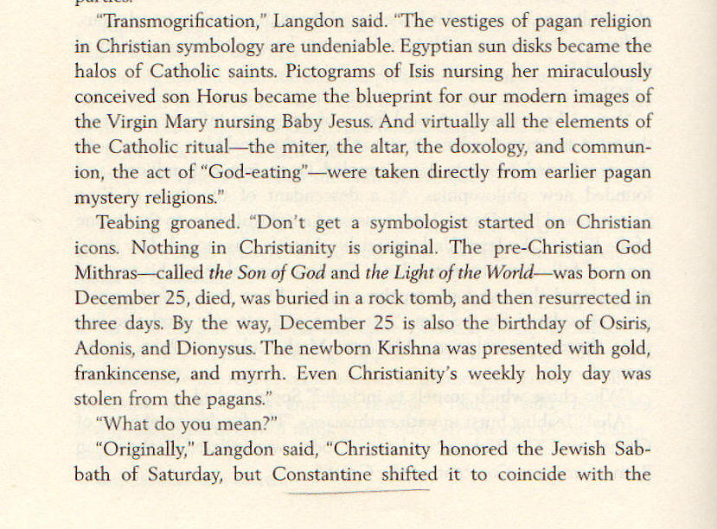
p 232
Nothing in Christianity is original

Slide 21
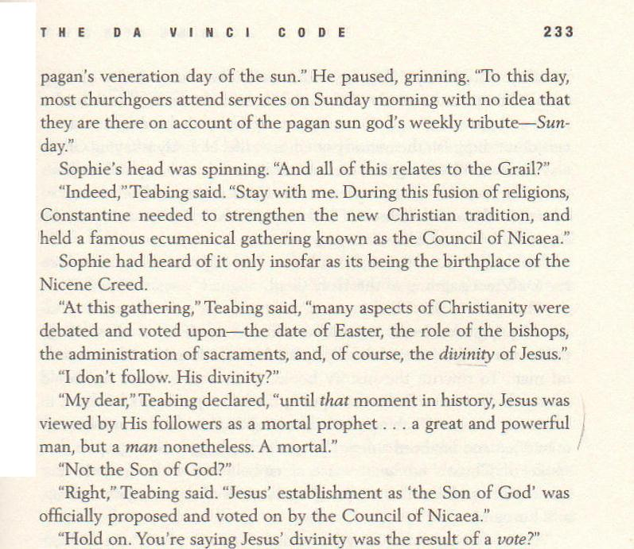
Jesus’ establishment as the Son of God was proposed & voted on by the Council of Nicaea

Slide 22
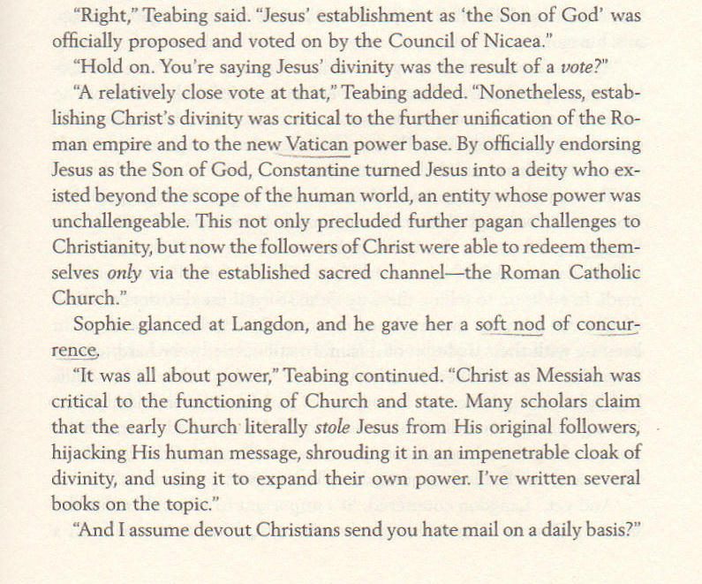
p 233
A relatively close
vote at that

Slide 23
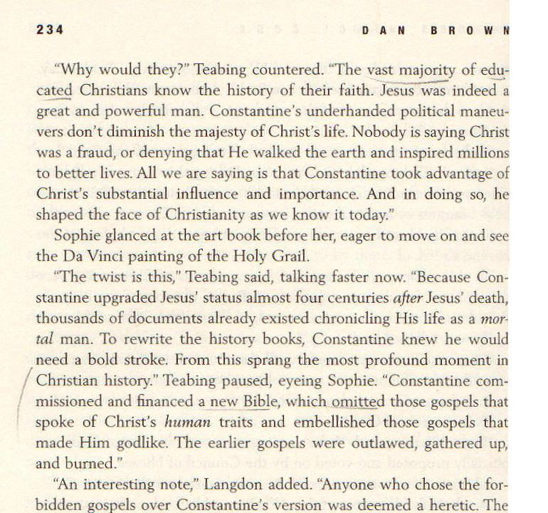
Constantine commissioned … a new Bible

Slide 24
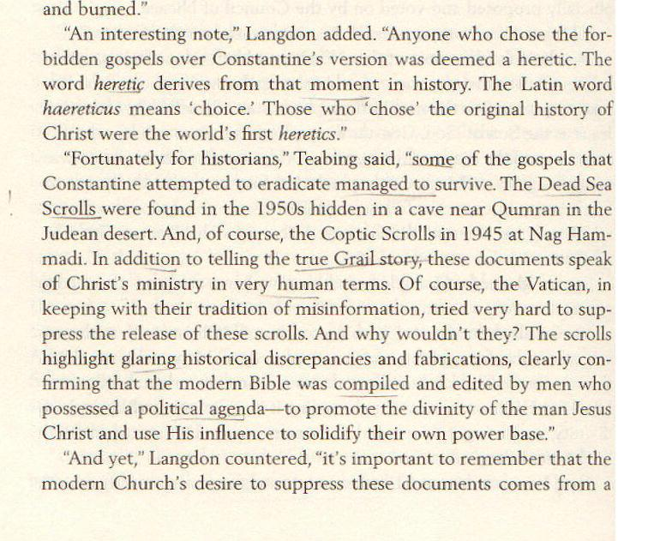
p 234
Some of the gospels managed to survive … The Dead Sea Scrolls … the Coptic Scrolls at Nag Hammadi

Slide 25
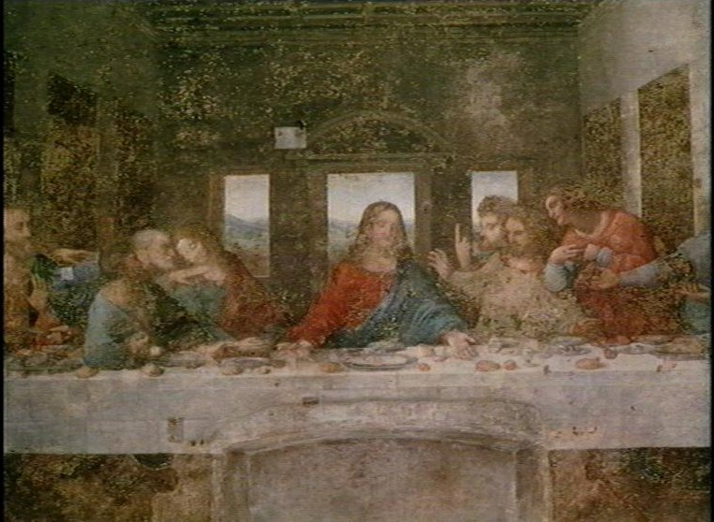
Da Vinci’s Last Supper
Teabing goes on to explain how Leonardo da Vinci has hidden clues in his famous paintings.
He says the figure thought to be St John is really Mary Magdalene, Jesus’ wife & mother of his child Sarah.

Slide 26
The Rest of the Plot
We won’t spoil the story by revealing how the book ends.
But after Jesus’ death, we are told, Mary M & Sarah were hidden away in France.
The church covered this up; male leadership took over & reconfigured Mary Magdalene as a prostitute, rejecting the sacred feminine.

Slide 27
Questions Raised by
The Da Vinci Code

Slide 28
Questions Raised
Include topics such as:
Christology
Scripture
Church History
Various others:
  Mary Magdalene
  Leonardo Da Vinci
  The Templars
  The Priory of Sion

Slide 29
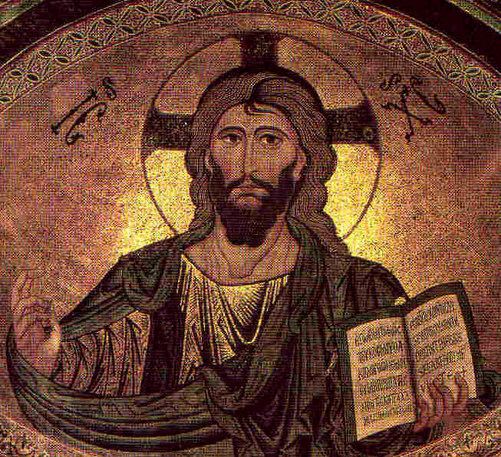
Questions about
Jesus Christ
Who was Jesus?
  Was he merely a human?
  Was his status upgraded by Constantine?
Was he raised from the dead after his crucifixion?
Did Jesus really marry?
Did he & Mary Magdalene have a child?

Slide 30
Questions about the Bible
Is our Bible very different from the one the early Christians had?
Did Constantine prepare a new Bible?
Did he destroy the Gospels which pictured a merely human Jesus?
Did he modify the Gospels in our Bible to make Jesus look divine?
What about the Gnostic Gospels?

Slide 31
Questions about
Church History
What happened at the Council of Nicea?
Was Constantine a Christian?
Did the Roman Catholic Church adopt many features from paganism?
Has it been covering up a huge secret for nearly 2000 years?

Slide 32
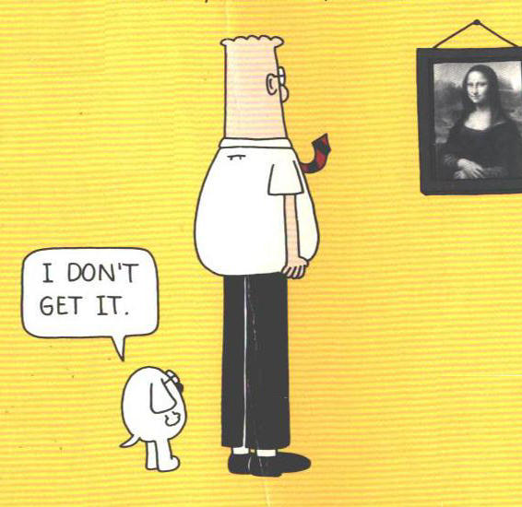
Miscellaneous questions
What do we know of Mary Magdalene?
Did Leonardo Da Vinci hide clues that reveal the secret of the Holy Grail?
What do we know about the Templars?
What do we know of the Priory of Sion?

Slide 33
Let’s Get
Started!

Slide 34
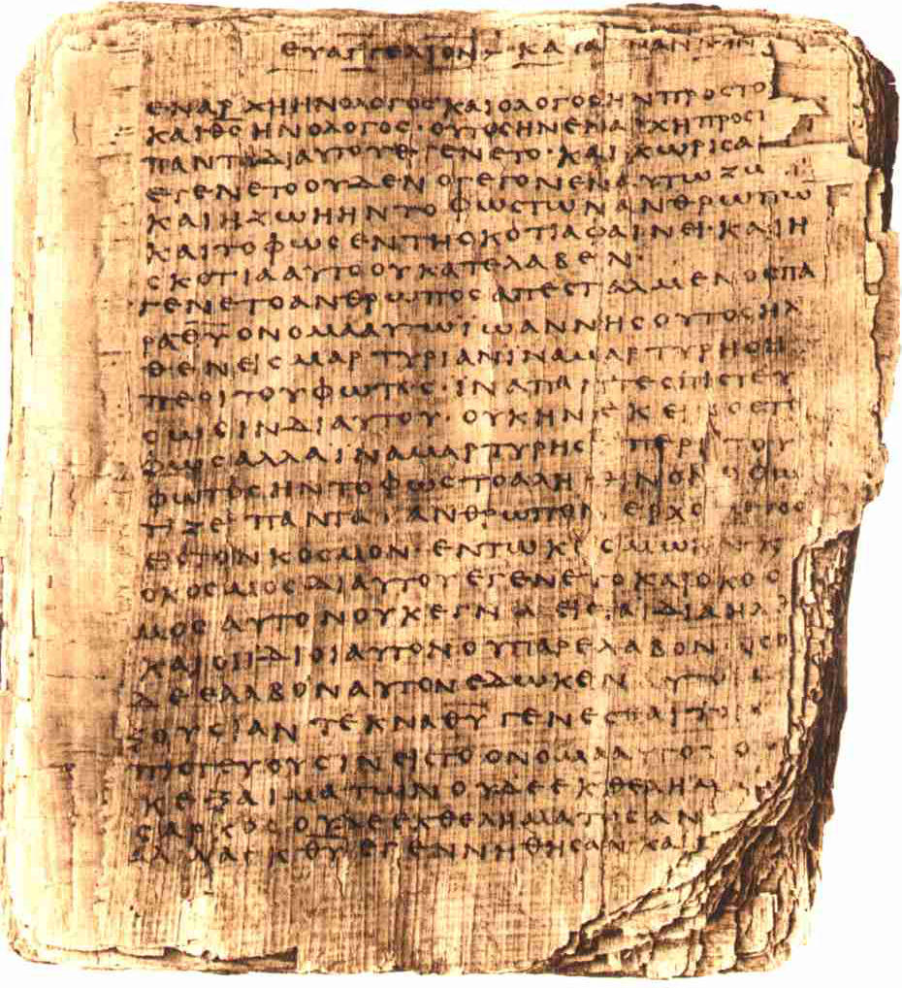
Evidence from the
New Testament

Slide 35
Jesus: What Says the Bible?
Who is Jesus?
  Jesus is human, but not just human.
  Jesus is also God.
He was raised from the dead after his crucifixion.
The Bible says nothing about Jesus having married.

Slide 36
Who is Jesus? Mark’s Testimony
Mark 1:1 (NIV) The beginning of the gospel about Jesus Christ, the Son of God. {[1] Some manuscripts do not have the Son of God.}
Mark 2:5-12 (NIV) When Jesus saw their faith, he said to the paralytic, "Son, your sins are forgiven." 6 Now some teachers of the law were sitting there, thinking to themselves, 7 "Why does this fellow talk like that? He's blaspheming! Who can forgive sins but God alone?" 8 Immediately Jesus knew in his spirit that this was what they were thinking in their hearts, and he said to them, "Why are you thinking these things? 9 Which is easier: to say to the paralytic, `Your sins are forgiven,' or to say, `Get up, take your mat and walk'? 10 But that you may know that the Son of Man has authority on earth to forgive sins . . . ." He said to the paralytic, 11 "I tell you, get up, take your mat and go home." 12 He got up, took his mat and walked out in full view of them all. This amazed everyone and they praised God, saying, "We have never seen anything like this!"

Slide 37
Mark’s Testimony
Mark 2:27-28 (NIV) Then he said to them, "The Sabbath was made for man, not man for the Sabbath. 28 So the Son of Man is Lord even of the Sabbath."
Mark 4:41 (NIV) They were terrified and asked each other, "Who is this? Even the wind and the waves obey him!"
Mark 15:39 (NIV) And when the centurion, who stood there in front of Jesus, heard his cry and {[39] Some manuscripts do not have heard his cry and.}saw how he died, he said, "Surely this man was the Son {[39] Or a son}of God!"

Slide 38
Who is this “Son of Man”?
Daniel 7:13-14 (NIV) "In my vision at night I looked, and there before me was one like a son of man, coming with the clouds of heaven. He approached the Ancient of Days and was led into his presence.
14 He was given authority, glory and sovereign power; all peoples, nations and men of every language worshiped him. His dominion is an everlasting dominion that will not pass away, and his kingdom is one that will never be destroyed.

Slide 39
Who is Jesus?
Mark 14:60 (NIV) Then the high priest stood up before them and asked Jesus, "Are you not going to answer? What is this testimony that these men are bringing against you?" 61 But Jesus remained silent and gave no answer. Again the high priest asked him, "Are you the Christ, {[61] Or Messiah} the Son of the Blessed One?" 62 "I am," said Jesus. "And you will see the Son of Man sitting at the right hand of the Mighty One and coming on the clouds of heaven." 63 The high priest tore his clothes. "Why do we need any more witnesses?" he asked.
64 "You have heard the blasphemy. What do you think?" They all condemned him as worthy of death.

Slide 40
John’s Testimony
John 1:1-4 (NIV) In the beginning was the Word, and the Word was with God, and the Word was God. 2 He was with God in the beginning. 3 Through him all things were made; without him nothing was made that has been made. 4 In him was life, and that life was the light of men.
John 1:14 (NIV) The Word became flesh and made his dwelling among us. We have seen his glory, the glory of the One and Only, {[14] Or the Only Begotten} who came from the Father, full of grace and truth.

Slide 41
Paul’s Testimony
Col 1:15-20 (NIV) He is the image of the invisible God, the firstborn over all creation. 16 For by him all things were created: things in heaven and on earth, visible and invisible, whether thrones or powers or rulers or authorities; all things were created by him and for him. 17 He is before all things, and in him all things hold together. 18 And he is the head of the body, the church; he is the beginning and the firstborn from among the dead, so that in everything he might have the supremacy. 19 For God was pleased to have all his fullness dwell in him, 20 and through him to reconcile to himself all things, whether things on earth or things in heaven, by making peace through his blood, shed on the cross.

Slide 42
Paul’s Summary
Rom 9:3-5 (NIV) For I could wish that I myself were cursed and cut off from Christ for the sake of my brothers, those of my own race, 4 the people of Israel. Theirs is the adoption as sons; theirs the divine glory, the covenants, the receiving of the law, the temple worship and the promises. 5 Theirs are the patriarchs, and from them is traced the human ancestry of Christ, who is God over all, forever praised! {[5] Or Christ, who is over all. God be forever praised! Or Christ. God who is over all be forever praised!}Amen.

Slide 43
The Testimony of Hebrews
Heb 1:1-4 (NIV) In the past God spoke to our forefathers through the prophets at many times and in various ways, 2 but in these last days he has spoken to us by his Son, whom he appointed heir of all things, and through whom he made the universe.
3 The Son is the radiance of God's glory and the exact representation of his being, sustaining all things by his powerful word. After he had provided purification for sins, he sat down at the right hand of the Majesty in heaven. 4 So he became as much superior to the angels as the name he has inherited is superior to theirs.

Slide 44
Hebrews on His Humanity
Heb 7:11-14 (NIV) If perfection could have been attained through the Levitical priesthood (for on the basis of it the law was given to the people), why was there still need for another priest to come--one in the order of Melchizedek, not in the order of Aaron?
12 For when there is a change of the priesthood, there must also be a change of the law. 13 He of whom these things are said belonged to a different tribe, and no one from that tribe has ever served at the altar. 14 For it is clear that our Lord descended from Judah, and in regard to that tribe Moses said nothing about priests.

Slide 45
Jesus: What Says the Bible?
So, Who is Jesus?
  Jesus is human, but not just human.
  Jesus is also God.
Let us next consider:
He was raised from the dead after his crucifixion.
The Bible says nothing about Jesus having married.

Slide 46
He Was Raised from the Dead
This is the uniform testimony of the New Testament:
Post-resurrection appearances are narrated in all four Gospels and Acts.
Post-resurrection appearances are also listed in 1 Corinthians 15.
His resurrection (or second coming) is referred to in nearly all of the other NT books.
  All but Philemon, 2 John, 3 John

Slide 47
Was Jesus Married?
If he was, this would not be a problem for the orthodox view of Jesus, in spite of the allegations Dan Brown makes.
The Bible teaches that Jesus was fully human, so he certainly could have married.
There is no specific statement in the Bible one way or the other whether Jesus was married, but the evidence suggests he was not.

Slide 48
Was Jesus Married?
Some have suggested that the wedding at Cana (John 2) was Jesus’ wedding:
  Mormons (Joseph Smith, at least)
  Authors of Holy Blood, Holy Grail
This is hardly likely:
  Jesus is invited to the wedding!
  He answers his mother’s request about the lack of wine with, “Why involve me?”
  The narrator distinguishes him from the bridegroom.

Slide 49
Was Jesus Married?
Though marriage was common in Jesus’ day (especially among Jews), it was not universal:
  Essenes/Qumran sect
  Therapeutae
It does not appear that John the Baptist or Paul were married.
Paul’s remarks (1 Cor 7) suggest he viewed singleness as more appropriate for special dedicated service to God.

Slide 50
Paul on Marriage
1Cor 7:32 (NIV) I would like you to be free from concern. An unmarried man is concerned about the Lord's affairs--how he can please the Lord. 33 But a married man is concerned about the affairs of this world--how he can please his wife– 34 and his interests are divided. An unmarried woman or virgin is concerned about the Lord's affairs: Her aim is to be devoted to the Lord in both body and spirit. But a married woman is concerned about the affairs of this world--how she can please her husband. 35 I am saying this for your own good, not to restrict you, but that you may live in a right way in undivided devotion to the Lord.

Slide 51
Paul’s List of Married People
Doesn’t Include Jesus
1Cor 9:1 (NIV) Am I not free? Am I not an apostle? Have I not seen Jesus our Lord? Are you not the result of my work in the Lord? 2 Even though I may not be an apostle to others, surely I am to you! For you are the seal of my apostleship in the Lord.
3 This is my defense to those who sit in judgment on me. 4 Don't we have the right to food and drink?
5 Don't we have the right to take a believing wife along with us, as do the other apostles and the Lord's brothers and Cephas{[5] That is, Peter}?
6 Or is it only I and Barnabas who must work for a living?

Slide 52
At Jesus’ Crucifixion
Jesus commits his mother Mary to the care of the apostle John.
He does nothing of the sort with Mary Magdalene, which is strange if she is really his wife!
Likewise, no arrangements are made for his alleged child.

Slide 53
Mary Magdalene?
None of the references to her in the NT suggest she is Jesus’ wife, which is very surprising if she was. Women were usually identified by their relationships.
Nor does the NT say she was a prostitute; this is an guess made later by combining some NT accounts.
She is pictured as having been delivered from seven demons, though the details of her deliverance are not narrated.

Slide 54

Summary on the
New Testament
So, the NT, as we have it, does not support Dan Brown’s claims about Jesus nor about Mary Magdalene.
But maybe this is part of the church’s cover-up!
This brings us to Brown’s allegations about the Bible.

Slide 55
Questions about the Bible
Is our Bible very different from the one the early Christians had?
Did Constantine prepare a new Bible?
Did he destroy the Gospels which pictured a merely human Jesus?
Did he modify the Gospels in our Bible to make Jesus look divine?
What about the Gnostic Gospels?

Slide 56
Is Our Bible Very Different?
Yes and No.
Yes, the earliest Christians had only the Old Testament until the NT was written.
No, there is no evidence that the NT books have been tampered with to produce a different Jesus than they originally gave.
Consider the Gospels:

Slide 57
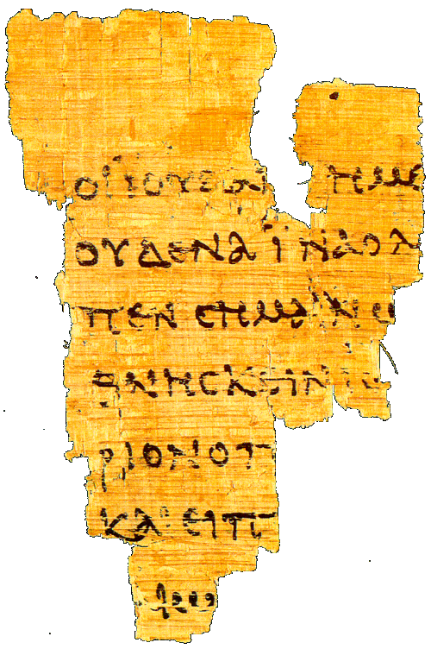
Early Manuscripts of the Gospels
The graph at right lists the number of surviving manuscripts written on papyrus for the four Gospels.
The light blue indicates the number from before AD 300, and thus before Constantine. There are 22 of these.

Slide 58
Summary on Gospels
Comparing these 22 manuscripts and fragments with Gospel manuscripts from Constantine’s time and later, we see no such variations as would make Jesus divine in the later texts but merely human in the earlier ones.
Thus it does not appear that Constantine modified the Gospels in our Bible to make Jesus look divine.
He could at most have selected those Gospels which served his purposes.
Did he?

Slide 59
Summary on Canon
The canon of the NT is the list of those books which Christians believe were inspired by God & given by him to his people to tell about Jesus.
Before the time of Constantine, we have abundant evidence that the recognized Gospels included our four Gospels and no others.
Some samples:

Slide 60
Irenaeus (~180)
Irenaeus was bishop of Lyons in southern France, but he grew up in Asia Minor, an early stronghold of Christianity.
He had studied under two students of the apostle John — Papias and Polycarp.
He wrote an extensive book Against Heresies, responding to the Gnostics, quoting from all the NT but a few of the shorter letters.

Slide 61
Irenaeus (~180)
Irenaeus takes our four Gospels for granted, and even seeks to give symbolic reasons for why there are exactly four of them.
He also says, “So firm is the ground upon which these Gospels rest, that the very heretics themselves bear witness to them, and starting from these documents, each one of them endeavors to establish his own peculiar doctrine.”
This is ~145 years before Constantine and the Council of Nicea.

Slide 62
Origen (~230)
In Caesarea, Origen develops the largest Christian library in antiquity.
He gives us the status of the canon question in his time. Two categories were commonly recognized by the orthodox:
  Books acknowledged by all Christians (21)
    4 Gospels, Acts, 13 Paul, 1 Peter, 1 John, Revelation
  Books disputed by some Christians (10)
    Hebrews, James, 2 Peter, 2-3 John, Jude,
    Ps-Barnabas, Hermas, Didache, Gospel of Hebrews
This is a century before Constantine!

Slide 63
Eusebius (~325)
Writing at Constantine’s time.
Four categories for canon discussion then:
  Acknowledged (21-22)
    Gospels, Acts, Paul + Hebrews, 1 Peter, 1 John, Revelation (?)
  Disputed but familiar to most (5)
    James, 2 Peter, 2-3 John, Jude
  Spurious but orthodox
    Acts of Paul, Hermas, Apoc of Peter, Ps-Barnabas
    Didache, Revelation (?), Gospel of Hebrews
  Heretical
    Gospels of Peter, Thomas, Matthaias, etc.
    Acts of Andrew, John, etc.

Slide 64
Summary on Canon
The evidence is clear that Constantine did not suddenly set off in a new direction, putting together a new Bible.
Rather, the four Gospels had been recognized by orthodox Christians as authoritative for at least 150 years.
Final decisions on the exact boundaries of the NT canon are made in the generation following Constantine, but this involves only one book that could be called a gospel, the Gospel of the Hebrews, not one used by Dan Brown.

Slide 65
Summary on NT Evidence
The teaching of the NT does not favor Brown’s views.
The NT manuscripts give no evidence of the sort of tampering Brown alleges.
The four canonical Gospels of the NT were recognized by the middle of the 2nd century at latest, about 150 years before Constantine.

Slide 66
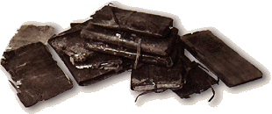
What about the Gnostic Gospels?
Good question!
All of these seem to be much later than our canonical (NT) Gospels, probably none before AD 140.
None of them picture a “more human” Jesus than do the NT Gospels.
On the contrary, their picture is less human, though not fully God either (as we use the term). Jesus is some sort of spirit being.

Slide 67
Questions about
Church History
What happened at the Council of Nicea?
Was Constantine a Christian?
Did the Roman Catholic Church adopt many features from paganism?
Has it been covering up a huge secret for nearly 2000 years?

Slide 68
What happened at the
Council of Nicea?
In 325 AD ~300 bishops from all over the Roman Empire gathered at Constantine’s request to settle a number of disputes.
The Christological question at this council was not whether Jesus was man or God.
  All agreed Jesus was human.
  The dispute was whether he was also uncreated God or a created god.
That he was uncreated God won by 300 to 2, not exactly “a relatively close vote”!

Slide 69
Was Constantine a Christian?
We cannot see inside people to tell what they really believe.
From external evidence, It looks like he became a Christian, probably after he was emperor.
Only ~10% of the Empire appears to have been Christian by 312 AD, so he was not obviously “backing the winning side.”
His “death-bed” baptism was not uncommon at that time for those who became believers as adults, since there was fear of committing an unpardonable sin after baptism.

Slide 70
Did the Roman Catholic Church adopt features from paganism?
Yes, Christianity in a culture typically adopts some features from that culture.
Since the Bible is not a picture book, artistic elements came from Roman culture: halos, cherubs, mother & child, good shepherd.
Christianity adopted certain features of liturgical dress, etc. from its culture also.
The same is true of the liturgical calendar.

Slide 71
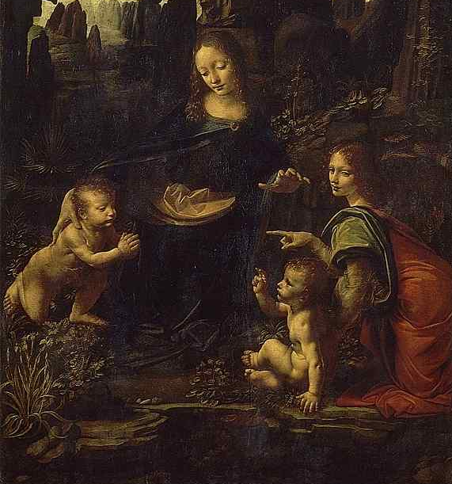
Miscellaneous questions
What do we know of Mary Magdalene?
Did Leonardo Da Vinci hide clues that reveal the secret of the Holy Grail?
What do we know about the Templars?
What do we know of the Priory of Sion?

Slide 72
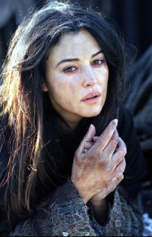
Mary Magdalene
As noted above, the New Testament gives no reason to believe she was married to Jesus.
The traditions we have about her differ in Eastern and Western Christendom, but none of them have her married at all, much less to Jesus.

Slide 73
Eastern Church Tradition
Mary followed the apostle John to Ephesus, where she died.
Modestus (~625) says she was a virgin throughout her life, and that she was martyred.
Her relics were later transferred to Constantinople by the emperor Leo 6 (ruled 886-912).

Slide 74
Western Church Tradition
Mary M belonged to a wealthy family with estates at Magdala & Bethany.
She went astray & tempted others, but was saved by Jesus.
In the persecution over Stephen, she and some others were set adrift in a boat on the Mediterranean.
Without oar or sail, they reached Marseilles, France.

Slide 75
Western Church Tradition
In Marseilles, through preaching and miracles, the pagans were saved.
Lazarus became their first bishop.
Mary went off to the wilderness and lived a monastic life for 30 years.
She was carried up to heaven by angels.
Her relics (!) are venerated at Aix.

Slide 76
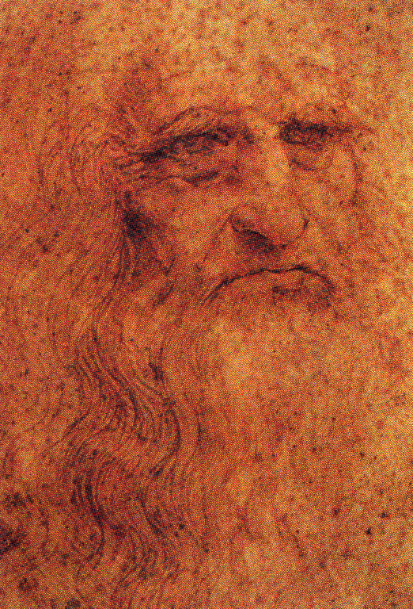
Leonardo da Vinci
Did he hide clues in his paintings re/ the secret of Jesus’ marriage?
Is the figure to Jesus’ right (our left) in The Last Supper really a woman?
Was Leonardo a grand master of the Priory of Sion, which guarded this secret?

Slide 77
The Last Supper, 1498

Slide 78
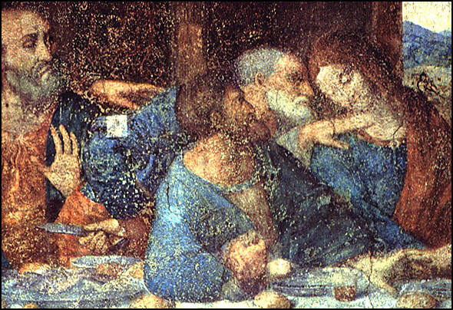
Detail before restoration

Slide 79
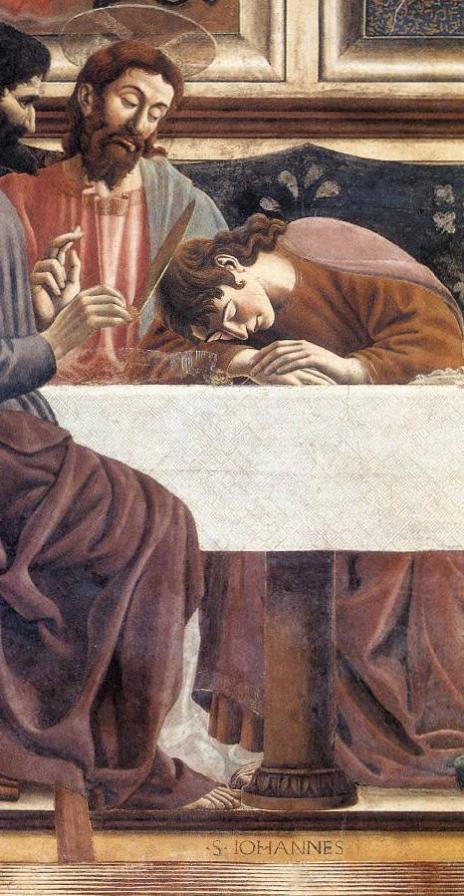
Del Castagno, 1447
Andrea del
Castagno,
1390-1457,
Florentine
painter

Slide 80
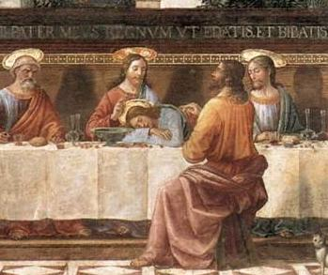
Ghirlandaio, 1486
Domenico Ghirlandaio,1449-1494, Florentine painter

Slide 81
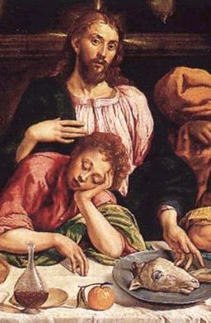
Da Ponte, 1542
Giacomo da Ponte, 1510-1592, Venetian painter

Slide 82
The secret of The Last Supper
John is traditionally shown as beardless and somewhat effeminate-looking in paintings of this period.
Leonardo’s painting depicts not the Eucharist, but the moment when Jesus has just said someone will betray him, and Peter is leaning over to John (with a knife in his hand) to find out who it is.
Judas, holding the money bag, is between them, within easy striking distance!

Slide 83
Detail before restoration
Peter
John
Judas

Slide 84
The Priory of Sion
Appears to be a hoax, an up-scaled version of an organization founded in 1956 to provide low-cost housing in France.
One of the founders, Pierre Plantard, later claimed it was founded in 1099. He appears to have invented the list of Grand Masters and viewed himself as an heir of the Merovingian line of French kings.

Slide 85
Summary
The Da Vinci Code is a complex mixture of fact and fiction that is difficult to untangle without considerable knowledge in many fields.
Were it not for the fact that it tends to turn people away from the real Jesus, there would be no reason to worry about it any more than multitudes of other conspiracy theories.

Slide 86
The Da Vinci Code:
A Hoax Packaged as an Exciting Mystery Thriller
Don’t let it keep you from the real Jesus!

