Slide 1
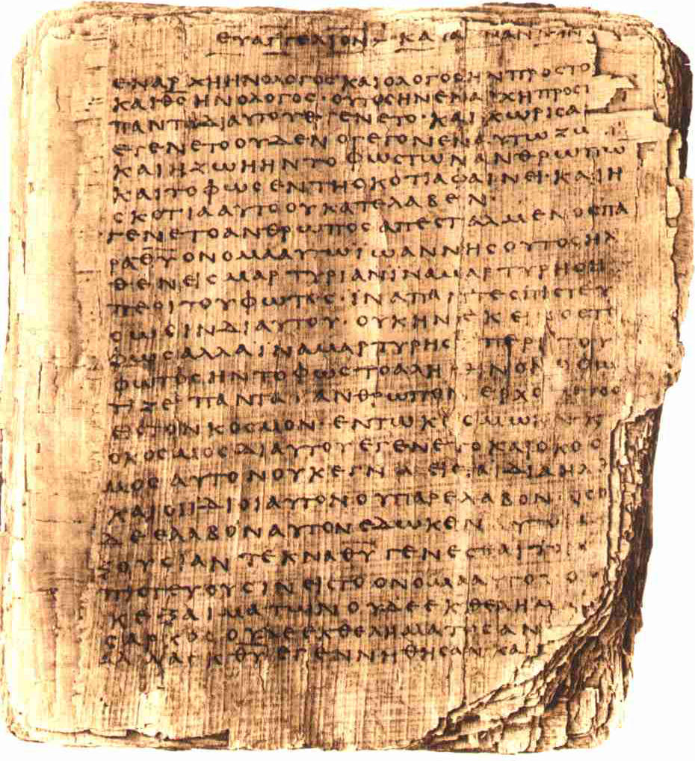

The DaVinci Code:
Evidence from the
New Testament
Robert C. Newman

Slide 2
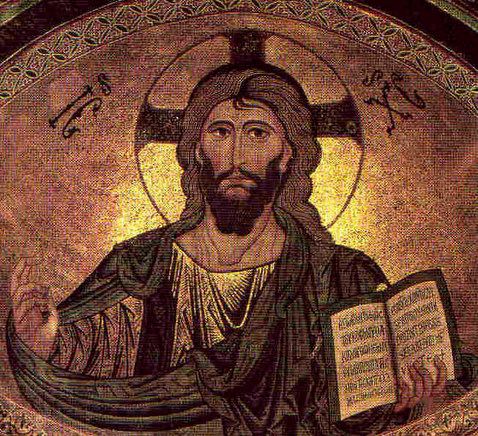
Questions about
Jesus Christ
Who was Jesus?
  Was he merely a human?
  Was his status upgraded by Constantine?
Was he raised from the dead after his crucifixion?
Did Jesus really marry?
Did he & Mary Magdalene have a child?

Slide 3
Questions about the Bible
Is our Bible very different from the one the early Christians had?
Did Constantine prepare a new Bible?
Did he destroy the Gospels which pictured a merely human Jesus?
Did he modify the Gospels in our Bible to make Jesus look divine?
What about the Gnostic Gospels?

Slide 4
Jesus: What Says the Bible?
Who is Jesus?
  Jesus is human, but not just human.
  Jesus is also God.
He was raised from the dead after his crucifixion.
The Bible says nothing about Jesus having married.

Slide 5
Who is Jesus? Mark's Testimony
Mark 1:1 (NIV) The beginning of the gospel about Jesus Christ, the Son of God. {[1] Some manuscripts do not have the Son of God.}
Mark 2:5-12 (NIV) When Jesus saw their faith, he said to the paralytic, "Son, your sins are forgiven." 6 Now some teachers of the law were sitting there, thinking to themselves, 7 "Why does this fellow talk like that? He's blaspheming! Who can forgive sins but God alone?" 8 Immediately Jesus knew in his spirit that this was what they were thinking in their hearts, and he said to them, "Why are you thinking these things? 9 Which is easier: to say to the paralytic, 'Your sins are forgiven,' or to say, 'Get up, take your mat and walk'? 10 But that you may know that the Son of Man has authority on earth to forgive sins . . . ." He said to the paralytic, 11 "I tell you, get up, take your mat and go home." 12 He got up, took his mat and walked out in full view of them all. This amazed everyone and they praised God, saying, "We have never seen anything like this!"

Slide 6
Mark's Testimony
Mark 2:27-28 (NIV) Then he said to them, "The Sabbath was made for man, not man for the Sabbath. 28 So the Son of Man is Lord even of the Sabbath."
Mark 4:41 (NIV) They were terrified and asked each other, "Who is this? Even the wind and the waves obey him!"
Mark 15:39 (NIV) And when the centurion, who stood there in front of Jesus, heard his cry and {[39] Some manuscripts do not have heard his cry and.}saw how he died, he said, "Surely this man was the Son {[39] Or a son}of God!"

Slide 7
Who is this "Son of Man"?
Daniel 7:13-14 (NIV) "In my vision at night I looked, and there before me was one like a son of man, coming with the clouds of heaven. He approached the Ancient of Days and was led into his presence.
14 He was given authority, glory and sovereign power; all peoples, nations and men of every language worshiped him. His dominion is an everlasting dominion that will not pass away, and his kingdom is one that will never be destroyed.

Slide 8
Who is Jesus?
Mark 14:60 (NIV) Then the high priest stood up before them and asked Jesus, "Are you not going to answer? What is this testimony that these men are bringing against you?" 61 But Jesus remained silent and gave no answer. Again the high priest asked him, "Are you the Christ, {[61] Or Messiah} the Son of the Blessed One?" 62 "I am," said Jesus. "And you will see the Son of Man sitting at the right hand of the Mighty One and coming on the clouds of heaven." 63 The high priest tore his clothes. "Why do we need any more witnesses?" he asked.
64 "You have heard the blasphemy. What do you think?" They all condemned him as worthy of death.

Slide 9
John's Testimony
John 1:1-4 (NIV) In the beginning was the Word, and the Word was with God, and the Word was God. 2 He was with God in the beginning. 3 Through him all things were made; without him nothing was made that has been made. 4 In him was life, and that life was the light of men.
John 1:14 (NIV) The Word became flesh and made his dwelling among us. We have seen his glory, the glory of the One and Only, {[14] Or the Only Begotten} who came from the Father, full of grace and truth.

Slide 10
Paul's Testimony
Col 1:15-20 (NIV) He is the image of the invisible God, the firstborn over all creation. 16 For by him all things were created: things in heaven and on earth, visible and invisible, whether thrones or powers or rulers or authorities; all things were created by him and for him. 17 He is before all things, and in him all things hold together. 18 And he is the head of the body, the church; he is the beginning and the firstborn from among the dead, so that in everything he might have the supremacy. 19 For God was pleased to have all his fullness dwell in him, 20 and through him to reconcile to himself all things, whether things on earth or things in heaven, by making peace through his blood, shed on the cross.

Slide 11
Paul's Summary
Rom 9:3-5 (NIV) For I could wish that I myself were cursed and cut off from Christ for the sake of my brothers, those of my own race, 4 the people of Israel. Theirs is the adoption as sons; theirs the divine glory, the covenants, the receiving of the law, the temple worship and the promises. 5 Theirs are the patriarchs, and from them is traced the human ancestry of Christ, who is God over all, forever praised! {[5] Or Christ, who is over all. God be forever praised! Or Christ. God who is over all be forever praised!} Amen.

Slide 12
The Testimony of Hebrews
Heb 1:1-4 (NIV) In the past God spoke to our forefathers through the prophets at many times and in various ways, 2 but in these last days he has spoken to us by his Son, whom he appointed heir of all things, and through whom he made the universe.
3 The Son is the radiance of God's glory and the exact representation of his being, sustaining all things by his powerful word. After he had provided purification for sins, he sat down at the right hand of the Majesty in heaven. 4 So he became as much superior to the angels as the name he has inherited is superior to theirs.

Slide 13
Hebrews on His Humanity
Heb 7:11-14 (NIV) If perfection could have been attained through the Levitical priesthood (for on the basis of it the law was given to the people), why was there still need for another priest to come--one in the order of Melchizedek, not in the order of Aaron?
12 For when there is a change of the priesthood, there must also be a change of the law. 13 He of whom these things are said belonged to a different tribe, and no one from that tribe has ever served at the altar. 14 For it is clear that our Lord descended from Judah, and in regard to that tribe Moses said nothing about priests.

Slide 14
Jesus: What Says the Bible?
So, Who is Jesus?
  Jesus is human, but not just human.
  Jesus is also God.
Let us next consider:
He was raised from the dead after his crucifixion.
The Bible says nothing about Jesus having married.

Slide 15
He Was Raised from the Dead
This is the uniform testimony of the New Testament:
Post-resurrection appearances are narrated in all four Gospels and Acts.
Post-resurrection appearances are also listed in 1 Corinthians 15.
His resurrection (or second coming) is referred to in nearly all of the other NT books.
  All but Philemon, 2 John, 3 John

Slide 16
Was Jesus Married?
If he was, this would not be a problem for the orthodox view of Jesus, in spite of the allegations Dan Brown makes.
The Bible teaches that Jesus was fully human, so he certainly could have married.
There is no specific statement in the Bible one way or the other whether Jesus was married, but the evidence suggests he was not.

Slide 17
Was Jesus Married?
Some have suggested that the wedding at Cana (John 2) was Jesus' wedding:
  Mormons (Joseph Smith, at least)
  Authors of Holy Blood, Holy Grail
This is hardly likely:
  Jesus is invited to the wedding!
  He answers his mother’s request about the lack of wine with, "Why involve me?"
  He is distinguished from the bridegroom.

Slide 18
Was Jesus Married?
Though marriage was common in Jesus' day (especially among Jews), it was not universal:
  Essenes/Qumran sect
  Therapeutae
It does not appear that John the Baptist or Paul were married.
Paul’s remarks (1 Cor 7) suggest he viewed singleness as more appropriate for special dedicated service to God.

Slide 19
Paul on Marriage
1Cor 7:32 (NIV) I would like you to be free from concern. An unmarried man is concerned about the Lord's affairs--how he can please the Lord. 33 But a married man is concerned about the affairs of this world--how he can please his wife– 34 and his interests are divided. An unmarried woman or virgin is concerned about the Lord's affairs: Her aim is to be devoted to the Lord in both body and spirit. But a married woman is concerned about the affairs of this world--how she can please her husband. 35 I am saying this for your own good, not to restrict you, but that you may live in a right way in undivided devotion to the Lord.

Slide 20
Paul's List of Married People
Doesn't Include Jesus
1Cor 9:1 (NIV) Am I not free? Am I not an apostle? Have I not seen Jesus our Lord? Are you not the result of my work in the Lord? 2 Even though I may not be an apostle to others, surely I am to you! For you are the seal of my apostleship in the Lord.
3 This is my defense to those who sit in judgment on me. 4 Don't we have the right to food and drink?
5 Don't we have the right to take a believing wife along with us, as do the other apostles and the Lord's brothers and Cephas {[5] That is, Peter}?
6 Or is it only I and Barnabas who must work for a living?

Slide 21
Mary Magdalene?
None of the references to her in the NT suggest she is Jesus' wife.
Nor does the NT say she was a prostitute; this is an guess made later by combining some NT accounts.
She is pictured as having been delivered from seven demons, though the details of the deliverance are not narrated.

Slide 22

Summary on the
New Testament
So, the NT, as we have it, does not support Dan Brown's claims about Jesus and Mary Magdalene.
But maybe this is part of the church’s cover-up!
This brings us to Brown's allegations about the Bible.

Slide 23
Questions about the Bible
Is our Bible very different from the one the early Christians had?
Did Constantine prepare a new Bible?
Did he destroy the Gospels which pictured a merely human Jesus?
Did he modify the Gospels in our Bible to make Jesus look divine?
What about the Gnostic Gospels?

Slide 24
Is Our Bible Very Different?
Yes and No.
Yes, the earliest Christians had only the Old Testament until the NT was written.
No, there is no evidence that the NT books have been tampered with to produce a different Jesus than they originally gave.
Consider the Gospels:

Slide 25
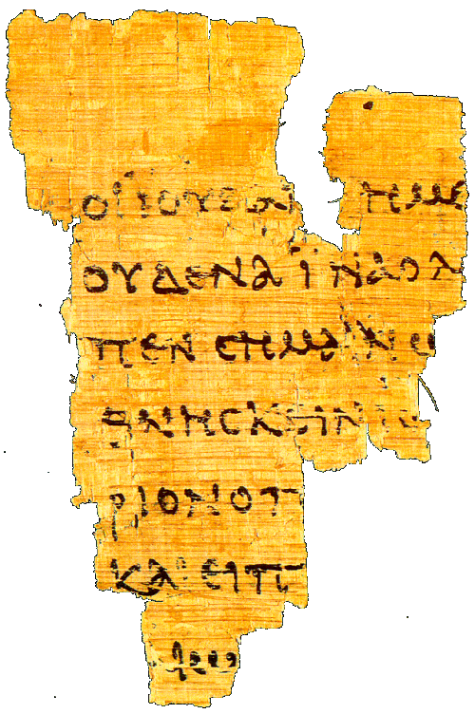
Early Manuscripts of the Gospels
The graph at right lists the number of surviving manuscripts written on papyrus for the four Gospels.
The light blue indicates the number from before AD 300, and thus before Constantine. There are 22 of these.

Slide 26
Summary on Gospels
Comparing these 22 manuscripts and fragments with Gospel manuscripts from Constantine’s time and later, we see no such variations as would make Jesus divine in the later texts but merely human in the earlier ones.
Thus it does not appear that Constantine modified the Gospels in our Bible to make Jesus look divine.
He could at most have selected those which served his purposes. Did he?
Let's see.

Slide 27
Summary on Canon
The canon of the NT is the list of those books which Christians believe were inspired by God & given by him to his people to tell about Jesus.
Before the time of Constantine, we have abundant evidence that the recognized Gospels included our four Gospels and no others.
Some samples:

Slide 28
Irenaeus (~180)
Irenaeus was bishop of Lyons in southern France, but he grew up in Asia Minor, an early stronghold of Christianity.
He had studied under two students of the apostle John — Papias and Polycarp.
He wrote an extensive book Against Heresies, responding to the Gnostics, quoting from all the NT but a few of the shorter letters.

Slide 29
Irenaeus (~180)
Irenaeus takes our four Gospels for granted, and even seeks to give symbolic reasons for why there are exactly four of them.
He also says, "So firm is the ground upon which these Gospels rest, that the very heretics themselves bear witness to them, and starting from these documents, each one of them endeavors to establish his own peculiar doctrine."
This is ~145 years before Constantine and the Council of Nicea.

Slide 30
Origen (~230)
Successor to Clement as head of the Christian school in Alexandria, Origen later moves to Caesarea, where he develops the largest Christian library in antiquity.
Origen gives some insight into the status of the canon question in his time. He notes that two categories were commonly recognized by the orthodox:
  Books acknowledged by all Christians (21)
    4 Gospels, Acts, 13 Paul, 1 Peter, 1 John, Revelation
  Books disputed by some Christians (10)
    Hebrews, James, 2 Peter, 2-3 John, Jude,
    Ps-Barnabas, Hermas, Didache, Gospel of Hebrews
This is a century before Constantine!

Slide 31
Eusebius (~325)
Writing at Constantine’s time.
Four categories for canon discussion then:
  Acknowledged (21-22)
    Gospels, Acts, Paul + Hebrews, 1 Peter, 1 John, Revelation (?)
  Disputed but familiar to most (5)
    James, 2 Peter, 2-3 John, Jude
  Spurious but orthodox
    Acts of Paul, Hermas, Apoc of Peter, Ps-Barnabas
    Didache, Revelation (?), Gospel of Hebrews
  Heretical
    Gospels of Peter, Thomas, Matthaias, etc.
    Acts of Andrew, John, etc.

Slide 32
Summary on Canon
Thus the evidence is clear that Constantine did not suddenly set off in a new direction, putting together a new Bible.
Rather, the four Gospels had been recognized by orthodox Christians as authoritative for at least 150 years.
Final decisions on the exact boundaries of the NT canon are made in the generation following Constantine, but this involves only one book that could be called a gospel, the Gospel of the Hebrews.

Slide 33
Summary on NT Evidence
The NT does not favor Brown’s views.
The NT manuscripts give no evidence of the sort of tampering Brown alleges.
The four canonical Gospels of the NT were recognized by the middle of the 2nd century at latest, about 150 years before Constantine.

Slide 34

The Evidence of the New Testament
Does not support
The DaVinci Code

