Slide 1
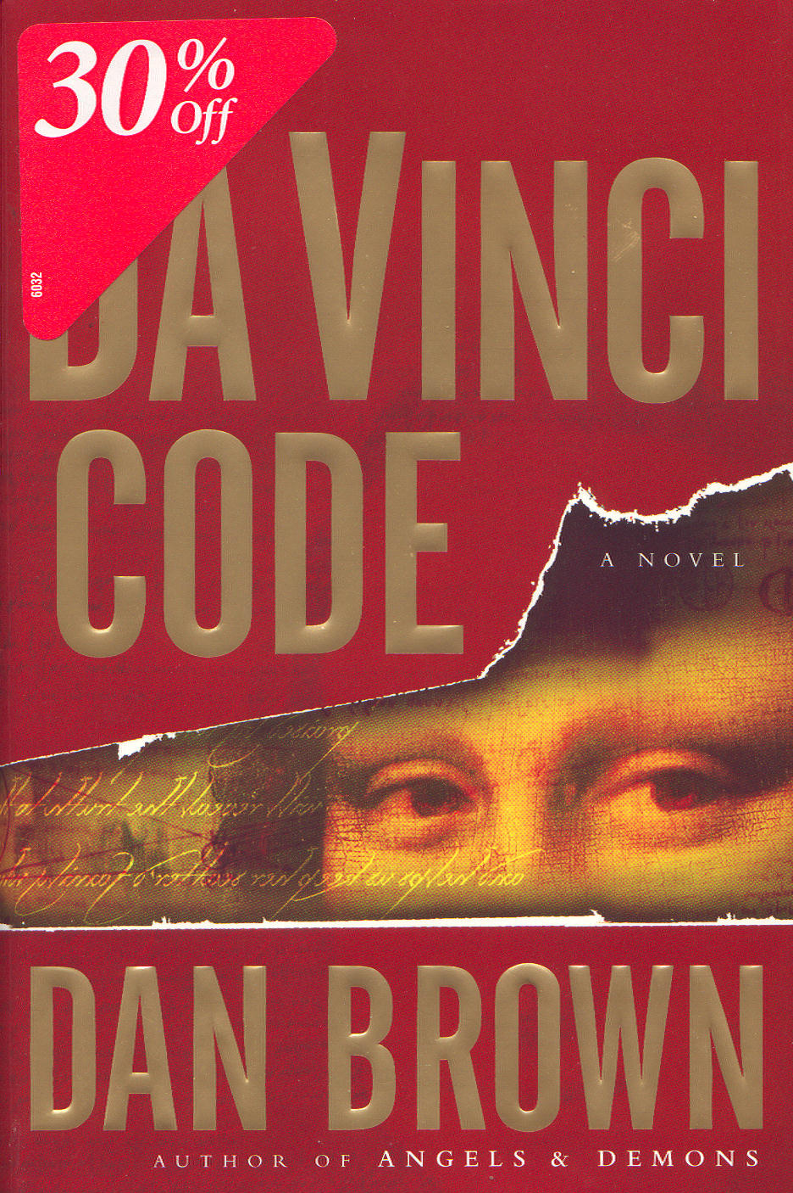

The Da Vinci Code Introduction &
Major Questions
Robert C. Newman

Slide 2
What's the Buzz?
The Da Vinci Code is a novel that has attracted an enormous amount of attention:
  A murder mystery
  Of the thriller sort
  Containing 454 pages in 105 short chapters
  A real page-turner!
Yet it claims to be a sort of historical novel:
  Historically accurate
  With fictional plot and main characters
  Consider this claim it makes:

Slide 3
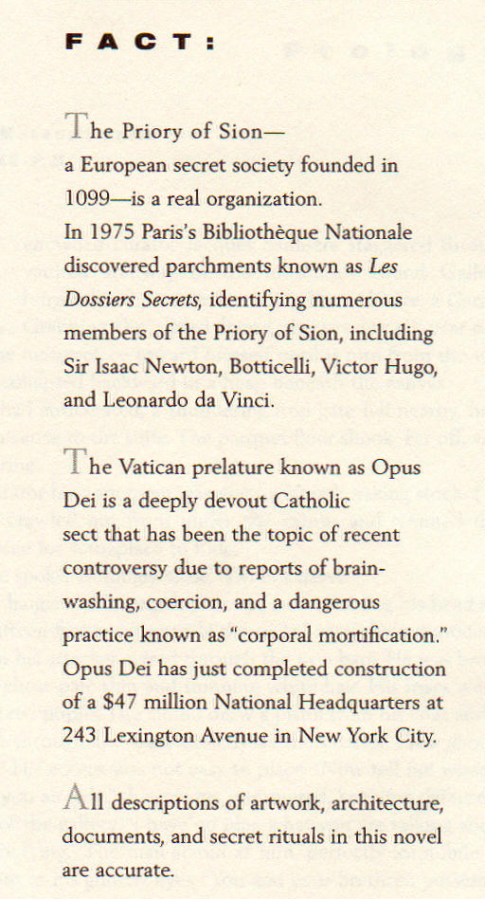
The complete text of page one of The Da Vinci Code.
The Priory of Sion – a European secret society founded in 1099 – is a real organization.
All descriptions of artwork,
architecture, documents,
and secret rituals in this
novel are accurate.

Slide 4
What's the Buzz?
The book has sold extremely well.
  Published April 2003, immediate best-seller
  Sold 40 million copies in hardback
  Still on NY Times best-seller list June 2006
A movie based on the book was released in May 2006 & did well.
The book is exciting & well-written (as this sort of book goes).
The book is highly controversial.

Slide 5
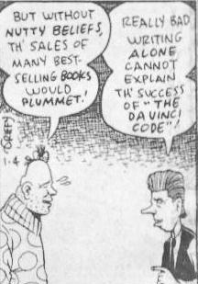
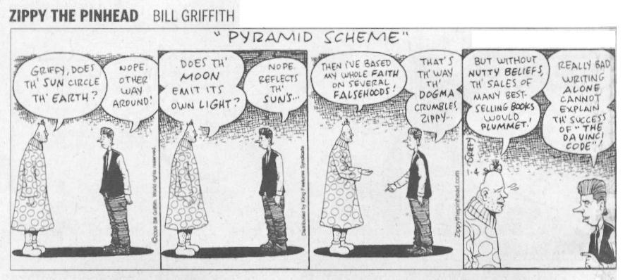
The Book is Controversial

Slide 6
The Book is Controversial
The popularity of the book is not totally about its attraction as a mystery thriller.
Much of the interest is surely about its claim that traditional Christianity is a hoax.

Slide 7
The Plot of The
Da Vinci Code

Slide 8
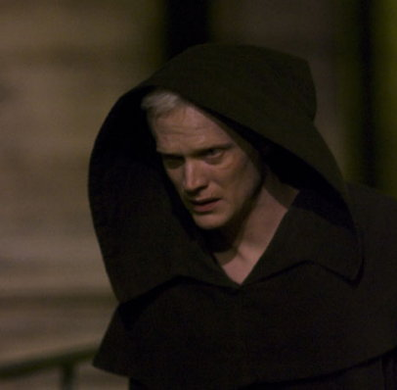
The Murder
Victim: Jacques Saunière
  Curator of the Louvre
  (Secretly) Grand Master of the Priory of Sion
Murderer: Silas
  Large albino Monk connected with Opus Dei
Master Plotter: The Teacher
  Mysterious, unseen, provides info to Silas

Slide 9
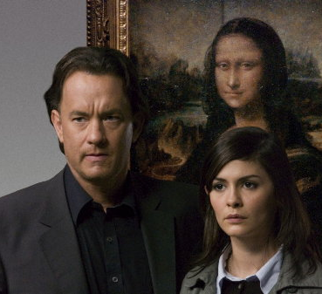
The Hero & Heroine
Robert Langdon
  Prof of Religious Symbology at Harvard
  In Paris to give a lecture when murder occurs
Sophie Neveu
  Cryptographer for French Judicial Police
  Grand-daughter of murder victim

Slide 10
The Plot
Story begins with the murder ~ 11 pm, inside the Louvre.
Langdon is awakened at his hotel an hour & a half later by a phone call from the police.
He is summoned to meet with Bezu Fache, crack investigator of the Judicial Police, at the scene of the crime.
Fache secretly suspects Langdon, as Langdon’s name was in Saunière's calendar to meet with Saunière earlier that evening.

Slide 11
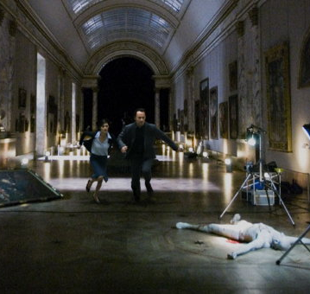
The Murder Scene
Saunière has been found dead, naked, and lying in a pose that matches that of Da Vinci’s "Vitruvian Man."
In the few minutes between being shot & dying, he managed to leave several cryptic clues about what is going on.

Slide 12
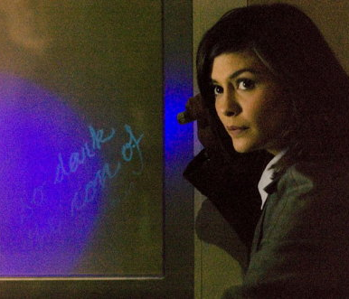
The Plot Thickens
As the police prepare to arrest Langdon, Sophie manages to spirit him away.
They decipher clues her grandfather has left behind.
These involve a secret group guarding a devastating secret about the Church.

Slide 13
The Plot Moves On
The rest of the book is a combination of their flight from the French police (and from Silas the murderer), while simultaneously seeking to locate and decipher the clues Saunière has left behind to direct them to the Grail.
In the course of their flight, Sophie and Langdon travel to several places in France, then to London, and finally to Scotland.

Slide 14
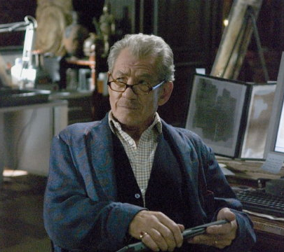
Sir Leigh Teabing
They seek out Leigh Teabing, ex-British Royal Historian, who lives in a chateau outside Paris.
Teabing is one of the world’s experts on the Holy Grail and the Priory of Sion.
Teabing fills them in on the Grail secret.

Slide 15
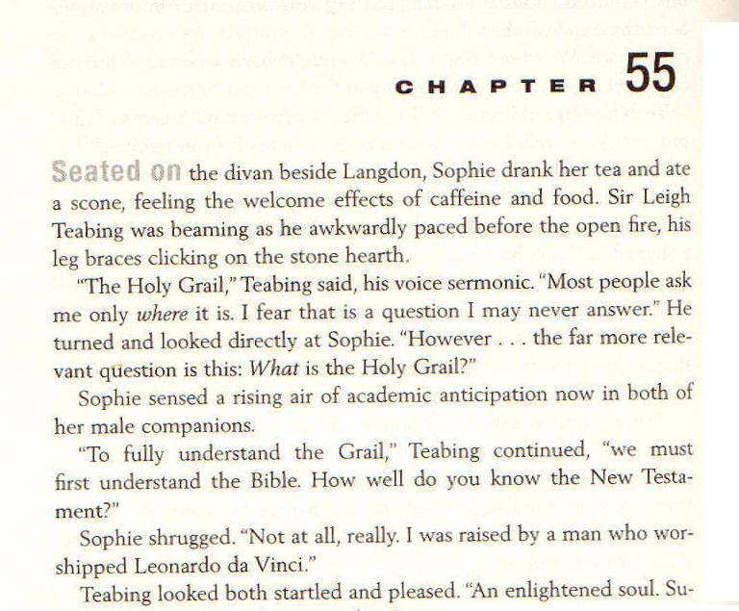
Page 230
What is the Holy Grail?

Slide 16
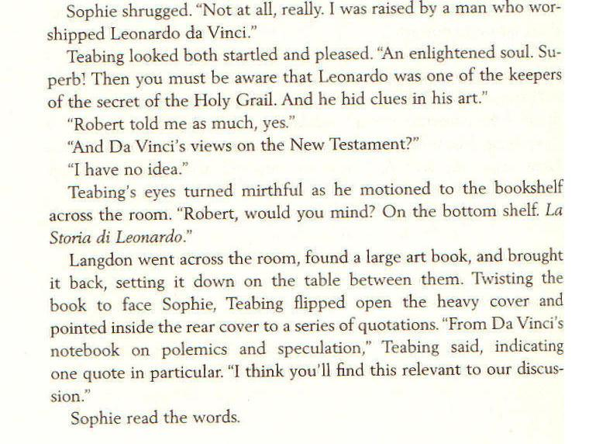
Page 230
Leonardo da Vinci one of the keepers of the secret of the Holy Grail. He hid clues in his art.

Slide 17
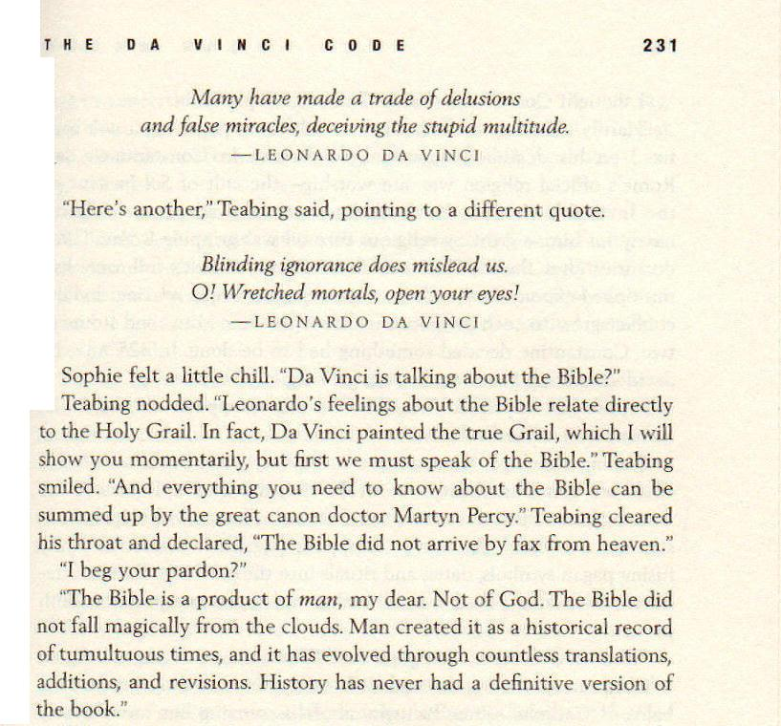
The Bible is a product of man … Not of God.

Slide 18
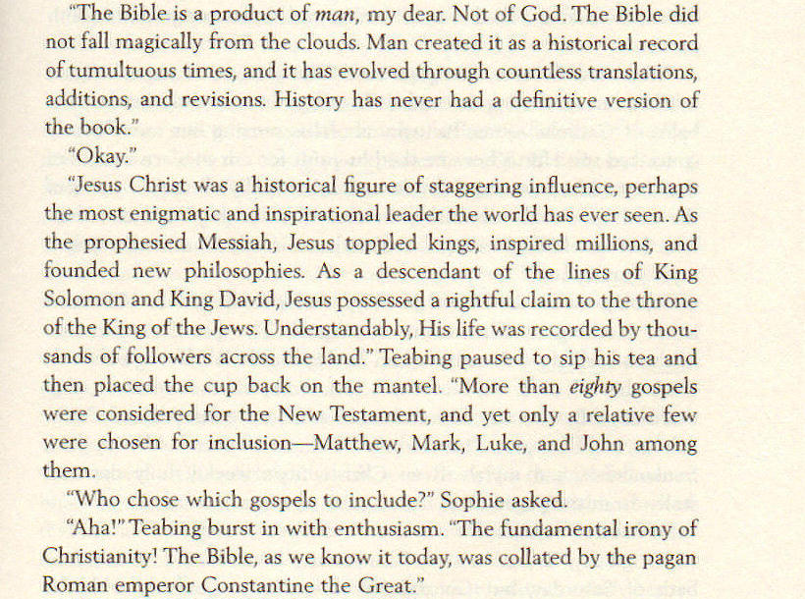
p 231
More than 80 Gospels were considered for the New Testament…

Slide 19
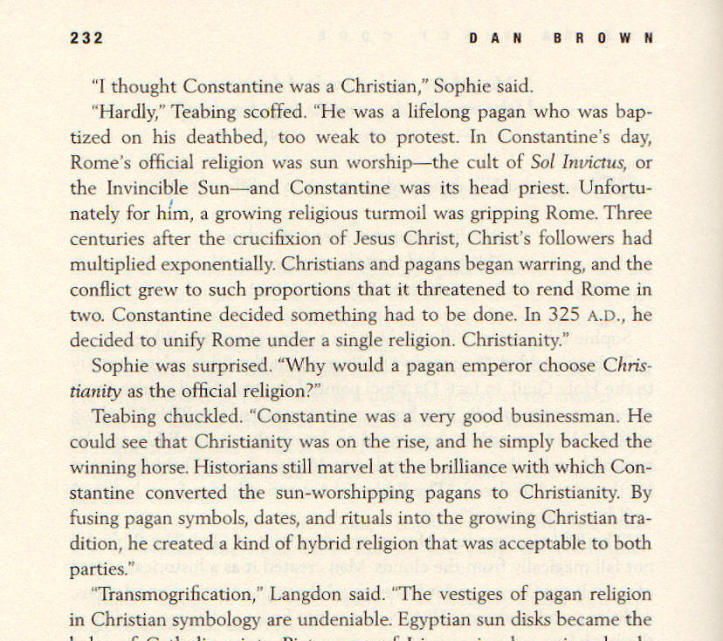
Constantine a lifelong pagan… baptized on his deathbed, too weak to protest

Slide 20
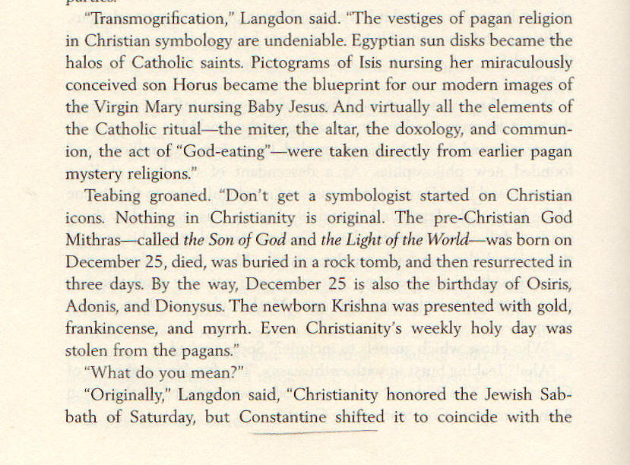
p 232
Nothing in Christianity is original

Slide 21
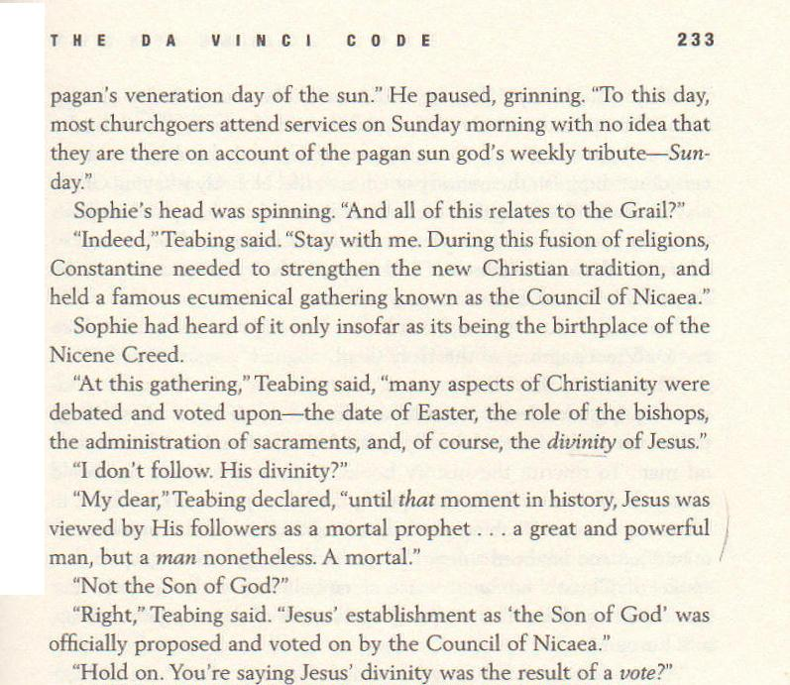
Jesus' establishment as the Son of God was proposed & voted on by the Council of Nicaea

Slide 22
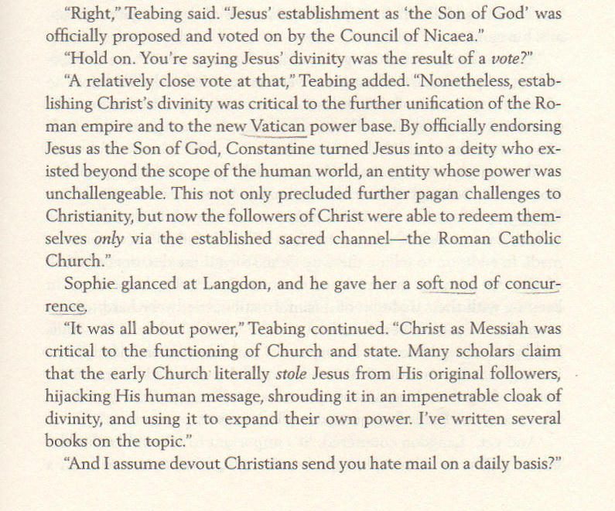
p 233
A relatively close
vote at that

Slide 23
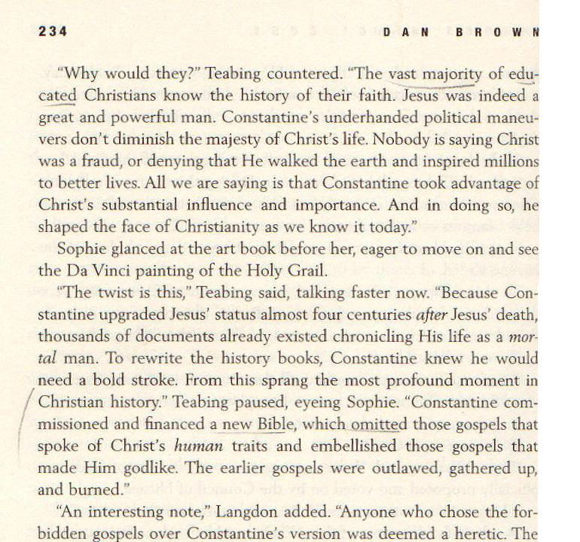
Constantine commissioned … a new Bible

Slide 24
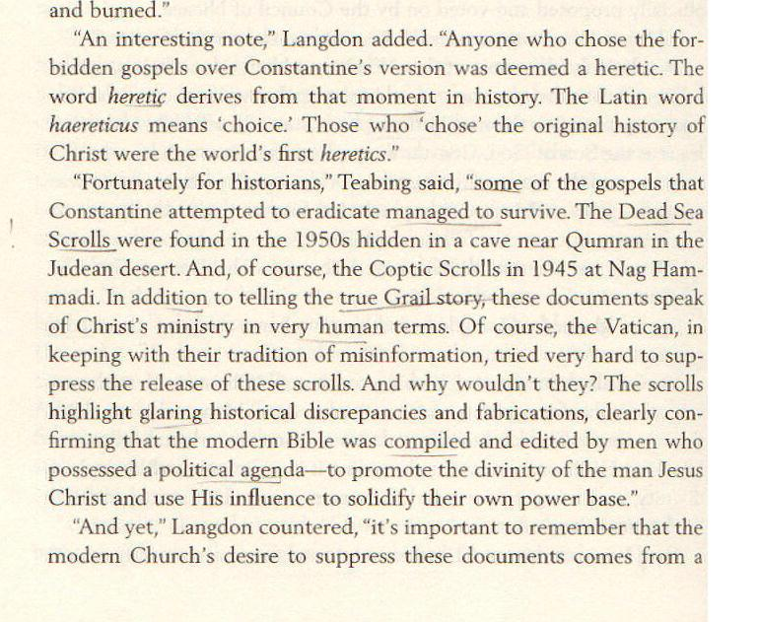
p 234
Some of the gospels managed to survive … The Dead Sea Scrolls … the Coptic Scrolls at Nag Hammadi

Slide 25
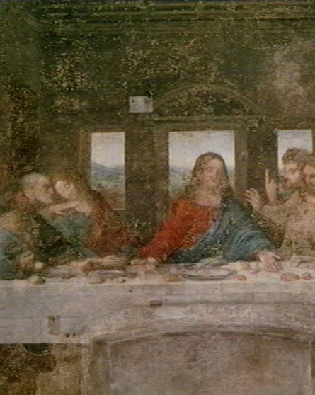
Da Vinci's Last Supper
Teabing goes on to explain how Leonardo Da Vinci has hidden clues in his famous painting.
He says the figure thought to be St John is really Mary Magdalene, Jesus’ wife & mother of his child Sarah.

Slide 26
The Rest of the Plot
We won't spoil the story by revealing how the book ends.
But after Jesus' death, we are told, Mary M & Sarah were hidden away in France.
The church covered this up, male leadership took over & reconfigured Mary Magdalene as a prostitute, rejecting the sacred feminine.

Slide 27
Questions Raised by
The Da Vinci Code

Slide 28
Questions Raised
Include topics such as:
Christology
Scripture
Church History
Various others:
  Mary Magdalene
  Leonardo Da Vinci
  The Templars
  The Priory of Sion

Slide 29
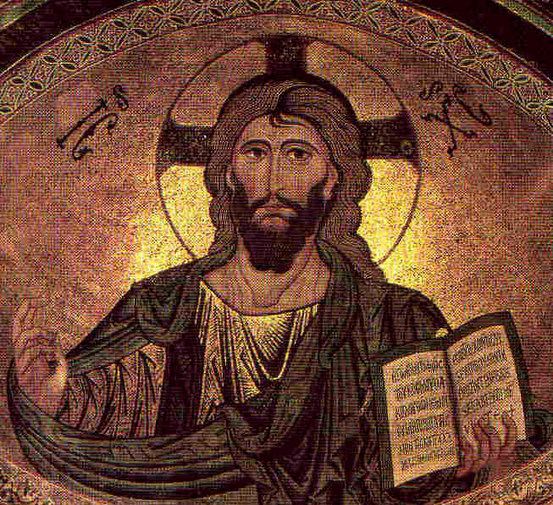
Questions about
Jesus Christ
Who was Jesus?
  Was he merely a human?
  Was his status upgraded by Constantine?
Was he raised from the dead after his crucifixion?
Did Jesus really marry?
Did he & Mary Magdalene have a child?

Slide 30
Questions about the Bible
Is our Bible very different from the one the early Christians had?
Did Constantine prepare a new Bible?
Did he destroy the Gospels which pictured a merely human Jesus?
Did he modify the Gospels in our Bible to make Jesus look divine?
What about the Gnostic Gospels?

Slide 31
Questions about
Church History
What happened at the Council of Nicea?
Was Constantine a Christian?
Did the Roman Catholic Church adopt many features from paganism?
Has it been covering up a huge secret for nearly 2000 years?

Slide 32
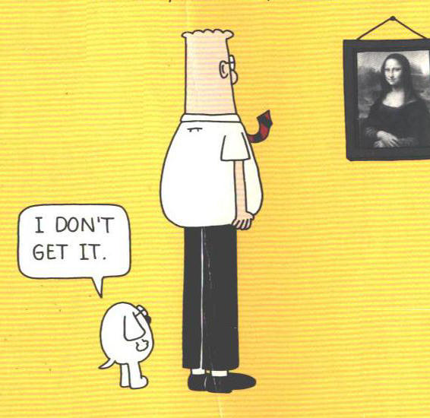
Miscellaneous questions
What do we know about Mary Magdalene?
Did Leonardo Da Vinci hide clues in his paintings that reveal the secret of the Holy Grail?
What do we know about the Templars?
What do we know about the Priory of Sion?

Slide 33
Let's Get
Started!

