Slide 1
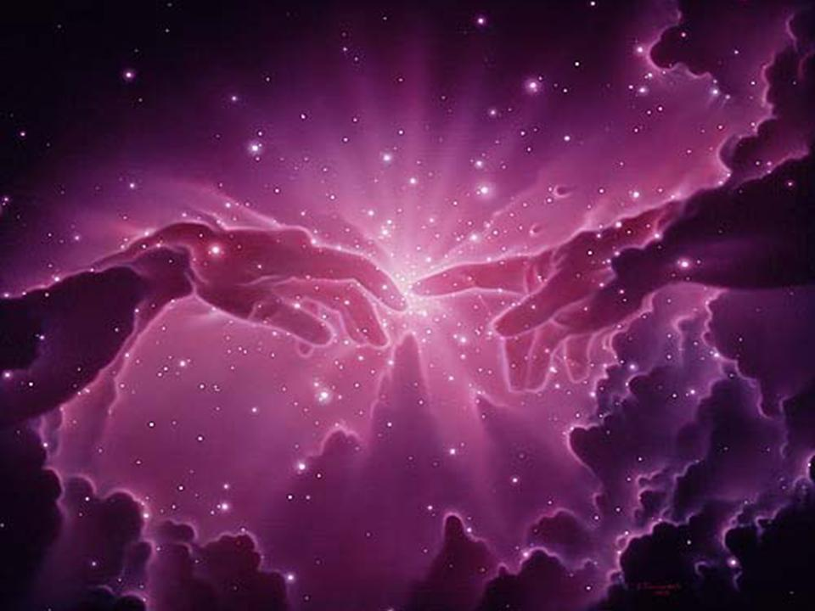
Creation
Robert C. Newman

Slide 2
What is Creation?
The view that everything but God was brought into existence by God, who alone has always existed.
This is in contrast to various alternative views:
Atheism
Pantheism
Panentheism
Dualism
Polytheism

Slide 3
Various Alternatives
Atheism
The cosmos has always existed.
There are no gods at all.
Pantheism
The cosmos is itself God.
Panentheism
The cosmos is God's body.
God is the cosmos' "spirit."

Slide 4
Various Alternatives
Dualism
The matter of the cosmos has always existed.
The cosmos is something shaped by God.
Polytheism
The matter of the cosmos has always existed.
The cosmos is something shaped by a god or the gods.

Slide 5
Creation
… is the teaching of the Bible and of traditional Judaism, Christianity & Islam.
Here we sketch the teaching given in the Old Testament and New Testament as understood by evangelical and fundamental Christians.
Their views of how to relate the idea of creation to scientific data range over a spectrum.

Slide 6
The Spectrum
Young-earth (or recent) creation
Old-earth (or progressive) creation
Theistic evolution (or fully-gifted creation)
We discuss these in another slide-talk entitled "Creationism."

Slide 7
Varieties of Creation
At its most basic level, creation is the bringing into existence of that which did not previously exist, traditionally called ex nihilo creation.
The Genesis account appears to apply this sort of creation to
The universe as a whole (heaven & earth)
Perhaps to life
Perhaps to the human spirit
But not to the human body

Slide 8
Varieties of Creation
God‘s other creative actions in Genesis may have been alternatively:
Ex nihilo creation
His miraculous working with existing materials
His non-miraculous (providential) guidance of natural processes
See our slide-talk "Creationism."

Slide 9
A Free Act
God's creation of the cosmos was a free, personal action.
He was not constrained by any logical necessity or by a need for companionship.
Christians see God as having always enjoyed companionship because of the three-person nature of His being.

Slide 10
A Trinitarian Act
Genesis tells us that God created all things by means of His Word ─ His spoken command.
Christians understand this Word (from the beginning of John's Gospel) to be Jesus before He became a human.
We learn also from Genesis that God's Spirit hovers over the waters at creation.
Apparently the Holy Spirit works within nature to carry out God's purposes.
God is thus both within & beyond His creation (immanent & transcendent).

Slide 11
God's Purpose in Creation
God's purpose (or one of God's purposes) in creation was to "declare His glory.“
This means to demonstrate His character…
… His wisdom, goodness, power, justice, etc.
… to the personal beings He would create
… & to share these & other good things with them.

Slide 12
God's Creation Initially Good
The creation was initially good, in fact, very good.
But God also created free moral agents who could choose either to trust & obey Him, or else doubt & reject Him.
The Bible's main plot line tells what happened as a result of the disobedience of the first humans, & how God subsequently reached out to rescue people from the consequences of their own & others' rebellion against Him.

Slide 13
The Great Dilemma
The dilemma of how God can be both a just judge & yet merciful to those who deserve punishment is solved when God Himself suffers their punishment & provides their righteousness.
God does this by becoming a created human being in Jesus of Nazareth, living a life of perfect obedience, & dying a criminal's death nailed to a wooden cross.

Slide 14
Created in God's Image
Humans were created in God's image.
This concept is not explained anywhere in the Bible, but it seems to be intended to contrast with animals being made "according to their kinds."
The point seems to be that humans share some features with God that animals do not.
As animals are called irrational in the NT, rationality is apparently part of this image.

Slide 15
Created in God's Image
Many passages indicate that humans are spirits (personal beings, which can survive death), so this is included in our resemblance to God.
Other features, such as moral and artistic capabilities, are probably a part of our spirituality.

Slide 16
Human Purpose
God created humans to have responsibility and rule over at least the earth-bound part of creation.
This means we are responsible under God for how we treat the plants, animals and non-living environment around us, as well as for how we treat one another.
Our ability to do this has been badly disrupted by our rebellion against God, as has our behavior in all of our authority relationships: to God, government, employment, marriage & family.

Slide 17
Importance of Creation
The idea that we & the cosmos are created has profound effects on how we view reality, & (if true) on the meaning & value of our lives.
Unlike the other worldviews, creation explains both the real, objective standards of ethics, logic & beauty (along with the fact that we regularly violate these standards), the existence of both good & evil, and why the one is different from & preferable to the other.

Slide 18
Importance of Creation
It explains why humans are more valuable than animals…
… why we view cannibalism with horror, but need not (& cannot) extend this to meat-eating and vegetable-eating.
It explains why we have longings for a life beyond this one, and how God can be just even though justice is not always done in this life.

Slide 19
The End of This Creation
According to the Bible, our cosmos has not always existed, and one day it will come to an end. It is "wearing out.“
One day, it will be replaced with a new heaven and a new earth, in which all will be well.

Slide 20
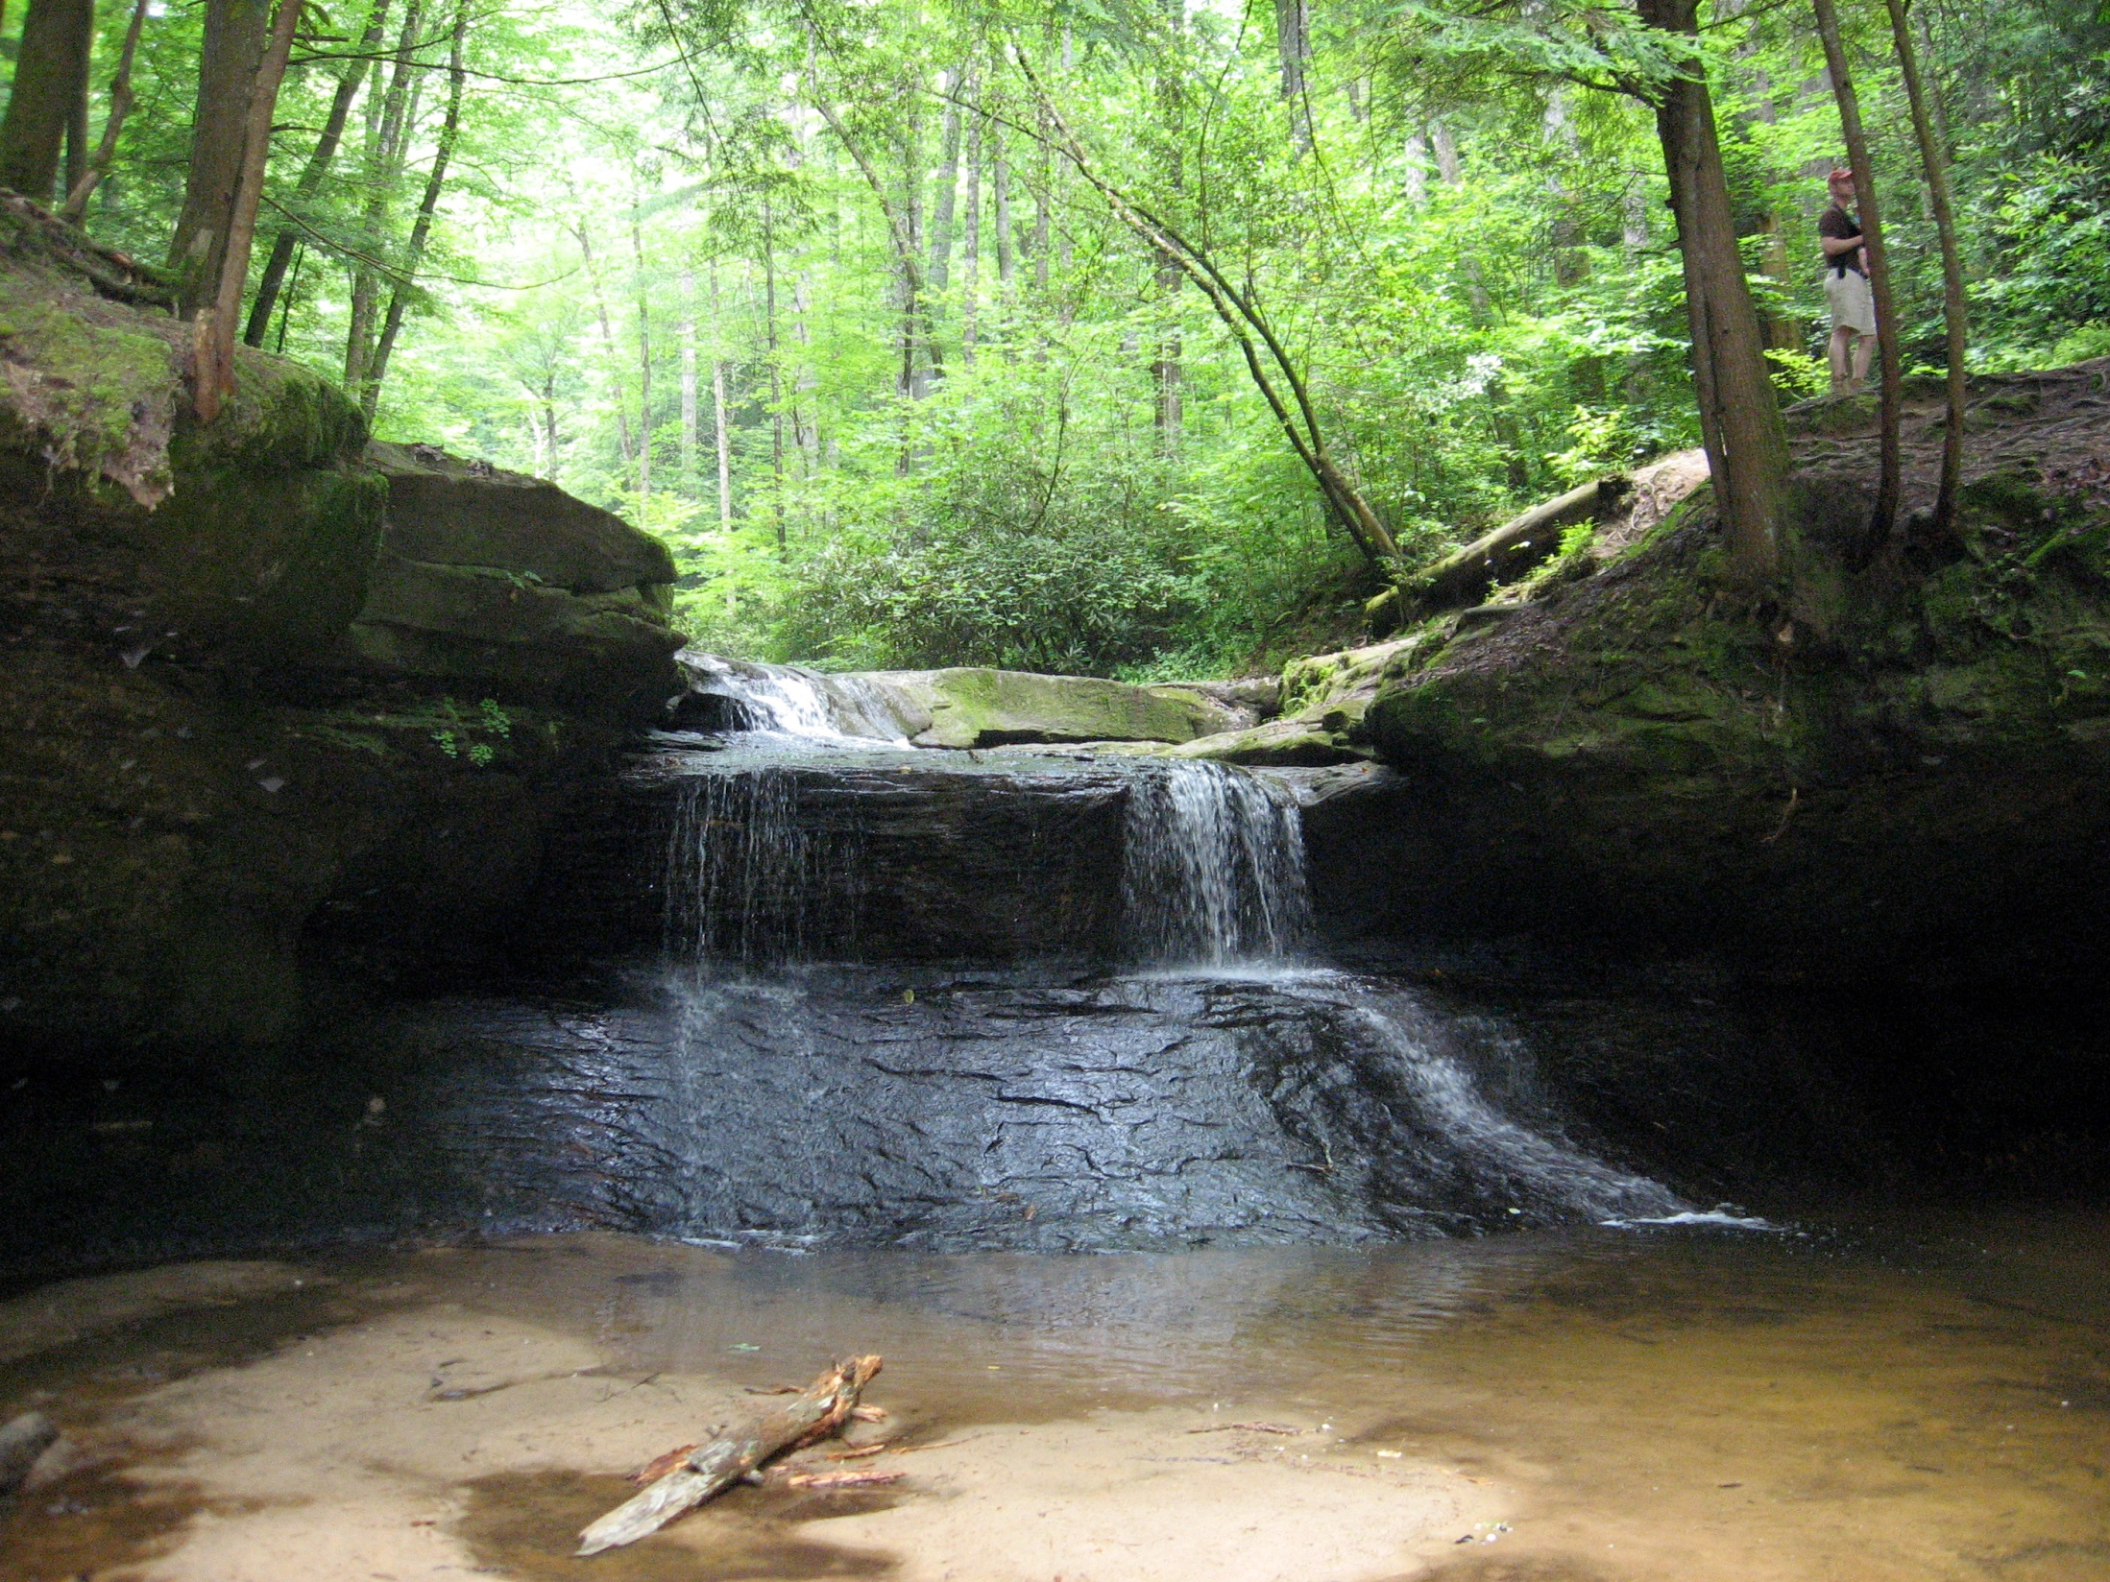
The End

