Slide 1


The Creation-Evolution Debate
Recent Developments
Robert C. Newman

Slide 2
Some Favorable Evidence for Evolution
Old earth, some 4-5 billion years
Initially no life
Then just simple life
Then the "Cambrian Explosion"
Then fish, amphibians, reptiles, birds & mammals, apes, finally humans
Similar biochemicals among living things
Similar bone structures among vertebrates

Slide 3
So why doesn't everyone believe in evolution?
Variety of reasons, depending on world-view:
  Some have other sources of information besides science which raise questions; these are often religious.
  But not all object for religious reasons:
    Michael Denton
    Dean Kenyon
    Hubert Yockey
Not all who have religious reservations think these are the decisive problems.

Slide 4
Could so many scientists be wrong?
Science must finally depend on evidence, not on opinion, even that of experts.
Thomas Kuhn, Structure of Scientific Revolutions, describes the sociology of paradigm changes.
Consider the case of continental drift.

Slide 5
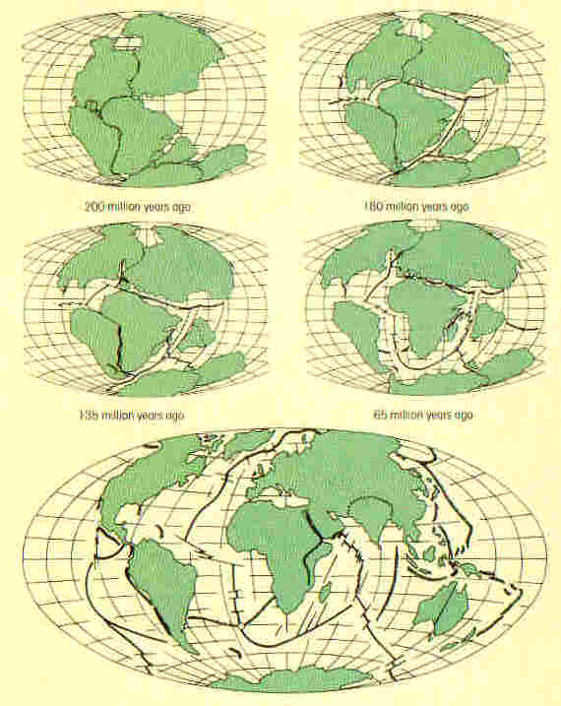
The Case of Continental Drift
Till the 1950s, most geologists considered moving continents a wacko idea, since they could not imagine any mechanism to do this.
As evidence piled up, a rather dramatic paradigm shift occurred, even though the mechanism has still not been fully worked out.

Slide 6
Some Problems for Evolution
Concerned here with scientific problems, rather than philosophical or theological
Concerned especially with problems facing naturalistic, rather the theistic evolution, that is, the sort espoused by:
  Charles Darwin, Origin of Species
  Richard Dawkins, Blind Watchmaker
  Daniel Dennett, Darwin’s Dangerous Idea

Slide 7
Some Problems for Evolution
Will deal with two main problems, which include various sub-problems:
(1) Problems with generating the observed level of order, given only random events and selection for survival to produce this
(2) Problems with the observed fossil record compared to expectations

Slide 8
Problems Generating Order
Using Merely Random Phenomena Selected for Survival

Slide 9
The Origin of Life
Mutation & natural selection will not work until there is something capable of reproducing for them to work upon.
The minimal complexity of self-replicating automata is beyond the capability of chance over the entire history of the universe.

Slide 10
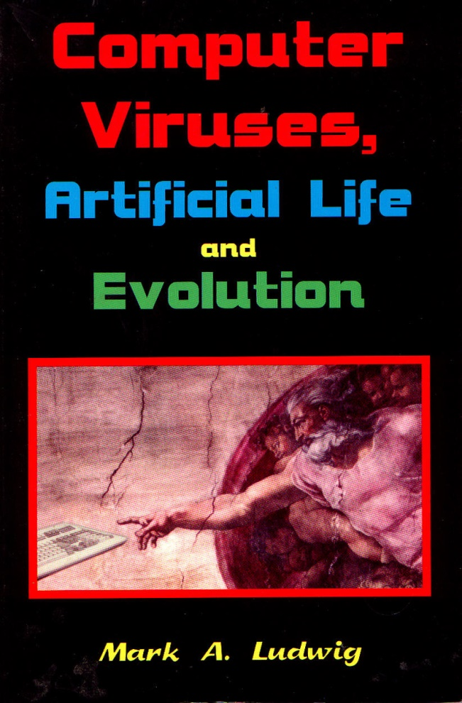
The Origin of Life
Computer viruses are the closest things to life that humans have created.
Even the simplest of these are far too complex to form by chance.

Slide 11
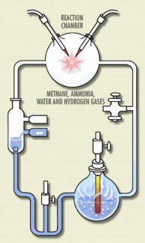
The Origin of Biochemicals
Stanley Miller's famous experiment is just a very small first step.
Functional proteins have over 100 amino acids each, in very specific order.

Slide 12
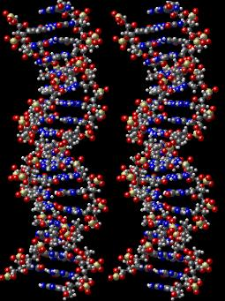
The Origin of Biochemicals
Making DNA & RNA is far harder.
These require a number of different environments.
To date they have only been produced using considerable intervention by the experimenter.

Slide 13
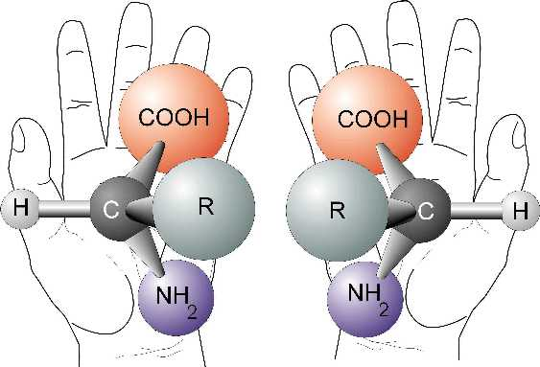
The Problem of Handedness
The amino acids in living things are left-handed.
The sugars in DNA and RNA are right-handed.
Undirected chemical processes produce equal numbers of left- and right-handed.

Slide 14
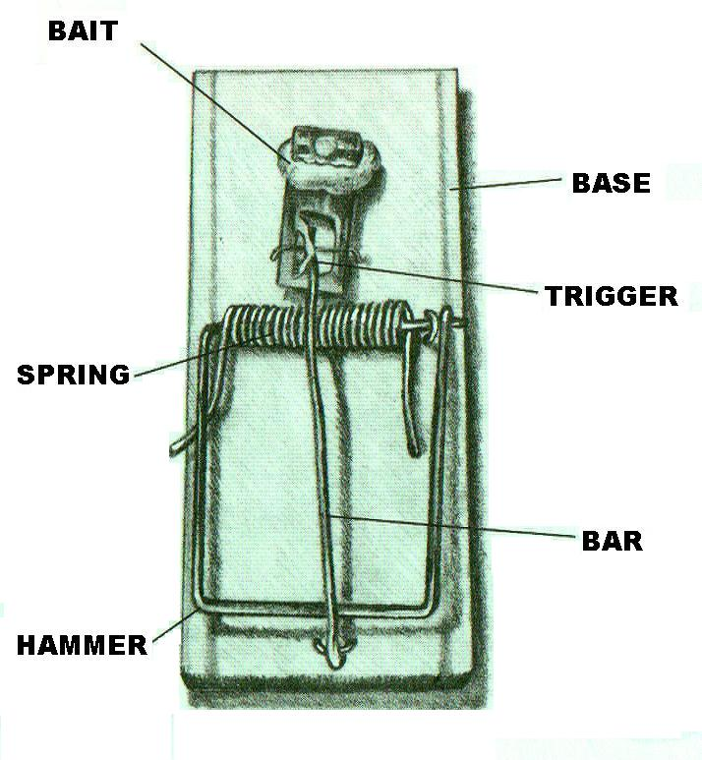
Origin of Chemical Processes and Complex Organs
The problem of large "minimal (irreducible) complexity"
What is "minimal complexity"?
Example:
  A mouse trap
  Must have all (irreducible) parts to function

Slide 15
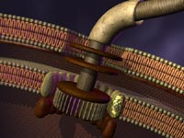
Problem of Processes & Organs
How build a system that requires many features working together to have any function?
Example: the rotary motor in E. coli flagellium

Slide 16
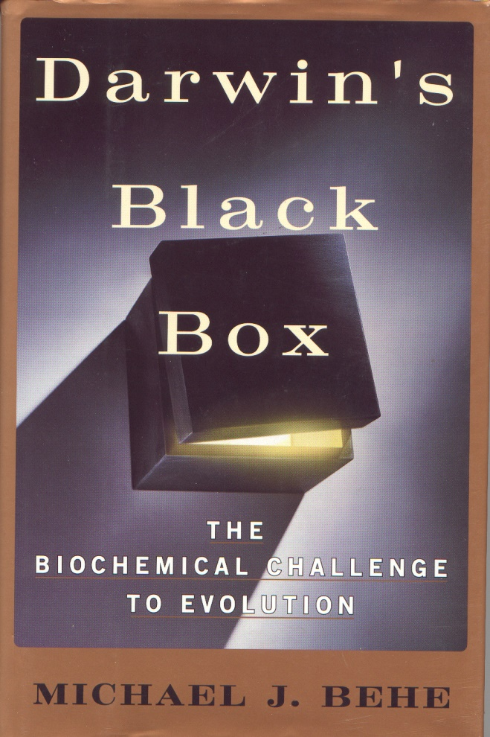
Problem of Processes & Organs
Other examples:
  Blood clotting mechanism
  Intra-cell transport
  Vision
See Michael Behe, Darwin's Black Box

Slide 17
Problems with the Fossil Record
Given only purely natural causes

Slide 18
The (Relative) Lack of
Transitional Fossils
"The extreme rarity of transitional forms in the fossil record persists as the trade secret of paleontology. The evolutionary trees that adorn our textbooks have data only at the tips and nodes of their branches; the rest is inference, however reasonable, not the evidence of fossils."
Stephen Jay Gould
Natural History 86, #5 (1977): 14

Slide 19
The (Relative) Lack of
Transitional Fossils
"Well, we are now about 120 years after Darwin… Ironically, we have even fewer examples of evolutionary transitions than we did in Darwin's time. By this I mean that some of the classic cases… have had to be discarded or modified…"
David Raup
Field Museum Bulletin 30 #1 (1979): 25

Slide 20
The (Relative) Lack of
Transitional Fossils
"Despite the detailed study of the Pleistocene mammals of Europe, not a single valid example is known of phyletic (gradual) transition from one genus to another."
Steven M. Stanley
Macroevolution: Patterns & Process (1979), 82

Slide 21
The (Relative) Lack of
Transitional Fossils
Notice we say 'relative' lack.
There is no need to argue that there are no fossils which might be transitional.
The problem is that Darwinian 'Blind Watchmaker' evolution has only a random walk to cross gaps.
But the fossil record looks like the transitions are sudden.

Slide 22
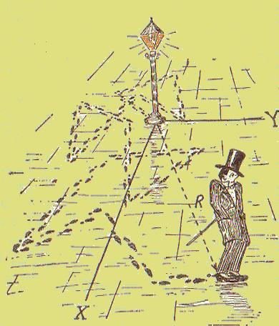
What is a 'Random Walk'?
A movement in which steps are taken in random directions, and often of random length.
Distance covered = average length of step times square root of number of steps.

Slide 23
Fragmentary Fossil Record?
Darwin (& many since) argued that the lack of transitions is due to the fragmentary nature of the fossil record.
But there are nearly ¼ billion fossils collected and housed in museums.
How detailed a picture can one construct with ¼ billion pixels?

Slide 24

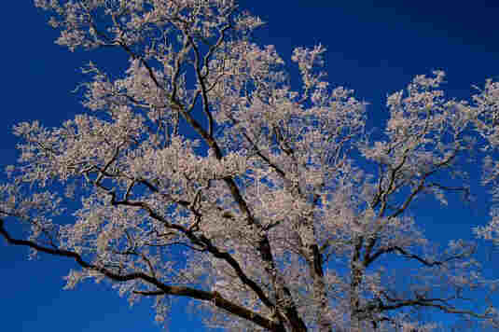
Fragmentary Fossil Record?
190,460 pixels
6700 pixels

Slide 25
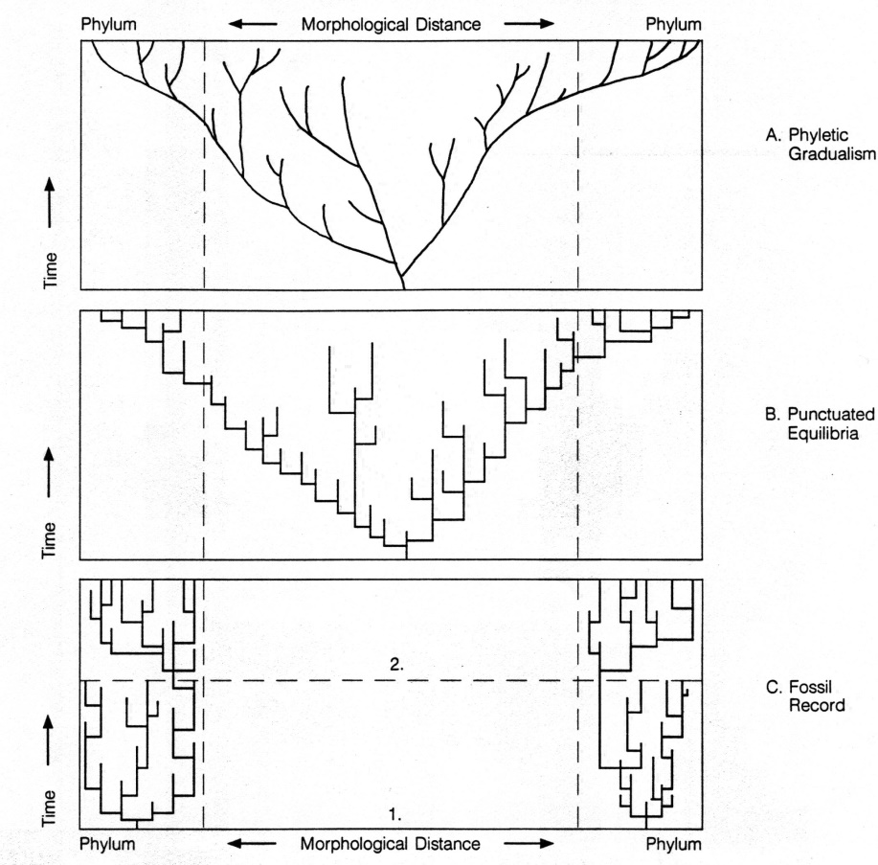
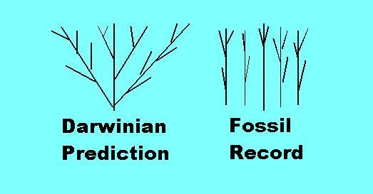
The 'Shape' of the Fossil Record
Darwinism predicts a tree of life formed by divergence of species into genera, etc., with the largest differences last.
The actual data shows the largest differences first, at the Cambrian Explosion.

Slide 26
Effect of Small Populations
A particular mutation is more likely to become dominant in a small population than a large one.
This is used by Darwinists today to argue that all the significant transitions took place in small populations, so we would not expect them to show up in the fossil record.

Slide 27
Effect of Small Populations
But for transitions across the upper levels of the biological classification system, many mutations would be needed, probably 100s or 1000s.
The chance of getting 5 (or 10) mutations of the right sort in a population varies with the 5th (or 10th) power of the population size, so large populations are heavily favored.
This more than cancels out the benefit of a small population.

Slide 28
Biological Classification
Kingdom: Animals
Phylum: Chordates
Subphylum: Vertebrates
Class: Mammals
Order: Carnivores
Family: Canidae
Genus: Canus
Species: familiaris

Slide 29
Punctuation
As Gould, Eldridge & others have noted, the fossil record typically shows sudden transitions to new forms rather than gradual ones.
Geneticists have not been able to figure out how such transitions could occur.
This does not favor evolution as an undirected process.

Slide 30
Stasis
Another feature noted by Gould & others is that living forms (after appearing suddenly) typically remain about the same until they become extinct.
This suggests mutation & natural selection is basically a conservative process rather than an innovative one.
This is confirmed by computer simulation.

Slide 31
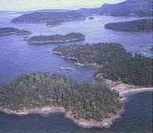
'Islands' of Function
Living organisms & the fossil record suggest that each living thing is surrounded by many alternative designs that won’t work.
Undirected evolution must assume all these "islands" are "land bridges" or they are close enough that one mutation can jump the gap.

Slide 32
'Islands' of Function
But how does one reach new innovations?
  2- to 3- to 4-chambered heart?
  Push-pull lungs to flow-through lungs?
  Black & white to color vision?
  Legs to wings?
  Scales to feathers?
Many such items have no intermediate forms, and numerous coordinated changes would be necessary for each to work.

Slide 33
Conclusions
Problems Generating Order
  Origin of life
  Origin of specific biochemicals
  Origin of processes & organs
Problems w/ the Fossil Record
  Relative lack of transitional fossils
  Shape of the fossil record
  Inadequacy of small populations
  Punctuation & stasis
  Islands of function

Slide 34
Conclusions
If you are determined to hold onto a world-view in which there is no God, undirected evolution must be your explanation, no matter how badly it works.
Consider for example this remark by noted evolutionist Richard Lewontin:

Slide 35
"We take the side of science in spite of the patent absurdity of some of its constructs … in spite of the tolerance of the scientific community for unsubstantiated just-so stories, because we have a prior commitment, a commitment to materialism. It is not that the methods and institutions somehow compel us to accept a material explanation of the phenomenal world, but, on the contrary, that we are forced by our a priori adherence to material causes to create an apparatus of investigation and a set of concepts that produce material explanations, no matter how counterintuitive, no matter how mystifying to the uninitiated. Moreover, that materialism is absolute, for we cannot allow a Divine Foot in the door."
Richard Lewontin, NY Review of Books (9 Jan 97)

Slide 36
Conclusions
If you are determined to hold onto a world-view in which there is no God, undirected evolution must be your explanation, no matter how badly it works.
But if you admit these problems indicate a Mind behind the universe, then that Mind may have worked by natural processes or abrupt means.
But having a God raises the question of what life is all about, and what I am going to do about it.

Slide 37
For Further Reading
Michael Behe, Darwin’s Black Box
William Dembski, Intelligent Design
Michael Denton, Nature’s Destiny
J. P. Moreland, Mere Creation
Hugh Ross, The Creator & the Cosmos
Hubert Yockey, Information Theory & Molecular Biology

Slide 38
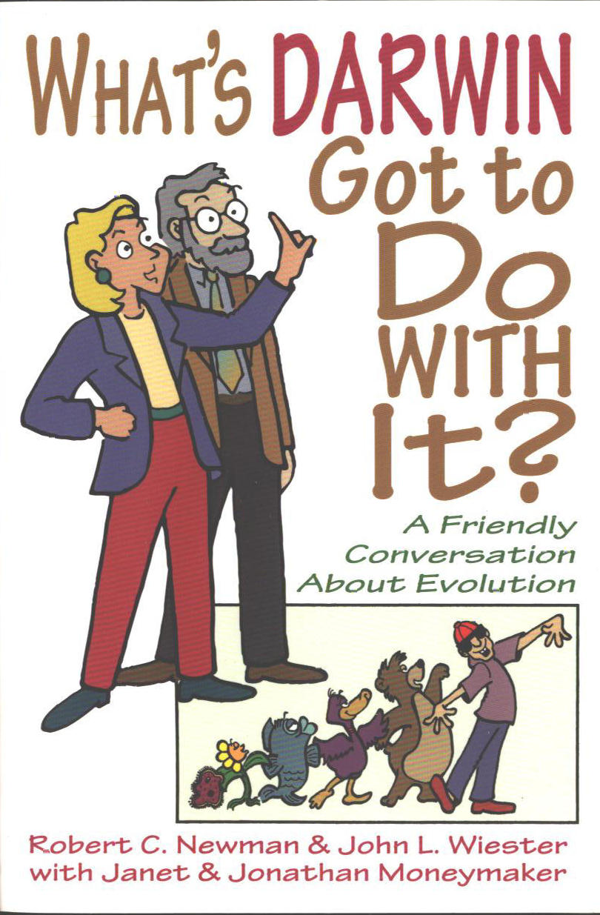
For Further Reading

