Slide 1
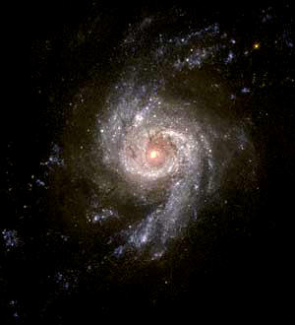
Cosmos & Contact
Evidence of Design
in the Universe
Robert C. Newman

Slide 2
Carl Sagan's Opening Statement in his PBS Series Cosmos
The cosmos is all that is,
or ever was,
or ever will be.

Slide 3
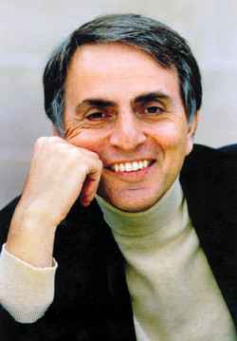
Carl Sagan on Extra-Terrestrial Life
Sagan doubts that God exists.
Yet he believes life exists elsewhere in the universe, in spite of life's enormous complexity.
He believes that (in some places) this life must include very advanced life forms.
He believes such advanced life is common enough to be worth searching for.

Slide 4
The Search for ET Intelligence
Many besides Sagan have such dreams.
Perhaps (they think) we can contact such life.
Perhaps these beings have solved the difficult and dangerous problems we face today.
The most likely way to contact an advanced civilization would be through its radio signals.

Slide 5
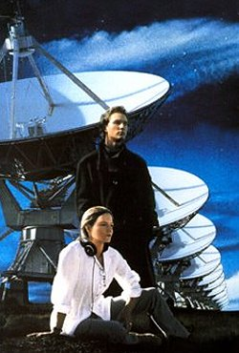
The Plot of Contact
Ellie Arroway, astrophysicist, devotes her professional career to searching for ETI.
Despite many setbacks, the long-awaited message finally comes, a strong signal from Vega.
The signal is seen to be more than radio noise by the presence of prime numbers, indicating an intelligent source.

Slide 6
The Plot of Contact
Eventually, a more complex message is found in the signal, instructions to build a device to transport a human to Vega.
After several twists in the plot, Ellie winds up going to Vega on the transporter.
Our clip picks up as she arrives …

Slide 7
Sagan on Recognizing an ET Message
Strong signal.
Detectible by multiple radiotelescopes.
Decisive against chance origin.
A few dozen prime numbers sufficient.
The whole message to build the transport machine is about fifty thousand pages.

Slide 8
How the Book Ends
Ellie discovers a message in the digits of pi.
Found in base 11 arithmetic
A square picture made up of 0s and 1s
The picture: a circle of 1s in a field of 0s
Simple message, but high statistical significance
The universe was made on purpose, the circle said.

Slide 9
How the Book Ends
359X21086652790X4312567089243
00000000000111111100000000000
00000001100000000000110000000
00000100000000000000000100000
00001000000000000000000010000
00001000000000000000000010000
00000100000000000000000100000
00000001100000000000110000000
00000000000111111100000000000

Slide 10
The film doesn't end this way…
No message from God in the film!
Why not?
Did Hollywood veto this ending?
Did Sagan back away from "the precipice of theism" in his last years?
Don't know
Sagan's novel Contact is more open to theism than his last book Demon Haunted World is.

Slide 11
Could God Do Something Like This?
Could God put a message in the digits of pi?
Seems doubtful God could put a message there:
Pi is built into the structure of logic and so not variable.
God cannot do what is contradictory.
Could God send us some other message?
Why not?

Slide 12
Where Might God Put Such a Message?
He could put it in something He has created.
Do we have any candidates for such a medium and such a message?
Yes, several. Here we consider three:
The universe itself
Our place in the universe
Living things

Slide 13
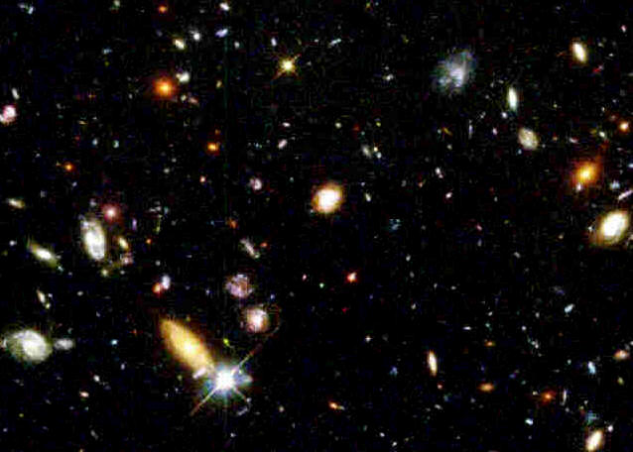
A Message in the Universe
Seen in its "fine-tuning"
Some bibliography:
L.J. Henderson, The Fitness of the Environment
Paul Davies, The Accidental Universe
John Barrow & Frank Tipler, The Anthropic Cosmological Principle
Hugh Ross, The Creator & the Cosmos
Michael Denton, Nature's Destiny

Slide 14
Fine-Tuning the Basic Forces
Strong Force
short range, strength 1
Electromagnetism
long range, strength 1/100
Weak Force
very short, strength 1/100,000
Gravity
long range, strength 1/10³⁹
As divergent in strength as these forces are, very slight changes in any would be disastrous.

Slide 15
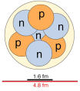
The Strong Force
Holds nucleus together.
50% weaker, no stable elements but H
5% weaker, no deuterium, stars won’t burn
5% stronger, diproton stable, stars explode
The strong force is tuned to ±5% on the basis of these considerations alone.

Slide 16
The Weak Force
Holds neutron together.
Neutron decay: half-life 13 minutes
Neutron ⇒ Proton + Electron + Antineutrino
Few % weaker, then few n, little He, few heavy elements; even these stay trapped in stars.
Few % stronger, then many n, too much He, too many heavy elements; but these, too, stay trapped in stars.
The weak force is tuned to a few percent.

Slide 17
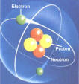
Electromagnetism
Holds atom together, also molecules.
Both repulsive & attractive, due to existence of positive & negative charges.
+ and – charges must be almost exactly equal in number, to better than one part in 10⁴⁰.
Yet protons (+) and electrons (-) drastically different in mass, and froze out at quite different times in the early universe.
If not for this equality, e-m would dominate gravity, so no galaxies, no stars, no planets.
E-m is tuned to one part in 10⁴⁰.

Slide 18
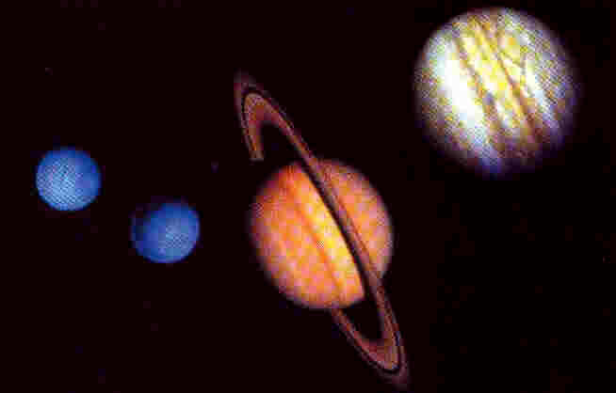
Gravity
Dominant force on astronomical size scale.
Need very close balance of gravity and cosmic expansion for stable universe.
If gravity weaker by 1 in 10⁶⁰, universe expands too quickly, no galaxies or stars formed.
If gravity stronger by 1 in 10⁶⁰, universe collapses without forming galaxies or stars.
Gravity is fine-tuned to 1 part in 10^{60.}

Slide 19
Summary on Fine-Tuning
Combining these cases gives fine-tuning of better than one part in 10¹⁰⁰.
How big is 10¹⁰⁰?
1 with 100 zeroes after it.
There are estimated to be some 10⁸⁰ elementary particles in our universe.
So we need to 10²⁰ universes to get 10¹⁰⁰ particles!
Imagine the chances of randomly picking one marked particle from all these universes!

Slide 20
Summary on Fine-Tuning
Fine-tuning of universe is about 1 part in 10¹⁰⁰ for the cases we have examined.
Hugh Ross, in The Creator & the Cosmos, lists 22 more items besides these four.
Do we really have any evidence for even 10¹⁰⁰ universes to make this likely merely by chance?
The universe looks designed.
It seems to be sending us a message to this effect.

Slide 21
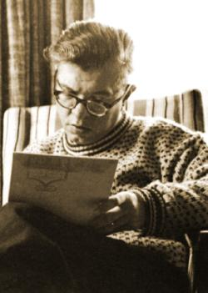
Sir Fred Hoyle on Fine-Tuning
"… a superintellect has monkeyed with physics, as well as with chemistry and biology."

Slide 22
Our Place in the Universe
Besides fine-tuning of basic forces, our particular location in the universe is quite special, a matter of many features being just right.
In his 1995 edition, Ross lists over 33 of these drawn from the scientific literature.
Let’s look at a few of these in this presentation.

Slide 23
The Right Planet: Temperature
Varies from place to place on Earth, but:
Few above boiling
Some below freezing
Contrast Venus, about 900 ºF (500 ºC).
Contrast Mars, barely gets above freezing in midsummer at the equator.
Earth is warm enough for water to be liquid, cool enough not to destroy biomolecules.

Slide 24
The Right Planet: Water
Much water is needed to support life, though a few organisms have techniques to conserve it and can live in arid regions.
Water on Venus and Mars is infinitesimal by comparison.
Earth's water is also concentrated at the surface.

Slide 25
The Right Planet: Atmosphere
Balance of oxygen and "inert" gases:
Few % less oxygen and animals can’t breathe
Few % more oxygen and plants burn up
Mars and Venus have virtually no free oxygen.

Slide 26
The Right Planet: Mass
If Earth were ¼ as massive, atmospheric pressure would be too low for life.
If Earth were twice as massive, atmospheric pressure would be too high, producing a greenhouse effect and killing all life.

Slide 27
The Right Moon: Size & Distance
Our Moon is unique in the Solar System, by far the largest compared with its planet.
If it were smaller (or further away), Earth’s climate would be unstable, tides too small for mixing.
If it were larger (or closer), tidal effects on Earth’s rotation, ocean & atmosphere too large.

Slide 28
The Right Moon & Earth's Crust
If Earth's crust thicker, it would eat up the atmospheric oxygen.
If Earth's crust thinner, too much volcanism and plate movement.
The Moon apparently formed from the Earth's crust, when we were struck by a Mars-sized planet, a very fluky event!

Slide 29
The Right Sun: Character
Mass in right range:
Heavier – luminosity changes too quickly
Lighter – life zone too narrow, tides too large
Temperature (color) in right range:
Redder – insufficient photosynthesis
Bluer – ditto
The Sun's radiation is right where our atmosphere is transparent.

Slide 30
The Right Sun: Location
Distance from center of galaxy:
Closer – gravity, radiation disruptive
Further – too few heavy elements
Right for supernovae:
More or closer – exterminate life
Less or further – too few heavy elements
Right number of stars in system, namely one!

Slide 31
The Right Galaxy
Our galaxy is a spiral, which produces stars over much of its history.
Not an elliptical, where star formation ends before there are many heavy elements.
Not an irregular, where radiation events would have destroyed life.

Slide 32
Our Place in the Universe
Right Planet:
Temperature, Water, Atmosphere, Mass
Right Moon:
Size, Distance, Earth's Crust
Right Sun:
Character, Location
Right Galaxy

Slide 33
Our Place in the Universe
Ross calculates the probability of accidentally getting his 33 items in the right range as 1 chance in 10⁵³.
What does this mean for the chances of finding an earth-like planet in our universe?
Surely not more than 10 planets per star.
If so, only 10²⁴ planets in the Hubble volume.
Thus only 1 chance in 10²⁹ of getting even one such planet in our universe!
Our place in the universe appears to be telling us something!

Slide 34
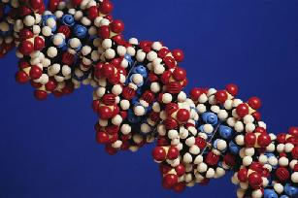
Living Things
Living things are by far the most complex objects we have yet found in our universe.
Sagan says of the E. coli bacterium:
Information content = 10¹² bits.
Equivalent to 100 million pages of the Encyclopaedia Britannica.
Humans have trillions of cells, each more complex than those of E. coli.

Slide 35
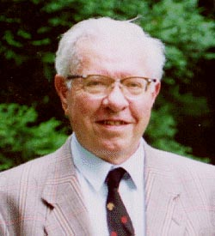
Fred Hoyle on Living Things
"The chance that higher life forms might have emerged [accidentally] is comparable with the chance that a tornado sweeping through a junk-yard might assemble a Boeing 747 from the materials therein."

Slide 36
Sagan on Recognizing an ET Message
Strong signal.
Detected by several radiotelescopes.
Decisive against chance.
A few dozen prime numbers sufficient.
The whole message to build the transport machine is about fifty thousand pages.

Slide 37
Recognizing the Life Message
Strong signal.
Seen in the DNA of all living things.
Decisive against chance.
The information content is beyond the probabilistic resources of the universe.
The whole message to build an E. coli bacterium is about 100 million pages.

Slide 38
Adjusting One’s Worldview
If Sagan was really open to the universe;
If he was really willing to consider the supernatural;
Why didn’t he respond to this sort of evidence?
Why did he draw back from "the precipice of theism"?
Do you need to adjust your worldview?

Slide 39
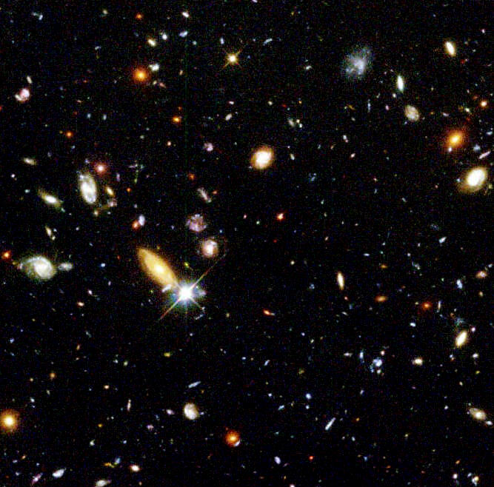
The End
What about you?
This could be just the beginning!

