Slide 1

The Cosmos & the Bible
Looking at Modern Cosmologies
Robert C. Newman

Slide 2
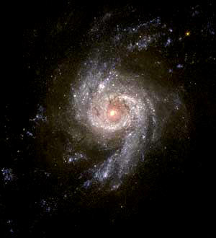
What is Cosmology?
A study of the known parts of the universe to try to describe the whole universe
Using the information now reaching earth to reconstruct the entire history of the cosmos

Slide 3
Importance Philosophically
One of the most basic questions we can ask
Hannes Alfvén – "A waste of time"
Too important to be ignored
But a large variety of cosmological models

Slide 4
Importance Biblically
The universe is created.
Its Creator is a person.
The Creator will one day call us to account for our every thought and action.
The Creator has embedded evidence in the cosmos that it is created.

Slide 5
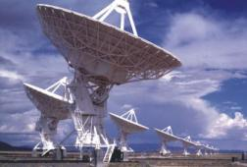
Importance Scientifically
One of the most basic questions of science
We have more evidence than ever, from:
  Radio telescopes
  Artificial satellites
  Understanding of nuclear & particle physics
The evidence points to a created cosmos.

Slide 6
Overview
Scientific data relevant to cosmology
Various cosmological models:
  Some proposed by secular scientists
  Some proposed by Bible believers
We suggest a best model, using both scientific & biblical data

Slide 7
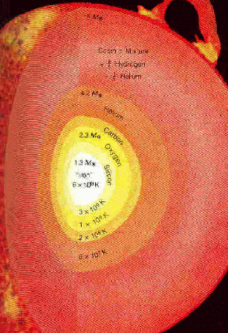
What are Stars?
Massive balls of gas, held together by own gravity, like our sun
Temperature 1000s of degrees at surface, millions at center
Heat produced by nuclear reaction like hydrogen bomb
Enough H in star of sun’s size to burn for about ten billion years

Slide 8
How do we know stars are suns?
Measuring their distances
  The jumping finger
  Parallax using width of earth's orbit
Apparent brightness of objects decreases with square of distance; stars are as bright as the sun.
Measuring their masses; they cover a range that includes the sun.
Stars vary greatly in size, mass, color; the Main Sequence stars

Slide 9
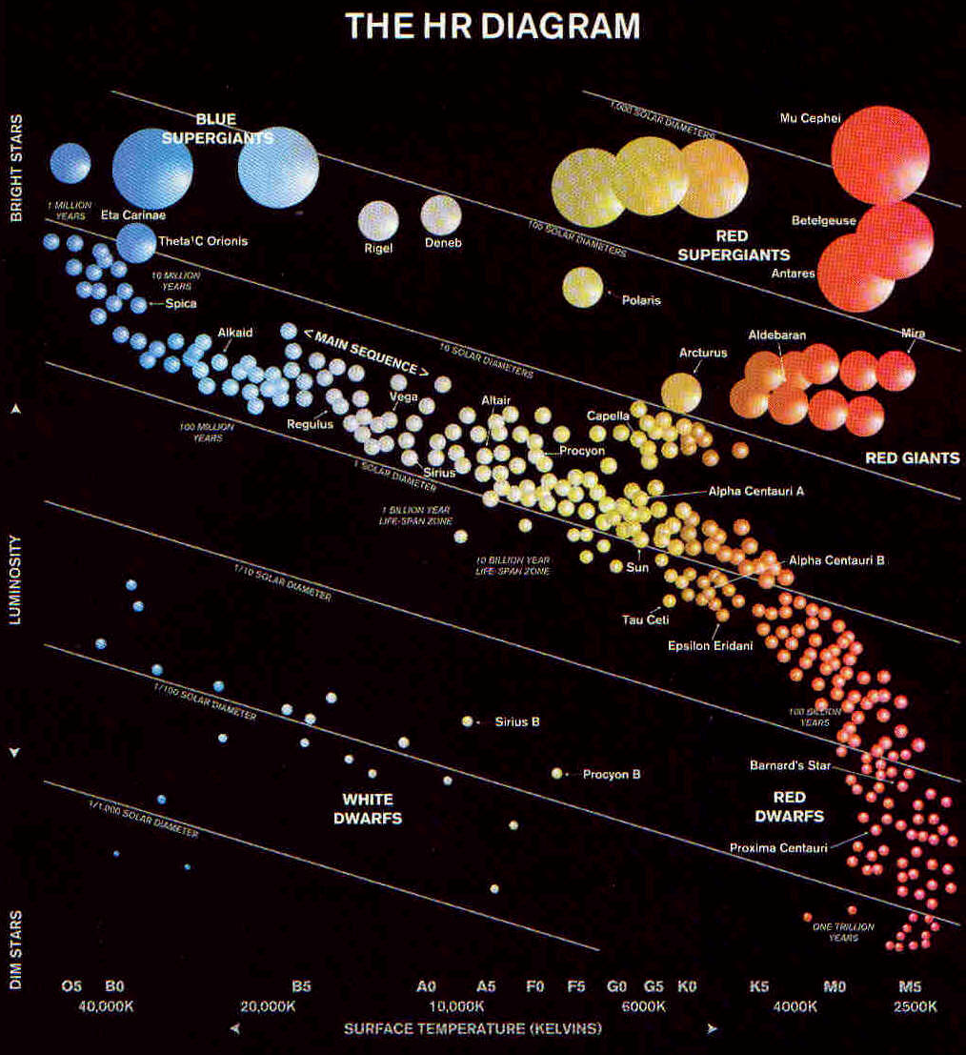
Hertzsprung-Russell Diagram
Brighter ➔
Cooler ➔

Slide 10
A Miniature Universe?
Harold Camping, Family Radio
The whole universe is only a few light-years across.
The parallax method shows the thousand nearest stars are closer, but doesn't show how far the background stars are.
All distance measurements used on the background stars are unreliable.

Slide 11
Problems for a miniature universe
Binary stars – compare speed in orbit to apparent size of orbit.
Dimmer stars – would be too small to hold their hot gases
Star clusters – give same sort of pattern as nearby stars, explained by same mechanism if they are at great distances

Slide 12
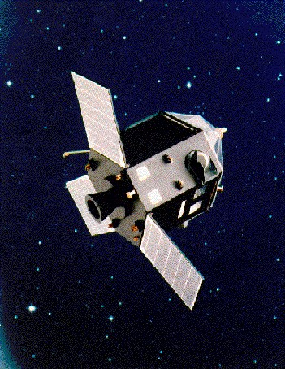
Problems for a miniature universe
Recent activity of Hipparcos satellite
Measures over a hundred times further using parallax than previous observations.
No sign of stars stopping beyond a few light years.

Slide 13
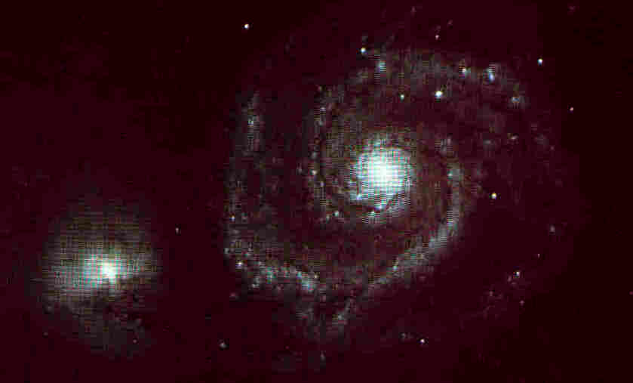
Galaxies
Huge collections of stars, up to hundreds of billions
Some are shaped like pinwheels (spirals), most like spheres, footballs, M & Ms (ellipticals), a few rather shapeless (irregulars)
These appear to be at distances of millions to billions of light-years.

Slide 14
Distances to Galaxies
Not measured by parallax, as too far away
Methods depend on comparing apparent & actual brightness of various objects
  Main sequence stars – color ➔ brightness
  Variable stars – period ➔ brightness
  Brightest stars & brightest (globular) clusters tend to have a fixed brightness
  Brightest galaxies in cluster same tendency

Slide 15
An Optically Small Universe?
Parry Moon & Domina Spencer
Some features of Einstein's Relativity could be explained otherwise if light travels in circles of radius 5 light-years.
So perhaps universe is just a dozen stars within this distance & their multiple images.
View attracted little interest in secular circles, but much among young-earth creationists.

Slide 16
Biblical Problems
Bible indicates a large number of stars, like sand on seashore, not just a few stars of which we see multiple images.
This model doesn't solve problem of light travel-time anyway.
  Light from objects that look thousands of light-years away must have made many circuits and taken thousands of years to do so.

Slide 17
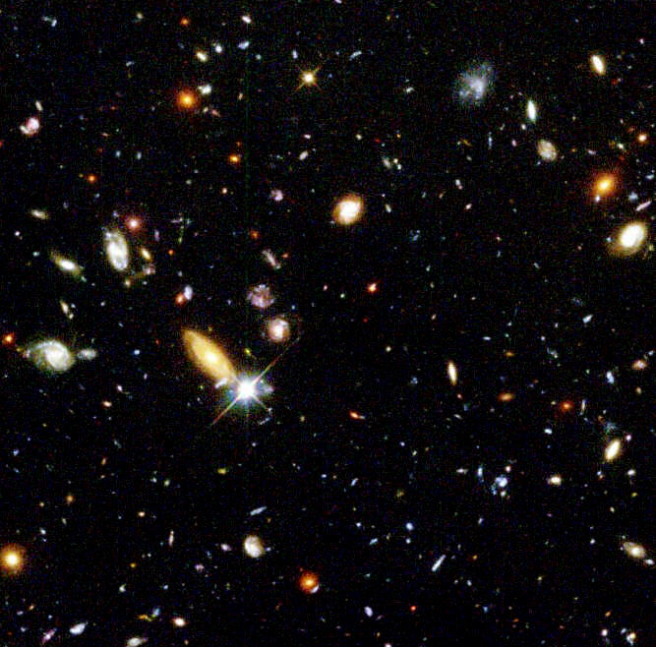
Scientific Problems
View postulates that all stars we see are just multiple images of the few within ten light-years.
  Like the multiple images in paired mirrors in clothing stores or amusement parks
But look at astronomical photos!
  Too much variety
  Too many large objects with coherent structure

Slide 18
Galactic Redshifts
In 1920s Slipher & Hubble found that all but the closest galaxies have their light shifted to the red, and shifted by greater amounts the greater their distance.
Redshift – dark or light lines in spectrum are at longer wavelengths (redder color) than for same lines in lab on earth.

Slide 19
Sources of Redshift
Gravity redshift – light coming out of a gravity field is redshifted; stronger field gives more redshift.
Motion redshift – used in police radar to catch speeders; motion away is redshifted, motion toward is blueshifted; amount indicates speed.
We have more experience with 'redshift' of sound waves from autos coming & going.

Slide 20
Explaining Cosmic Redshift
Gravity redshift requires enormous gravity field with no explanation for such.
Motion redshift implies universe is expanding, as though from an explosion, though most cosmologists think this is space expanding rather than physical movement of galaxies.

Slide 21
"Tired Light" Explanation
Jean-Pierre Vigier, et al, give this alternative to motion redshift.
Light is redshifted when traveling over long distances due to some unknown mechanism.
Not impossible for a finite, created universe, though even here this postulates an unknown mechanism for which there is no other evidence.

Slide 22
"Tired Light" Problems
Gravity is attractive, so how can a universe remain static rather than collapsing?
Stars don't burn forever, so how recycle to have an eternal universe?
If universe is infinite in size & age, it violates Olbers' paradox.

Slide 23
The Problem of Olbers' Paradox
The sky is relatively dark at night, but in an infinite, eternal universe it should be at least as bright as the sun’s surface!
  Imagine universe divided up into spherical shells centered on us (like layers of an onion)
  If stars reasonably uniform in distribution, then number of stars per shell increases with square of distance.
  But apparent brightness of each star decreases with square of distance, so each shell provides an equal amount of brightness, and total will be infinite!

Slide 24
The Solution to Olbers' Paradox
Analogous to question of how deep one must go into woods to see only tree trunks all around.
To have a dark sky, universe must not be deep enough to see only star surfaces in all directions.
Thus the universe is of finite age, or finite size, or average star density = 0.

Slide 25
A Young
"Created Light" Universe
Most common young-earth view
Universe very large, but only some 10,000 years old
Since most objects visible in large telescopes are more than 10,000 light-years away, the light coming from them must have been created on the way.

Slide 26
Problems with a Young
"Created Light" Universe
Stars & galaxies are sending us a stream of information about their history.
For objects > 10,000 light-years away, this history (on this view) is fictitious, telling us what the object would have been doing had it existed.
Given that God cannot lie, it seems this view has more problems than an old universe view.

Slide 27
Changing Speed of Light
Barry Setterfield, to avoid this problem, suggested speed of light was infinite at creation, has recently settled down to current value.
Thus Adam & Eve could see distant stars right away.
No need to accuse God of giving us fictitious history.

Slide 28
Problems with
Changing Speed of Light
Einstein’s equation E = mc² measures energy produced by nuclear reactions.
If humans existed when c was 100x larger, then c² was 10,000x larger, and sun would fry the earth!
If m is adjusted downward to keep E constant, then masses too small to keep air or people on earth.

Slide 29
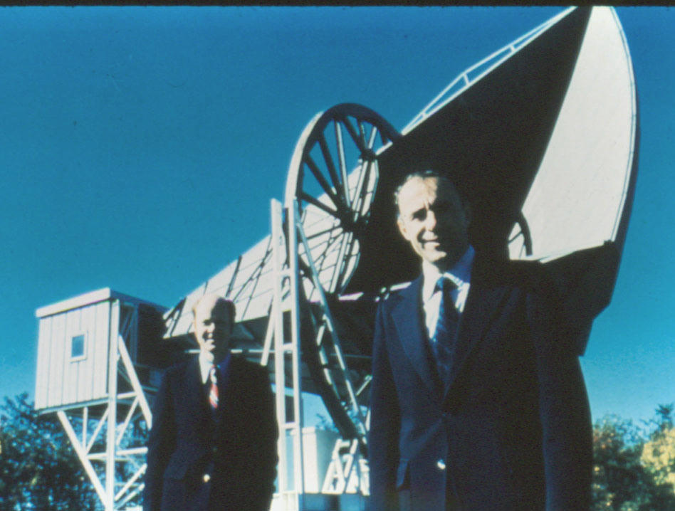
The Isotropic Radio Background
Won Nobel prize for discoverers Penzias and Wilson.
At radio wavelengths, sky is not black but gray.
This is very uniform in all directions, times and seasons, so it comes from beyond our galaxy.

Slide 30
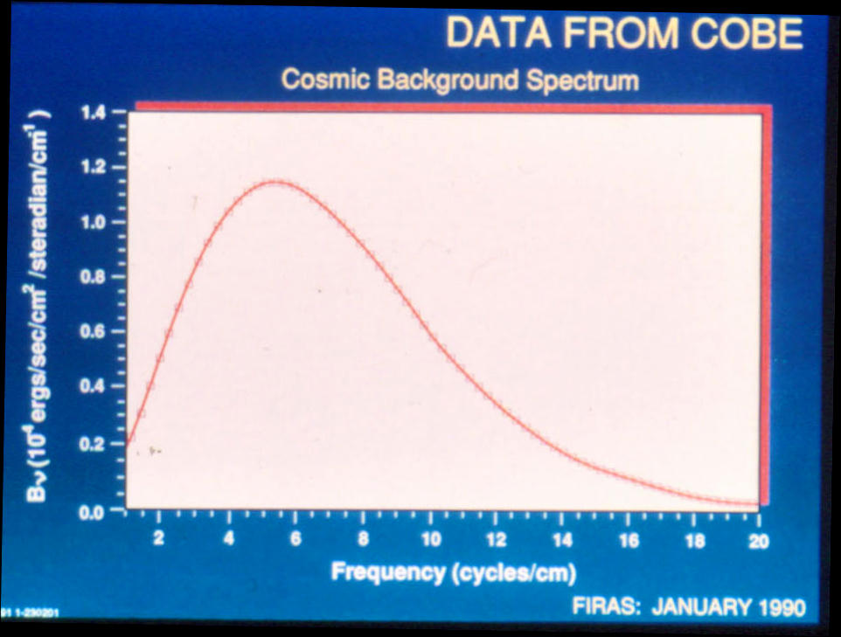
The Isotropic Radio Background
The recent COBE observations show a perfect fit to a 2.7 degree blackbody.
The individual data points fit the predicted curve in a spectacular way.

Slide 31
Significance of the Isotropic Radio Background
It was predicted years in advance by George Gamow as a natural consequence of a 'Big-Bang' cosmology.
In such a scheme, it is the glow from the time when the universe became transparent, about 100,000 years after its creation.
Other cosmologies have no natural explanation for this phenomenon.

Slide 32
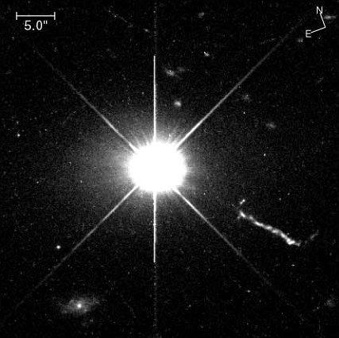
Quasars
Look like stars through optical telescopes
Unusually bright in radio telescopes
Have enormous redshifts, with most of them apparently billions of light-years away.

Slide 33
The Steady-State Cosmology
Bondi, Gold and Hoyle
Takes account of redshifts & finite lifespan of stars
Seeks to preserve an infinite, eternal universe (no Creator); seen as more satisfying philosophically
Universe is constantly expanding, but new matter pops into existence to keep density constant.

Slide 34
Problems for the
Steady-State Cosmology
Violates virtually all known conservation laws!
Doesn't have a natural explanation for:
  Isotropic radio radiation
  Quasar density being higher earlier in history of universe

Slide 35
The Big-Bang Cosmology
Fits observations of expanding universe and stars of finite age.
Predicts isotropic radio radiation, giving its frequency dependence exactly and its temperature approximately.
Fits observation that quasars more common early in history of universe.

Slide 36
Varieties of the
Big-Bang Cosmology
No-bounce version – universe began at the big bang.
One-bounce version – eternal universe, bounced once at the big bang.
Oscillating version – eternal universe, bouncing every 100 billion years; bounced at last big-bang event.

Slide 37
No-Bounce Big-Bang
George Lemaitre
Universe has not always existed.
It came into existence at the big-bang event.
Future:
  It might expand forever.
  It might collapse into a black hole.

Slide 38
One-Bounce Big-Bang
George Gamow
Universe has always existed.
Far back in past – just a thin soup of H gas
Gradually pulled together by gravity.
Bounced at big-bang event.
Since then – formed galaxies, stars, planets, life
Future – all will end with a whimper.

Slide 39
Oscillating Big-Bang
Sagan, Asimov have popularized
Eternal, like Gamow's One-Bounce
But have bounce every 100 billion years
Perhaps each bounce changes the basic physical constants, giving a different type of universe each time round.
For each cycle, universe ends with a bang.

Slide 40
Problems for an
Oscillating Big-Bang
Universe doesn't appear to have enough matter to collapse; in fact, expansion appears to be speeding up.
A contracting universe would collapse into a black hole instead of bouncing.
Even if both were not problems, would a universe be able to expand & contract forever without irreversible changes?

Slide 41
Problems for an
One-Bounce Big-Bang
Shares problems of bounce with oscillating big-bang.
Problem of infinitesimal rate of contraction producing a single universe-wide big-bounce

Slide 42
No-Bounce Big-Bang Favored
Most cosmologists are working with varieties of this today, at least to the extent that our universe is finite in size and began with the big bang.
Many are apparently hoping that our universe is just a subset of an infinite, eternal universe, of which ours is just a transient bubble, but it is hard to see how to test this.

Slide 43
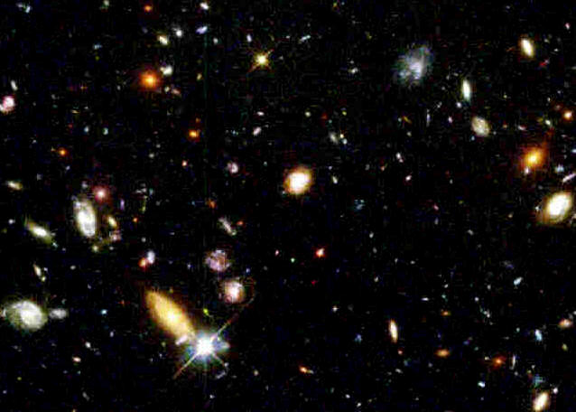
Summary of Scientific Data
Still cannot specify a single model, but:
  The universe is very large.
  The universe is very old, but of finite age.
  The universe appears to be created.
  Some variety of the no-bounce big-bang best fits the current data.

Slide 44
Biblical Data
The Bible pictures the universe as immeasurably large but finite.
It says the cosmos was created at a finite time in the past by the infinite, personal God of the Bible, and it evidences his craft.
It pictures the universe as running down.
Many see the Bible as picturing a young universe.

Slide 45
Universe as Immeasurably Large
I will make the descendants of David… as countless as the stars of the sky and as measureless as the sand of the seashore – Jeremiah 33:22
When I consider your heavens, the work of your fingers, the moon and stars, which you have set in place, what is man that you are mindful of him? – Psalm 8:3-4

Slide 46
Universe as Finite
He determines the number of the stars and calls them each by name – Psalm 147:4

Slide 47
Universe as Created
In the beginning God created the heavens and the earth – Genesis 1:1
By faith we understand that the universe was formed at God's command, so that what is seen was not made out of what is visible – Hebrews 11:3

Slide 48
Universe as Designed
The heavens declare the glory of God, the skies proclaim the work of his hands – Psalm 19:1
Since the creation of the world God‘s invisible qualities – his eternal power and divine nature – have been clearly seen, being understood from what has been made, so that men are without excuse – Romans 1:20

Slide 49
Universe Running Down
In the beginning you laid the foundations of the earth, and the heavens are the work of your hands. They will perish, but you remain; they will all wear out like a garment. Like clothing you will change them and they will be discarded – Psalm 102:25-27

Slide 50
Universe Young?
The traditional understanding of the Bible
Main reason for the influence of the young-earth creation movement among Bible-believers.
Bible does not teach the earth is young.
Bible does not say the days of Genesis 1 are literal or consecutive.
Bible does not say the genealogies of Genesis 5 and 11 should be added up to get a chronology.

Slide 51
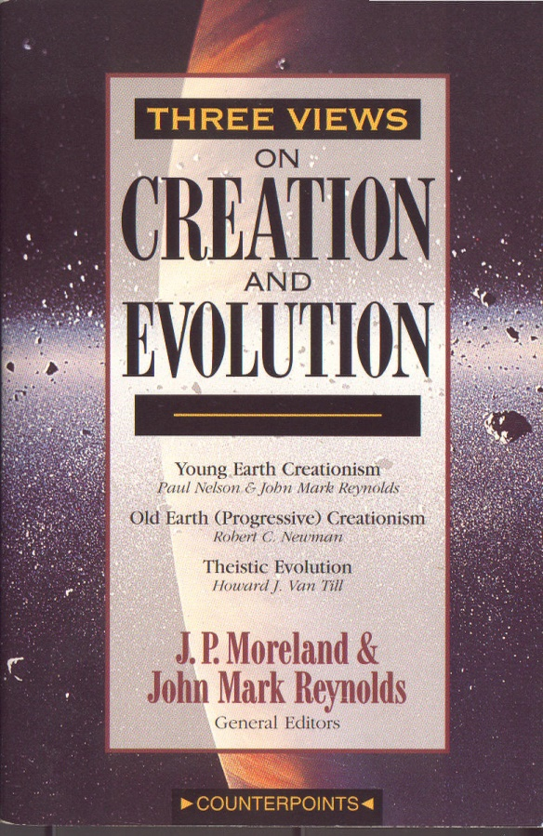
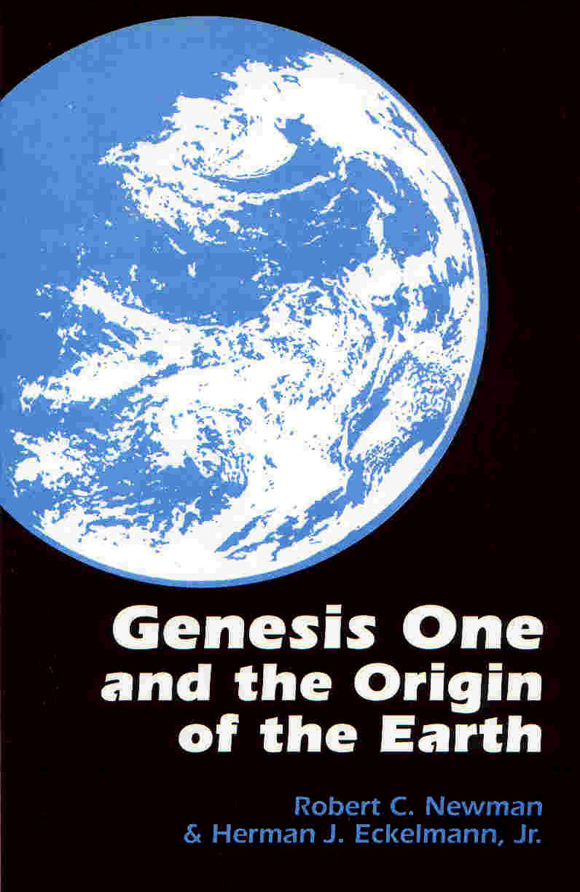
Universe Old?
A universe billions of years old is not taught in the Bible either, but it does not disagree with a fair and reasonable interpretation of the biblical creation account.
See my arguments in Genesis One & the Origin of the Earth and in Three Views on Creation & Evolution, plus those of Hugh Ross in Creation and Time.

Slide 52
The Cosmos & the Bible
Scientific Data relevant to Cosmology
Various Cosmological Models
  Some proposed by secular scientists
  Some proposed by Bible believers
Propose a Best Model, using both Scientific & Biblical Data
  An old, created universe like we actually see!

