Slide 1

Conflict between Christianity & Science
Robert C. Newman

Slide 2
Is there a conflict?
This is a matter of dispute:
Some see conflict.
Others see complementarity.
Still others see a more positive sort of interaction.

Slide 3
Conflict Model
A conflict between facts and faith:
  Science is never wrong, or at it is least self-correcting.
  Theology is never right, or it's always retreating.
This is the approach of:
  John W. Draper, History of the Conflict between Religion and Science (1874).
  Andrew Dickson White, A History of the Warfare of Science with Theology in Christendom (1895).

Slide 4

Complementarity Model
Science and religion each answer a different set of human needs.
The main problem is that each tends to tread on the other's turf.
These two activities should be kept separate.
This is the approach of:
  Howard Van Till
  Stephen Jay Gould

Slide 5
Interaction Model
Certain religious beliefs are conducive to the practice of science.
Interaction between science and religion can work for the advantage of both.
This is the approach of:
  Alfred North Whitehead
  Robert K. Merton

Slide 6
History of Science
The conflict approach is currently being panned by some historians of science:
  Colin Russell
  John Hedley Brooke
But we want to avoid over-reaction in the other direction also.
It appears there is both conflict and other sorts of interaction.

Slide 7
Sociology of Knowledge
Sociologists have noted that desire for the truth is not the only (nor even the main) motivation behind most group endeavors.
We see this is true for various groupings within Christianity:
  Denominations
  Congregations
  Schools
This is also true in science; see Thomas Kuhn, The Structure of Scientific Revolutions.

Slide 8
What is in conflict?
Do we compare 'science' with:
  Religion?
  Christianity?
  Theology?
  The Bible?
We suggest:
  Bible with nature (data)
  Theology with theoretical science (method)
  Exegesis with experimental science (interpretation)

Slide 9
Science: method or goal?
Method?
  Explanation without recourse to miracle?
Goal?
  Trying to understand what really exists?
Methodologically, 'science' and 'exegesis' are very similar.
No distinctive method divides various scholarly disciplines in such a way as to make science unique.

Slide 10
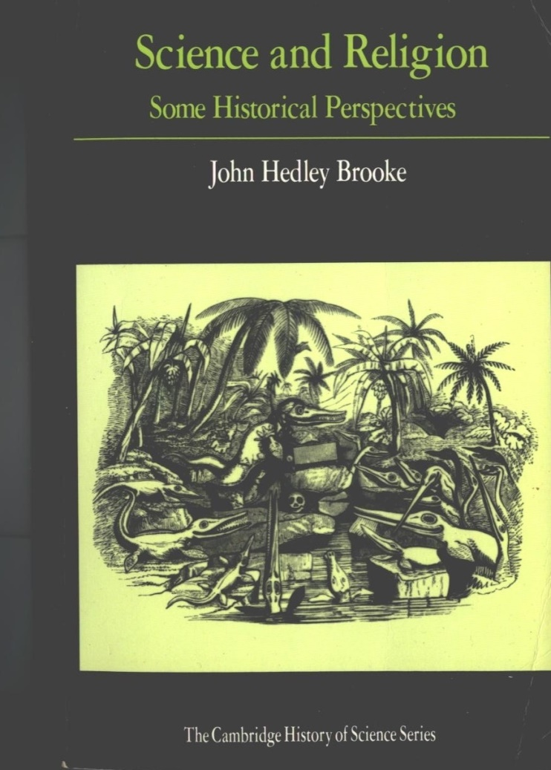
History of science & Christianity
As Brooke shows, the relations between the two have been a complex mixture of the three models:
Conflict
Complementarity
Interaction

Slide 11
Is theology never right?
This is rather unfair:
Nature (general revelation) provides enormous detail.
  The Bible (special revelation) does not.
Nature keeps showing us new pages every few years, as technology develops new instruments.
  We have had all of the Bible for centuries.
Still, if the Bible is what it claims to be, then we should see some evidence it is right about nature.
We do!

Slide 12
Some evidence
Matthew Maury, 'pathfinder of the seas'
S. I. McMillen, None of These Diseases
John W. Montgomery, Evidence for Faith
Robert C. Newman, The Biblical Firmament
My PowerPoint Astronomy and the Bible

Slide 13

Matthew Maury (1806-1873)
US Navy oceanographer, he was the first to recognize oceans as system of circulating currents.
Got this idea from biblical picture of 'paths in the seas' (Psalm 8:8).
Thinking through what a path does on land (makes travel easier, faster), he began to investigate travel time by sea.
His massive examination of ships' logbooks led to making charts for winds and currents.
Came to be called 'the pathfinder of the seas. '

Slide 14
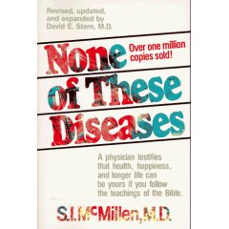
McMillen, None of These Diseases
Contrasts Bible on medical matters with other ancient ideas:
Contagion and quarantine
Cleanliness and spread of disease
Circumcision and cancer
Life style and health
Mental health

Slide 15
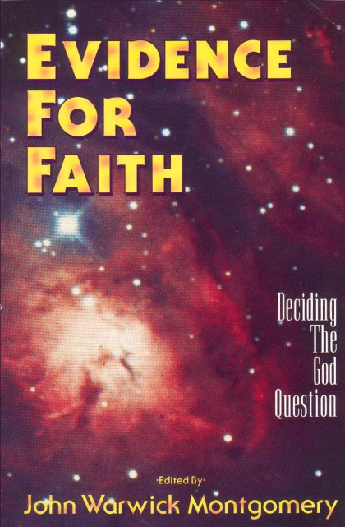
Montgomery, Evidence for Faith
22 chapters on various sorts of evidence for the truth of Christianity
4 chapters on medical evidences by Dr. William J. Cairney, Professor of Biology at the Air Force Academy:
  What is Life?
  Hebrew Dietary Laws
  Pride & Prejudice in Science
  How’s Your Lifestyle?

Slide 16
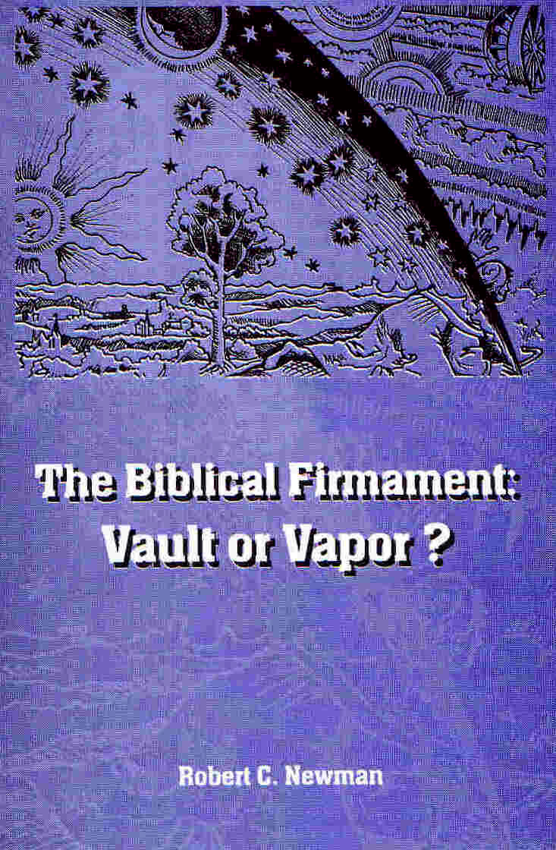
Newman, The Biblical Firmament
Responding to the claim that the Bible teaches the sky is a solid dome.
Shows that this view is a result of assigning an ancient view to the Bible without warrant, and of mistranslation of several passages.

Slide 17
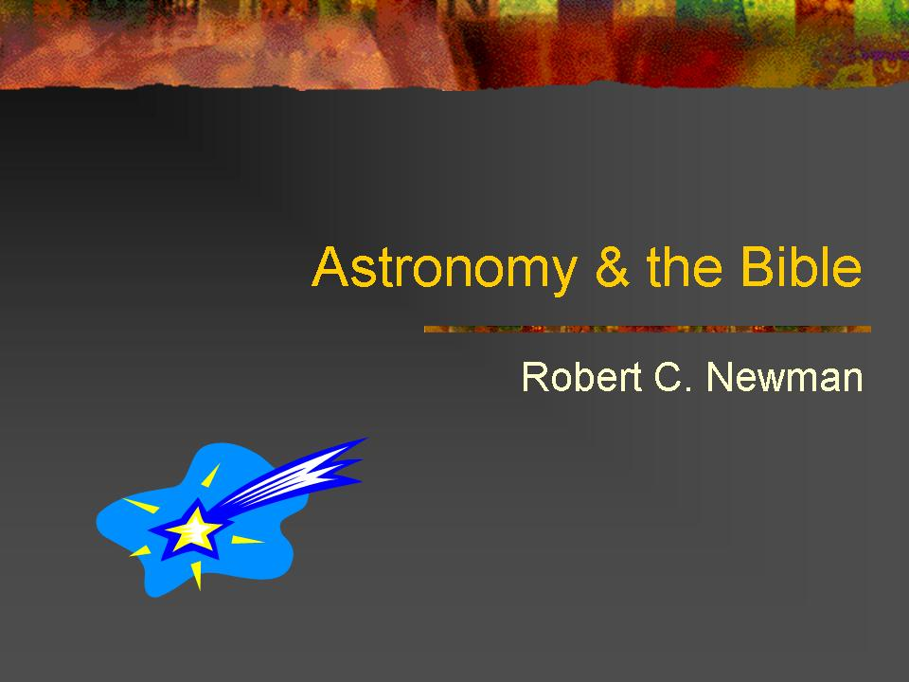
Newman, Astronomy and the Bible
Compares Bible with ancient ideas and modern science re:
Size of the Universe
Number of Stars
Support of the Earth
Shape of the Earth

Slide 18
Christianity as a Basis for Modern Science
Without claiming any intellectual superiority for the scientists of the Renaissance and Baroque periods over their ancient and medieval European predecessors or over Oriental philosophers, one has to recognize as a simple fact that 'classical modern science' arose only in the western part of Europe in the 16th and 17th centuries .... from this point on, anyone with the necessary talent may help build up science on solidly estab-lished foundations. Scientists from nations whose own culture did not give birth to anything like modern science have already made valuable contributions to it. Western people who have lost all contact with the religion of their forefathers continue in their scientific activities the tradition inherited from them. R. Hooykas, Religion and the Rise of Modern Science, 161

Slide 19
Christianity as a Basis for Modern Science
The confrontation of Graeco-Roman culture with biblical religion engendered, after centuries of tension, a new science. This science preserved the indispensable parts of the ancient heritage (mathematics, logic, methods of observation and experimentation), but it was directed by different social and methodological conceptions, largely stemming from a biblical worldview. Metaphorically speaking, whereas the bodily ingredients of science may have been Greek, its vitamins and hormones were biblical. Hooykas, Religion and the Rise of Modern Science, 162

Slide 20
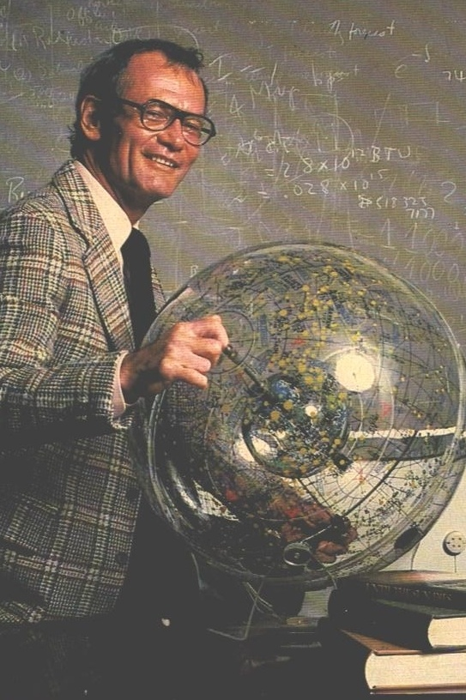
Creation & Modern Cosmology
For the scientist who has lived by his faith in the power of reason, the story ends like a bad dream. He has scaled the mountains of ignorance; he is about to conquer the highest peak; as he pulls himself over the final rock, he is greeted by a band of theologians who have been there for centuries. Robert Jastrow, God and the Astronomers, 116.

Slide 21
Some Conclusions
Yes, there has been conflict between science & Christianity, just as there has been conflict within Christianity and within science.
No, there is no need to see this as necessary conflict, so long as one does not define science so as to rule out the supernatural and miraculous in the history of the universe.

Slide 22
For further reading
John Hedley Brooke, Science and Religion: Some Historical Perspectives (Cambridge, 1991).
R. Hooykas, Religion and Rise of Modern Science (Eerdmans, 1972).
Newman & Eckelmann, Genesis One & the Origin of the Earth (IVP, 1977).
John L. Wiester, Genesis Connection (Nelson, 1983).

Slide 23
The End
… of this talk. The conflict will not end any time soon

