Slide 1

Computer Viruses, Artificial Life & the Origin of Life
Robert C Newman

Slide 2
Origin of Life
Many talk today as though life came about by purely natural processes, and it’s only a matter of time until we learn how it happened.
Here we suggest that life is far more complex than most people think, and it is hardly likely to have happened by chance.

Slide 3
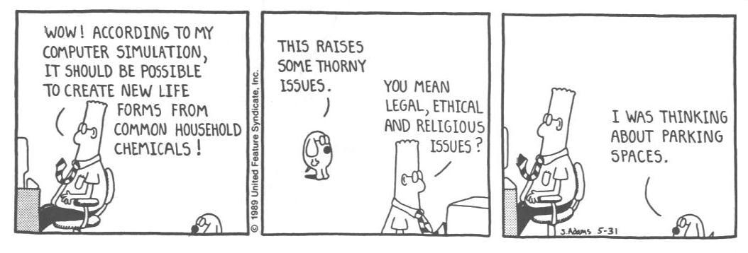
Origin of Life

Slide 4
Topics of Discussion
In thinking about the complexity of life, we will take a different tack than is usual.
We will look at computers rather than biology.
We want to look at:
  Computer Viruses
  Artificial Life

Slide 5
Computer Viruses
What are computer viruses?
Computer programs which invade a computer and try to take over its functions, rather like biological viruses do with human cells.
Most of us with computer experience have had to deal with such viruses from time to time.

Slide 6
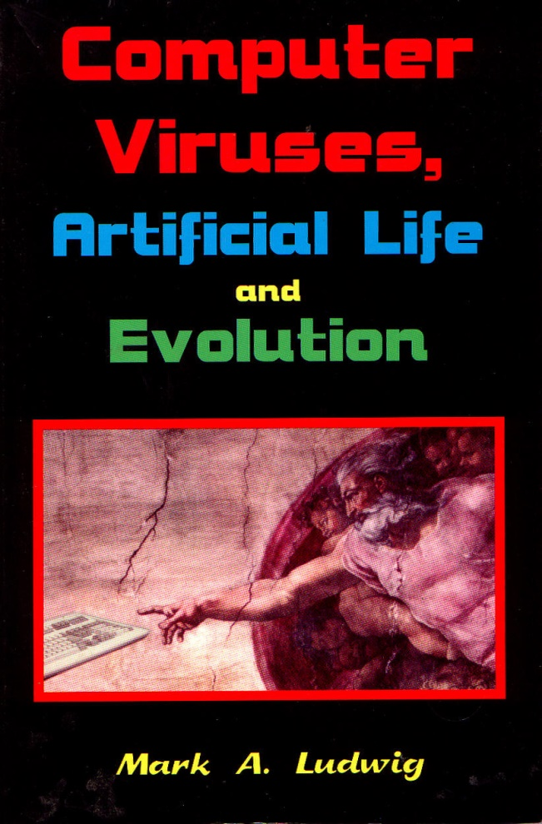
Computer Viruses
Excellent discussion in Mark Ludwig, Computer Viruses, Artificial Life & Evolution.
CVs are closer to artificial life than anything else humans have made.
They are able to reproduce.
They can often hide from predators.
They can survive outside captivity.

Slide 7
Origin of Computer Viruses
No one claims they arose by chance.
They are designed by intelligent (if malevolent) creators.
How likely would it be for something as complex as a computer virus to arise by chance in the computer environment?

Slide 8
How Likely to Arise by Chance?
Ludwig's "First International Virus Writing Contest" (1993)
  Devise shortest virus possible.
  Must have certain minimal functions.
Ludwig gives a sample, the grand prize winner, and several runners-up.
All are over 100 bytes in length.

Slide 9
How Likely to Arise by Chance?
Shortest virus is 101 bytes
There are 10²⁴³ possible files of length 101 bytes.
If we have all 100 million PCs in world run full-time, making only 101-byte files at 1000/sec:
Probability (hist univ) = 4 x 10⁻²¹⁴
If every elementary particle in universe such a PC, then Probability = 6 x 10⁻¹⁰⁰

Slide 10
Summary on
Computer Viruses
Even very simple computer viruses are very complex from the viewpoint of random assembly.
So we can see why no one thinks computer viruses formed by accident.
But perhaps some other form of artificial life will show us how this could have happened.

Slide 11
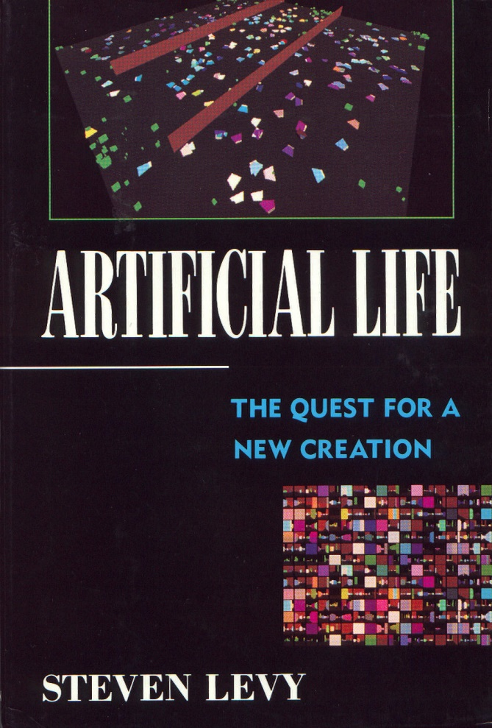
Artificial Life
What is artificial life?
Attempts to mimic or reproduce life by human ingenuity.
The term is commonly used today for attempts to mimic life by computer simulation, rather than by building up life from its basic biological components.

Slide 12
Making Artificial Life
Over 50 years ago, John von Neumann sought to design a self-reproducing automaton.
He imagined a rectangular array of identical computer chips, each wired to four neighbors.
Though identical, the chips will behave differently depending on what operational state each is in.

Slide 13
Von Neumann's Chips
4
2
2
1
1
0
1
0
3
2
0
5

Slide 14
Von Neumann's Automaton
Unit Under
Construction
Constructing
Unit
Constructing Arm
Memory
Control
Instruction Tape

Slide 15
Von Neumann's Automaton
Memory Control Unit – 300 x 500 chips
Constructing Unit – 300 x 500 chips
Instruction Tape – 150,000 chips
Whole thing about as complicated as a modern computer!

Slide 16
Langton's Simple Automaton
Much simpler than von Neumann’s
Modified a small component part of a previous automaton so that it would reproduce itself
A 10 x 10 loop with a 5 x 3 arm
The "instruction tape" fits inside and extends arm by 6 units, turns left, repeats this 3 times, till arm collides with self, breaks off new loop and makes new arms for each.
Reproduces in 151 time-steps

Slide 17
Langton's Simple Automaton
22222222
2170140142
2022222202
272 212
212 212
202 212
272 212
21222222122222
207107107111112
2222222222222

Slide 18
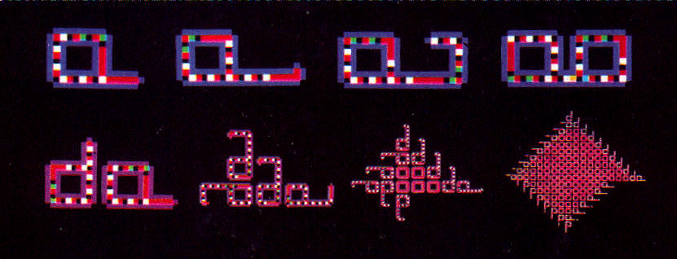
Langton's Simple Automaton
Bottom panel shows later generations:

Slide 19
Byl's Simpler Automaton
T = 0 T = 5 T = 10
22 22 22 3
2632 2342 2462
2642 266633 23664363
25 2212 221222
T = 15 T = 20 T = 25
22 3 22 2 22 22
2662 3 2632 362 2345 2632
243664362 264366432 2662 2642
2212222 2212222 22 2 25

Slide 20
Ludwig's Simpler Automaton
T = 0 T = 1 T = 2 T = 3 T = 4 T = 5
2 2 2 2 2 25
212 212 212 21 213 21 4
3 5 2 2 2
4 636 626 2
6 262 212

Slide 21
Probabilities for
Random Formation
Langton's Automaton
  P (hist univ) = 1 x 10⁻¹²⁹
Byl's Automaton
  P (hist univ) = 1 x 10⁻⁶⁹
Ludwig's Automaton
  P(Byl assump) = 1 every 10⁻¹⁴ sec
  P(more reasonable) = 1 x 10⁻⁸⁶

Slide 22
Problems w/ Simple Automata
Not good for anything but reproduction.
Reproduction typically collapses with any mutation.
A viable automaton will need to be able to reproduce while changing.
Thus we need to add more chip states, increasing complexity.

Slide 23
A "Life" Automaton
Try to be more general than three above automata.
Don't tie to substrate especially designed for automaton.
Use John Conway's game "Life" as substrate.
Simplest reproducer is enormously complex, like von Neumann's!

Slide 24
The Problem of Fragility
All these automata run in an empty environment.
What happens if they contact other objects in their space?
Have tested Langton automaton for this; results are disastrous.
Automaton is too fragile to function in such a space.

Slide 25
Summary on Automata
Universal constructors far too complex.
Special constructors too specialized, too fragile to handle mutations.
Need to build automata that are:
  general enough to be flexible,
  are robust, and
  not too complex to form randomly.
This looks to be impossible.

Slide 26
Real Life
So far, the artificial life project is like the biological origin-of-life project.
Both have produced some minor results, which have been hyped far out of proportion to their actual significance.
Researchers realize you can't get funding if the funders think the project is hopeless!

Slide 27
What This Means
Don't mistake research proposals for results!
Don't mistake worldview-driven visions for a view of the real world.
The results look far more like evidence of intelligent design.

Slide 28
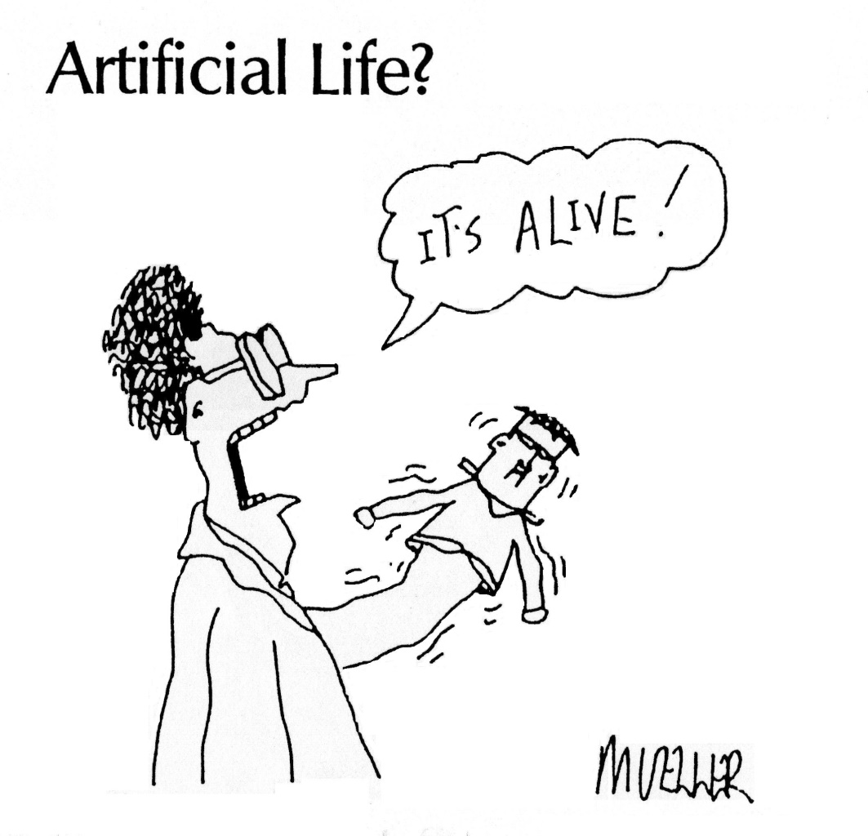
What This Means

Slide 29
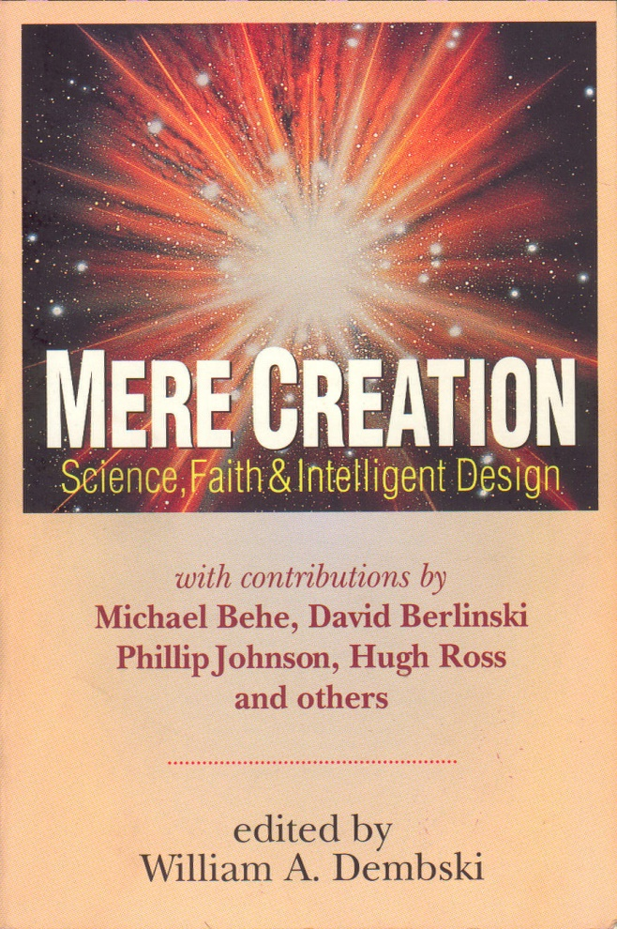
For Further Reading…
My article "Artificial Life & Cellular Automata" in Mere Creation: Science, Faith & Intelligent Design, edited by William Dembski

Slide 30
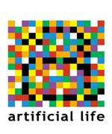
The End …
Will man-made simulations prove life happened by itself?
Don't count on it!

