Slide 1

Computer Simulations of Evolution
Robert C. Newman

Slide 2
What are we doing here?
Not a literature search
Not dealing with origin of life
Nor with competition & spread of varieties
Rather a description & investigation of three programs re/ mechanism of evolution:
  Two described by Dawkins, Blind Watchmaker
    BIOMORPH
    SHAKES
  One devised by myself
    MUNSEL

Slide 3
Program BIOMORPH
Slightly simplified from Dawkins.
Building 'organisms' from genetic information, then selecting among mutants.
Gene is a sequence of eight small integers.
Integers generate 'tree' by controlling:
  Branch length
  Angles
  Recursion depth (number of levels of branching)

Slide 4
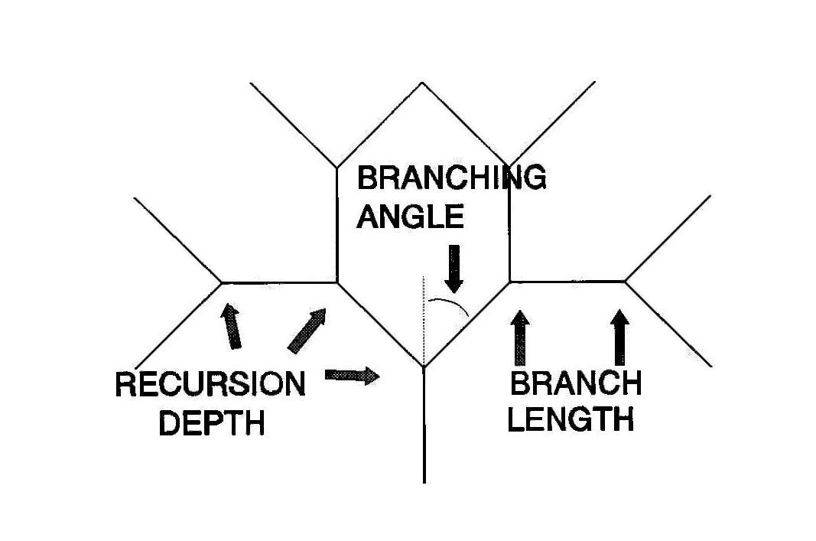
Sample BIOMORPH Tree

Slide 5
Program BIOMORPH
Trees have mirror symmetry.
Given a starting gene, program constructs all 'one-step' mutations, displays them on screen.
Operator selects which mutant will succeed parent.
Program repeats, using chosen mutant.

Slide 6
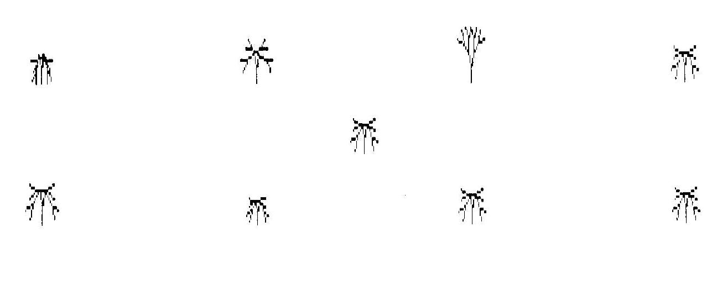
BIOMORPH Output
Mother surrounded by next generation of mutant daughters

Slide 7
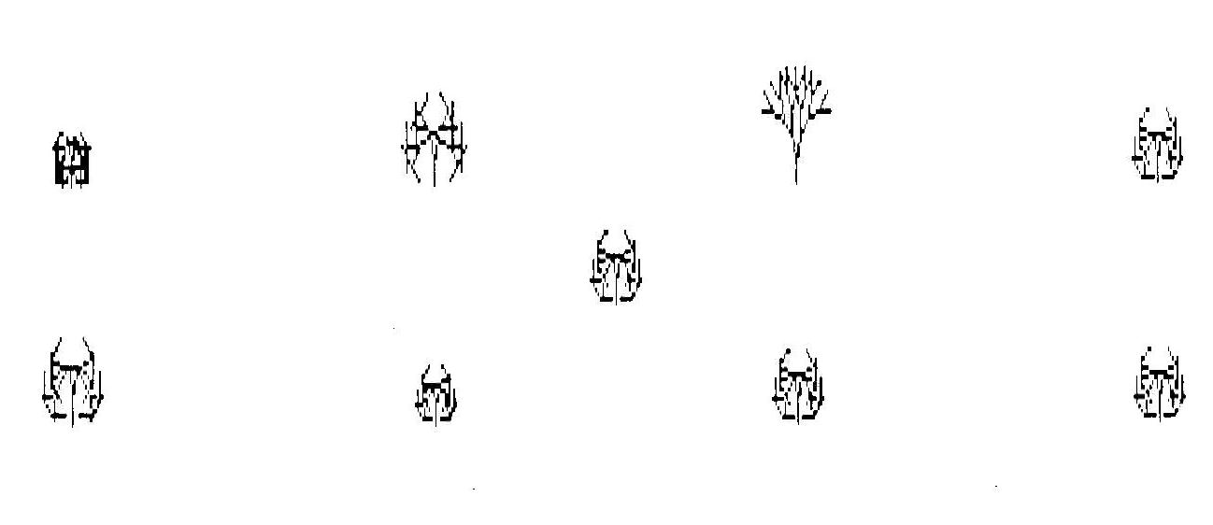
BIOMORPH Output
Another mother surrounded by next generation of mutant daughters

Slide 8
Lessons from BIOMORPH
Shows how:
  Mutation operates on DNA
  Selection operates on developed form, not DNA
We see that:
  Identical forms can conceal different genetics
  This leaves room for neutral mutation

Slide 9
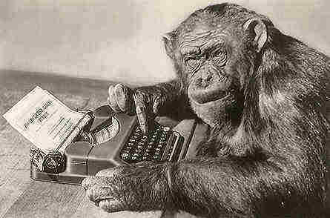
Program SHAKES
Give a few monkeys enough time and they will eventually type out the works of Shakespeare.

Slide 10
Program SHAKES
Dawkins in SHAKES seeks to circumvent problem of "monkeys typing Shakespeare" taking an utterly outrageous time to do so.
Choose a target sentence or phrase, e.g, "METHINKS IT IS LIKE A WEASEL"
Start with gibberish of same length.
Mutate gibberish, selecting mutant (if closer to target) as new parent.
Repeat with new parent.

Slide 11
Program SHAKES
Gibberish converges to target to reach goal much faster than if monkeys were typing randomly.
Dawkins gets convergence in typically 40-70 generations.
Dawkins doesn't describe his program in detail, so can't tell how he generated mutants, nor how many per generation.

Slide 12
Sample from Dawkins
(0) Y YVMQKZPFJXWVHGLAWFVCHQXYOPY
(10) Y YVMQKSPFTXWSHLIKEFV WQYSPY
(20) YETHINKSPITXISHLIKEFA WQYSEY
(30) METHINKS IT ISSLIKE A WEFSEY
(40) METHINKS IT ISBLIKE A WEASES
(50) METHINKS IT ISJLIKE A WEASEO
(60) METHNNKS IT IS LIKE A WEASEP
(64) METHINKS IT IS LIKE A WEASEL

Slide 13
Program SHAKES
My version: one mutation each generation, randomly chosen for location & type.
This mutant compared with parent.
Better of two survives.
I get much slower convergence than Dawkins does, typically over 1,000 generations.
So Dawkins is doing something much more favorable than this.

Slide 14
Program SHAKES
My version:
Target METHINKS IT IS LIKE A WEASEL not reached in 1,000 generations.
Target HAPPY BIRTHDAY not reached in 1,000 generations!
Target QUO VADIS reached in 867 generations.

Slide 15
Sample from Newman
(0) NEOW KERA
(50) QVOBUBEGM
(100) QVOBUAEGS
(200) QUOAUADHS
(300) QUO UADHS
(400) QUO UADIS
(500) QUO UADIS
(867) QUO VADIS

Slide 16
Program SHAKEH
My version modified: one mutant at each position each generation.
This multi-mutant compared with parent.
Better of two survives.
I now get much faster convergence than before, but still slower than Dawkins does.
So Dawkins is doing something still more favorable than this!

Slide 17
Sample from Newman
(0) NEOW KERA
(20) RSOBVADJQ
(30) RSOAVADJS
(40) RUOAVADJS
(50) RUOAVADIS
(60) RUOAVADIS
(70) RUOAVADIS
(92) QUO VADIS

Slide 18
Lessons from SHAKES
Shows that a 'rachet mechanism' does work.
This is an important reason why many are convinced evolution must be correct.
But this is guided evolution, i.e., intelligent design!
This is a considerably more efficient process even than artificial selection (since it has a target) – to say nothing of natural selection!

Slide 19
Lessons from SHAKES
This does not solve the time problem.
  Which of these versions is most realistic?
  Mutation rate in eukaryotes is 10⁻⁸ per replication.
  All these versions ignore time involved for mutant to take over the population.
All the versions suggest a problem for mutating into complex or optimal structures:
  Last pieces of puzzle are highly constrained
  Therefore very unlikely!

Slide 20
Program MUNSEL
Simulate mutation and natural selection by analogy with human language.
A letter string is both the gene & organism.
Mutation is random change in content and/or length.
Selection is 'naturalized' by requiring that each grouping in the string be an English word.

Slide 21
A Sample Run of MUNSEL
Start with a single letter:
(0) C
(4) O (first 1-letter word)
(28) LA (first 2-letter word)
(43) FAY (first 3-letter word)
(54) CARE (first 4-letter word)
(61) CARED (first 5-letter word)
(382) WOOED (no 6-letter word yet)

Slide 22
A Sample Run of MUNSEL
Fix length; start with gibberish:
(0) MWEOOHA OWM H AOE EKEHT QOEN
(11) MWEOOHA CWM Y AFU EO HI QOHN
(66) MSEOMD DOWM V ART EI HI QWTB
(81) MHEHO DOWM W ART ME HI IWXY
(98) MH GO DZWR W ART RE HI ISIY
With 98 generations get four words, longest 3 letters.

Slide 23
Program MUNSEL
Current version has operator do selecting, but using a spell-checker would be more objective.
Program generates words of 1-4 letters rather easily.
Relative frequency of space character (and nature of selection) tends to keep words short.
Little success in getting intelligibility in 100s of steps.

Slide 24
Lessons from MUNSEL
Complex organisms involve hierarchies of structure, somewhat like intelligible writing.
  Letters > Words > Phrases > Sentences …
Mutation only works at lowest level
  nucleotides ←→ letters
  So becomes tougher to get anything acceptable as we move up the hierarchy
Non-selected mutation → gibberish

Slide 25
Lessons from MUNSEL
Neutral mutations spread only by random walk.
Functional isolation seen here
  Many combinations cannot be reached by single mutations from acceptable smaller groups
  What is relative size of islands of intelligibility vs oceans of gibberish?
Can you really get there from here?
  Complex organs/organisms
  Crossing higher levels of biological classification

Slide 26
Computer Simulations of Evolution?
Don't look promising!
Suggest some sort of
Intelligent design

