Slide 1

Christianity & Science
Robert C. Newman

Slide 2
What is Christianity?
Various Definitions:
Sociological:
  The religion & culture of those who call themselves Christians.
  There is enormous variety here.
Theological:
  The beliefs, attitudes & lifestyle taught in the Bible.
  We will try to work with this approach, as best I understand what the Bible teaches.

Slide 3
What is Christianity?
The universe is the creation of a single, infinite, personal God.
Among created beings, some were made with the ability to make moral choices & act on them.
The first humans did so by rebelling against God.
The main story of our world since then has been God’s action to remedy this problem, especially through Jesus.

Slide 4
What is Science?
Various Definitions:
Sociological:
  The activities & culture of those who call themselves scientists.
Methodological Alternatives:
  An attempt to explain nature without recourse to the supernatural.
  An attempt to explain nature by inference to the best explanation, whether or not this involves the supernatural.

Slide 5
Are Christianity
& Science Compatible?
Depends on definition of science:
  If science excludes supernatural, no.
  If science allows supernatural, yes.
We will suggest, in the course of this talk, that the latter definition of science is to be preferred if one truly wishes to find out what reality is like.

Slide 6
Christianity on
Matters re/ Science

Slide 7
A Beginning
In the beginning God created the heavens and the earth.
Genesis 1:1

Slide 8
Christianity on Matters re/ Science
Christianity sees a universe with a beginning.

Slide 9
Universe Displays Craftsmanship
The heavens declare the glory of God, their expanse proclaims his handiwork.
Psalm 19:1

Slide 10
Christianity on Matters re/ Science
Christianity sees a universe with a beginning.
It sees the universe as telling us about God by means of its craftsmanship.

Slide 11
Universe Displays
God's Wisdom
The Lord created me [Wisdom] at the beginning of his work, the first of his acts of old. Ages ago I was set up, at the first, before the beginning of the earth. When there were no depths I was brought forth, when there were no springs abounding with water. Before the mountains had been shaped … then I was beside him, like a master workman, and I was daily his delight.
Proverbs 8:22-31

Slide 12
Christianity on Matters re/ Science
Christianity sees a universe with a beginning.
It sees the universe as telling us about God by means of its craftsmanship.
The universe shows us His wisdom.

Slide 13
God's Power & Deity Seen in the Universe
The wrath of God is revealed from heaven against all ungodliness and unrighteousness of men, who by unrighteousness suppress the truth. For what can be known about God is plain to them … For his invisible attributes … his eternal power and divine nature, have been clearly perceived, ever since the creation of the world, in the things that have been made, so they are without excuse.
Romans 1:18-20

Slide 14
Christianity on Matters re/ Science
Christianity sees a universe with a beginning.
It sees the universe as telling us about God by means of its craftsmanship.
The universe shows us His wisdom.
It shows His power & deity in such a clear way as to render us without excuse for not recognizing & responding to it.

Slide 15
God in Control of the Universe
I am God, and there is no other; I am God, and there is none like me, declaring the end from the beginning and from ancient times things not yet done, saying, 'My counsel shall stand, and I will accomplish all my purpose.'
Isaiah 46:9-10

Slide 16
Christianity on Matters re/ Science
Christianity sees a universe with a beginning.
It sees the universe as telling us about God by means of its craftsmanship.
The universe shows us His wisdom.
It shows His power & deity in such a clear way as to render us without excuse for not recognizing & responding to it.
Christianity sees God in complete control of the universe.

Slide 17
Universe will End
Of old you laid the foundation of the earth, and the heavens are the work of your hands. They will perish, but you will remain; they will all wear out like a garment. You will change them like a robe, and they will pass away, but you are the same, and your years have no end.
Psalm 102:25-27

Slide 18
Christianity on Matters re/ Science
Christianity sees a universe with a beginning.
It sees the universe as telling us about God by means of its craftsmanship.
The universe shows us His wisdom.
It shows His power & deity in such a clear way as to render us without excuse for not recognizing & responding to it.
Christianity sees God in complete control of the universe.
It sees God as bringing it to an end.

Slide 19
Science/Nature & Christian Claims

Slide 20
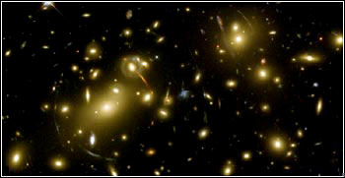
Cosmology
The Bible says there was a beginning, when God created heaven & earth.
Until recently, many scientists claimed the universe always existed.
Now evidence has accumulated that the universe apparently began (from nothing) at a finite time in the past.
Nature says there was a beginning.

Slide 21
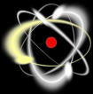
Design in the Universe
The Bible pictures God as having made the universe by His wisdom.
Scientists who are atheists claim that the universe is the way it is by chance.
In recent years, strong evidence has accumulated that the universe is marvelously adjusted to allow life to exist.
Nature says the universe is designed.

Slide 22
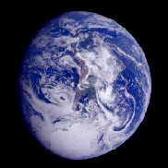
Origin of the Earth
Bible believers often claim the earth was made instantly in its finished form just a few thousand years ago.
Nature seems to teach that the earth had a long history before it reached the form it has today.
The Biblical account of creation in Genesis 1 is consistent with the evidence from astronomy & geology for an old earth.

Slide 23
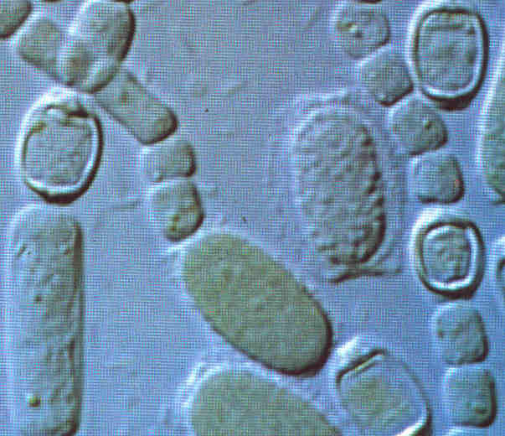
Origin of Life
The Bible says that God created life.
Some scientists claim that life arose from non-life by purely natural processes.
The complex functionality of living things seems clearly to surpass what could happen by chance in our universe.
Nature points to something beyond itself by containing the phenomenon we call "life."

Slide 24
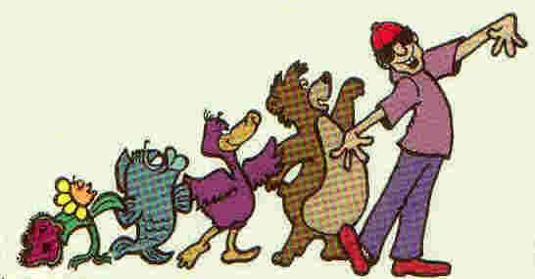
The Diversity of Life
The Bible says God made the diverse living things, but does not give us much information about how He did so.
Many scientists claim that all the variety of life evolved from the simplest living things by purely mindless, random processes.
Detailed studies of the fossil record and of living things point to some sort of intelligent guidance or intervention.

Slide 25
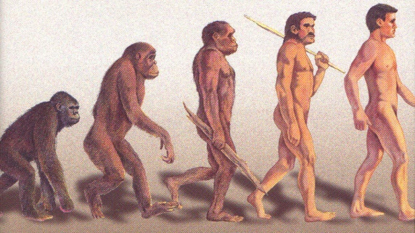
Origin of Humans
The Bible says God made humans in His own image.
Many scientists claim humans developed naturally from apes.
Though humans are quite similar to the apes physically, there is a great chasm between them in regard to intellect, initiative and spirituality.
This does not look like something that happened by chance.

Slide 26
A Tour of Genesis One
In the beginning, God created heaven & earth.
  A beginning, perhaps the "big bang."
The earth was formless & empty.
  Earth (& Sun) formed from cloud of gas & dust.
Darkness over the surface of the deep.
  Gas cloud becomes dark within as it contracts.

Slide 27
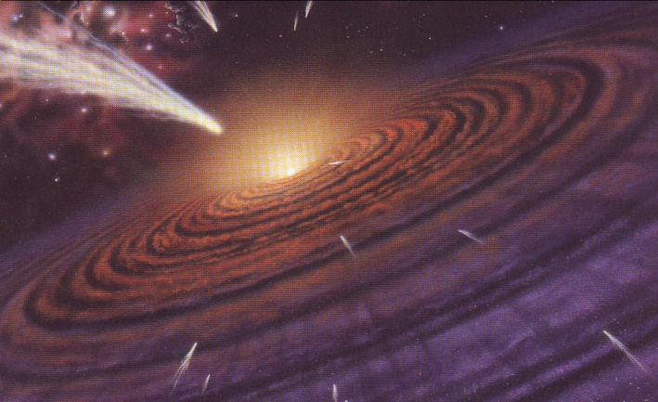
Tour of Genesis
God says, "Let there be light."
  With further contraction, cloud begins to glow.
God separates light from darkness.
  Material to form planets pushed outside central bulge.
God calls light 'day' & darkness 'night.'
  Planets form; their rotation gives night & day.

Slide 28
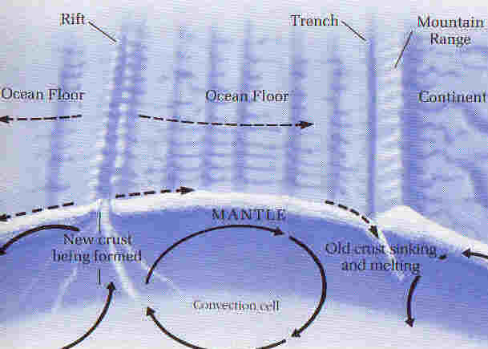
Tour of Genesis
Let the waters be gathered, land appear.
  Motion of plates produces continents, basins.
Let the land produce vegetation.
  Plant life appears on land.
Let sun, moon and stars appear in the sky.
  Plants oxygenate atmosphere, clearing sky so space visible; provide air for animals.

Slide 29
Tour of Genesis
Let waters & air fill with animals.
  Marine and air animals appear.
Let the land produce various animals.
  Land animals appear.
Let us make mankind in our image.
  Humans appear last in the fossil record.

Slide 30
Conclusions
A striking correlation between nature and Scripture!
Both picture:
  A universe with a beginning
  A designed universe
  An origin of life that surpasses chance
  A diversity of life that suggests intervention
The details of Genesis 1 match our best scientific model for the early earth.

Slide 31
Conclusions on Origins
All this comes by taking the biblical account of origins seriously, but not taking it to teach a recent creation in just a few days.
This is reasonable in view of the biblical teaching that both nature and the Bible are God's revelation, and that God cannot lie.

Slide 32
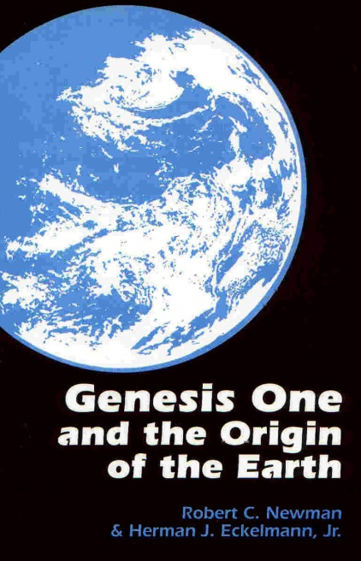
For Further Reading
Websites:
  www.ibri.org
  www.reasons.org
Ross, Creator & Cosmos
Newman & Eckelmann, Genesis One & the Origin of the Earth
Denton, Nature's Destiny
Behe, Darwin's Black Box
Newman & Wiester, What's Darwin Got to Do With It?

