Slide 1

Erich von Däniken's
Chariots of the Gods
Fact or Fiction?
Robert C. Newman

Slide 2

Von Däniken's Theory
Strong interest in extra-terrestrials for almost a century now.
Von Däniken claims ETs have visited the earth again & again throughout history.

Slide 3
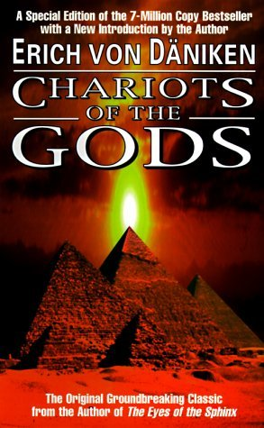
Von Däniken's Theory
Where is his evidence for this? See his book.
Not only in UFO stories, but also, he claims, in history & archaeology:
  Strange art-forms
  Impressive structures beyond human capabilities
  Stories of miraculous events

Slide 4
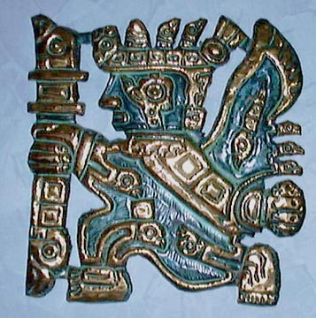
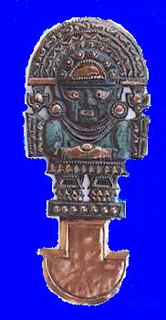
Strange Art-Forms

Slide 5
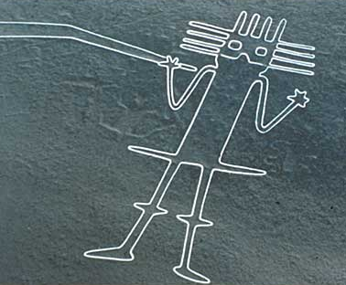
Strange Art-Forms

Slide 6
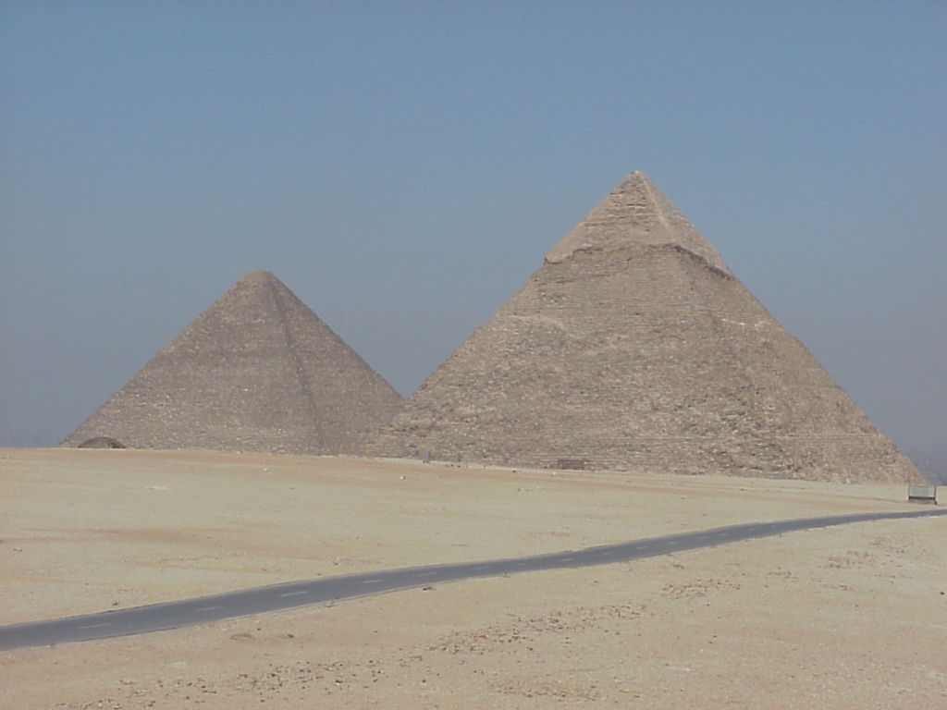
Impressive Structures

Slide 7
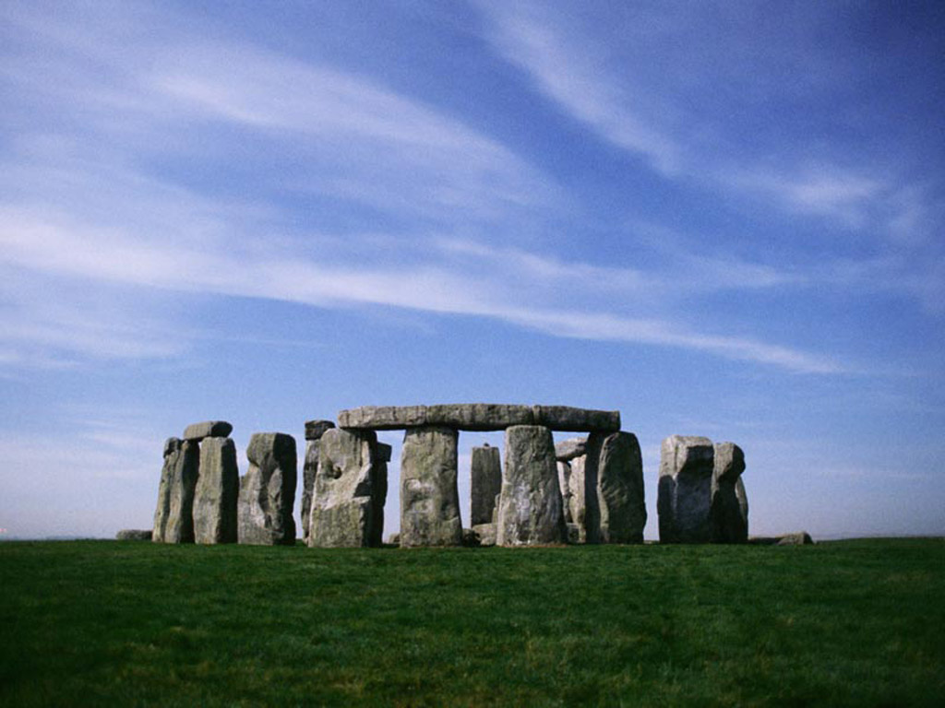
Impressive Structures

Slide 8
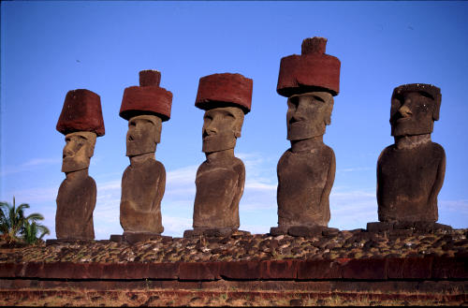
Impressive Structures

Slide 9
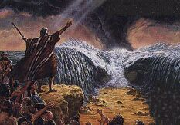
Miracle Stories

Slide 10
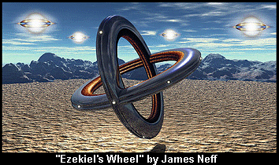
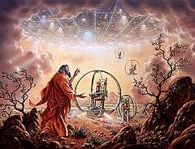
Miracle Stories

Slide 11
Archaeology vs.
Von Däniken

Slide 12
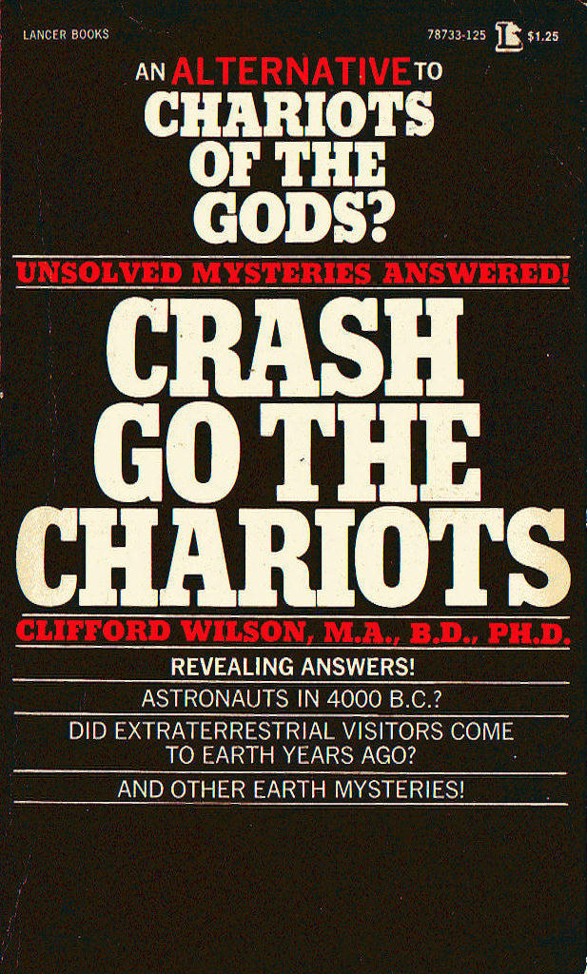
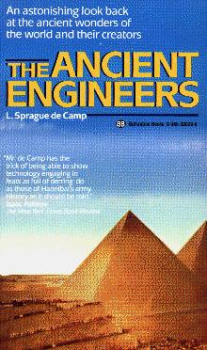

Our Approach
Look at some of von Däniken's evidence.
Respond to it in the light of archaeology.
VD is easier to answer archaeologically than by other sciences.
Some references:

Slide 13
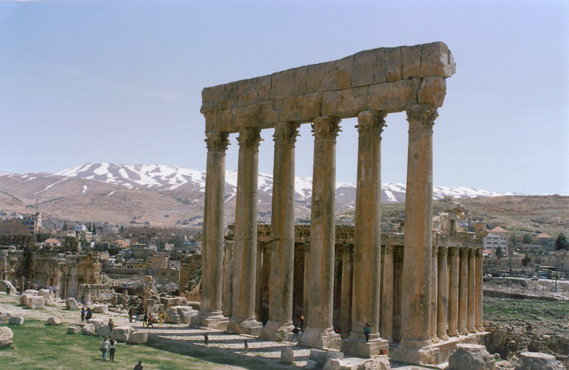
Baalbek, Lebanon

Slide 14

Ancient Marvels or
Space Travel Centers?
To the north of Damascus lies the terrace of Baalbek—a platform built of stone blocks, some of which have sides more than 65 feet long and weigh nearly 2,000 tons. Until now archaeologists have not been able to give a convincing explanation why, how or by whom the terrace of Baalbek was built. Russian Professor Agrest considers it possible that the terrace is the remains of a gigantic airfield. (Chariots of the Gods, 93)

Slide 15
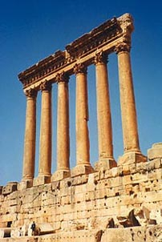
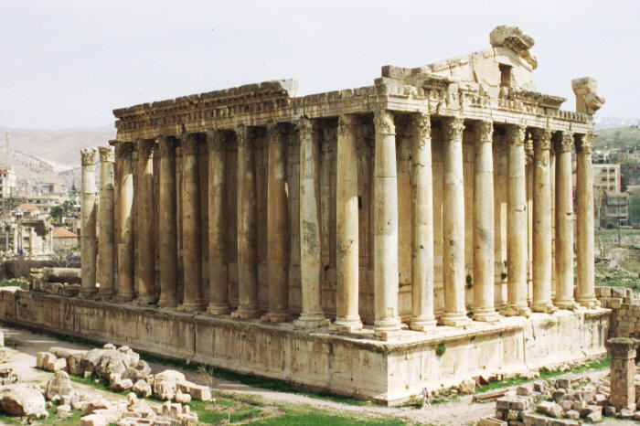
Baalbek
A large temple complex about an hour east of Beiruit.
The temple of Bacchus:
The Temple of Jupiter, located on von Däniken's platform/terrace:

Slide 16
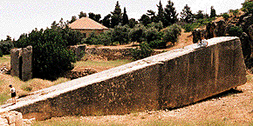
Baalbek
Largest 3 stones in Jupiter temple are 64x14x12 feet, and weigh ~800 tons.
Largest stone on the site is this one: 70x16x14, at ~1500 tons.
A launching ramp?

Slide 17
Baalbek
Most inscriptions at the site are in Latin, so after 63 BC, when the Romans came into the East.
A few earlier are Greek, so after 330 BC.
The main platform was apparently not there when the Seven Wonders were enumerated, about 200 BC, as not included in list.
The style of the temples is Roman in any case, as they built their temples on platforms.
But someone did move stones weighing 800-1500 tons. How did they do it?

Slide 18
A 'Sunday' Archaeologist
Von Däniken is, as he says, a 'Sunday' or amateur archaeologist.
A danger of amateurism in any subject is that of making big theories which fit only a small portion of the data.
Von Däniken also treats the ancients as ignoramuses, a popular (but false) idea.

Slide 19
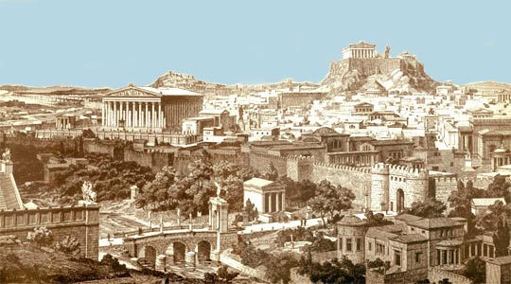
Athens, Greece

Slide 20
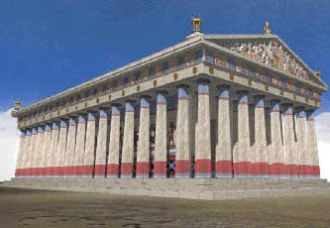
Athens
Not one of the sites mentioned by von Däniken, but one of the more impressive in antiquity.
The Parthenon, especially, shows evidence of great sophistication in its design.

Slide 21
The Parthenon
Some optical illusions are overcome by designing the pillars to be slightly bulging in their middles, and by having the floor slightly humped.
We know when the Parthenon was built (447-438 BC), who ruled Athens then (Pericles), and who was the architect (Phidias).

Slide 22
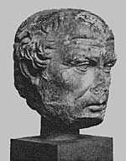
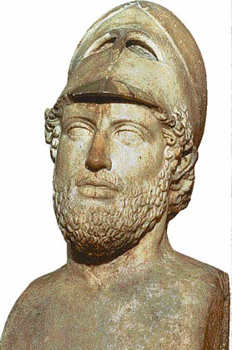
Parthenon
Pericles
Phidias
No evidence of help in design or building by divine charioteers!

Slide 23
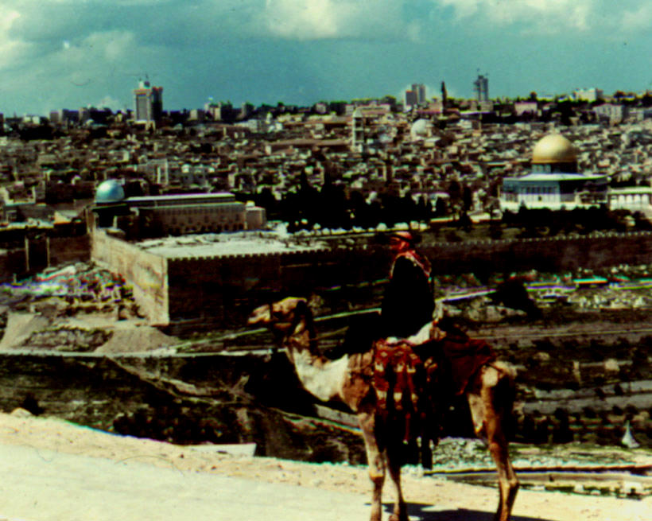
Jerusalem

Slide 24
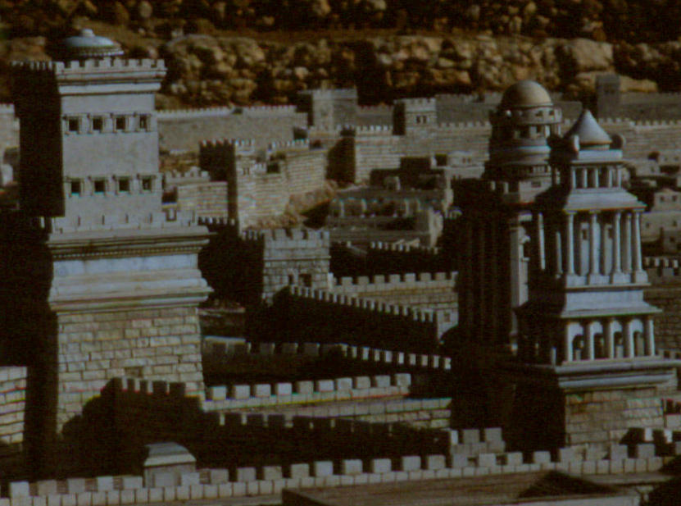
Jerusalem
Herod's towers at the Joppa Gate in ancient Jerusalem
According to Josephus, some of the stones in these towers were up to 25 feet long.

Slide 25
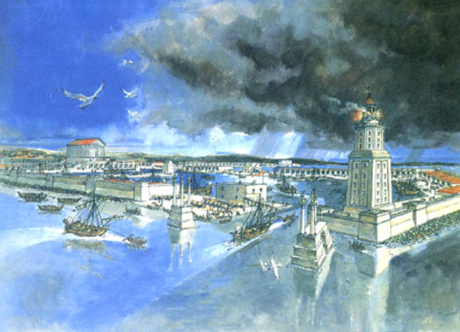
Caesarea
Artificial port built by Herod the Great, just before the time of Jesus
For the breakwater, Herod used concrete and stones up to 50 feet long.

Slide 26
Moving Big Stones
To protect the wealth of the gods and the kings, military engineers built walls and dug moats around cities. In the lower Euphrates Valley, where there was practically no stone, walls were made of brick. Elsewhere, they were made of stone—preferably the largest stones that could be moved. (de Camp, Ancient Engineers, 10)

Slide 27
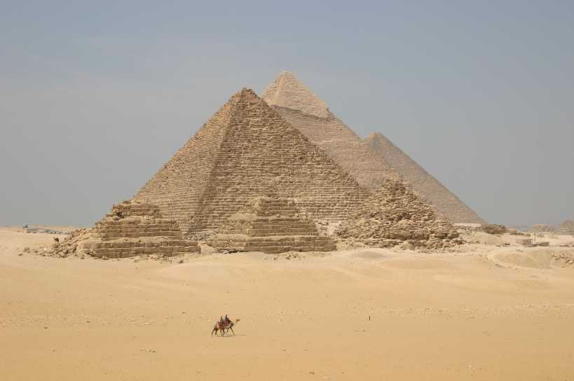
The Pyramids of Egypt

Slide 28
Pyramids
Is it really a coincidence that the height of the pyramid of Cheops multiplied by a thousand million—98,000,000 miles—corresponds approximately to the distance between the earth and the sun? … that a meridian running through the pyramids divides continents and oceans into two exactly equal halves? … that the area of the base of the pyramid divided by twice its height gives the celebrated figure π = 3.14159? (Chariots, 96)

Slide 29
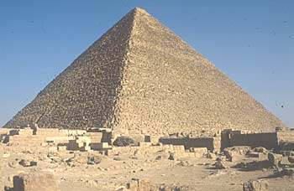
Great Pyramid
The pyramid of Cheops or Khufu, commonly known as the Great Pyramid
The sheathing stone is missing, making the exact size uncertain.

Slide 30
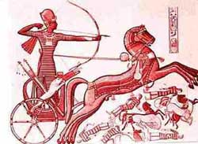
Value of π?
Egyptians built fairly impressive chariots.
After making round wheels, one can easily measure the value of π to a decimal place or two.

Slide 31
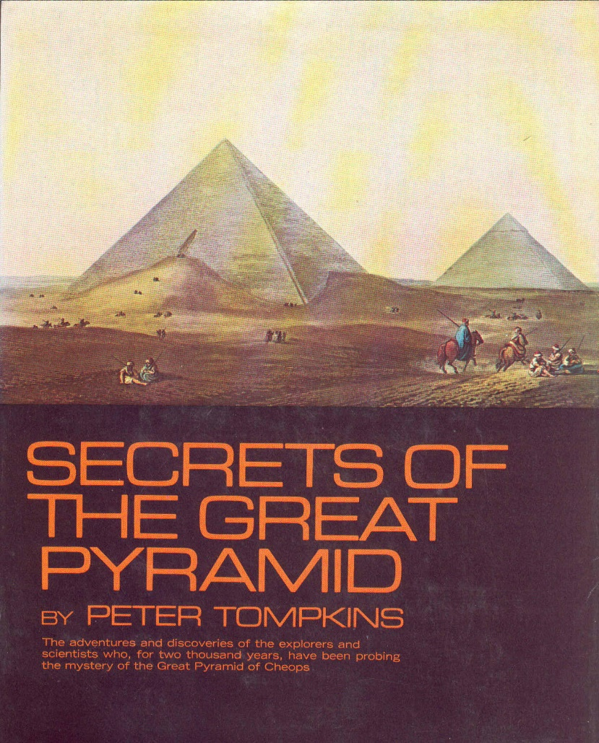
Great Pyramid
Most of this material mentioned by von Däniken was in print a century ago.
The distance to the sun is probably a coincidence. Note that it is 5% off, not an error spacemen would make.

Slide 32
Building the Great Pyramid
The core of pyramid consists of some 2.5 million stones, averaging 2.5 tons each.
Von Däniken scoffs at using rollers to move these stones:
I shall be told that the stone blocks used for building the temple were moved on rollers. In other words, wooden rollers! But the Egyptians could scarcely felled and turned into rollers the few trees, mainly palms, that then (as now) grew in Egypt, because the dates from the palms were urgently needed as food and the trunks and fronds were the only things giving shade to the dried-up ground. (Chariots, 94)

Slide 33
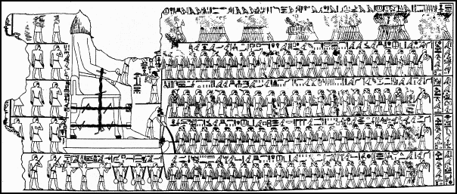
Moving Big Stones
A picture from the wall of an Egyptian temple, showing men moving a large stone statue.

Slide 34
Moving Big Stones
This picture, carved on the wall of an Egyptian temple, shows how they moved a large statue.
Here a sledge was used instead of rollers, with some liquid used to reduce friction.
Estimating the weight of the statue, it would take only 8 men to move a 2.5 ton block by this means.

Slide 35
Time to Build the Pyramid?
Von Däniken estimates it would have taken 664 years for humans to build the great pyramid, so not done by men (98).
Herodotus says the Egyptian priests told him it took 20 years.
Clifford Wilson notes some objective evidence from a pyramid at Dashur where two of the stones are dated.

Slide 36
Time to Build the Pyramid?
Another pyramid at Dashur actually has a date on the north-eastern corner stone — it was laid in the 21st year of the Pharaoh Senefru. About halfway up there is another date, this time dating to the same Pharaoh's 22nd year. If the dating is accurate, the maximum between the two would be under two years. This pyramid is about two-thirds the volume of the Great Pyramid. (Wilson, Crash Go the Chariots, 29)

Slide 37
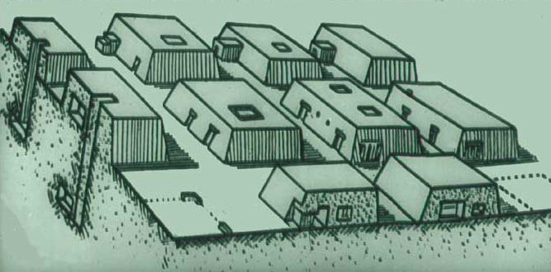
The Developing Technology of Pyramid Building
We have evidence from antiquity that the oldest pyramids are not the most sophisticated.
The early and smaller tombs are just one-story buildings, called mastebas.

Slide 38
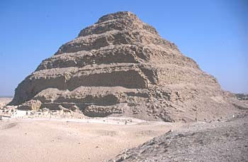
The Developing Technology of Pyramid Building
For kings, these mastebas are later elaborated by stacking.
Thus we come to have step pyramids.

Slide 39
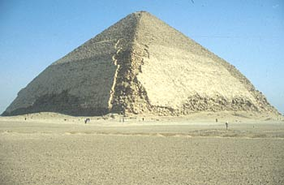
The Developing Technology of Pyramid Building
We think the bent pyramid is an early attempt to make a smooth sided structure, in which the initial slope was too steep!

Slide 40
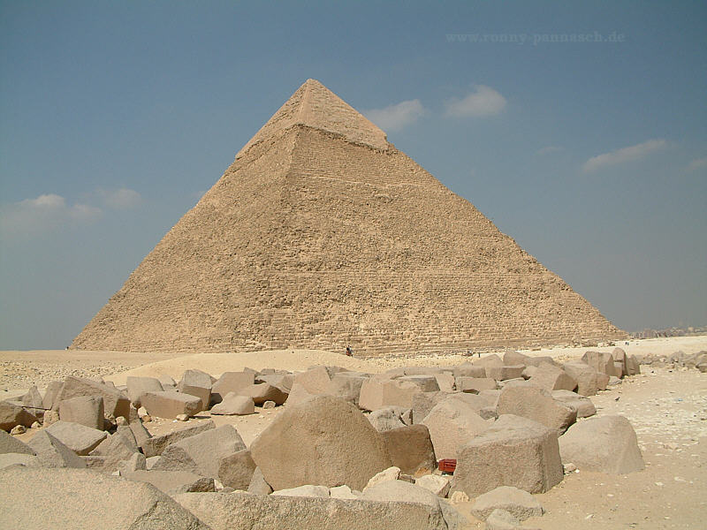
The Developing Technology of Pyramid Building
Finally they get it right!
Does this look like the work of an advanced civilization that has mastered interstellar space travel?

Slide 41
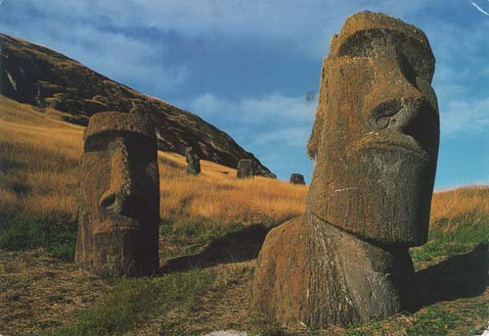
Easter Island
Far out in the Pacific Ocean lies isolated Easter Island.
This island is populated by some 200 humans and hundreds of huge stone heads.

Slide 42
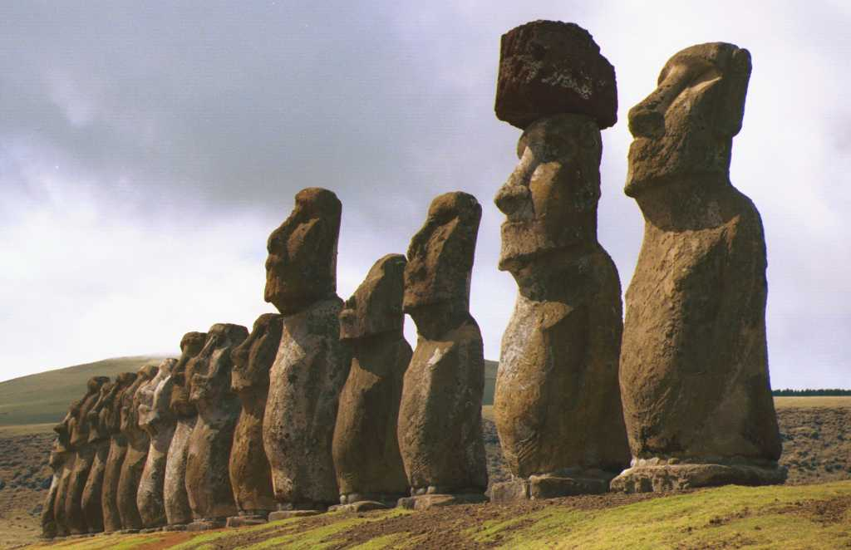
Easter Island

Slide 43
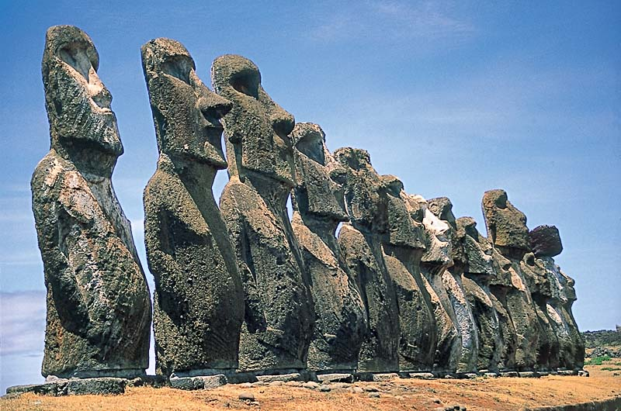
Easter Island

Slide 44
Easter Island
Some of these heads even have hats on them, which are made from a different color stone!
Did the inhabitants of Easter Island really build these statues themselves?

Slide 45
Von Däniken on Easter Island
Even if people with lively imaginations have tried to picture the Egyptian pyramids being built by a vast army of workers using the 'heave-ho' method, a similar method would have been impossible on Easter Island for lack of manpower. Even 2,000 men, working day and night, would not be nearly enough to carve these colossal figures out of the steel-hard volcanic stone with rudimentary tools — and at least a part of the population must have tilled the barren fields, woven cloth and made ropes. (Chariots, 110)

Slide 46
Thor Heyerdahl
Remember Thor Heyerdahl?
He is the fellow who built the balsa raft Kon-Tiki to drift across the Pacific.
He also studied the stone heads on Easter Island.

Slide 47
Easter Island
Von Däniken: impossible for only 200 inhabitants to set up several hundred 50-ton stones! (110)
Heyerdahl disagrees. His tests show:
  Six men could carve a head in one year.
  Whole population could move a head to its site in a day or two.
  12 men could erect a head in 18 days.

Slide 48
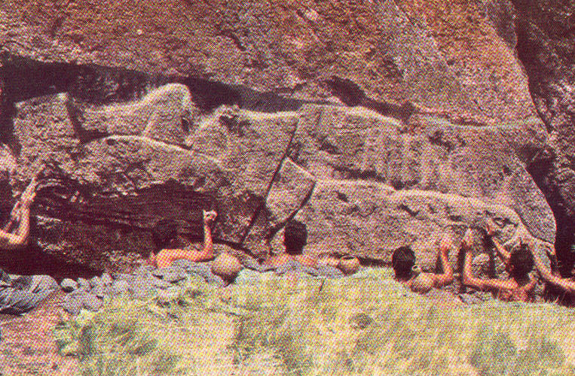
Carving the Heads

Slide 49
Moving a Head
After providing a luau for the island’s inhabitants, 180 of them (with full stomachs) were easily able to move a 12-ton statue on a sledge they had made (see Aku-Aku, 149-150).

Slide 50
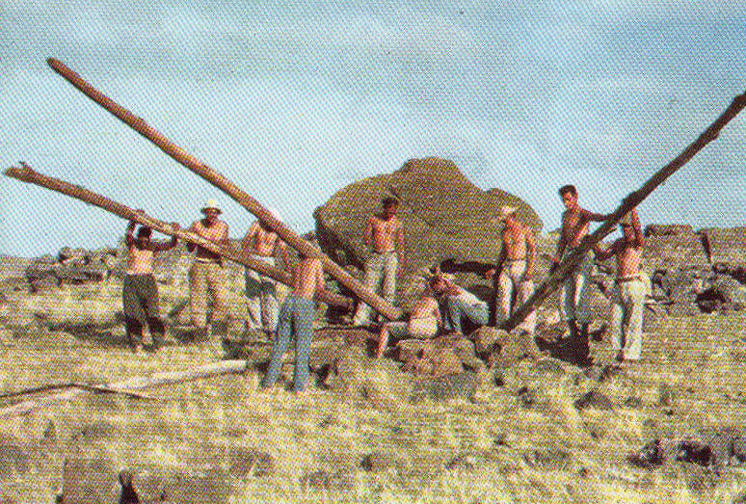
Raising a Head

Slide 51
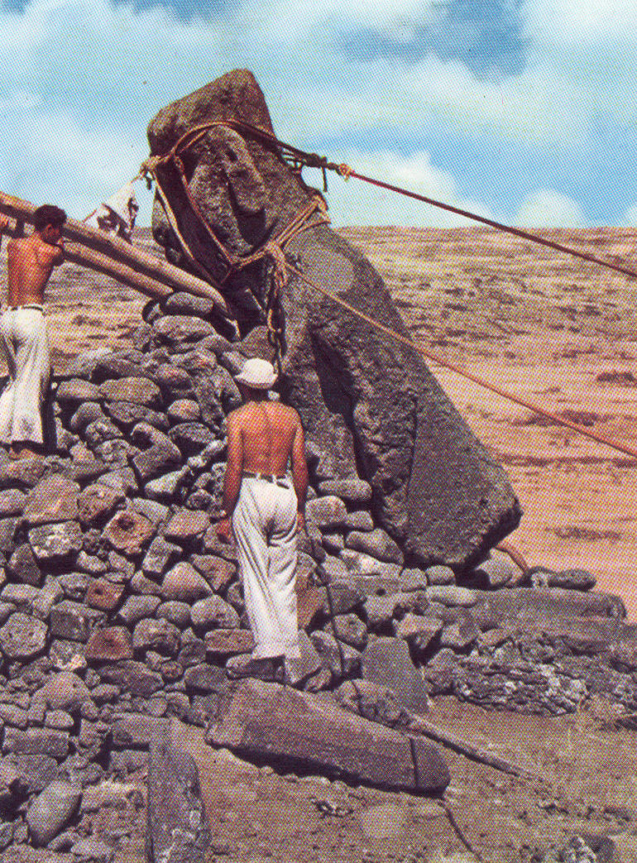
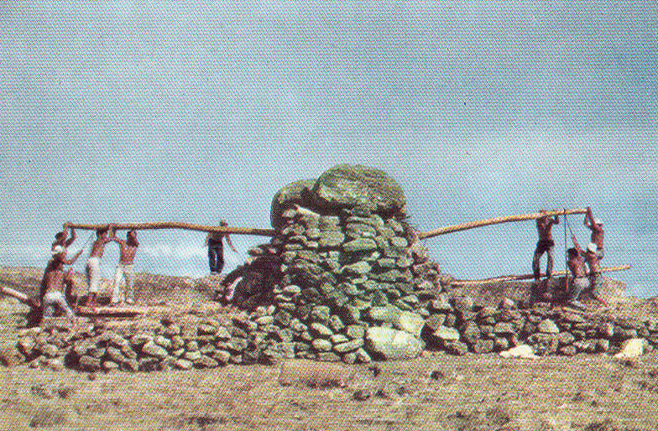
Raising a Head

Slide 52
Easter Island
Heyerdahl's results:
Six men could carve a head in one year.
Whole population could move the head to a site in a day or two.
12 men could erect a head in 18 days.
So the island's current population could easily produce & set up one head per year.

Slide 53
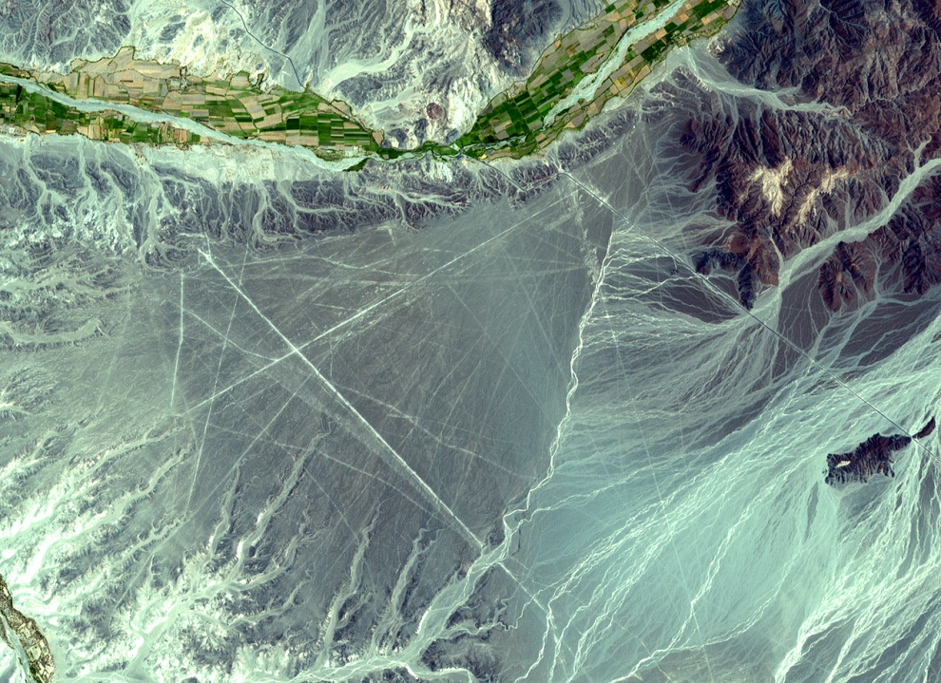
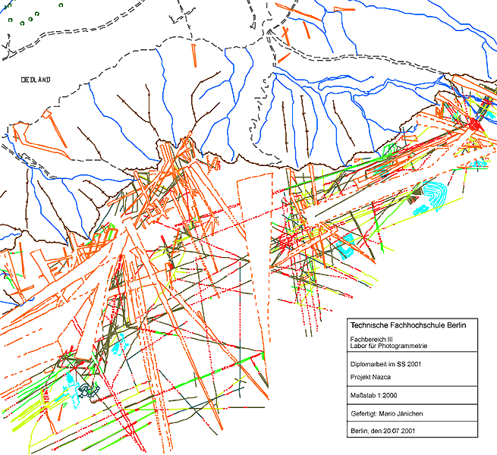
Nazca, Peru
The plains of Nazca are quite unusual in being criss-crossed by numerous lines, some of which give the appearance of highways or airport runways.

Slide 54
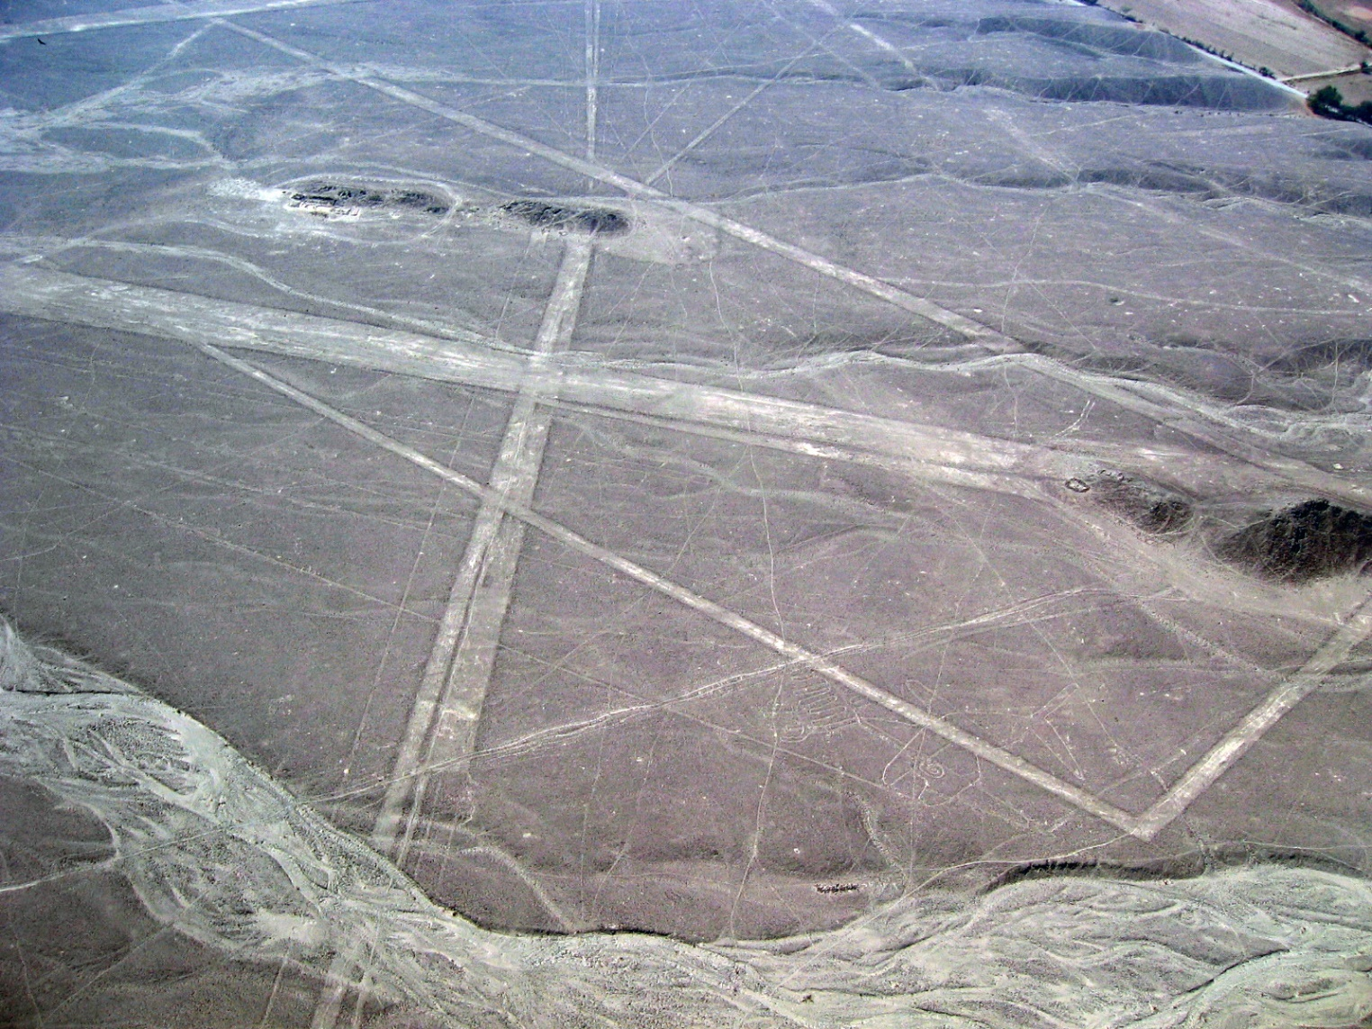
Nazca

Slide 55
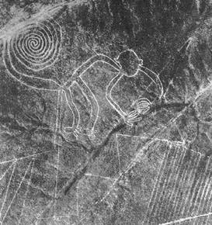
Nazca

Slide 56
Nazca
… archaeologists have been racking their brains over the geometric system of lines, animal drawings and neatly arranged bits of stone which extend over an area some 30 miles long between Palpa in the north and Nazca in the south. To me, they look just like an airport layout… (Gods from Outer Space, 115)
At some time in the past, unknown intelligences landed on the uninhabited plain near the present-day town of Nazca and built an improvised airfield for their spacecraft which were to operate in the vicinity of the earth. (Gods from Outer Space, 117)

Slide 57
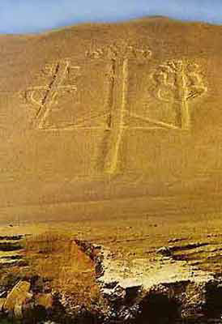
Nazca
According to von Däniken:
The lines are runways of a spaceport.
The large animal figures are only viewable from the air, so made by astronauts (34).
A trident on the coast points to the spaceport (33-34 & fig. 7).

Slide 58
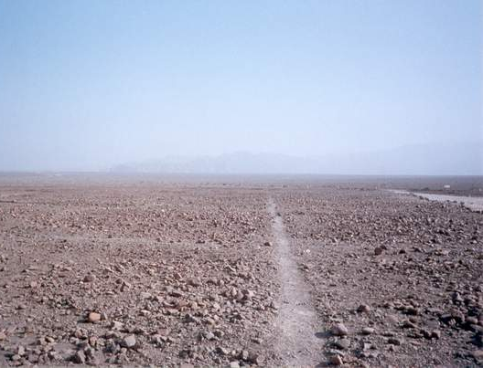
Response to von Däniken
Runways?:
Rocky
Cross hills
Deeply furrowed at intersections
Ground too soft

Slide 59
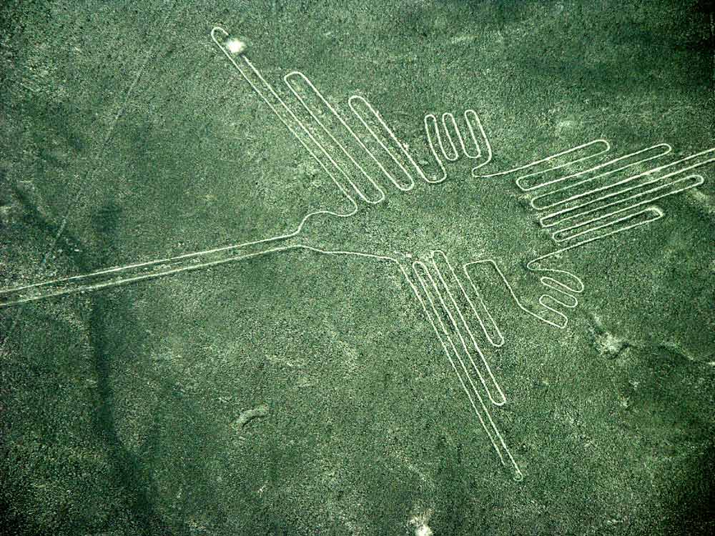
Response to von Däniken
Large figures are typically made of one continuous line.
Maria Reicke thinks these were perhaps paths for dancing in a sympathetic magic ceremony.

Slide 60
Response to von Däniken
Do astronauts of an advanced civilization capable of traveling through space really need arrows to guide them to a spaceport?

Slide 61

Summary
Do all the strange figures humans have drawn have to actually exist or be realistic?

Slide 62


Summary
The more you read of this stuff, the more skeptical you become!

Slide 63
Summary
When von Däniken reads the Bible, I shudder!
Undoubtedly the Ark was electrically charged! If we reconstruct it today according to the instructions handed down by Moses, an electric conductor [condenser?] of several hundred volts is produced… If, in addition, one of the two cherubim on the mercy seat acted as a magnet, the loudspeaker—perhaps even a kind of set for communication between Moses and the spaceship—was perfect. (Chariots, 57)

Slide 64
Summary
Von Däniken's research methodology is scary, too:
The details of the construction of the Ark of the Covenant can be read in the Bible in their entirety. Without actually consulting Exodus, I seem to remember that the Ark was often surrounded by flashing sparks and that Moses made use of this 'transmitter' whenever he needed help and advice. (Chariots, 58)

Slide 65
Recommended Reading
Books by Clifford Wilson:
Crash Go the Chariots
The Chariots Still Crash
Gods in Chariots and Other Fantasies

Slide 66
Some Advice
Proverbs 16:25 (NIV) There is a way that seems right to a man, but in the end it leads to death.
1Thessalonians 5:21 (NIV) Test everything. Hold on to the good.

Slide 67
Erich von Däniken's
Chariots of the Gods
Fiction!

