Slide 1
The Bruised Reed & Smoldering Wick
Matthew 12:20 & Isaiah 42:3
Robert C. Newman

Slide 2
Introduction
In Matthew 13:52, Jesus gives us the parable of the householder bringing out things old and new:
(NIV) He said to them, "Therefore every teacher of the law who has been instructed about the kingdom of heaven is like the owner of a house who brings out of his storeroom new treasures as well as old."
The point, I believe, is that Jesus’ followers are to be continually learning from Scripture.

Slide 3
Introduction
This talk is a sample of this from my own life.
In preparing a sermon to preach in chapel at Biblical Seminary back in 1984, I planned to preach on one topic, but then found that the passage I had chosen was really about something else!
Rather than going back to look for another passage, I changed the subject of my sermon instead.

Slide 4
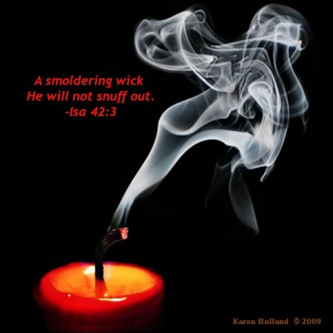
The Meaning of Matthew 12:20

Slide 5
Matthew 12:15-21
15 (NIV) Aware of this, Jesus withdrew from that place. Many followed him, and he healed all their sick, 16 warning them not to tell who he was. 17 This was to fulfill what was spoken through the prophet Isaiah: 18 "Here is my servant whom I have chosen, the one I love, in whom I delight; I will put my Spirit on him, and he will proclaim justice to the nations. 19 He will not quarrel or cry out; no one will hear his voice in the streets. 20 A bruised reed he will not break, and a smoldering wick he will not snuff out, till he leads justice to victory. 21 In his name the nations will put their hope." {Isa 42:1-4}

Slide 6
Matthew 12:20 & Context
The larger context here is the growing opposition to Jesus:
Jesus’ warning to unrepentant cities (11:20-24)
Things hidden from wise & revealed to babies (11:25-30)
Sabbath controversies (12:1-14), ending with Pharisees plotting how to kill Jesus.
So Jesus withdraws & (while continuing to heal) discourages publicity.

Slide 7
Matthew 12:20 & Context
Matthew is quoting Isa 42:3 as fulfilled here.
I initially thought that the reference to the bruised reed & smoldering wick meant that Jesus will not crush the weak.
This is certainly a biblical truth & a good sermon topic (compare Isa 40:11):

Slide 8
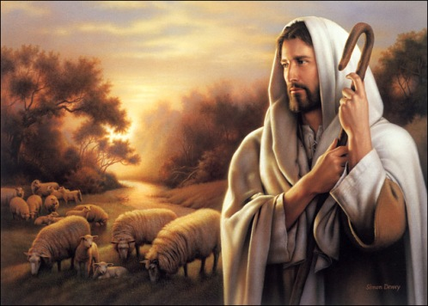
Isaiah 40:11
(NIV) He tends his flock like a shepherd:
He gathers the lambs in his arms
and carries them close to his heart;
he gently leads those that have young.

Slide 9
Matthew 12:20 & Its Images
But if you examine the figurative use of the two images in our verse…
Reed staff
Wick, smoldering
… these images suggest that it is the “wicked” that are in view, not the “weak.”
Let’s see.

Slide 10
Reed staff
Isa 36:6 (NIV) Look now, you are depending on Egypt, that splintered reed of a staff, which pierces a man's hand and wounds him if he leans on it! Such is Pharaoh king of Egypt to all who depend on him.
Ezek 29:6 (NIV) Then all who live in Egypt will know that I am the LORD. You have been a staff of reed for the house of Israel. 7 When they grasped you with their hands, you splintered and you tore open their shoulders; when they leaned on you, you broke and their backs were wrenched.
2 Kings 18:21 (NIV) Look now, you are depending on Egypt, that splintered reed of a staff, which pierces a man's hand and wounds him if he leans on it! Such is Pharaoh king of Egypt to all who depend on him.

Slide 11
Wick, Smoldering
Isa 43:17 (NIV) [The LORD] who drew out the chariots and horses, the army and reinforce-ments together, and they lay there, never to rise again, extinguished, snuffed out like a wick…
Prov 13:9 (NIV) The light of the righteous shines brightly, but the lamp of the wicked is snuffed out.
Isa 7:4 (NIV) Say to him, “Be careful, keep calm and don't be afraid. Do not lose heart because of these two smoldering stubs of firewood n because of the fierce anger of Rezin and Aram and of the son of Remaliah.”

Slide 12
Context in Matthew
Also the context in Matthew suggests the wicked are in view rather than the weak.
12:20b: That Jesus won’t crush “till he leads justice to victory” implies that he might crush them at that time, but won’t before then.
12:17 (about fulfillment) connects the Isaiah quotation with vv 15-16, where Jesus withdraws from those plotting to kill him & damps down the publicity about his activities:
i.e., Jesus leaves his opponents room to respond, not forcing their hands before his hour has come.

Slide 13
Context in Isaiah
This also fits the context in Isaiah 42, though here it is more ambiguous.
The Isaiah context emphasizes the servant as one who “brings justice to the nations” (vv 1, 3, 4), which normally implies judicial or military action against the wicked.
But the servant’s procedure is unusual:
Not shouting, nor raising his voice in streets
Doesn’t break bruised reed or snuff smoldering wick.

Slide 14
My Suggestion
Both passages look at Jesus’ redemptive work, but the “till” clause gives a hint that he will not use force until the second coming.
This is characteristic of Jesus’ ministry, and is at least as important as the other suggestion of not crushing the weak.
Some examples:

Slide 15
Examples
God could have stopped Paul on the way to Damascus (Acts 9) by crushing him.
As he did Pharoah at the Red Sea,
Or the troops coming to arrest Elijah (2 Kings 1).
Instead he redeems Paul so that he becomes one of His servants.

Slide 16
Examples
Jesus rebukes James and John for wanting to call down fire on the inhospitable Samaritans (Luke 9:51-56).
Jesus stops Peter from fighting when the soldiers come to arrest him (Matthew 26 and parallels).

Slide 17
Application for Us

Slide 18
God’s Agenda
As God’s servants, we are to be little models of Christ.
As such, our agenda is to be God’s:
In this age, the work of redemption.
We are bringing justice
Not by demanding our rights,
But by giving them up in such a way that wicked people may be redeemed.

Slide 19
Our Response to Mistreatment
This is the rationale behind Jesus’ commands in Matthew 5:38-48, which otherwise seem so unrealistic:
Turn the other cheek
Give him your cloak also
Go the second mile
Love your enemies
Pray for your persecutors

Slide 20
Matthew 5:38-42
38 (NIV) You have heard that it was said, “Eye for eye, and tooth for tooth.” 39 But I tell you, Do not resist an evil person. If someone strikes you on the right cheek, turn to him the other also. 40 And if someone wants to sue you and take your tunic, let him have your cloak as well. 41 If someone forces you to go one mile, go with him two miles. 42 Give to the one who asks you, and do not turn away from the one who wants to borrow from you.

Slide 21
Matthew 5:43-48
Matt 5:43 (NIV) You have heard that it was said, “Love your neighbor and hate your enemy.” 44 But I tell you: Love your enemies and pray for those who persecute you, 45 that you may be sons of your Father in heaven… 46 If you love those who love you, what reward will you get? Are not even the tax collectors doing that? 47 And if you greet only your brothers, what are you doing more than others? Do not even pagans do that? 48 Be perfect, therefore, as your heavenly Father is perfect.

Slide 22
Modelling Jesus
May we, like Jesus, not crush the bruised reed nor snuff out the smoldering wick.

Slide 23
The End

