Slide 1
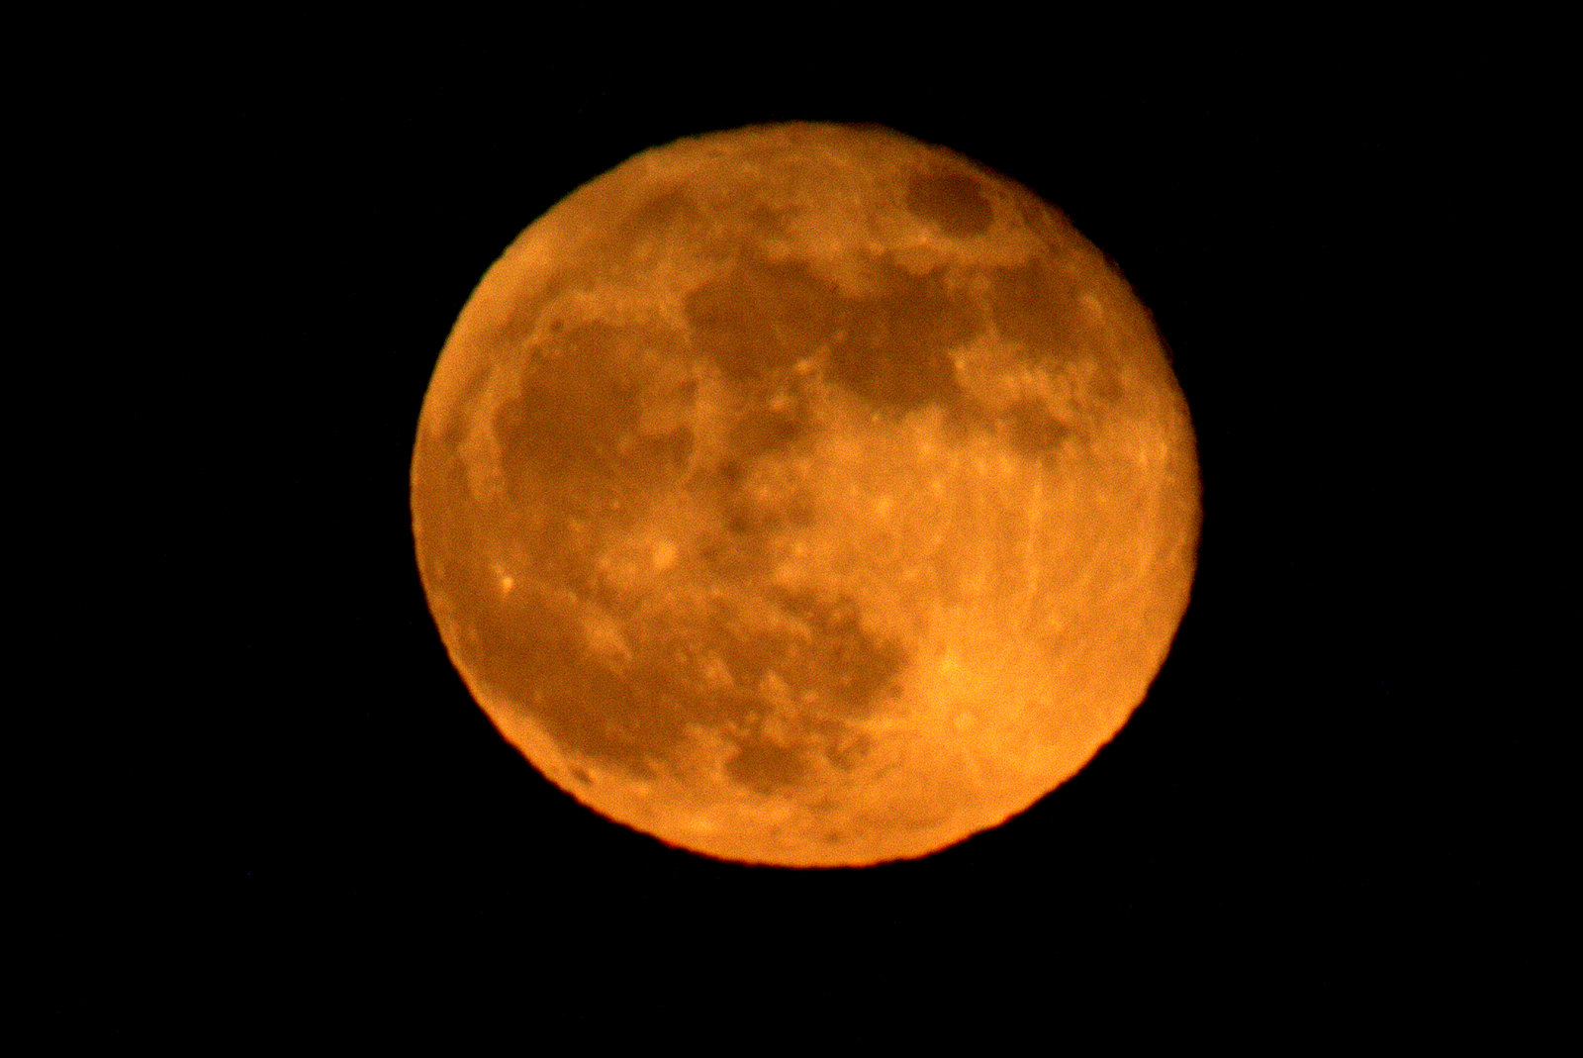
Blood Moon Prophecies
Robert C. Newman

Slide 2
The Blood Moon Prophecies
Recent excitement concerning “end of the age” predictions involving “blood moons”
These prophecies involve four eclipses of the moon, and two eclipses of the sun, to occur in 2014 and 2015.
The lunar eclipses are rather well aligned with the Jewish feasts of Passover & Tabernacles.

Slide 3
The Lunar Eclipses
2014:
15 April: total – visible in Australia, Pacific, Americas
8 October: total – visible in Asia, Australia, Pacific, Americas
2015:
4 April: total – visible in Asia, Australia, Pacific, Americas
28 September: total – visible in Asia, Australia, Pacific, Americas

Slide 4
The Prophecies
Originally predicted Jesus’ second coming at fourth lunar eclipse, so 28 Sept 2015.
But for pre-trib rapture, this would put rapture of church in 2008; didn’t happen!
Even for mid-trib rapture, this would put rapture in 2012; didn’t happen!
So now climax on 28 Sept 2015 is claimed to be the rapture, not the second coming.

Slide 5
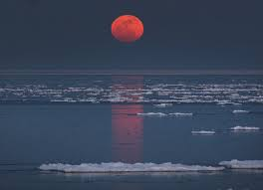
What is a ‘Blood Moon’?
Term used in two rather different ways:
(1) Synonym for ‘Hunter’s Moon’
(2) Term for a reddish moon:
(a) Moon at rising or setting
(b) Moon seen thru haze, etc.
(c) Eclipsed moon when enough light from sun gets thru earth’s atmosphere to make moon look rather blood red

Slide 6
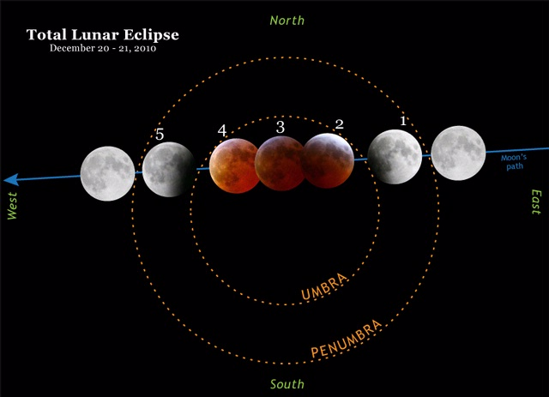
Blood Moon (2c)

Slide 7
Prophecies Built from Two Passages
Joel 2:28-31 (NIV):
²⁸ And afterward, I will pour out my Spirit on all people. Your sons and daughters will prophesy, your old men will dream dreams, your young men will see visions. ²⁹ Even on my servants, both men and women, I will pour out my Spirit in those days. ³⁰ I will show wonders in the heavens and on the earth, blood and fire and billows of smoke. ³¹ The sun will be turned to darkness and the moon to blood before the coming of the great and dreadful day of the Lord

Slide 8
Prophecies Built from Two Passages
Acts 2:14-21, where Peter, in his speech in Jerusalem at Pentecost, quotes the Joel passage as being fulfilled:
¹⁴ Then Peter stood up with the Eleven, raised his voice and addressed the crowd: “Fellow Jews and all of you who live in Jerusalem, let me explain this to you; listen carefully to what I say. ¹⁵ These people are not drunk, as you suppose. It’s only nine in the morning! ¹⁶ No, this is what was spoken by the prophet Joel: [quotes Joel passage]

Slide 9
What Should We Think?
The Biblical passages are fully trustworthy, since they are the revelation of the God who cannot lie.
But our interpretations may not be trustworthy, since we are finite creatures and sinners on top of that.
How did the interpreters get from these two passages to their predictions?

Slide 10
Assumptions Made
I see several assumptions that were made to construct the blood moon prophecies.
(1) The changes in the sun & moon are natural eclipses rather than something more spectacular.
(2) Jesus’ remark “no one knows” was true then, but not now, or means only day & hour.
(3) End-time events occur on Jewish feasts.

Slide 11
1. Non-Miraculous Signs
The word “sign” doesn’t necessarily mean something miraculous.
Moses told he will worship God on this mountain
Shepherds will find baby Jesus in a manger
But both the Joel & Acts passages also call these “wonders.”
This term implies something more spectacular.

Slide 12
1. Non-Miraculous Signs
This looks like the event mentioned by Jesus in Matthew 24:29:
Immediately after the distress of those days, the sun will be darkened, and the moon will not give its light; the stars will fall from the sky, and the heavenly bodies will be shaken.
But this comes after the great tribulation, not before the rapture.

Slide 13
1. Non-Miraculous Signs
We have a similar problem in Rev 6:12-17:
¹² I watched as he opened the sixth seal. There was a great earthquake. The sun turned black like sackcloth made of goat hair, the whole moon turned blood red, ¹³ and the stars in the sky fell to earth, as figs drop from a fig tree when shaken by a strong wind. ¹⁴ The heavens receded like a scroll being rolled up, and every mountain and island was removed from its place.
¹⁵ Then the kings of the earth, the princes, the generals, the rich, the mighty, and everyone else, both slave and free, hid in caves and among the rocks of the mountains. ¹⁶ They called to the mountains and the rocks, “Fall on us and hide us from the face of him who sits on the throne and from the wrath of the Lamb! ¹⁷ For the great day of their wrath has come, and who can withstand it?”

Slide 14
1. Non-Miraculous Signs
Note the great earthquake, the stars falling, the heavens receding, every mountain & island being removed, and especially the reaction of the unsaved people.
These suggest something much closer to the end than the usual pre-trib rapture (think of the Left Behind series), where the unsaved are mystified as to what has happened in the rapture.

Slide 15
1. Non-Miraculous Signs
It looks like assumption #1 is mistaken.
These Scripture passages seem to point to something much more spectacular (earth-shaking) than what the blood moon prophecies suggest.

Slide 16
2. We Know the Time
What about Jesus’ statement that no one knows the day nor hour of his return?
Date-setters throughout church history have tried to get around this by claiming either:
No one knew back then, but we have recently discovered the time.
We can’t know the day or hour, but we can know the week, month or year.

Slide 17
2. We Know the Time
We know the week, month or year.
Jesus’ response in Acts 1:6-8 suggests this is just quibbling over words:
⁶ Then they gathered around him and asked him, “Lord, are you at this time going to restore the kingdom to Israel?”
⁷ He said to them: “It is not for you to know the times or dates the Father has set by his own authority. ⁸ But you will receive power when the Holy Spirit comes on you; and you will be my witnesses in Jerusalem, and in all Judea and Samaria, and to the ends of the earth.”

Slide 18
2. We Know the Time
Paul’s statement in 1 Thessalonians 5:1-3 sounds the same note:
Now, brothers and sisters, about times and dates we do not need to write to you, ² for you know very well that the day of the Lord will come like a thief in the night. ³ While people are saying, “Peace and safety,” destruction will come on them suddenly, as labor pains on a pregnant woman, and they will not escape.

Slide 19
2. We Know the Time
Here “times and dates” translates two very general Greek words chronos and kairos.
These are certainly not to be restricted to mean ‘day’ or ‘hour.’
Thus Jesus and Paul are really telling the disciples that no one knows the time of Jesus’ return.

Slide 20
2. We Know the Time
But maybe they didn’t know the time back then, but we have just found it out!
Yes, that’s what the date-setters throughout church history have claimed.
But so far, their batting average is zero, and Jesus’ batting average is one thousand!
I suggest the blood moon prophets are mistaken about assumption #2 also.

Slide 21
3. Connection to Jewish Feasts
Do the major events of the end of the age happen at the time of particular Jewish feast days?
It is possible:
Jesus’ crucifixion fell on Passover
Jesus’ resurrection on the day of First Fruits
The pouring out of the Holy Spirit on the Feast of Pentecost (Feast of Weeks)

Slide 22
3. Connection to Jewish Feasts
So a number of interpreters have suggested that Jesus’ second coming will occur on the Feast of Trumpets (Rosh Hashanah)
Or maybe it will be the rapture instead.
But even if so, this does not tell us the year.
So assumption #3 is questionable:
It is a guess
It doesn’t tell us what or when

Slide 23
Conclusions
What should we make of the blood moon prophecies?
The assumptions on which they are based are problematic:
#1 (non-miraculous) looks too weak
#2 (time known) is contradicted by Scripture
#3 (Jewish feasts) is speculative
Time will tell.

Slide 24
Conclusions
Date-setting has an abysmal record all thru church history.
There is the danger that we see in the story of the boy who cried “wolf!”
People who are disappointed by false claims of the time of Jesus’ return often wind up throwing out Christianity altogether.
May we not be found contributing to that.

Slide 25
The End
Will come in God’s time

