Slide 1

The Birth Pains of the Messiah
Have They Started Yet?
Robert C. Newman

Slide 2
As he sat on the Mount of Olives, the disciples came to him privately, saying, "Tell us, when will these things be, and what will be the sign of your coming and of the close of the age?" And Jesus answered them, "See that no one leads you astray. For many will come in my name, saying, 'I am the Christ,' and they will lead many astray. And you will hear of wars and rumors of wars. See that you are not alarmed, for this must take place, but the end is not yet. For nation will rise against nation, and kingdom against kingdom, and there will be famines and earthquakes in various places. All these are but the beginning of the birth pains."
Matthew 24:3-8, ESV

Slide 3
Questions to consider:
What is this "birth pains" image?
When do these pains begin?
Any reason to think they have already begun?

Slide 4
Other occurrences in the NT
Parallel passage in Mark (13:8)
Paul in 1 Thess 5:3
John’s vision in Rev 12:1-2
Paul’s quotation from Isa 54:1

Slide 5
Now concerning the times and seasons, brothers, you have no need to have anything written to you. For you yourselves are fully aware that the day of the Lord will come like a thief in the night. While people are saying, "There is peace and security, " then sudden destruction will come upon them as labor pains come upon a pregnant woman, and they will not escape.
1 Thess 5:1-3

Slide 6
Paul in 1 Thessalonians 5:1-3
Birth pains come suddenly.
Birth pains are inescapable.
Like Matt 24 and Mark 13, looks eschatological.

Slide 7
And a great sign appeared in heaven: a woman, clothed with the sun, with the moon under her feet, and on her head a crown of twelve stars. She was pregnant and was crying out in birth pains and the agony of giving birth.
Rev 12:1-2

Slide 8
John’s Vision in Rev. 12:1-2
Puzzling!
Context suggests event is set at birth of Christ.
Could it refer to Jewish recognition of Jesus as Messiah at end of age?
See passages below.

Slide 9
Paul’s Quotation from Isa 54:1
The heavenly Jerusalem has no labor pains.
Her rival (earthly Jerusalem?) does.

Slide 10
Birth Pains in the OT
Isaiah 26
Isaiah 66
Isaiah 13
Psalm 48
Isaiah 21
Jeremiah

Slide 11
Like a pregnant woman who writhes and cries out in her pangs when she is near to giving birth, so were we because of you, O LORD; we were pregnant, we writhed, but we have given birth to wind. We have accomplished no deliverance in the earth, and the inhabitants of the world have not fallen.
Isa 26:17-18

Slide 12
Before she was in labor she gave birth; before the pain came upon her she delivered a son. Who has heard of such a thing? Who has seen such things? Shall a land be born in one day? Shall a nation be brought forth in one moment? For as soon as Zion was in labor she brought forth her children.
Isa 66:7-8

Slide 13
Wail, for the day of the LORD is near; as destruction from the Almighty it will come! Therefore all hands will be feeble and every human heart will melt. They will be dismayed: pangs and agony will seize them; they will be in anguish like a woman in labor. They will look aghast at one another; their faces will be aflame. Behold, the day of the LORD comes, cruel, with wrath and fierce anger, to make the land a desolation and to destroy its sinners from it. Isa 13:6-9

Slide 14
As soon as they saw it, they were astounded; they were in panic; they took to flight. Trembling took hold of them there, anguish as of a woman in labor. By the east wind you shattered the ships of Tarshish.
Ps 48:5-7

Slide 15
Isaiah 21
Prophet is seized with pain "like the pangs of a woman in labor."
This apparently refers to the destruction of Babylon by the Medes & Elamites.
One verse (9) "fallen, fallen, is Babylon," is applied in Rev 18:2 to a future event.

Slide 16
Birth Pains in Jeremiah
Occurs several times.
Usually for Israel or neighbors being overcome by the prospect of invasion.
Only Jeremiah 30 seems to be eschatological.

Slide 17
Thus says the LORD: We have heard a cry of panic, of terror, and no peace. Ask now, and see, can a man bear a child? Why then do I see every man with his hands on his stomach like a woman in labor? Why has every face turned pale? Alas! That day is so great there is none like it; it is a time of distress for Jacob; yet he shall be saved out of it.
Jer 30:5-7

Slide 18
Birth Pains in OT and NT
Reaction of humans to terrifying circumstances that have come upon them
Prominent is idea of circumstances being inescapable
Less frequently, an implication of sudden or unexpected coming

Slide 19
Birth Pains in Rabbinic Literature
Suggest this was commonly used in NT period, not just by Christians
Rabbinic literature has phrase "birth pains of the Messiah"
Means not the Messiah's pains, but those out of which the Messianic age will be born

Slide 20
R Eliezer (c90) said: If you observe the Sabbath, then you would be protected from three punishments, from the birth pains of the Messiah, from the day of Gog, and from the day of the Great Judgment.
Mek Ex 16:29 (59a)

Slide 21
God has shown mercy to Israel, that he led the ones with Jeconiah into the exile before the ones with Zedekiah, so that the oral Torah would not be forgotten by them and so that they would remain in Babel in their schools from that time until now. And over them has neither Edom [Rome] nor Greece had authority, nor has anyone threatened them with religious persecution. And even in the days of the Messiah they will not see the birth pains of the Messiah. Tanh 9a

Slide 22
'Ulla said, Let him [Messiah] come, but let me not see him. Rabbah said likewise: Let him come, but let me not see him. R Joseph said: Let him come, and may I be worthy of sitting in the shadow of his ass's saddle. Abaye inquired of Rabbah: What is your reason [for not wishing to see him]? Shall we say, because of the birth pains of the Messiah?
Sanh 98b

Slide 23
Birth Pains in Rabbis
They expected difficult times to come just before the Messiah appears.
These times would be disastrous for:
  Unfaithful Jews
  Pagan nations
They would even be fearsome for the righteous.

Slide 24
What are the Birth Pains?
From Matthew 24:3-8:
False Messiahs
Wars & rumors of wars
Famines
Earthquakes

Slide 25
What are the Birth Pains?
From context in Matt 24:9-14:
Persecution
Apostasy
Betrayal
False prophets
Lawlessness
Weakened love
Worldwide Gospel proclamation

Slide 26
When do they begin?
These various disasters have been happening throughout church history.
The Gospel has gradually spread until it has nearly covered the earth.
Looks like the birth pains began with the earthly ministry of Jesus.

Slide 27
Similar picture in Revelation 6
Seals 1-5 are parallel to birth pains in Matthew 24.
Not till seal 6 do we reach anything that is clearly unprecedented.
The throne room scene in Revelation 5 suggests that no one is qualified to open the seals till Jesus becomes so by his atoning death & resurrection.

Slide 28
Birth Pains as Signs of End
How function so, if they began in 1st century?
Perhaps they show us that God’s intervention is necessary.
Perhaps the phenomenology of birth pains is implied:
  More frequent as birth approaches
  More severe as birth approaches

Slide 29
Are they expected to get worse?
More false Christs and prophets?
  Yes, fits Olivet Discourse, Two beasts of Rev 13, and Man of Sin in 2 Thessalonians.
More persecution, moral decay?
  Yes, see 2 Timothy 3
Worse disasters?
  Yes, see growing severity of seals, trumpets, bowls

Slide 30
Are they getting worse yet?
See chart "Most costly US disasters to January 1994" from USA Today 1/20/94
  7 of 10 in past ten years
See my update to same to 2001:
  6 of 10 in past ten years
  9 of 10 in past twenty years
But these are generic disasters limited to US, and Jesus' birth pains are not.

Slide 31
Jesus’ List, condensed
False religions (prophetic, messianic)
Wars
Famines
Earthquakes
Persecution
Moral Decay
Spread of Gospel

Slide 32
False Religions
Lots of religions out there! (adherents.com has over 4200)
All false but Christianity, though not all prophetic, messianic
Abundant anecdotal testimony for proliferation of false messiahs, false prophets

Slide 33
Problem of Statistics
Recent statistics far more complete than earlier
Easier to count larger events, harder to keep track of smaller ones

Slide 34
False Religions
Probably increasing number, since:
Increasing world population
More people in contact with Christianity
Those who reject Xy more open to combining Xy with non-Xn elements
More mixing of religious ideas
Supernatural has not gone away

Slide 35
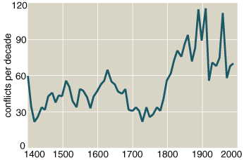
Wars, Frequency 1400-2000

Slide 36
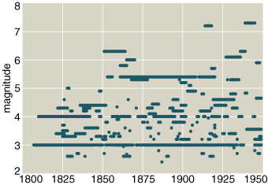
Wars, Severity & Duration 1800-1950

Slide 37
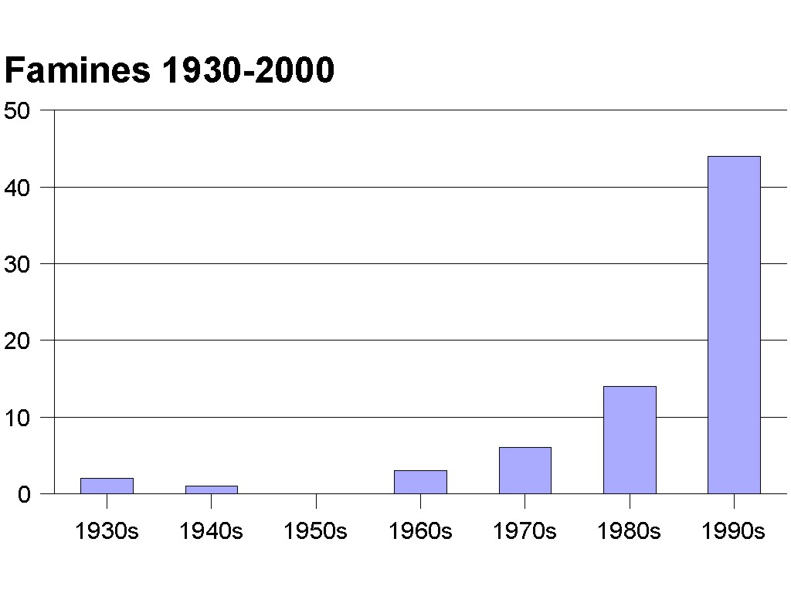
Famines 1930-2000

Slide 38
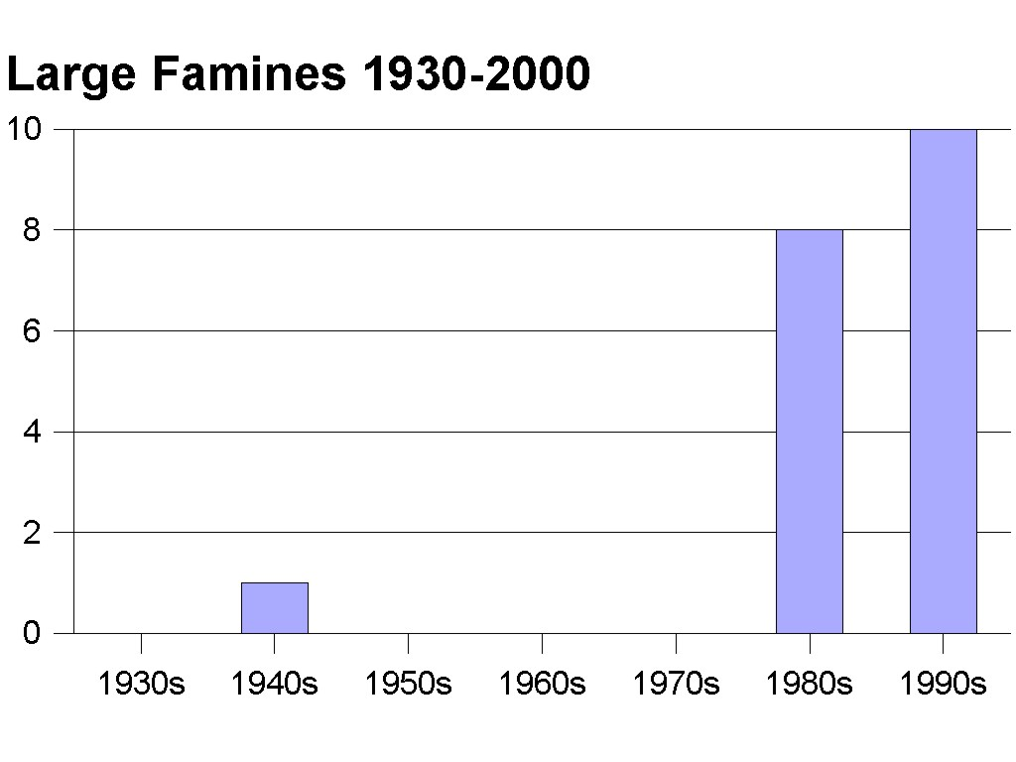
Large Famines 1930-2000

Slide 39
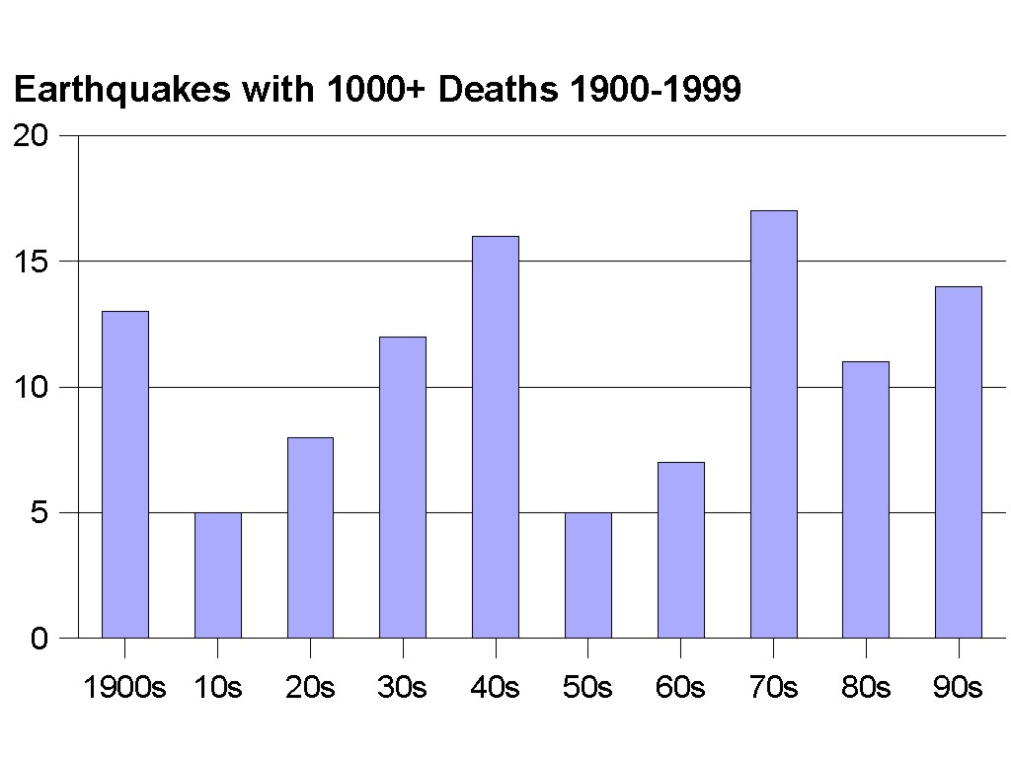
Earthquakes 1900-1999

Slide 40
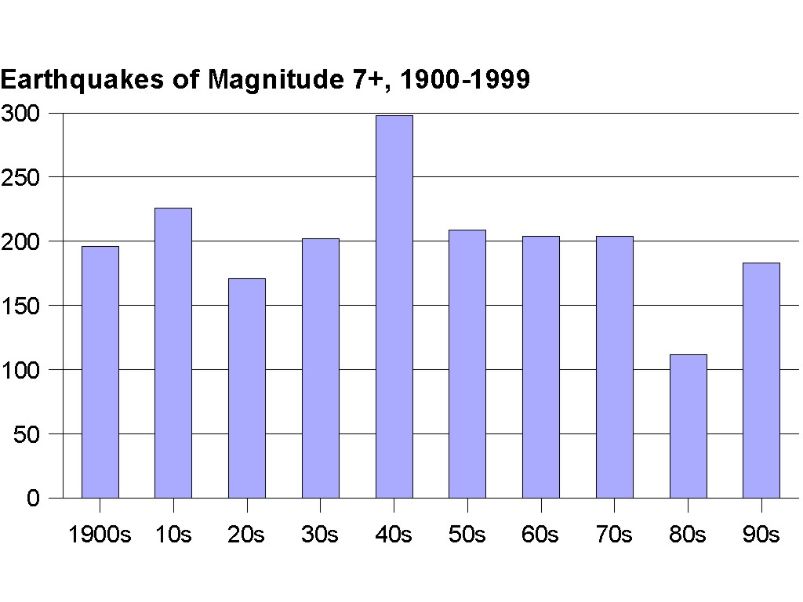
Earthquakes 1900-1999

Slide 41
Persecution
World Christian Encyclopedia estimates 69.4 million Xns killed by persecution since AD 33.
Of these, 45.4 million killed in 20th century.
Of these, 13.3 million since 1950.

Slide 42
Persecution
So rate for 1st 19 centuries is .75 million per century.
Rate for 20th cen is 45.4 million.
Rate currently is 16 million per century.

Slide 43
Moral Decay
Using crime statistics to estimate this.
Worldwide crime statistics just getting started.
UN has now conducted five global crime surveys, in 1974, 78, 84, 88, and 94.

Slide 44
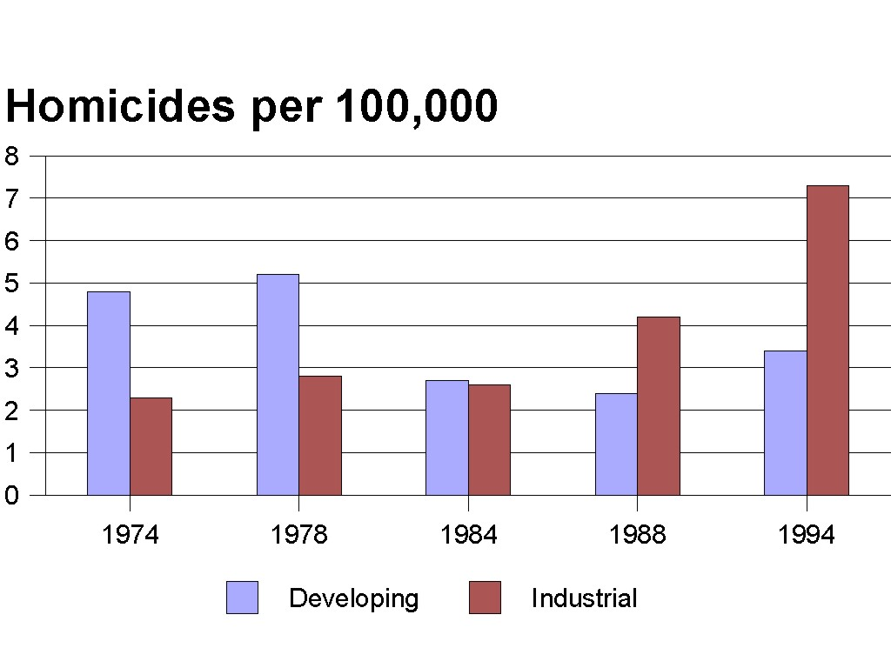
Moral Decay

Slide 45
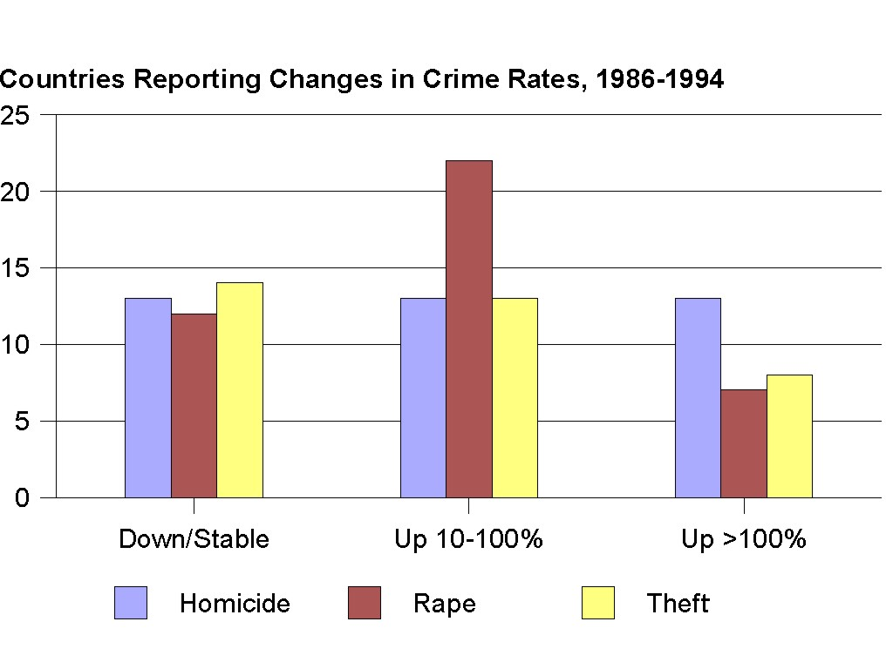
Moral Decay

Slide 46
Spread of the Gospel
Jesus (& Bible) do not say that all or nearly all will accept Christ.
Jesus does say the Gospel will be proclaimed throughout the whole world before the end comes.

Slide 47
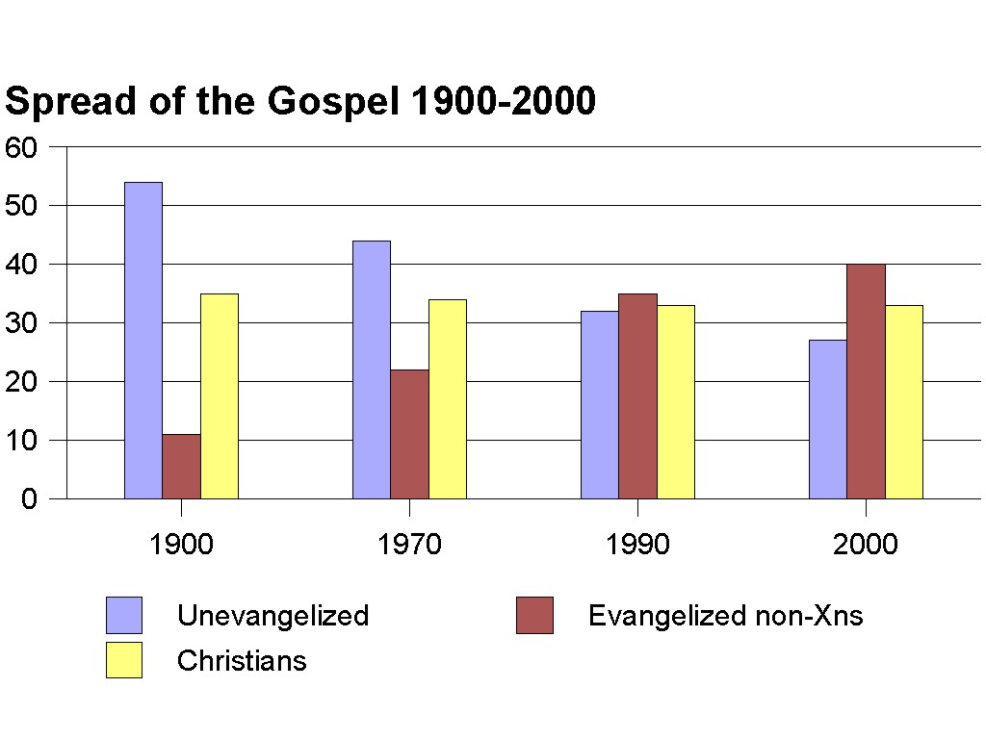
Spread of the Gospel 1900-2000

Slide 48
Conclusions
These seven items characterize the period between the 1st & 2nd comings.
They certainly function as signs of the end in the sense that they show us we need God's intervention to rescue us from sin & its effects.
There is good exegetical warrant to suppose they will increase in severity & frequency as the end arrives.

Slide 49
Conclusions
Whether they are currently increasing gives a mixed answer.
Yes:
  Wars
  Famines
  Persecution
  Moral decay
  Spread of Gospel
No:
  Earthquakes
Uncertain:
  False religions

Slide 50
Conclusions
Given these items, we may well be in the beginning of the end.
There is still about 30% of the world’s population unexposed to the Gospel.
Earthquakes have not apparently begun to increase.

Slide 51
Conclusions
Now learn this lesson from the fig tree: As soon as its twigs get tender and its leaves come out, you know that summer is near. Even so, when you see all these things, you know that it is near, right at the door. I tell you the truth, this generation will certainly not pass away until all these things have happened. Heaven and earth will pass away, but my words will never pass away. Matthew 24:32-35

Slide 52
The End…
… is not yet, but it may very well be near.

