Slide 1
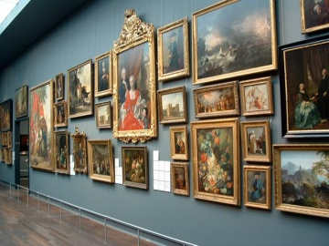

Biblical Pictures of the Christian Life
Robert C. Newman

Slide 2
Biblical Pictures
Though the Bible is a book without graphics, it provides many word-pictures to help us (especially those with visual rather than verbal inclination) to understand its message.
In previous PowerPoint talks, we have looked at “God’s Self-Portraits,” “Biblical Pictures of Salvation,” and “Going Home.”

Slide 3
Biblical Pictures
In this talk, we wish to sketch a number of Biblical pictures of the Christian life.
We will categorize these under three headings, pictures related to:
  Growth
  Work
  Athletics

Slide 4
Pictures Related to Growth
Here we will further subdivide our pictures into pictures of:
  Human Growth
  Plant Growth
  ‘Growth’ of a Building
We will look at each of these, giving some further subdivisions, some relevant Scriptures, and the significance of each.

Slide 5
Pictures Related to Work
Here we will subdivide our discussion into various occupations:
  Shepherding
  Fishing
  Farming
  Trading (Commerce)
  Warfare (Fighting, Soldiering)
Again, we will look at relevant Scriptures and the significance of each.

Slide 6
Biblical Pictures
Related to Athletics
Here we take the term “athletics” somewhat broadly, and include:
  Running
  Boxing
  Hiking (Travel by Foot)
Again, we will provide relevant Scriptures, and sketch the significance of each.

Slide 7

Biblical Pictures of Growth

Slide 8
Human Growth

Slide 9
Babies
Recent converts are pictured as babies in regard to their spiritual state:
1 Pet 2:1 (NIV) Therefore, rid yourselves of all malice and all deceit, hypocrisy, envy, and slander of every kind. 2 Like newborn babies, crave pure spiritual milk, so that by it you may grow up in your salvation, 3 now that you have tasted that the Lord is good.

Slide 10
Various Stages of Life
John seems to do this in 1 John 2:
1 John 2:12 (NIV) I write to you, dear children, because your sins have been forgiven on account of his name. 13 I write to you, fathers, because you have known him who is from the beginning. I write to you, young men, because you have overcome the evil one. I write to you, dear children, because you have known the Father. 14 I write to you, fathers, because you have known him who is from the beginning. I write to you, young men, because you are strong, and the word of God lives in you, and you have overcome the evil one.

Slide 11
Various Stages of Life
The writer of Hebrews certainly does:
Heb 5:11 (NIV) We have much to say about this, but it is hard to explain because you are slow to learn. 12 In fact, though by this time you ought to be teachers, you need someone to teach you the elementary truths of God's word all over again. You need milk, not solid food! 13 Anyone who lives on milk, being still an infant, is not acquainted with the teaching about righteousness. 14 But solid food is for the mature, who by constant use have trained themselves to distinguish good from evil.

Slide 12
Maturity
James speaks of proper response to trials as developing spiritual maturity.
James 1:2 (NIV) Consider it pure joy, my brothers, whenever you face trials of many kinds, 3 because you know that the testing of your faith develops perseverance. 4 Perseverance must finish its work so that you may be mature and complete, not lacking anything.

Slide 13
Human Growth
So the Bible sometimes pictures the spiritual growth of believers in terms of physical growth.
Elementary teaching is like milk for babies, proper nourishment for that stage in life.
More difficult material is for the mature, like solid food for older people.
Response to trials tests our faith, adds to our experience, and leads us to maturity.

Slide 14
Plant Growth

Slide 15
Planting Seed
Jesus gives this illustration to picture varied responses to the Gospel:
Matt 13:3 (NIV) A farmer went out to sow his seed. 4 As he was scattering the seed, some fell along the path, and the birds came and ate it up. 5 Some fell on rocky places, where it did not have much soil. It sprang up quickly, because the soil was shallow. 6 But when the sun came up, the plants were scorched, and they withered because they had no root. 7 Other seed fell among thorns, which grew up and choked the plants. 8 Still other seed fell on good soil, where it produced a crop─a hundred, sixty or thirty times what was sown.

Slide 16
Prosperous Plant
The righteous will (spiritually) prosper and bear fruit.
Ps 92:12 (NIV) The righteous will flourish like a palm tree, they will grow like a cedar of Lebanon; 13 planted in the house of the LORD, they will flourish in the courts of our God. 14 They will still bear fruit in old age, they will stay fresh and green…

Slide 17
Contrast Righteous & Wicked
Multi-season vs one-year usefulness.
Ps 1:3 (NIV) He is like a tree planted by streams of water, which yields its fruit in season and whose leaf does not wither. Whatever he does prospers. 4 Not so the wicked! They are like chaff that the wind blows away.

Slide 18
Separation at Harvest
Here Jesus tells a parable in which the wheat represents the “sons of the kingdom” and the weeds the “sons of the evil one.”
Matt 13:24 (NIV) Jesus told them another parable: "The kingdom of heaven is like a man who sowed good seed in his field. 25 But while everyone was sleeping, his enemy came and sowed weeds among the wheat, and went away. 26 When the wheat sprouted and formed heads, then the weeds also appeared. 27 The owner's servants came to him and said, 'Sir, didn't you sow good seed in your field? Where then did the weeds come from?' 28 'An enemy did this,' he replied. The servants asked him, 'Do you want us to go and pull them up?' 29 'No,' he answered, 'because while you are pulling the weeds, you may root up the wheat with them. 30 Let both grow together until the harvest. At that time I will tell the harvesters: First collect the weeds and tie them in bundles to be burned; then gather the wheat and bring it into my barn.'"

Slide 19
Plant Growth
Here the Christian life is pictured in terms of planting, growth & harvest of trees or grains.
The emphasis is mainly on:
  Health
  Fruitfulness
  The farmer’s oversight
The contrast of righteous & wicked is also developed.

Slide 20
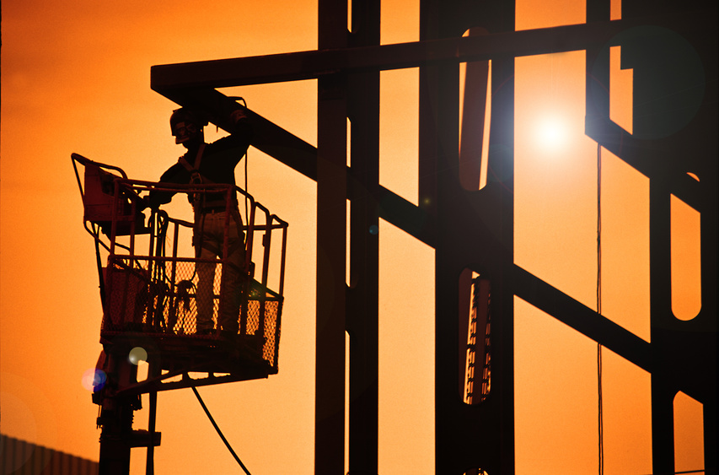
Growth of a Building

Slide 21
Proper Foundation
Here seen as proper resonse to Jesus’ teaching, i.e., obedience rather than just hearing:
Luke 6:46 (NIV) "Why do you call me, 'Lord, Lord,' and do not do what I say? 47 I will show you what he is like who comes to me and hears my words and puts them into practice. 48 He is like a man building a house, who dug down deep and laid the foundation on rock. When a flood came, the torrent struck that house but could not shake it, because it was well built. 49 But the one who hears my words and does not put them into practice is like a man who built a house on the ground without a foundation. The moment the torrent struck that house, it collapsed and its destruction was complete."

Slide 22
Foundation & Superstructure
Here we see Jesus as foundation, but with varied quality of work on the subsequent structure:
1 Cor 3:9 (NIV) For we are God's fellow workers; you are … God's building. 10 By the grace God has given me, I laid a foundation as an expert builder, and someone else is building on it. But each one should be careful how he builds. 11 For no one can lay any foundation other than the one already laid, which is Jesus Christ. 12 If any man builds on this foundation using gold, silver, costly stones, wood, hay or straw, 13 his work will be shown for what it is, because the Day will bring it to light. It will be revealed with fire, and the fire will test the quality of each man's work. 14 If what he has built survives, he will receive his reward. 15 If it is burned up, he will suffer loss; he himself will be saved, but only as one escaping through the flames.

Slide 23
God’s People as Temple
Eph 2:19 (NIV) Consequently, you are no longer foreigners and aliens, but fellow citizens with God's people and members of God's household, 20 built on the foundation of the apostles and prophets, with Christ Jesus himself as the chief cornerstone. 21 In him the whole building is joined together and rises to become a holy temple in the Lord.

Slide 24
God’s People as Temple
Individuals as individual stones in temple:
1 Pet 2:4 (NIV) As you come to him, the living Stone─rejected by men but chosen by God and precious to him─ 5 you also, like living stones, are being built into a spiritual house to be a holy priesthood, offering spiritual sacrifices acceptable to God through Jesus Christ.

Slide 25
Growth of Building
Picturing God’s people as a building emphasizes their:
  Collective nature
  Unity
  Interdependence
The growth presumably emphasizes the development of God’s people over time, now seen to be many centuries.

Slide 26
Biblical Pictures of Work

Slide 27
Shepherding

Slide 28
Elders as Shepherds
1 Pet 5:1 (NIV) To the elders among you, I appeal as a fellow elder, a witness of Christ's sufferings and one who also will share in the glory to be revealed: 2 Be shepherds of God's flock that is under your care, serving as overseers─not because you must, but because you are willing, as God wants you to be; not greedy for money, but eager to serve; 3 not lording it over those entrusted to you, but being examples to the flock. 4 And when the Chief Shepherd appears, you will receive the crown of glory that will never fade away.

Slide 29
False Shepherds
Jude 1:12 (NIV) These men are blemishes at your love feasts, eating with you without the slightest qualm─shepherds who feed only themselves. They are clouds without rain, blown along by the wind; autumn trees, without fruit and uprooted─twice dead. 13 They are wild waves of the sea, foaming up their shame; wandering stars, for whom blackest darkness has been reserved forever.

Slide 30
Shepherding
This figure applies directly to leaders among Christians, who have oversight of the spiritual welfare of others.
It continues an OT figure, and both share in the idea that humans are assistant shepherds to God, the chief shepherd.
For the individual Christian life, it implies the need for oversight from a more mature believer.

Slide 31
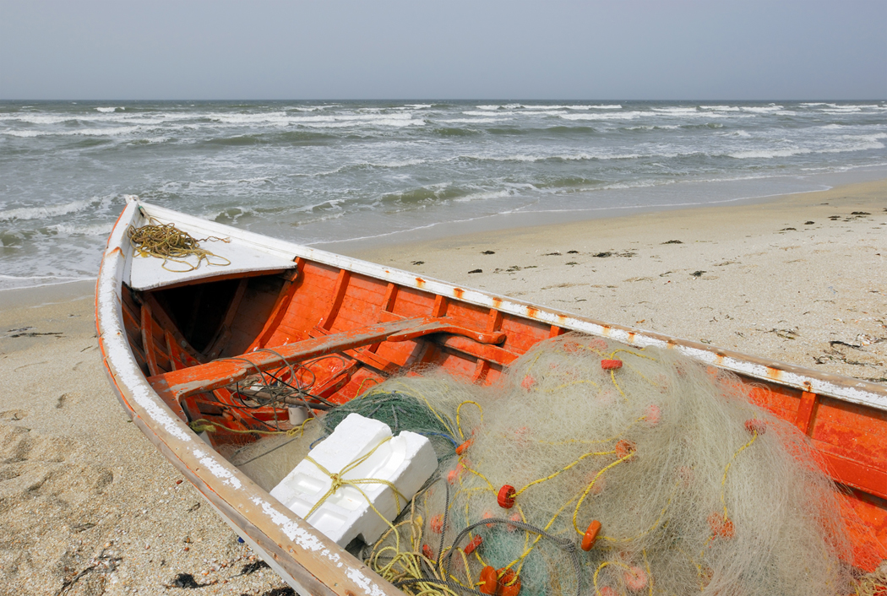
Fishing

Slide 32
Fishers of Men
Jesus calls his disciples to fish for men.
Matt 4:18 (NIV) As Jesus was walking beside the Sea of Galilee, he saw two brothers, Simon called Peter and his brother Andrew. They were casting a net into the lake, for they were fishermen. 19 "Come, follow me," Jesus said, "and I will make you fishers of men."

Slide 33
Fishing
The figure is only used in this one context.
It has usually been generalized (as Jesus appears to be speaking generally) to picture the Christian’s work of reaching out to the unsaved.
The nearest comparable figure is found in Jesus’ parable of the dragnet, but this has angels collecting humans at the end of the age.

Slide 34
Farming

Slide 35
Sowing Seed
In this parable, the seed is the Gospel.
Mark 4:3 (NIV) "Listen! A farmer went out to sow his seed. 4 As he was scattering the seed, some fell along the path, and the birds came and ate it up."
Mark 4:13 (NIV) Then Jesus said to them, "Don't you understand this parable? How then will you understand any parable? 14 The farmer sows the word."

Slide 36
Sharing the Produce
This figure appears to refer to Christian workers receiving support, as in the more general “a laborer is worthy of his hire.”
2 Tim 2:6 (NIV) The hardworking farmer should be the first to receive a share of the crops. 7 Reflect on what I am saying, for the Lord will give you insight into all this.

Slide 37
Awaiting the Harvest
This is more like the Dragnet parable, with the harvest as the end of the age.
James 5:7 (NIV) Be patient, then, brothers, until the Lord's coming. See how the farmer waits for the land to yield its valuable crop and how patient he is for the autumn and spring rains. 8 You too, be patient and stand firm, because the Lord's coming is near.

Slide 38
Farming
In representing the work of Christians, farming would seem to picture our activity in the lives of others:
  Evangelism
  Nurture
But it may also picture the broader scope of salvation history, as in the Wheat & the Weeds or the Dragnet, with planting as initial evangelism & harvest as the end of the age.

Slide 39

Trading

Slide 40
A Pearl Merchant
Matt 13:45 (NIV) "Again, the kingdom of heaven is like a merchant looking for fine pearls. 46 When he found one of great value, he went away and sold everything he had and bought it.
This seems to point to a seeker who has some idea what he is looking for, recognizes it when he finds it, and is willing to give up everything to have it.

Slide 41
Using Our Abilities
Jesus’ parables of the Talents (Matt 25:14-30) and the Pounds/Minas (Luke 19:11-27) picture believers trading with wealth with which they have been entrusted until the master returns.
The parable of the Crooked Business Manager (Luke 16:1-13) does something similar, but with an unusual twist. See my PowerPoint talk on this.

Slide 42
Trading
As a picture of the Christian life, trading helps us visualize the fact that God has entrusted us with all we have, and that we are to use it as faithful managers until the Lord returns.
The Pearl of Great Price shows us that the Gospel (or Jesus) is more valuable than anything we can have, and we should gladly give up everything to have it.

Slide 43
Warfare

Slide 44
Our Life as Warfare
We are fighting Satan and Satanic ideas.
2 Cor 10:3 (NIV) For though we live in the world, we do not wage war as the world does. 4 The weapons we fight with are not the weapons of the world. On the contrary, they have divine power to demolish strongholds. 5 We demolish arguments and every pretension that sets itself up against the knowledge of God, and we take captive every thought to make it obedient to Christ.

Slide 45
Divine Armaments
God has provided us with what we need for the fight.
Eph 6:11 (NIV) Put on the full armor of God so that you can take your stand against the devil's schemes. 12 For our struggle is not against flesh and blood, but against the rulers, against the authorities, against the powers of this dark world and against the spiritual forces of evil in the heavenly realms. 13 Therefore put on the full armor of God, so that when the day of evil comes, you may be able to stand your ground, and after you have done everything, to stand. 14 Stand firm then, with the belt of truth buckled around your waist, with the breastplate of righteousness in place, 15 and with your feet fitted with the readiness that comes from the gospel of peace. 16 In addition to all this, take up the shield of faith, with which you can extinguish all the flaming arrows of the evil one. 17 Take the helmet of salvation and the sword of the Spirit, which is the word of God.

Slide 46
Life as Struggle
We must flee, pursue, fight, take hold.
1 Tim 6:11 (NIV) But you, man of God, flee from all this, and pursue righteousness, godliness, faith, love, endurance and gentleness. 12 Fight the good fight of the faith. Take hold of the eternal life to which you were called when you made your good confession in the presence of many witnesses.

Slide 47
Warfare
This picture emphasizes the struggle and violence of the Christian life, not against human opponents, but against Satan and even our own sinful tendencies.
It reminds us that this is a struggle beyond our abilities, and that we must have God’s help and provision in order to be able to stand and be successful.

Slide 48
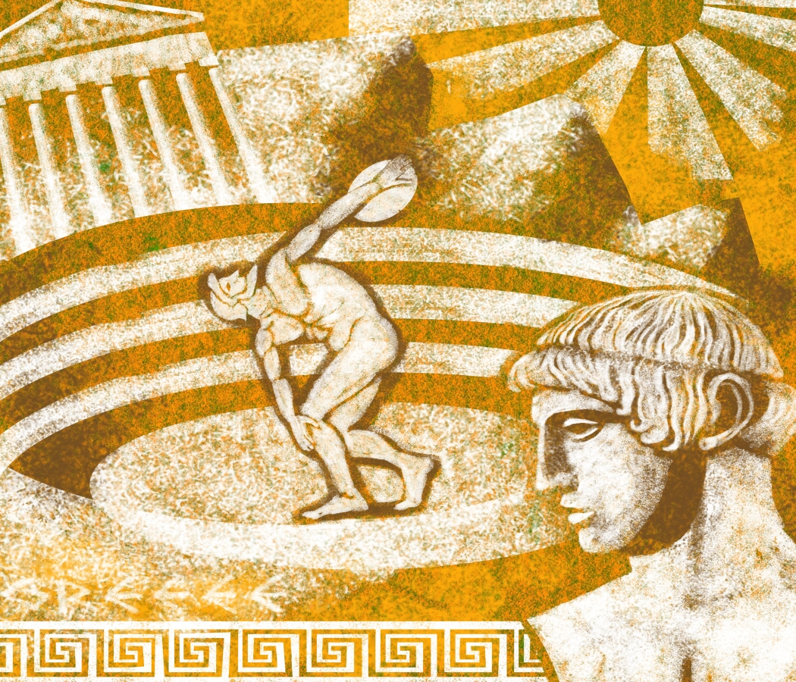
Biblical Pictures of Athletics

Slide 49
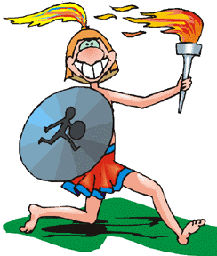
Running

Slide 50
Disciplined Running
I must discipline myself to be successful.
1 Cor 9:26 (NIV) Therefore I do not run like a man running aimlessly…. 27 No, I beat my body and make it my slave so that after I have preached to others, I myself will not be disqualified for the prize.

Slide 51
Endurance Running
Heb 12:1 (NIV) Therefore, since we are surrounded by such a great cloud of witnesses, let us throw off everything that hinders and the sin that so easily entangles, and let us run with perseverance the race marked out for us. 2 Let us fix our eyes on Jesus, the author and perfecter of our faith, who for the joy set before him endured the cross, scorning its shame, and sat down at the right hand of the throne of God. 3 Consider him who endured such opposition from sinful men, so that you will not grow weary and lose heart…. 12 Therefore, strengthen your feeble arms and weak knees. 13 "Make level paths for your feet" [Prov 4:26], so that the lame may not be disabled, but rather healed.

Slide 52
Running
This picture emphasizes the endurance and discipline needed in the Christian life.
The Hebrews passage hints at the spectators watching us.
Other passages suggest the prizes for successful running.

Slide 53
Boxing

Slide 54
Good Focus
1 Cor 9:26 (NIV) Therefore… I do not fight like a man beating the air. 27 No, I beat my body and make it my slave so that after I have preached to others, I myself will not be disqualified for the prize.
This suggests both the struggle of the Christian life, and the need for focus on what we are trying to do.

Slide 55
Hiking

Slide 56
Walking the Right Road
The idea of walking as a picture of how one conducts his life, and of keeping to the right road, are very common Old Testament figures.
They are continued into the New Testament.

Slide 57
God’s Law as the Right Road
Deut 5:32 (NIV) So be careful to do what the LORD your God has commanded you; do not turn aside to the right or to the left. 33 Walk in all the way that the LORD your God has commanded you, so that you may live and prosper and prolong your days in the land that you will possess.

Slide 58
The Road as the Course of Life
Ps 1:1 (NIV) Blessed is the man who does not walk in the counsel of the wicked or stand in the way of sinners or sit in the seat of mockers.
Ps 23:4 (NIV) Even though I walk through the valley of the shadow of death, I will fear no evil, for you are with me; your rod and your staff, they comfort me.

Slide 59
Walking in the Way of Death
Col 3:5 (NIV) Put to death, therefore, whatever belongs to your earthly nature: sexual immorality, impurity, lust, evil desires and greed, which is idolatry. 6 Because of these, the wrath of God is coming. 7 You used to walk in these ways, in the life you once lived. 8 But now you must rid yourselves of all such things as these: anger, rage, malice, slander, and filthy language from your lips.

Slide 60
Walking in the Light
1 John 1:5 (NIV) This is the message we have heard from him and declare to you: God is light; in him there is no darkness at all. 6 If we claim to have fellowship with him yet walk in the darkness, we lie and do not live by the truth. 7 But if we walk in the light, as he is in the light, we have fellowship with one another, and the blood of Jesus, his Son, purifies us from all sin.

Slide 61
Walking in God’s Glory
Rev 21:22 (NIV) I did not see a temple in the city, because the Lord God Almighty and the Lamb are its temple. 23 The city does not need the sun or the moon to shine on it, for the glory of God gives it light, and the Lamb is its lamp. 24 The nations will walk by its light, and the kings of the earth will bring their splendor into it.

Slide 62
Hiking
Walking is used as a picture of progress through life, with perhaps the ideas of path or road representing particular lifestyles.
Straying from the path represents departure from God’s appointed way of living.
Walking in the darkness vs the light pictures the danger & futility of going one’s own way vs living God’s way.

Slide 63
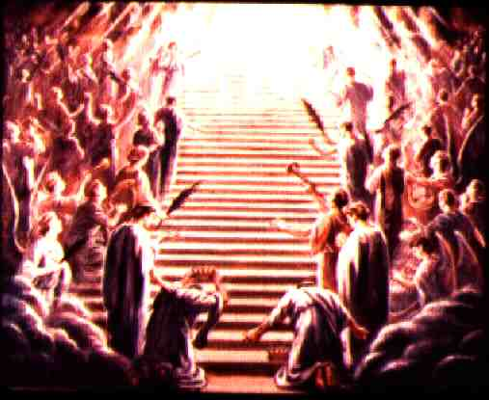
The End
Lord, help us to visualize, and to live, the kind of life that pleases You!

