Slide 1
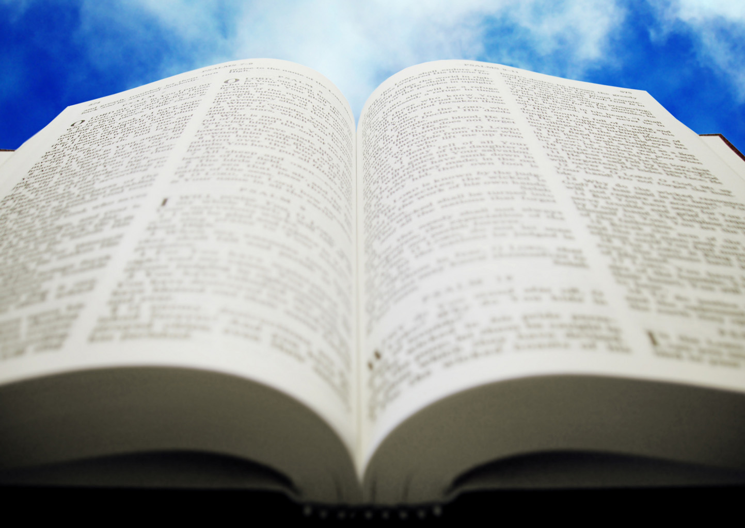

Is the Bible Reliable?
Robert C. Newman

Slide 2
A Problem Today
Many people are suspicious of the claims of Christianity.
Some doubt that it is true because they don't think they can trust the Bible.
Why is this?
For many, it is the presence of miracles in the Bible.
They don't believe miracles ever happen.

Slide 3
The Problem with Miracles
Many are convinced that miracles don't happen, and cannot happen.
Yet the Bible, especially in the Gospels, reports many miracles.
But if miracles cannot happen, then these miracles didn't.
And if all these miracles never happened, then the Gospels can't very well be considered reliable.

Slide 4
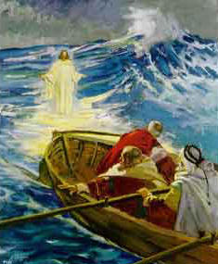
The Usual Arguments
Against Miracles
Hume
Harnack
Bultmann

Slide 5
Hume: Would you believe?
"When anyone tells me that he saw a dead man restored to life, I immediately consider with myself whether it be more probable that this person should either deceive or be deceived, or that the fact which he relates should really have happened. I weigh the one miracle against the other, and according to the superiority which I discover, I pronounce my decision and always reject the greater miracle."

Slide 6
Hume: Would you believe?
David Hume's argument has been quite influential in the history of Western thought.
But it has recently come under severe attack from philosophers.
Hume claims that universal human experience is against miracles by rejecting all miracle reports, which are not themselves that rare.
Hume advises us to reject all current miracle reports, so we would not recognize one even if it actually occurred.
This is not a very good way to find out what has really happened!

Slide 7
Harnack: Ignorant Ancients
"In those days, the strict conception which we now attach to the word 'miracle' was as yet unknown; it came in only with a knowledge of the laws of nature and their general validity. Before that, no sound insight existed into what was possible and what was impossible, what was rule and what was exception."

Slide 8
Harnack: Ignorant Ancients
Adolf von Harnack notes that the ancients were ignorant of modern science.
As a result, they couldn't distinguish between miracles and natural phenomena.
Give me a break!
  Is that how Joseph reacted to Mary's pregnancy?
  Can we really explain Jesus' miracles as misunderstood natural events?

Slide 9
Bultmann: Impenetrable Nature
"In the modern conception of the world, the cause-and-effect nexus [connection] is fundamental. Although modern physical theories take account of chance in the chain of cause and effect in subatomic phenomena, our daily living, purposes and actions are not affected. In any case, modern science does not believe that the course of nature can be interrupted or, so to speak, perforated, by supernatural powers."

Slide 10
Bultmann: Impenetrable Nature
Rudolf Bultmann believes nature is a closed system of cause & effect, into which not even God can break.
He alleges that science has proved this; but how can science know that the universe is a closed system?
Science does not know what is going on below the level of quarks, beyond the universe, or before the big bang. In regard to the future, it even has trouble predicting the weather.

Slide 11
Testing Biblical Reliability

Slide 12
Testing Biblical Reliability
How can we test the Bible's reliability?
It would be nice if we had a time machine.
Unfortunately, we cannot go back into the past to see what really happened.
We will have to use some other methods.

Slide 13
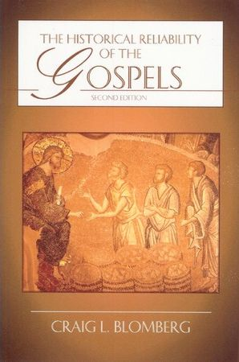
Testing Biblical Reliability
Suppose we leave open the question of the occurrence of miracles.
Then the Gospel accounts look very good…
  If we use the other criteria of secular historians;
  If we use the other criteria of secular New Testament scholars.
See Blomberg, Historical Reliability of the Gospels

Slide 14
Miraculous Intervention in Nature
We suggest in some other talks that there is good evidence for some sort of Mind behind the universe.
This Mind apparently has intervened to produce and fine-tune the universe.
It almost certainly has intervened to produce biochemical life & its complex functional diversity.

Slide 15
Miraculous Intervention in History
In still other talks, we have suggested that there is also a Mind behind history.
We noted that this Mind has intervened to produce fulfillment of numerous significant predictions in the history of:
  Israel
  Various nations around Israel
  Jesus as the predicted Messiah

Slide 16
Miraculous Intervention in the Gospel Events
So, if there is a Mind which has intervened in the history of the universe…
If there is a Mind which has intervened in human history, especially that of Israel…
Shouldn’t we expect to see miracles in the events surrounding the career of Jesus if he is Israel’s predicted Messiah?

Slide 17
Corroboration from
Other Historical Sources
Besides the Gospels, the other writings of the NT and the early church fathers say that Jesus worked miracles and made Messianic claims.
So do other Jewish sources.
So do Pagan sources.

Slide 18
Corroboration from
Other Christian Sources
Acts 1:1-3 (NIV) In my former book, Theophilus, I wrote about all that Jesus began to do and to teach 2 until the day he was taken up to heaven, after giving instructions through the Holy Spirit to the apostles he had chosen. 3 After his suffering, he showed himself to these men and gave many convincing proofs that he was alive. He appeared to them over a period of forty days and spoke about the kingdom of God.

Slide 19
Corroboration from
Other Christian Sources
1Cor 15:3-8 (NIV) For what I received I passed on to you as of first importance: that Christ died for our sins according to the Scriptures, 4 that he was buried, that he was raised on the third day according to the Scriptures, 5 and that he appeared to Peter, and then to the Twelve. 6 After that, he appeared to more than five hundred of the brothers at the same time, most of whom are still living, though some have fallen asleep. 7 Then he appeared to James, then to all the apostles, 8 and last of all he appeared to me also, as to one abnormally born.

Slide 20
Corroboration from
Other Christian Sources
Hebrews 2:3-4 (NIV) …how shall we escape if we ignore such a great salvation? This salvation, which was first announced by the Lord, was confirmed to us by those who heard him. 4 God also testified to it by signs, wonders and various miracles, and gifts of the Holy Spirit distributed according to his will.

Slide 21
Corroboration from
Jewish Sources
About this time there lived Jesus, a wise man, if indeed one ought to call him a man. For he was one who wrought surprising feats and was a teacher of such people as accept the truth gladly. He won over many Jews and many of the Greeks. He was the Messiah. When Pilate, on hearing him accused by men of highest standing among us, had condemned him to be crucified, those who had in the first place come to love him did not give up their affection for him. On the third day he appeared to them restored to life, for the prophets had prophesied these and countless other marvelous things about him. Josephus, Antiquities 18.63-64

Slide 22
Corroboration from
Jewish Sources
On the eve of Passover Yeshua was hanged. For forty days before the execution a herald went forth and cried, "He is going to be stoned because he has practiced sorcery and enticed Israel to apostasy. Anyone who can say anything in his favor, let him come forward and plead on his behalf." But since nothing was brought forward in his favor he was hanged on the eve of Passover. Babylonian Talmud, Sanhedrin 43a

Slide 23
Corroboration from
Pagan Sources
They also declared that the sum total of their guilt or error amounted to no more than this: they had met regularly before dawn on a fixed day to chant verses alternately among themselves in honor of Christ as if to a god… This made me decide it was all the more necessary to extract the truth by torture from two slave-women, whom they call deaconesses. I found nothing but a degenerate sort of cult carried to extravagant lengths. I have therefore postponed any further examination and hastened to consult you.
Pliny the Younger, Letters 10.96

Slide 24
Corroboration from
Pagan Sources
For what else have we to say, when wise men are forcibly dragged by the hands of tyrants, and their wisdom is taken captive by calumny, and they are oppressed in their intelligence without defense? For what advantage did the Athenians gain by their murder of Socrates…. Or the people of Samos by the burning of Pythagoras… Or the Jews by the death of their wise king, because from that time their kingdom was taken away? For with justice did God make recompense to the wisdom of these three: for the Athenians died of famine; and the Samians were overwhelmed by the sea without remedy; and the Jews, desolate and driven from their own kingdom, are scattered through every country. Socrates is not dead, because of Plato; neither Pythagoras, because of the statue of Juno; nor the wise King, because of the laws which he promulgated.
Mara bar Serapion, Letter to His Son

Slide 25
Summary on Corroboration
Not only do Christian sources speak of Jesus' miracle working, Messianic claims, and resurrection…
Pagan and Jewish sources also corroborate a number of features of Jesus' ministry, features that many moderns are reluctant to admit, even when these sources are not favorable to Jesus and Christianity.

Slide 26
Pagan Corroboration
Jesus lived in Judea in the reign of Tiberius.
A Messianic claim was ascribed to him.
He apparently was a teacher.
He was put to death by Pontius Pilate and/or the Jews.
His followers continued after his death.
They worshiped Jesus as God, though they would not worship the gods.
They were willing to endure torture and death rather than curse Jesus.

Slide 27
Jewish Corroboration
Jesus lived in Judea during the rule of Pontius Pilate.
His birth was alleged to be unusual, illegitimate.
His character was controversial.
He worked miracles, also controversial.
He gathered followers, who considered him the Messiah.
He was condemned by Pilate, accused by Jews.
He was hanged/crucified on Passover eve.
His resurrection was reported on the third day.

Slide 28

Do we have the right books in the Bible?

Slide 29
Right Books?
Some may admit miracles but wonder whether we have an accurate picture of Jesus. Are the right books in the Bible?
We give considerable detail on this in our PowerPoint "The Canon of the NT."
That talk includes general principles regarding the canon, and specific detail on the canon of the NT.
Let us look here at the matter of the Gospels.

Slide 30
Right Gospels?
Besides the four Gospels in our NTs, there are perhaps 20-30 gospels that were known in the ancient world.
Some of these have been known to some extent ever since, but a few have been rediscovered in the last century.
We look at several of these in some detail in two of our PowerPoint talks.

Slide 31
The Four Canonical Gospels
Matthew, Mark, Luke & John are known to have been in existence by early in the 2nd century.
The testimony of the early church fathers and the early manuscripts give the traditional authors.
Most scholars date all of these to the first century.

Slide 32
The Gospel of Thomas
Rediscovered in Egypt ~1945, along with some 50 other Gnostic documents.
This gospel contains some 114 alleged sayings of Jesus, many with parallels in the 4 Gospels, some with dependence on other NT works.
The usual date suggested is ~140, though some radical scholars favor a 1st century date.
The work appears to depend on Tatian's Diatessaron, which would give ~175 instead.

Slide 33
The Gospel of Thomas
Inscription and #1: These are the secret sayings which the living Jesus spoke and which Judas Didymus Thomas wrote down. (1) And he said, "Whoever finds the interpretation of these sayings will not experience death."
#114: Simon Peter said to them, "Let Mary leave us, for women are not worthy of Life." Jesus said, "I myself shall lead her in order that she too may become a living spirit resembling you males. For every woman who will make herself male will enter the Kingdom of Heaven."

Slide 34
The Gospel of the Hebrews
This is the only non-canonical Gospel mentioned at all favorably in canon discussions (Origen and Eusebius).
It probably originated in Egypt, sometime between 100 and 150.
It seems to be Jewish-Christian, with a mixture from Gnosticism and other religions.
Of the few quotations surviving, two are quite strange!

Slide 35
The Gospel of the Hebrews
When the Christ wished to come upon the earth to men, the good Father summoned a mighty power in heaven, which was called Michael, and entrusted Christ to the care thereof. And the power came into the world and it was called Mary, and Christ was in her womb seven months.
Here the Savior says, "Even so did my mother, the Holy Spirit, take me by one of my hairs and carry me away on to the great mountain Tabor."

Slide 36
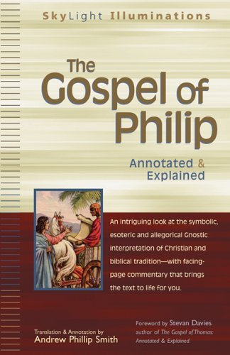
The Gospel of Philip
A Gnostic gospel, probably written in Syriac, 250-300, known to us in Coptic.
It rejects creation by God for creation by a lesser power.
It rejects Jesus being born of virgin for a strange reason, and similarly argues that Jesus had an earthly father.

Slide 37
The Gospel of Philip
The world came about through a mistake. For he who created it wanted to create it imperishable and immortal. He fell short of attaining his desire. For the world never was imperishable, nor, for that matter, was he who made the world. – 75.2-9

Slide 38
The Gospel of Philip
Some said, "Mary conceived by the Holy Spirit." They are in error. They do not know what they are saying. When did a woman ever conceive by a woman? Mary is the virgin whom no power defiled. She is a great anathema to the Hebrews, who are the apostles and the apostolic men.… And the Lord would not have said "My Father who is in heaven" unless he had had another father, but he would have said simply "my father." – 55.23-36

Slide 39
The Gospel of Philip
This Gospel demonstrates rather fishy interpretation of the Bible:
  The Holy Spirit is feminine (because the Hebrew and Syriac words for 'spirit' are feminine).
  The apostles & their followers are mistaken.
  Jesus had an earthly father because he refers to God as his Father in heaven.
All these arguments depend upon using our Bible, and twisting it to make points the Bible does not.

Slide 40
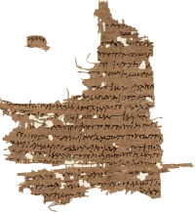
The Gospel of Mary
Slightly under ½ of this gospel survives (8 of 18 pages), in the Coptic language, in the Berlin Codex from the 5th century.
The last two pages are also preserved in Greek from the early 3rd century.
The gospel thus dates from sometime before AD 200.

Slide 41
The Gospel of Mary
The first six pages are missing. On page seven we come in just at the end of a conversation of the risen Christ with his disciples. Then he blesses and leaves them.
The disciples are sad and fearful, given their commission and what happened to Jesus.
Mary Magdalene encourages them.

Slide 42
The Gospel of Mary
Peter asks Mary to tell them the revelations she received from Jesus, who loved her above all other women.
We begin to get a presentation of this when the text breaks off again (pp 11-14 are missing).
When the text resumes, she is describing how the soul passes through the planetary spheres, and how the soul is to speak with the hostile powers guarding each sphere — a standard Gnostic motif.

Slide 43
The Gospel of Mary
When she finishes, Andrew & Peter do not believe her.
Mary weeps, saying she is no liar.
Levi rebukes Peter, and the disciples go out to preach to the world.
That's what we know of the Gospel of Mary.

Slide 44
The Gospel of Judas
Mentioned by the early church father Irenaeus (~180), but the text lost for centuries.
Recently recovered in a Gnostic booklet dating to ~300.
The media and National Geographic gave it a great deal of hype in 2006.
Opens with statement: "the secret account of the revelation that Jesus spoke in conversation with Judas Iscariot…"

Slide 45
The Gospel of Judas
Jesus laughs at the apostles' prayers to the Creator God.
Jesus gives Judas the 'real scoop' on creation – the Gnostic version.
Judas is to bring about the death of Jesus' body, so that his spirit may escape from the world of matter.
These are all standard Gnostic motifs.

Slide 46
Summary on Gnostic Gospels
They tell us little of Jesus' actions, as the Gnostics had no interest in history.
They have little interest in the OT or the fulfillment of its prophecies.
Instead, Jesus is a guru expounding the Gnostic worldview – an ignorant creator, certain humans as spirits trapped in bodies, whose salvation consists of escaping this world by means of secret knowledge or passwords.

Slide 47
Contrast with NT Gospels
The NT Gospels are mainly narrative, what Jesus said & did in public among the Jews.
The NT Gospels continue the emphases of the OT – God the Creator, acting in history, bringing the predictions of his prophets to fulfillment, to make his Messiah a light for the Gentiles, to rescue people from their sins.
The NT Gospels look like the work of the God of the Bible; the Gnostic Gospels look like the work of someone else.

Slide 48
Historical Verification
The four NT Gospels are being quoted or alluded to by 100 and regularly thereafter.
Irenaeus (~180) assumes these four are the only authentic Gospels and have been known time out of mind. He is aware of and responds extensively to Gnosticism and its gospels.
These four are listed as part of the NT over a century before Constantine.

Slide 49
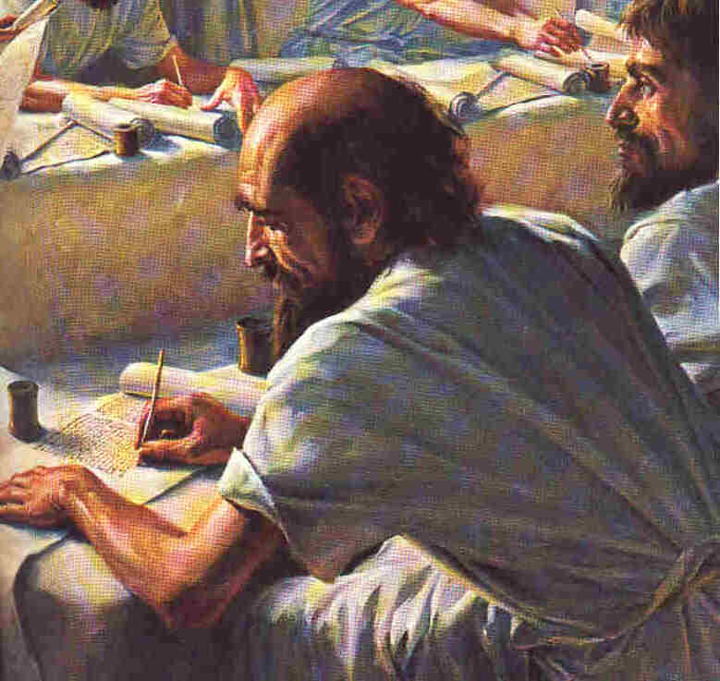
Do we know what these books originally said?

Slide 50
The Problem of Time
As time passes, a manuscript suffers increasing damage from wear & tear, decay, and various other hazards.
As a result, for virtually any ancient work, we are more likely to have fragments that have survived than complete copies.
How do we know what the original manuscripts actually said?

Slide 51
Textual Criticism
To study the texts of writings composed before the invention of printing, scholars have developed a science called textual criticism.
The procedure used to establish the best text of the OT or NT is like that used to determine the best text of Homer, Plato, Herodotus, or Caesar.

Slide 52
New Testament Manuscripts
The originals were probably written over the period AD 50 to 100.
Our earliest fragment is a scrap from the Gospel of John, copied about AD 125, less than a generation after John wrote.
The oldest nearly complete copy of a whole book (also John) comes from ~ AD 200.
The oldest known copy of the whole NT dates from about AD 350.

Slide 53
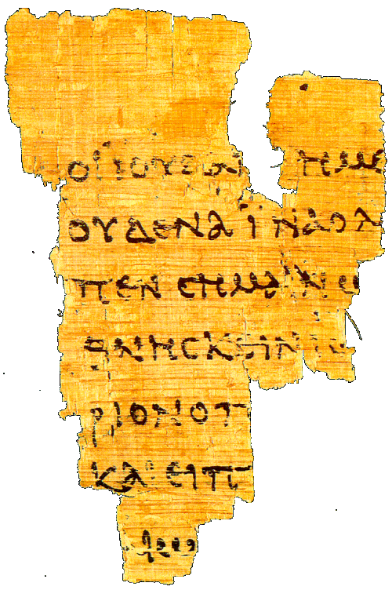
New Testament Manuscripts
P⁵² – John Rylands papyrus of the Gospel of John, chapter 18, from the first third of the second century (AD 100-135).

Slide 54
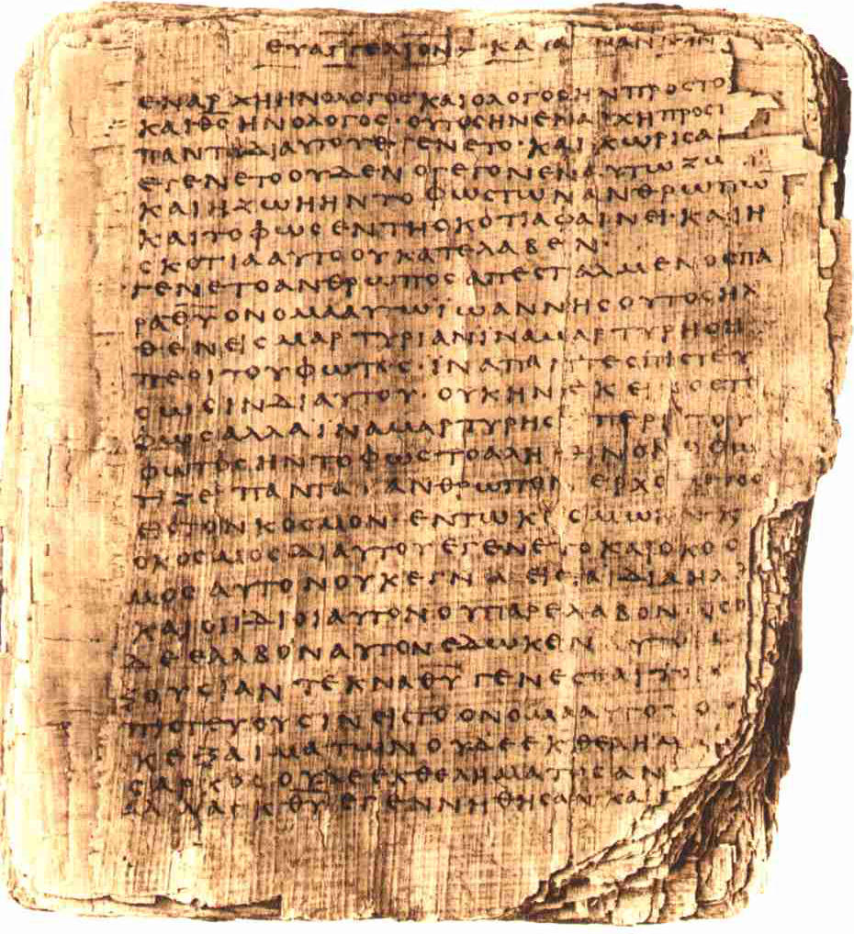
New Testament Manuscripts
P⁶⁶ – Papyrus Bodmer II, an almost complete copy of the Gospel of John, from about AD 200.

Slide 55
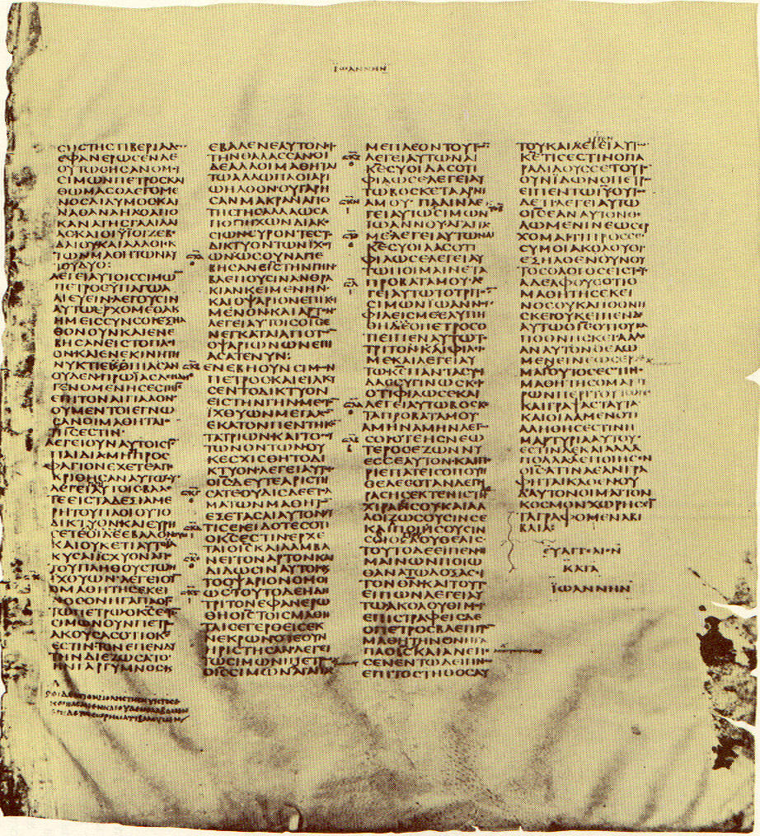
New Testament Manuscripts
Codex Sinaiticus – from ~AD 350 oldest complete manuscript of the NT; end of John's Gospel.

Slide 56
Old Testament Manuscripts
The originals were probably written over the period 1400-400 BC.
The earliest fragments discovered to date are among the Dead Sea Scrolls: parts of Exodus and Samuel from ~250 BC.
The earliest complete book (Isaiah) comes from the same find, dating to ~125 BC.
The earliest complete copy of the whole OT, surprisingly, is a Greek translation, from ~AD 350.
The earliest complete Hebrew manuscript only goes back to about AD 950.

Slide 57
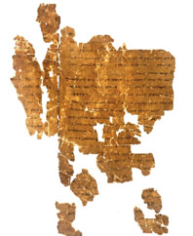
Old Testament Manuscripts
A fragment of Exodus from the Dead Sea Scrolls, dating to about 250 BC.

Slide 58
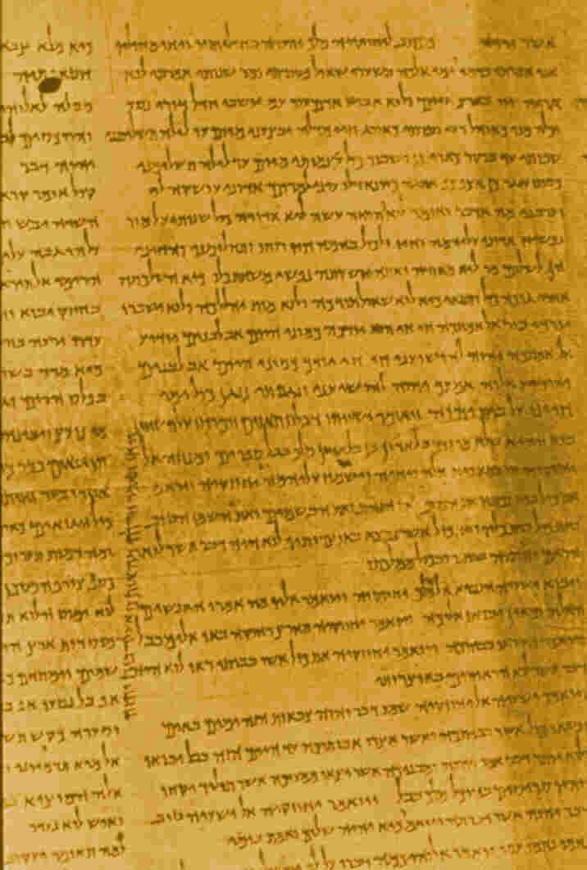
Old Testament Manuscripts
1QIsaiahª – the earliest complete book ms of the OT, dating to ~125 BC, found in cave 1 at Qumran.

Slide 59
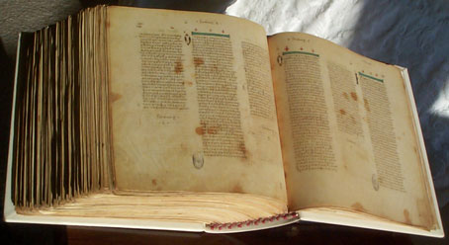
Old Testament Manuscripts
Codex Vaticanus – about AD 350, contains all of the OT in Greek except for a large part of Genesis and the Psalms added in the 15th century.

Slide 60
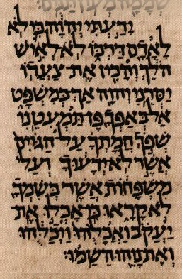
Old Testament Manuscripts
A portion of Codex Aleppo, the oldest known surviving complete manuscript of the OT in Hebrew, from ~AD 950.

Slide 61
Comparison with Other Works
Work Originally Written Earliest Comp Ms Difference
New Testament ~75 ~ 350 ~275
Josephus ~90 ~1000 ~900
Plutarch ~100 ~950 ~850
Tacitus ~100 ~850 ~750
Old Testament 1400-400 ~350 750-1750
Enuma Elish ~1750 BC ~650 BC ~1100
Rigveda 1500-1000 ~1350 AD ~2600
Iliad bef 700 BC ~1050 AD 1750+

Slide 62
Conclusions
We could go on to give more detail on the transmission of the texts of the OT and NT.
Or we could get into the matter of the translation of the OT and NT into modern languages.
But these are both features of all works transmitted from ancient times, and the Bible is in better shape than any of these.

Slide 63
Conclusions
There is no reason to fear that the Bible has been changed from what it originally read.
There is a desire on the part of some to have it read differently because they do not like its message.
If the God of the Bible really does exist (as considerable evidence indicates), he is certainly capable of protecting his message from corruption.

Slide 64
The End

