Slide 1
The Biblical Firmament
Vault or Vapor?
Robert C. Newman

Slide 2
Does the Bible teach a hard sky?
Today often claimed the Bible mistaken, that it agrees with the ancients in seeing the sky as a solid dome
Want to look at this question carefully, since the Bible claims to be a revelation from the Creator

Slide 3
Modern Claims
Many moderns claim the Bible mistaken about the nature of the sky:
Some think there is no God behind the Bible.
Others think there is, but he wasn't concerned to have the Bible writers get their science straight.
If either are right, why should we believe the Bible is from the Creator, if it doesn't get the facts of nature correct?

Slide 4
Modern Claims
Consider Schiaparelli, Astronomy in the OT:
"[The biblical concept of the firmament is] a vault of great solidity, compared in Job (37:18) to a metal mirror; a transparent vault allowing the light of the stars, which are placed higher, to pass through. Its main duty is to support the 'upper waters'…"

Slide 5
Modern Claims
"In the Scriptures the flat earth is founded on an underlying sea; it is stationary; the heavens are like an upturned bowl or canopy above it; the circumference of this vault rests on pillars; the sun, moon and stars move within this firmament of special purpose to illumine man; there is a sea above the sky, 'the waters which were above the heavens,' and through the 'windows of heaven' the rain comes down…. This is the worldview of the Bible."
Harry Emerson Fosdick, Modern Use of the Bible, 46-47

Slide 6
Modern Claims
"The second day brings the creation of the firmament, which the ancients imagined as a gigantic hemispherical and ponderous bell…. This heavenly bell, which is brought into the waters of chaos, forms first of all a separating wall between the waters beneath and above."
Gerhard von Rad, Genesis, 51

Slide 7
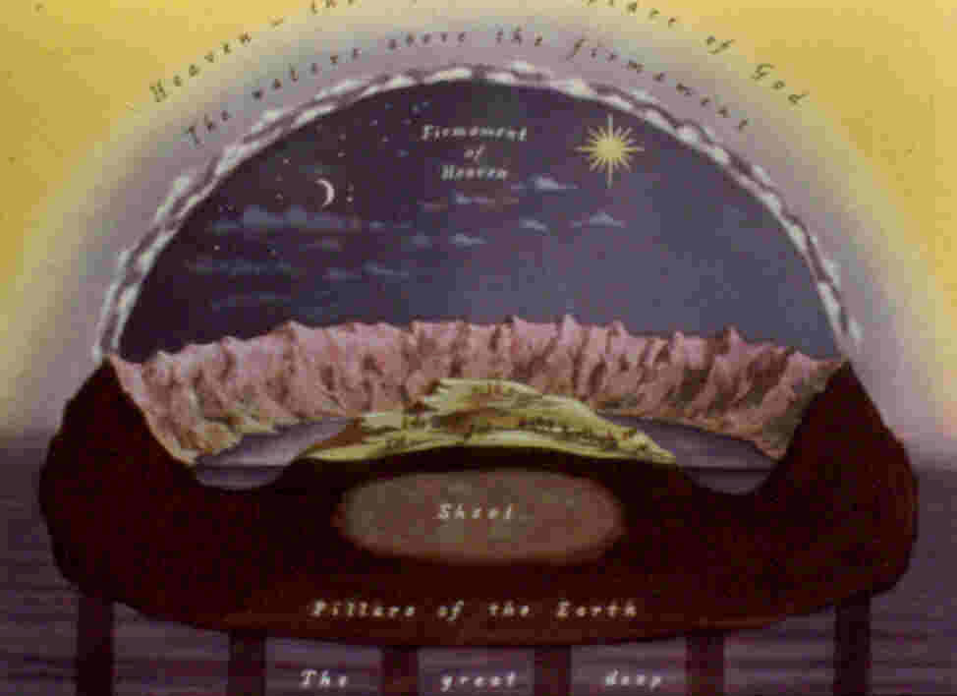
Alleged Biblical Cosmos

Slide 8
Arguments for a Dome View
It is a common ancient view.
The word 'firmament' implies it.
The 'pillars of heaven' also fit this view.
The Bible pictures the sky as a heavy metal mirror.
Amos speaks of building stories in heaven and of a vault.

Slide 9
Ancient Views
It is true that belief in the sky as a solid dome was common in the ancient world.
We see this idea among pagans, Jews and Christians.
The early Greek philosopher Anaximenes of Miletus (c550 BC) saw the sky as a crystal sphere to which the stars were nailed.

Slide 10
Ancient Views
"After this, on the second day, [God] placed the heavens over the whole world, and separated it from the other parts…. He also placed a crystalline [firmament] round it, and put it together in a manner agreeable to the earth, and fitted it for giving moisture and rain, and for affording the advantage of dews."
Josephus, Antiquities, 1.1.1.

Slide 11
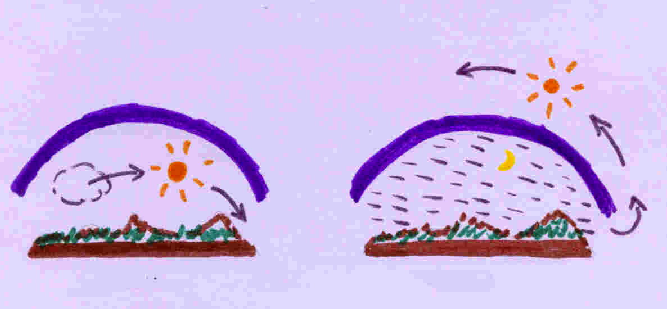
Ancient Views
"The Sages of Israel say: the sun travels beneath the sky during the day and above the sky during the night, while the Sages of the world maintain that the sun travels beneath the sky by day and beneath the earth by night. It seems that their opinion is better than ours, because during the day the wells are cool, but at night they are warm."
Pesahim 94b

Slide 12
Ancient Views
"For the Spirit being one, and holding the place of light, was between the water and the heaven, in order that the darkness might not in any way communicate with the heaven, which was nearer God, before God said, 'Let there be light.' The heaven, therefore, being like a dome-shaped covering, comprehended matter, which was like a clod."
Theophilus to Autolycus 2:13

Slide 13
Ancient Views
"Waters embrace the back of the visible heaven on all parts, and yet they neither flow down, nor are moved out of their place…. Besides, the water has not quenched the sun, nor has the sun, which has gone on his way beneath for so long a time, dried up the water that lies above."
Chrysostom, Concerning the Statues 9.9

Slide 14
Ancient Views
A dome sky was a common view among the ancients.
Yet not all ancients viewed the sky as solid.
For instance, the Greek philosopher Anaxagoras (c450 BC) thought it was a whirling, airy "ether" which swept the sun, moon and stars around the earth.
The Egyptians sometimes viewed the sky as a goddess.

Slide 15
Ancient Views
G. Ernest Wright, in The OT Against Its Environment, points out that the teaching of the OT often contrasts with that of the nations surrounding Israel.
Since there is a variety of ancient views of the sky, and since the Bible claims to be a revelation from the Creator, we really need to see what the Bible itself says, rather than assume it agrees with other ideas in the ancient Near East.

Slide 16
The Word 'Firmament'
"And God said, Let there be a firmament in the midst of the waters, and let it divide the waters from the waters. And God made the firmament, and divided the waters which were under the firmament from the waters which were above the firmament; and it was so. And God called the firmament Heaven."
Genesis 1:6-8 (KJV)

Slide 17
The Word 'Firmament'
Our English is borrowed from the Latin Vulgate translation of Jerome, who used firmamentum here.
The ancient Greek LXX translation uses stereoma (sterewma).
The original Hebrew is raqia (uyqr).

Slide 18
The Word 'Firmament'
Firmamentum – a means of support, a prop; Jerome uses this in his Vulgate for the sky, perhaps as fixed above the earth.
Stereoma – solid body, foundation; skeleton; keel; strength, stedfastness; in LXX, firmament
Raqia – extended surface, (solid) expanse; the vault of heaven

Slide 19
Etymology of Raqia
Noun from same word group as verb raqa (uqr)
The standard dictionary of Brown, Driver and Briggs translates the verb as 'beat, stamp, beat out' and 'spread out.'
From this it is commonly argued that the Bible pictures the sky as something solid which has been 'spread out by beating.'
The verb is used eleven times in the Bible.

Slide 20
Usage of Raqa
"Give thanks to the LORD, for he is good,
His love endures forever…
Who spread out the earth upon the waters,
His love endures forever…"
Psalm 136:6
Here raqa is applied to spreading the earth.

Slide 21
Usage of Raqa
"To whom, then, will you compare God? What image will you compare him to? As for an idol, a craftsman casts it, and a goldsmith overlays it with gold and fashions silver chains for it." Isaiah 40:19
Here raqa is applied to spreading gold leaf over a cast image, which is a rather more delicate operation than beating or stamping!

Slide 22
Usage of Verb Raqa
Verb used 11x in the Bible:
2x to 'stamp one’s feet' and once to stamp something with the feet;
4x for spreading metal, but not always in the sense of beating or hammering;
3x for spreading out the earth, which is nowhere said to be spread by beating;
1x for spreading the sky or the clouds.
It thus need not mean more than 'spread out,' whatever the means for accomplishing this.

Slide 23
Usage of Noun Raqia
Noun used 17x in Bible
11 of these refer to 'firmament' of heaven, which is the meaning in dispute;
5 others refer to some object in Ezekiel’s vision, which may be solid, but this is not certain;
The other, Ps 150:1, may refer to the heavenly firmament, or to the 'expanse' of God’s power.
In any case, the noun raqia refers to something expanded, whether solid or not, thick or thin, however it was spread out.

Slide 24
The 'Pillars of Heaven'
Occurs only once, in Job 26:11: "The pillars of heaven quake, aghast at his rebuke."
Three other passages refer to 'pillars' of the earth.
But in Hebrew usage, pillars do not always support something. Sometimes they are free-standing.

Slide 25
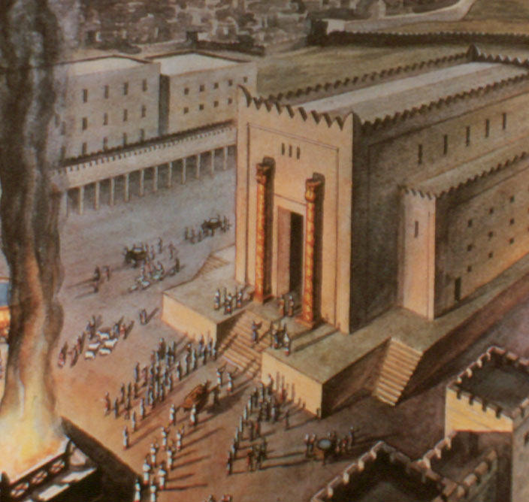
Usage of 'Pillars'
Solomon's Temple is usually pictured with free-standing pillars.

Slide 26
Usage of 'Pillars'
In context, the 'pillars' of heaven and earth suggest that the objects referred to are mountains.
The idea may be that the mountains are made of earth and extend into heaven, rather than that they support earth or heaven.
In any case, there is no explicit statement that these 'pillars' hold up heaven or earth.

Slide 27
The sky a 'heavy metal mirror'
"Can you, with Him, spread out the skies, strong as a molten mirror?" (Job 37:17, NASB)
"Can you beat out vault of the skies, as he does, hard as a mirror of cast metal?" (NEB)
"Hast thou, with him, spread out the sky, which is strong, and as a molten looking glass?" (KJV)

Slide 28
The sky a heavy metal mirror?
This passage certainly looks like the Bible teaches a solid sky – or more precisely, that the speaker Elihu believed in one.
Elihu might have been mistaken and the Bible merely reporting his words, but is this what he really said?
There are serious problems with the translation of two crucial words here – 'mirror' and 'sky.'

Slide 29
The sky a heavy metal mirror?
The word translated 'mirror' is listed as occurring only once in the Hebrew Bible, with no cognates given from related languages.
A word with identical spelling is listed below it. This occurs 4x, once by Elihu in Job.
I suggest this is the word in our passage, usually translated 'appearance.'

Slide 30
The sky a heavy metal mirror?
The word translated 'sky' or 'skies' here is shahaq.
It occurs 21x in the Bible.
The dictionary lists the main meanings as 'dust' and 'cloud'; 'sky' is only given as a secondary meaning under cloud.
Elihu uses the word 3 other times, always translated 'cloud.'
I suggest we try 'cloud' here, too.

Slide 31
The sky a heavy metal mirror?
With these changes we get:
"Can you, with Him, spread out the mighty clouds, with an appearance of being poured out?"
As an alternative to:
"Can you, with Him, spread out the skies, strong as a molten mirror?"

Slide 32
The sky a heavy metal mirror?
The LXX translates this word by horasis, which means 'appearance' rather than 'mirror.'
The two alternatives picture different events:
Spreading the skies speaks of creation;
My suggestion, everyday weather.
Which of these best fits the context of Job 37?

Slide 33
The sky a heavy metal mirror?
Is Job 37 a creation or weather context?
2-5 – thunder and lightning
6 – rain
9-10 – wind, cold, frost
11-13 – rain and clouds
15-16 – clouds
17 – warmth, south wind
18 – our verse
21-22 – clouds, wind, fair weather

Slide 34
Building 'stories' in heaven
"It is he that buildeth his stories in the heavens, and hath founded his troop in the earth." (Amos 9:6, KJV)
"The LORD, God of Hosts… who builds his upper chambers in the heavens, and founds his vault upon the earth…" (RSV)
"The One who builds His upper chambers in the heavens, and has founded His vaulted dome over the earth…" (NASB)

Slide 35
Building 'stories' in heaven
But the word translated 'stories' (KJV) or 'upper chambers' (RSV, NASB) is only so translated here; elsewhere it is 'step, stair, ascent, what comes up.'
We suggest it refers to God piling up clouds in the heavens, literally "He that builds in the heavens his ascents…"

Slide 36
Building 'stories' in heaven
The word translated 'vault' (RSV) or 'vaulted dome' is so translated only here.
Elsewhere it is 'band, thong, bunch.' This is why the KJV has 'troop.'
Here we suggest "appoints his bunch (or troop) above the earth," referring to the gathering of clouds.

Slide 37
Building 'stories' in heaven
With these changes, we get this translation:
"Who piles up his clouds in the heavens
And gathers them over the earth…"
Notice how this fits the context following:
"Who calls for the waters of the sea
And pours them on the face of the earth…"

Slide 38
Summary on dome view
Resemblance to ancient views of sky:
Variety of ancient views
OT often against its environment
Etymology of Hebrew for 'firmament'
True, related verb can mean 'beat, stamp'
But usage includes 'spread out' without beating
It appears to be used for spreading out clouds in Job 37:18.

Slide 39
Summary on dome view
Pillars of heaven imply dome sky
Possible, but pillars have other uses too
Nothing said about these holding up sky
Probably they refer to mountains rising into the sky
Sky a heavy metal mirror
A bad translation!
Building stories, vault
Also a bad translation!

Slide 40
Evidence for a vapor firmament
We believe the Bible teaches a vapor firmament, namely the atmosphere.
Nothing is said about any space between firmament & earth, nor about opening such a space at creation.
The biblical picture of 3 heavens fits this vapor view rather than the dome view.
The Bible pictures birds flying upon the firmament, not under it.

Slide 41
The 'Firmament' Created
"And God said, Let there be a firmament in the midst of the waters, and let it divide the waters from the waters. And God made the firmament, and divided the waters which were under the firmament from the waters which were above the firmament; and it was so. And God called the firmament Heaven…"
Genesis 1:6-8 (KJV)

Slide 42
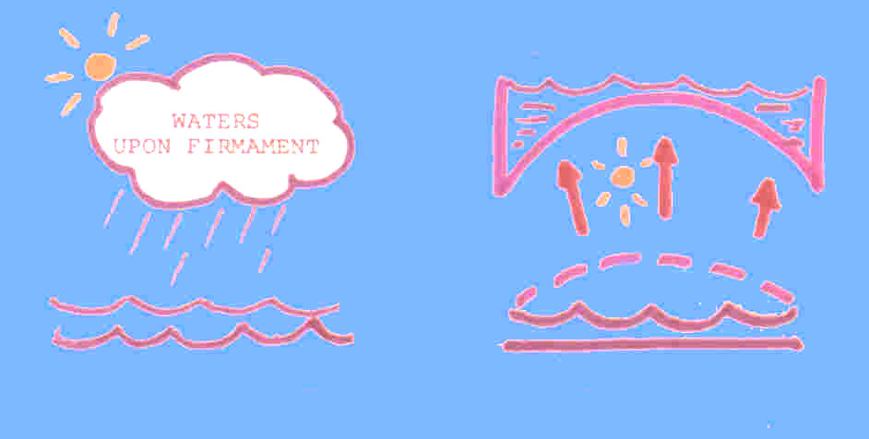
Space between firmament & earth?
In this account, there is no suggestion that the firmament moves to separate water from water. Nor is there any elsewhere in the Bible.
This fits an atmosphere model, not a dome.

Slide 43
The Three Heavens
"I know a man in Christ who 14 years ago was caught up to the third heaven. And I know that this man – whether in the body or out of the body I do not know, but God knows – was caught up to paradise. He heard inexpressible things, things that man is not permitted to tell." 2 Corinthians 12:2-4

Slide 44
The Three Heavens
Solomon, in dedicating the temple, seems to refer to three heavens:
Heaven
The heaven of heavens
Heaven, God's dwelling place
Modern translations usually render the 2nd of these "the highest heaven," based on the common Hebrew idiom, 'x of x,' meaning x to the highest degree.

Slide 45
The Three Heavens
"But will God really dwell on earth? The heavens, even the highest heaven, cannot contain you. How much less this temple I have built." 1 Kings 8:27 (NIV)
"Hear the supplication of your servant and of your people Israel when they pray toward this place. Hear from heaven, your dwelling place, and when you hear, forgive." 1 Kings 8:30

Slide 46
The Three Heavens
In the dome view, the 3 heavens are:
The space below the dome
The dome itself
The invisible space above the dome
In the atmosphere view, they are:
The atmospheric firmament
The realm of sun, moon, stars
The invisible dwelling place of God

Slide 47
The Three Heavens
“Praise ye the LORD. Praise ye the LORD from the heavens; praise him in the heights. Praise ye him, all his angels; praise ye him, all his hosts. Praise ye him, sun and moon; praise him all ye stars of light. Praise him, ye heaven of heavens, and ye waters that be above the heavens. Let them praise the name of the LORD; for he commanded, and they were created." Psalm 148:1-5 (KJV)

Slide 48
The Heaven of Heavens
Psalm 148 indicates the heaven of heavens was created.
1 Kings 8, that it is finite & cannot contain God.
Thus it appears that the heaven of heavens is where the stars are rather than the invisible dwelling of God.
But this does not fit the dome view, where the highest heaven is God's dwelling place.
It does fit the atmosphere view, where the invisible realm of God is all around us, not above some dome.

Slide 49
Heaven, the invisible realm
"The people remained at a distance, while Moses approached the thick darkness where God was. Then the LORD said to Moses, 'Tell the Israelites this: You have seen for yourselves that I have spoken to you from heaven.' " Exodus 20:21-22

Slide 50
Heaven, the invisible realm
"From heaven he made you to hear his voice to discipline you. On earth he showed you his great fire, and you heard his words from out of the fire." Deuteronomy 4:36

Slide 51
Heaven, the invisible realm
"You came down on Mount Sinai; you spoke to them from heaven. You gave them regulations and laws that are just and right, and decrees and commands that are good." Nehemiah 9:13

Slide 52
Heaven, the invisible realm
Though travel to and from heaven is usually spoken of as 'up' and 'down,' this is not always the case.
In 2 Kings 6, Elisha prays that his servant may see that they are protected by an invisible heavenly army. "And the LORD opened the eyes of the young man; and he saw, and behold, the mountain was full of horses and chariots of fire round about Elisha."

Slide 53
The Three Heavens
Thus, in the dome view, the highest heaven must be God's dwelling place, which starts above the dome.
In the atmosphere view, God's dwelling place is not highest, since it starts below the level of sun, moon and stars.
This latter is what we actually find in the biblical material on heaven.

Slide 54
Birds and Heaven
In the dome view, the birds fly under the firmament of heaven.
In the atmosphere view, the birds fly upon the firmament of heaven.
Genesis 1:20 literally reads: "…birds that may fly upon the face of the firmament of heaven."
Atmosphere
Dome

Slide 55
Hebrew Prepositions
When Hebrew uses prepositions with tenuous objects, it often sounds like they are solid:
Objects are carried 'before' the wind
Clouds hold up water from 'beneath'
So birds fly 'upon' the firmament
And the water 'above' the firmament is merely cloud water in the atmosphere

Slide 56
Hebrew Prepositions
"How often are they like straw before the wind, like chaff swept away by a gale?" Job 21:18
"Although the peoples roar like the roar of surging waters, when he rebukes them they flee far away, driven before the wind like chaff on the hills, like tumbleweed before a gale." Isaiah 17:13

Slide 57
Conclusions
Some negatives:
The liberal claim that the Bible teaches a solid-dome sky is incorrect.
There is nothing in the usage of raqia or its related verb that requires the solidity or rigidity of the biblical firmament.
The Bible gives no indication that anything supports the firmament nor that it supports water in the form of a massive sea.

Slide 58
Conclusions
Some positives:
The word 'heaven' has 3 meanings – (1) the invisible abode of God, (2) the starry heavens, (3) where the birds fly.
The third of these is the firmament, the atmosphere.
The water 'above' the firmament is actually floating 'upon' the atmosphere.
This water takes the form of cloud droplets and perhaps water vapor also.

Slide 59
Conclusions
Some implications:
This suggestion is consistent with the Bible's own claim to be from God.
No special revelation would have been necessary to construct this model, other than information about God's abode.
We should not be surprised that ancient translations and translation traditions need to be re-examined in the light of scientific discovery.

Slide 60
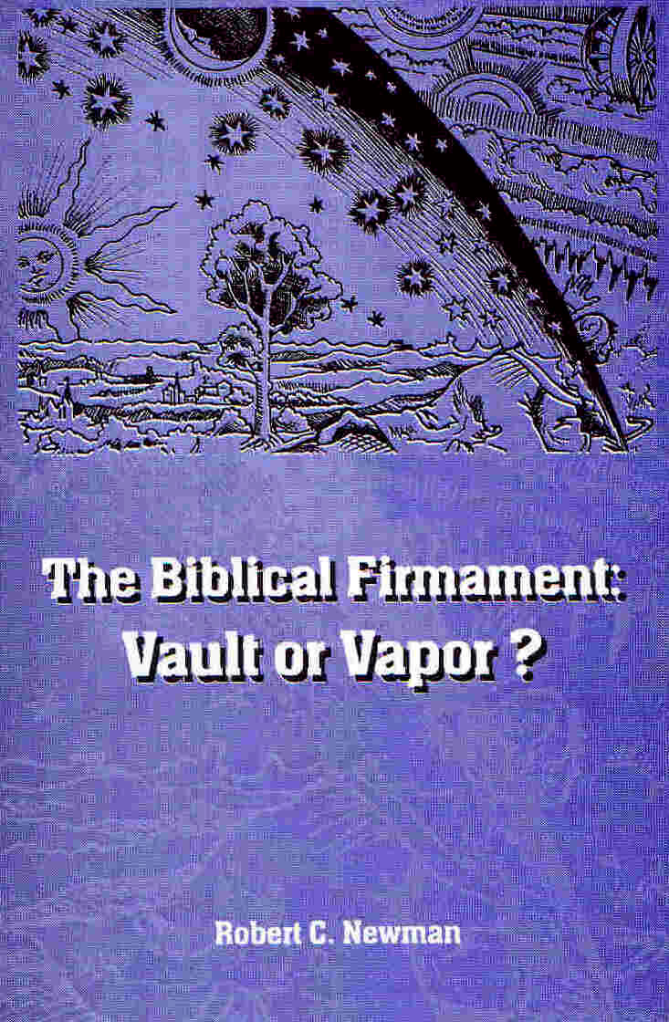
For More Detail

