Slide 1

Biblical Pictures of Salvation
Robert C. Newman

Slide 2
Biblical Pictures of Salvation
Salvation
Redemption
Pardon
Justification
Cleansing
Healing
Reconciliation
Adoption
Regeneration
Resurrection
Creation

Slide 3
Salvation
Rescued
from danger

Slide 4
Salvation
The problem: In danger from…
  Enemies
  Ourselves
  Wrath to come.
The solution:
  Jesus rescues us from all these.
The Christian life:
  We are safe!

Slide 5
Salvation: the problem
Danger from enemies:
  He delivered us from the domain of darkness (Col 1:13)
Danger from ourselves:
  Your rod & your staff, they comfort me (Psalm 23:4)
Danger from God’s wrath:
  Jesus, who delivers us from the wrath to come (1 Thess 1:10)

Slide 6
Salvation: the solution
Jesus rescues us from all these:
He who was delivered up because of our transgressions, and was raised because of our justification (Rom 5:9)
He [God] made Him [Jesus] who knew no sin to be sin on our behalf, that we might become the righteousness of God in Him (2 Cor 5:21)

Slide 7
Salvation: the Christian life
We are safe!
No one can snatch them out of my Father's hand (John 10:29)
I am convinced that neither death nor life, neither angels nor demons … nor anything else in all creation, will be able to separate us from the love of God that is in Christ Jesus our Lord (Rom 8:38-39)

Slide 8
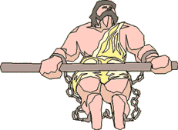
Redemption
Purchased
from slavery

Slide 9
Redemption
The problem: In slavery to…
  Sin
  Satan
The solution:
  Jesus pays the price to buy us back.
The Christian life:
  We are free!

Slide 10
Redemption: the problem
In slavery to sin & Satan:
A man is a slave to whatever has mastered him (2 Pet 3:19)
Everyone who sins is a slave to sin (John 8:34)
The devil, who has taken them captive to do his will (2 Tim 2:26)

Slide 11
Redemption: the solution
Jesus pays the price to buy us back:
Who gave Himself as a ransom for all (1 Tim 2:6)
In Him we have redemption through His blood, the forgiveness of our trespasses, according to the riches of His grace (Eph 1:7)

Slide 12
Redemption: the Christian life
We are free!
Live as free men, but do not use your freedom as a cover-up for evil (1 Pet 2:16)
You have been set free from sin and have become slaves to righteousness (Rom 6:18)

Slide 13
Pardon
Forgiven a debt

Slide 14
Pardon
The problem:
  We owe God a debt we cannot pay.
The solution:
  Jesus pays our debt.
The Christian life:
  We are free from debt!

Slide 15
Pardon: the problem
We owe God a debt we cannot pay:
When they were unable to pay… (Luke 7:42)
There was brought to him one who owed him 10,000 talents (Matt 18:24)

Slide 16
Pardon: the solution
Jesus pays our debt:
Having cancelled out the certificate of debt, consisting of decrees against us and which was hostile to us; and He has taken it out of the way, having nailed it to the cross (Col 2:14)

Slide 17
Pardon: the Christian life
We are free from debt:
He cancelled the debts of them both (Luke 7:42)
Let no debt remain outstanding, except the continuing debt to love one another (Rom 13:8)

Slide 18
Justification
Acquitted in court

Slide 19
Justification
The problem:
  We are (justly) charged with crimes.
The solution:
  Jesus takes our punishment.
  Jesus provides our righteousness.
The Christian life:
  We are no longer guilty!
  We won't be punished!

Slide 20
Justification: the problem
We are justly charged with crimes:
You have no excuse, you who pass judgment on someone else, for at whatever point you judge the other, you are condemning yourself, because you who pass judgment do the same things (Rom 2:1)
There is no one righteous, not even one (Rom 2:10; Psalm 14:1)

Slide 21
Justification: the solution
Jesus takes our punishment:
  God made him who had no sin to be sin for us (2 Cor 5:21)
  He was pierced for our transgressions (Isa 53:5)
Jesus provides our righteousness:
  But now a righteousness from God, apart from law … This righteousness from God comes through faith in Jesus Christ (Rom 3:21-22)

Slide 22
Justification: the Christian life
We are no longer guilty:
  Who will bring any charge against those whom God has chosen? It is God who justifies (Rom 8:33)
We won’t be punished:
  Since we have now been justified by his blood, how much more shall we be saved from God’s wrath through him (Rom 5:9)

Slide 23
Cleansing
Washed from dirt

Slide 24
Cleansing
The problem:
  We are filthy from our sins.
The solution:
  Jesus' blood cleanses us.
The Christian life:
  We are clean!

Slide 25
Cleansing: the problem
We are filthy from our sins:
All our righteous acts are like filthy rags (Isa 64:6)
What goes into a man's mouth does not make him unclean, but what comes out of his mouth, that is what makes him unclean (Matt 15:11)

Slide 26
Cleansing: the solution
Jesus' blood cleanses us:
They have washed their robes and made them white in the blood of the Lamb (Rev 7:14)
Such [sinners] were some of you, but you were washed … in the name of our Lord Jesus Christ (1 Cor 6:11)

Slide 27
Cleansing: the Christian life
We are clean!
The bride has made herself ready. Fine linen, bright and clean, was given her to wear. Fine linen stands for the righteous acts of the saints. (Rev 19:8)
You are already clean because of the word I have spoken to you (John 15:3)

Slide 28
Healing
Cured
from disease

Slide 29
Healing
The problem:
  We are diseased with sinfulness.
The solution:
  Jesus is our physician & remedy.
The Christian life:
  We are healed!

Slide 30
Healing: the problem
We are diseased with sinfulness
There is no health in my bones because of my sin (Psalm 38:3)
Ah, sinful nation, a people loaded with guilt … your whole head is injured, your whole heart afflicted. From the sole of your foot to the top of your head, there is no soundness (Isa 1:4-6)

Slide 31
Healing: the solution
Jesus is our physician and remedy:
He was pierced for our transgressions, he was crushed for our iniquities, the punishment that brought us peace was upon him, and by his wounds we are healed (Isa 53:5)
But for you who revere my name, the sun of righteousness will rise with healing in its wings (Mal 4:2)

Slide 32
Healing: the Christian life
We are healed!
By his wounds you were healed (1 Pet 2:24)
I pray that you may enjoy good health and that all may go well with you, even as your soul is getting along well (3 John 2)

Slide 33
Reconciliation
Made friends
from enemies

Slide 34
Reconciliation
The problem:
  We are enemies of God.
  And he of us!
The solution:
  Jesus is the mediator.
The Christian life:
  We are friends of God.
  We seek to bring others to Him.

Slide 35
Reconciliation: the problem
We hate God:
  Why do the nations conspire and the peoples plot in vain? … against the LORD and his Anointed One. "Let us break their chains," they say, "and throw off their fetters." (Psalm 2:1-3)
And He hates us:
  The arrogant cannot stand in your presence; you hate all who do wrong (Psalm 5:5)

Slide 36
Reconciliation: the solution
Jesus is the mediator:
If while we were enemies, we were reconciled to God through the death of his Son… (Rom 5:10)
All this is from God, who reconciled us to himself through Christ (2 Cor 5:18)

Slide 37
Reconciliation: Christian life
We are friends of God:
  As the Father has loved me, so have I loved you … I no longer call you servants … instead I have called you friends (John 15:9-15)
We seek to bring others to Him:
  All this is from God, who reconciled us to himself … and gave us the ministry of reconciliation (2 Cor 5:18)

Slide 38
Adoption
Made son
and heir

Slide 39
Adoption
The problem:
  We are children of Adam.
  We are children of Satan.
The solution:
  God adopts us as his own.
The Christian life:
  We are now in God’s family!
  We will inherit his kingdom.

Slide 40
Adoption: the problem
We are children of Adam:
  As in Adam all die, so in Christ all will be made alive (1 Cor 15:22)
We are children of Satan:
  You belong to your father, the devil, and you want to carry out your father’s desire (John 8:44)

Slide 41
Adoption: the solution
God adopts us as His own:
When the time had fully come, God sent his Son … to redeem those under law, that we might receive the full rights of sons (Gal 4:4-5)
You did not receive a spirit that makes you a slave again to fear, but you received the Spirit of sonship (Rom 8:15)

Slide 42
Adoption: the Christian life
We are now in God's family:
  You are all sons of God through faith in Christ Jesus (Gal 3:26)
We will inherit His kingdom:
  You are no longer a slave, but a son; and since you are a son, God has made you also an heir (Gal 4:7)

Slide 43
Regeneration
Born a
second time

Slide 44
Regeneration
The problem:
  We are by nature unfit due to our sinfulness.
The solution:
  God causes us to be born again into a new human race, of which Jesus is the 2nd Adam.
The Christian life:
  We now have a new (eternal) life.

Slide 45
Regeneration: the problem
We are by nature unfit due to our sin:
The LORD looks down from heaven on the sons of men to see if there are any who understand, any who seek God … there is none who does good, not even one (Psalm 14:2-3)
Can the Ethiopian change his skin or the leopard its spots? Neither can you do good who are accustomed to do evil (Jer 13:23)

Slide 46
Regeneration: the solution
God causes us to be born again into a new human race (of which Jesus is the 2nd Adam):
I will … put a new spirit in them … They will be my people & I will be their God (Ezk 11:19-20)
No one can see the kingdom of God unless he is born again (John 3:3)

Slide 47
Regeneration: Christian life
We now have a new (eternal) life:
Whoever hears my word and believes him who sent me has eternal life and will not be condemned; he has crossed over from death to life (John 5:24)
He saved us … by the washing of regeneration and renewing by the Holy Spirit (Tit 3:5)

Slide 48
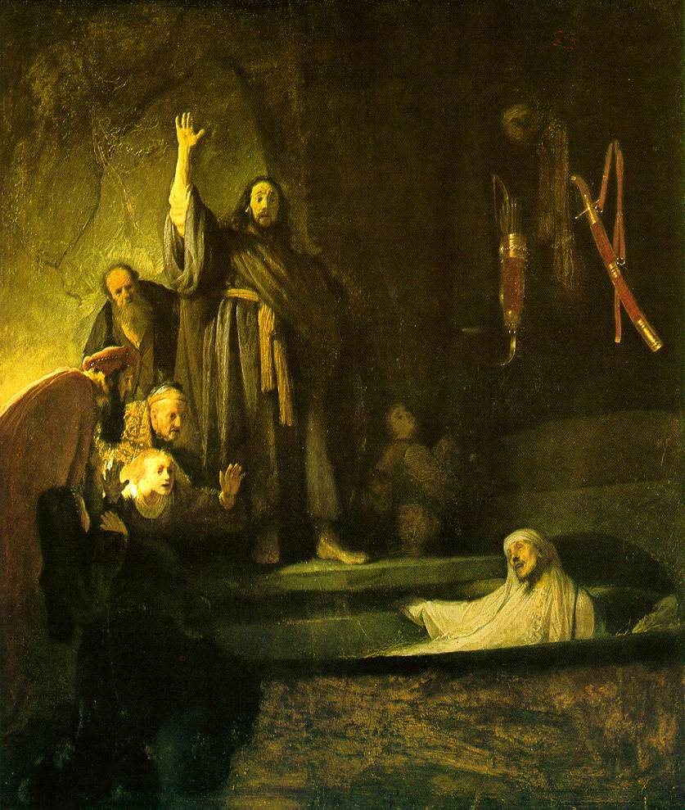
Resurrection
Brought
back to life

Slide 49
Resurrection
The problem:
  We are dead in our sins.
The solution:
  God makes us alive with Christ.
The Christian life:
  We are alive to God.

Slide 50
Resurrection: the problem
We are dead in our sins:
Little do they know that the dead are there, that [Folly's] guests are in the depths of the grave (Prov 9:18)
You were dead in your transgressions and sins, in which you used to live when you followed the ways of this world (Eph 2:1-2)

Slide 51
Resurrection: the solution
God makes us alive with Christ:
But God, who is rich in mercy, made us alive with Christ even when we were dead in transgressions (Eph 2:4-5)
In [Christ] you have been made complete … having been buried with him in baptism and raised with him through your faith in the power of God (Col 2:11-12)

Slide 52
Resurrection: Christian life
We are alive to God:
This son of mine was dead, and is alive again (Luke 15:24)
Count yourselves dead to sin but alive to God in Christ Jesus (Rom 6:11)
God made us alive with Christ. He forgave us all our sins (Col 2:13)

Slide 53
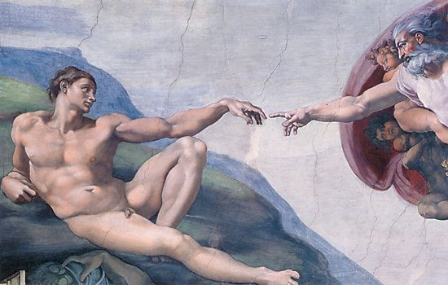
Creation
Given a
new existence

Slide 54
Creation
The problem:
  We are by nature unfit due to our sins.
The solution:
  God makes us new creations as children of the 2nd Adam Jesus.
The Christian life:
  We have a new existence.

Slide 55
Creation: the problem
We are by nature unfit due to our sin:
The LORD looks down from heaven on the sons of men to see if there are any who understand, any who seek God … there is none who does good, not even one (Psalm 14:2-3)
Can the Ethiopian change his skin or the leopard its spots? Neither can you do good who are accustomed to do evil (Jer 13:23)

Slide 56
Creation: the solution
God makes us new creations as children of the 2nd Adam Jesus:
If anyone is in Christ, he is a new creation; the old has gone, the new has come! (2 Cor 5:17)
For we are God's workmanship, created in Christ Jesus to do good works, which God prepared in advance for us to do (Eph 2:10)

Slide 57
Creation: the Christian life
We have a new existence:
I will be their God … They will all know me, from the least of them to the greatest (Jer 31:33-34)
The old has gone, the new has come! (2 Cor 5:17)
I am making everything new (Rev 21:5)

Slide 58
Biblical Pictures of Salvation
Salvation
Redemption
Pardon
Justification
Cleansing
Healing
Reconciliation
Adoption
Regeneration
Resurrection
Creation

Slide 59
Our Salvation
Praise God for what He has done through Jesus!
May these pictures help us understand and appreciate who God is and what He has done.
Do you know Jesus as your savior?

Slide 60
The End
… is just the beginning if you know the true & living God!

